Slide 1
DIGITAL FORENSIC INVESTIGATION
INTO THE QT‑AI‑2025 PATENT LEAK
Course: Digital Forensics Analysis
MD. MEHEDI HASAN MIXON
ID: 2436061

Slide 2
CASE BACKGROUND
Quantum Tech uncovered that patent QT‑AI‑2025 had been compromised. Evidence suggests Emma was the insider who leaked information, using Joe as a middleman to arrange a deal with Norman, who planned to pass the technology on to their rival, NexGen.

Slide 3

AIM & OBJECTIVES
The investigation’s purpose is to determine whether the digital evidence supports the allegation that Emma attempted to pass restricted patent information to Norman, using Joe as the go‑between.
Gather all the digital material and do an initial review of messages, contacts, files, and metadata.
Figure out what each suspect did by laying out the events in order and showing how the information moved between them.
Finally, compare the evidence to the standards used to decide whether corporate espionage took place.

Slide 4
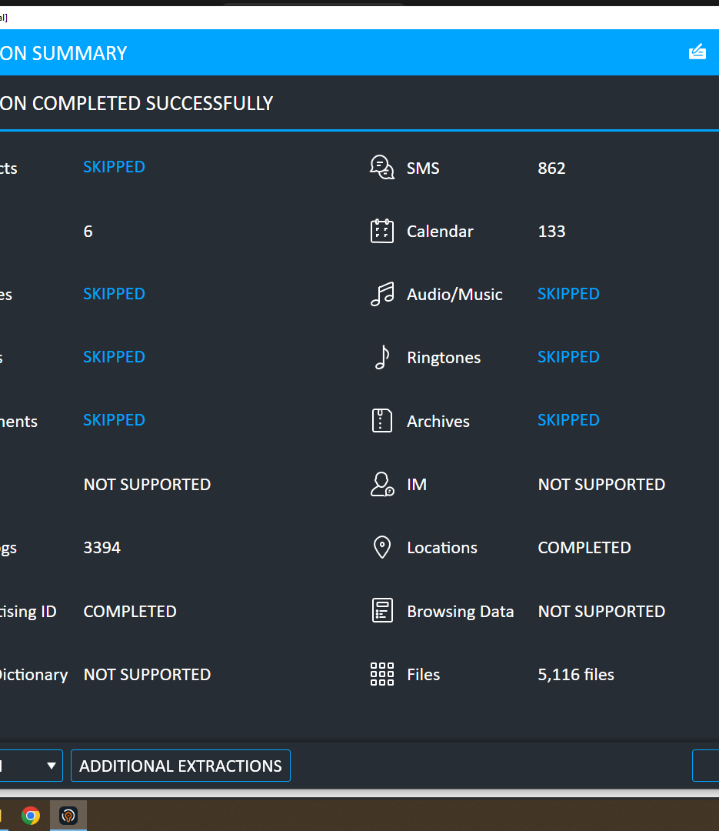
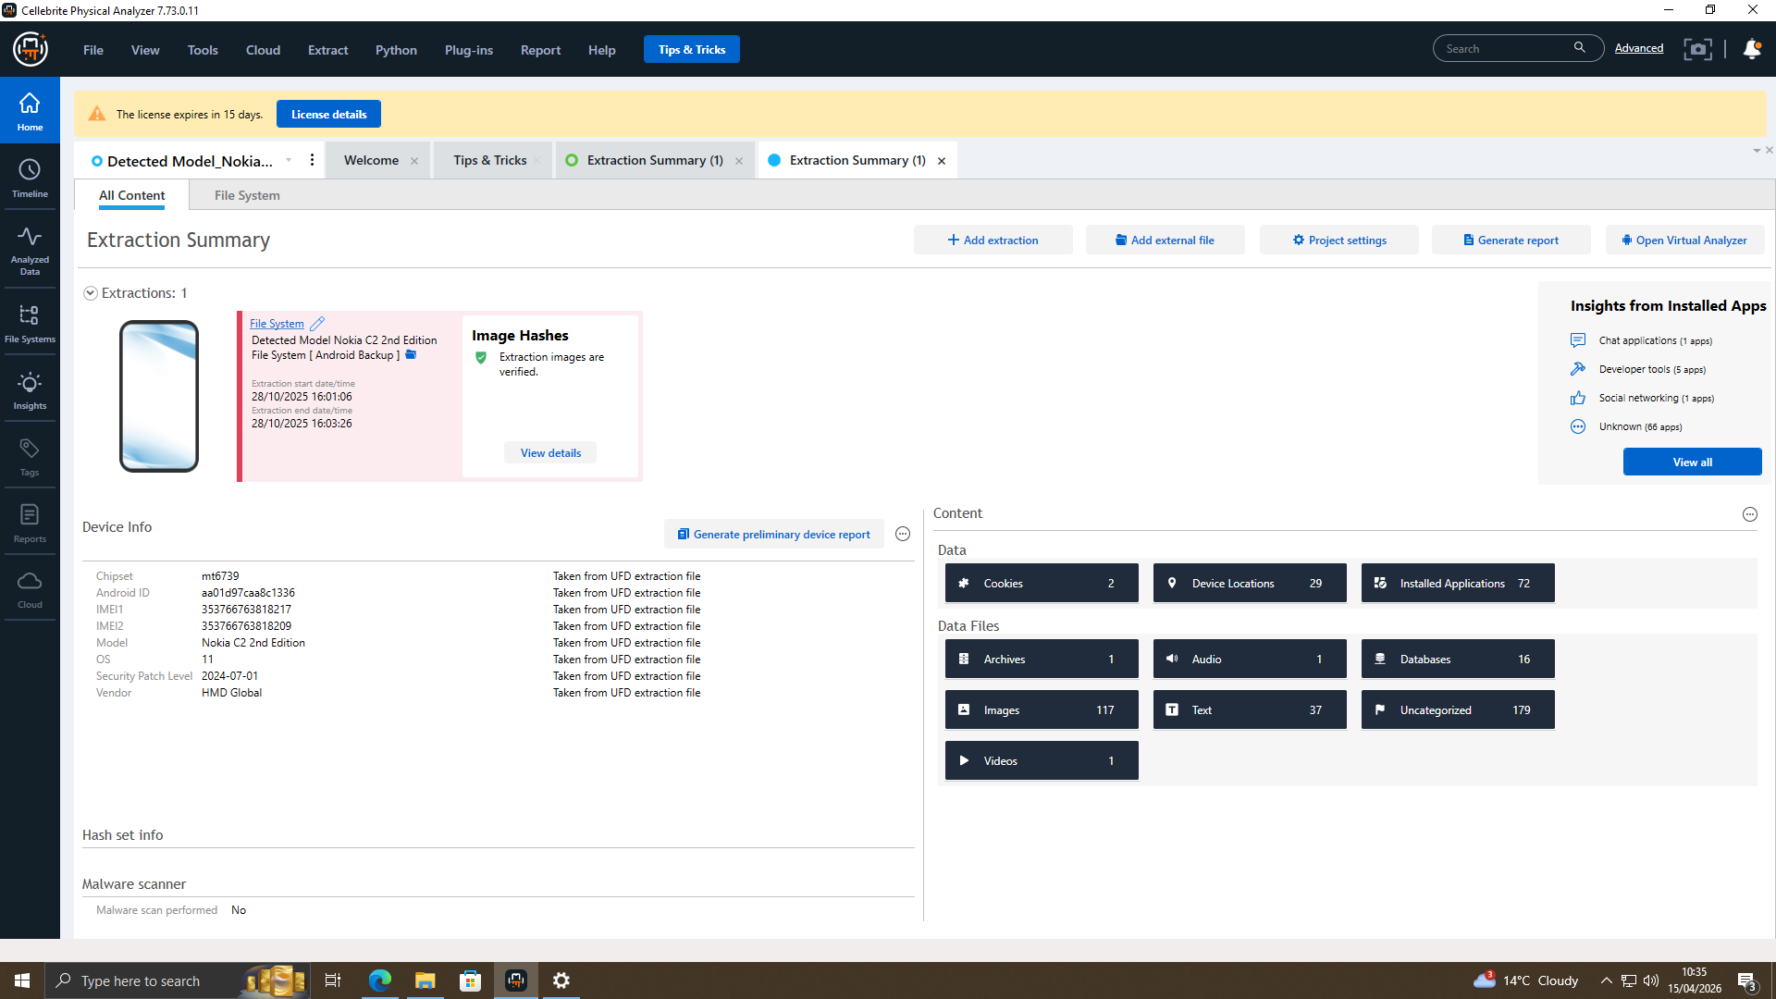
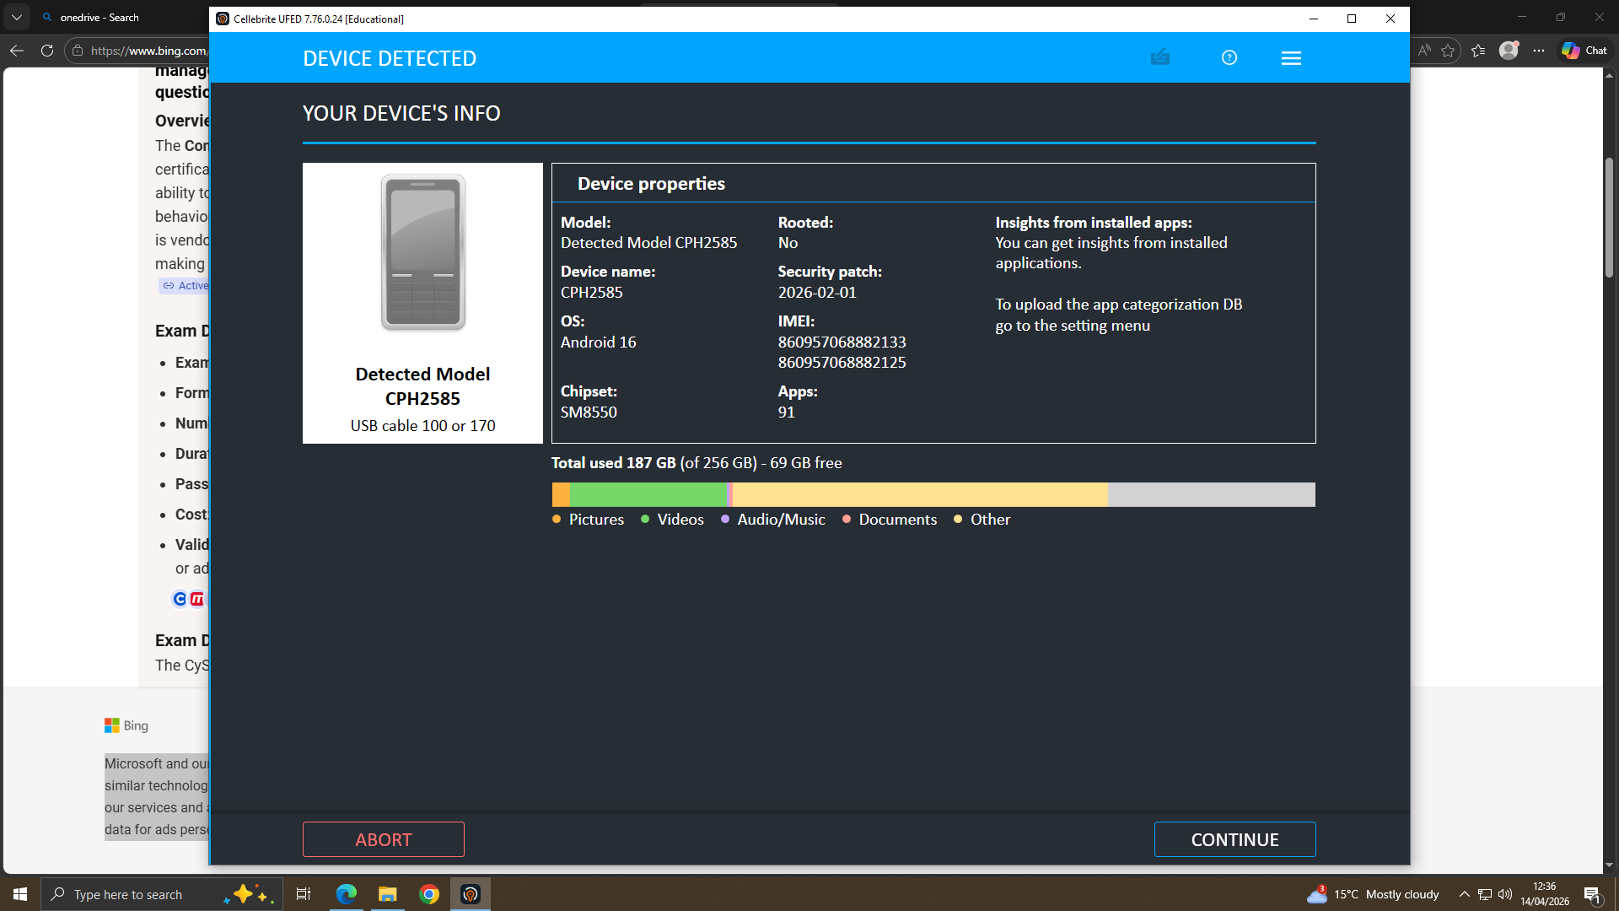
DEVICE COLLECTION AND ANALYZE
UFED acquisition screenshots
Analysed in Physical Analyser

Slide 5
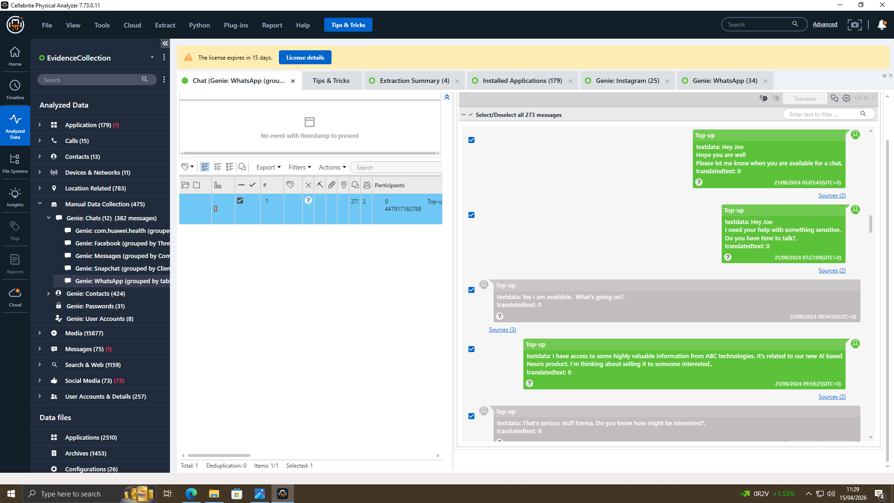
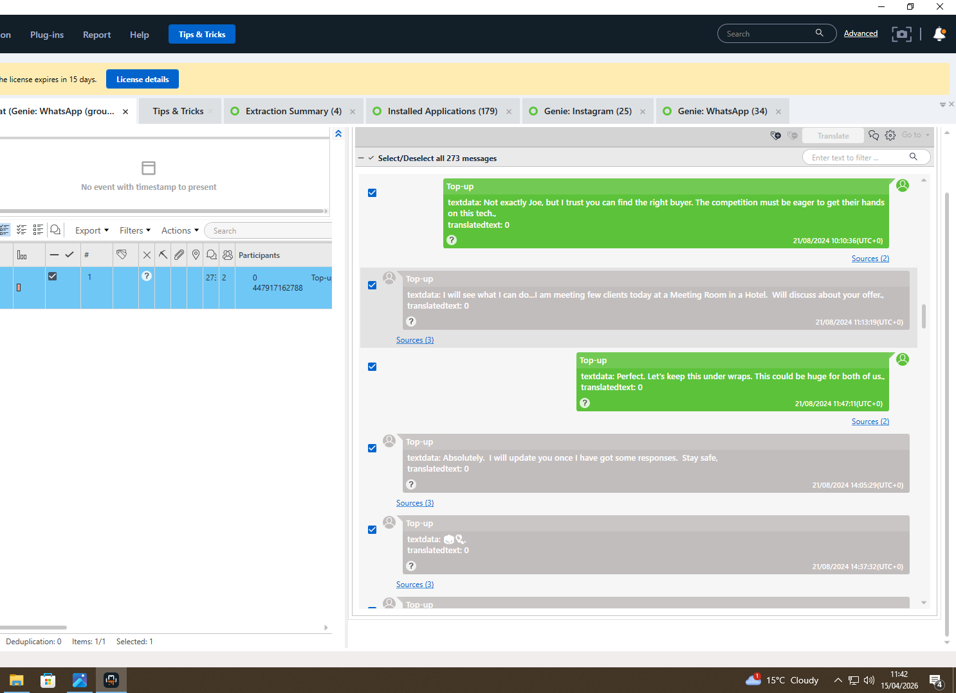
CHAT INITIALIZATION
The digital evidence shows that Emma was the one who deliberately reached out about restricted information. By revealing that she had access to valuable AI‑related intellectual property and using wording that emphasized its importance, she showed she understood both how sensitive the material was and how much it was worth.

Slide 6
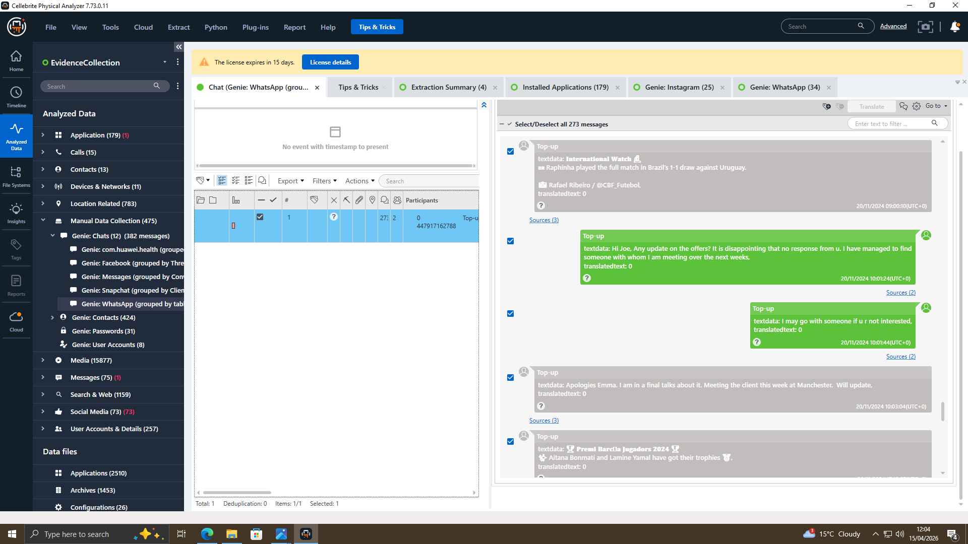
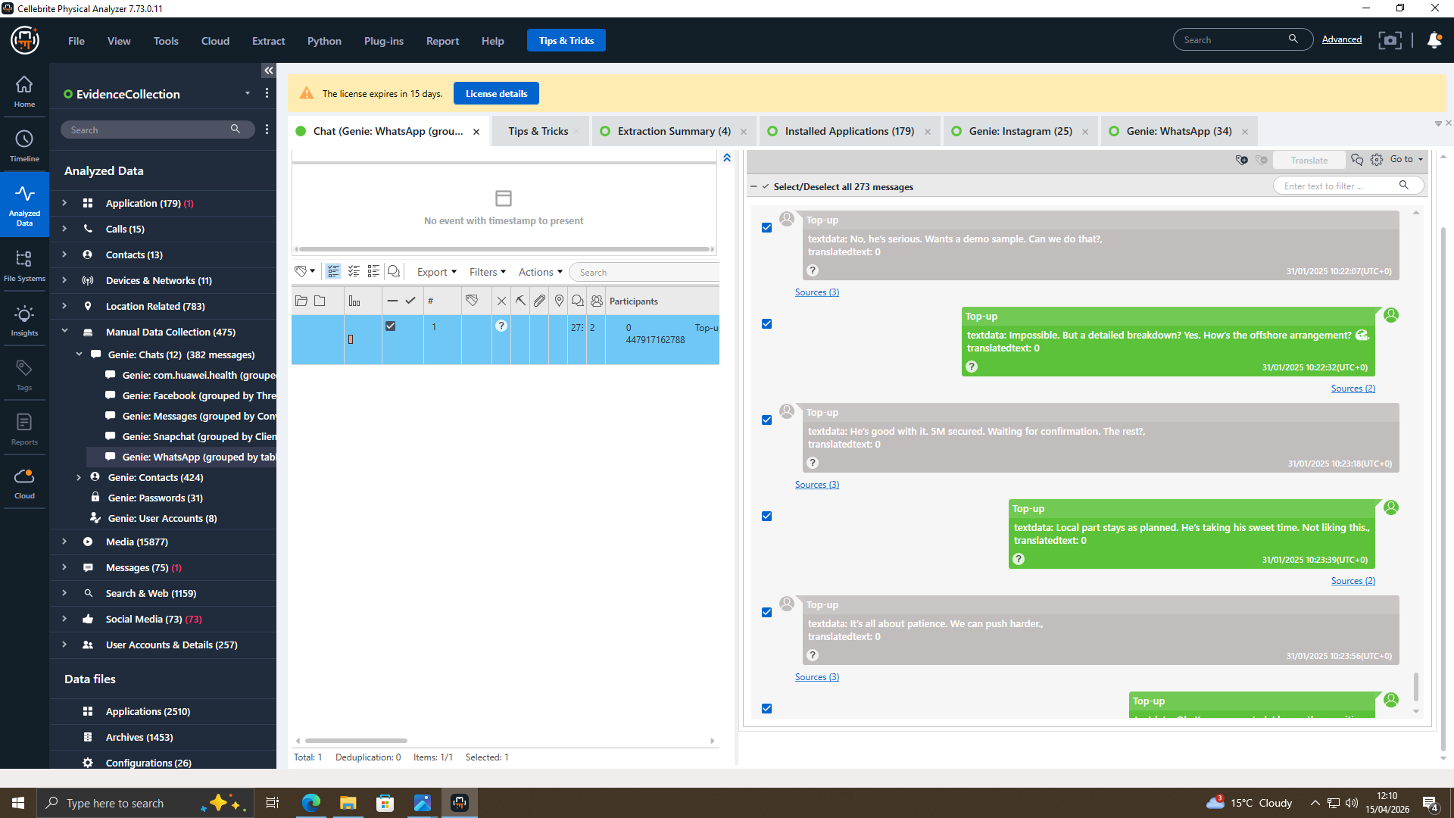
DEAL ESTABLISHMENT
The digital evidence shows how the deal developed, with Joe arranging meetings and organizing the trip to Manchester to settle the terms. During the verification stage, Emma was careful and only allowed the buyer to see part by part release instead of the full patent. The final phase of the negotiation involved setting up offshore payments and confirming a 5M agreement.

Slide 7
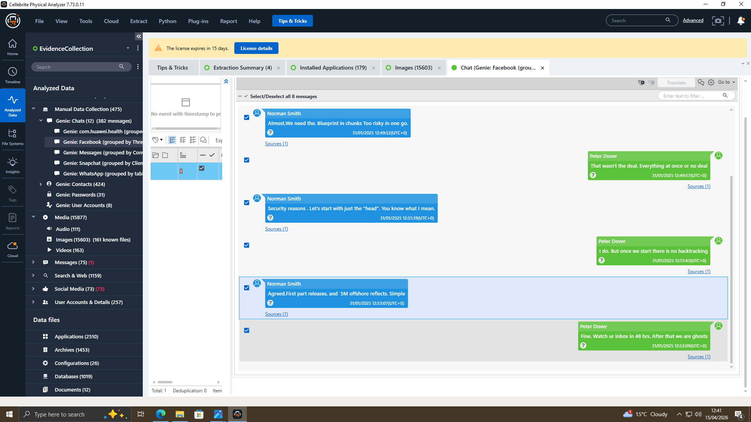
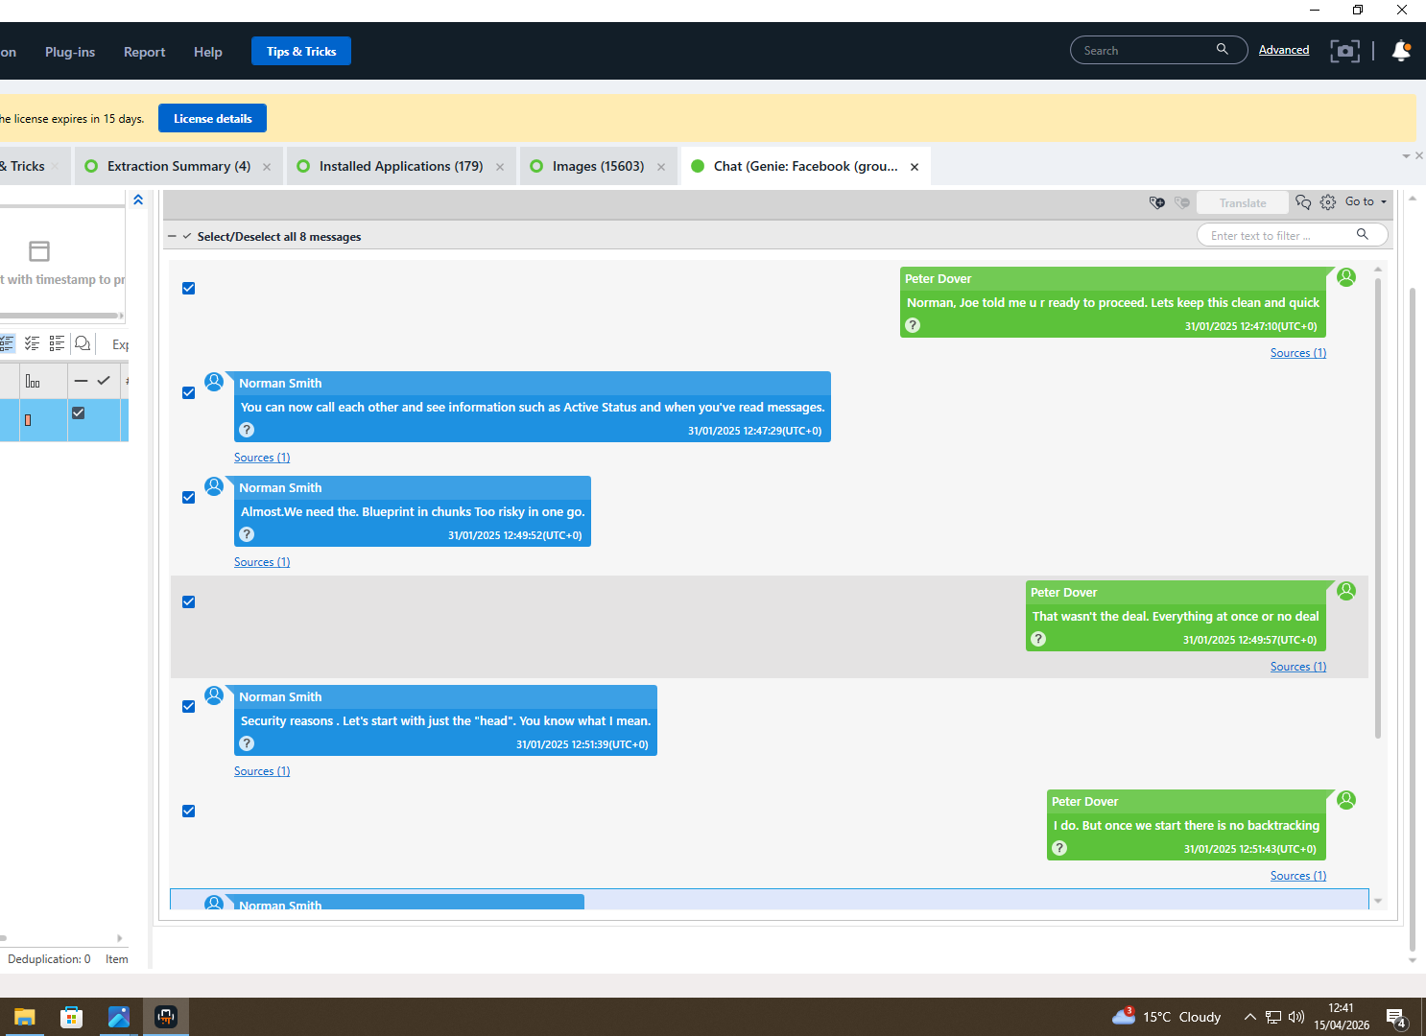
EXCHANGE WITH BUYER
Norman was directly connected to the deal as the buyer.
The blueprint was provided in separate portions rather than being released all at once.
The evidence shows that offshore payment was part of the arrangement.
The agreed delivery timeframe was within 48 hours.

Slide 8
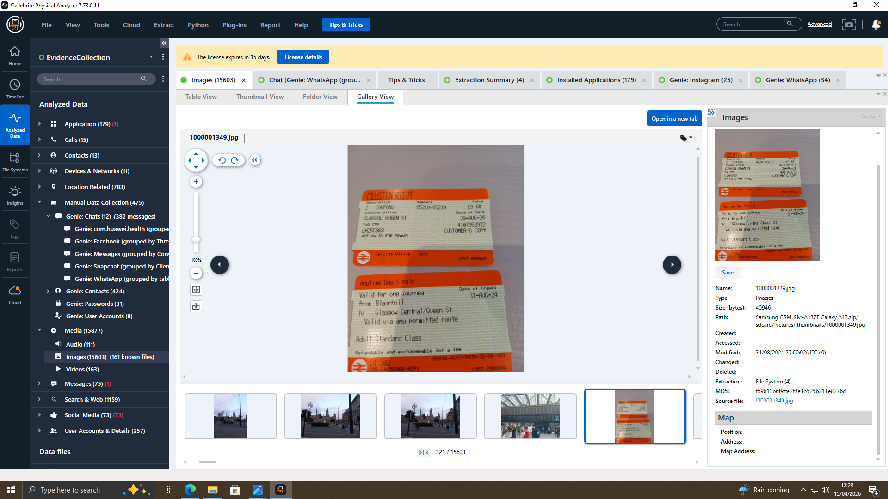
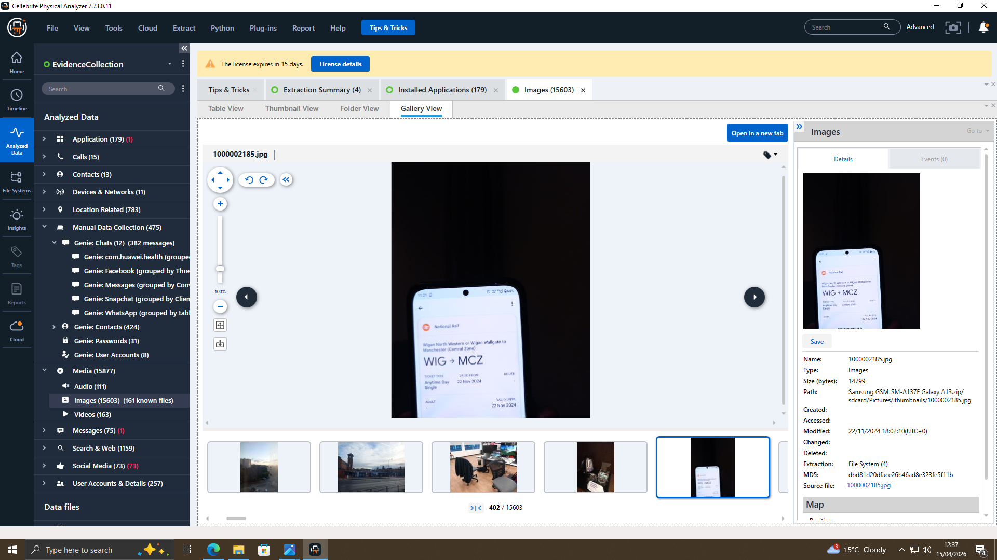
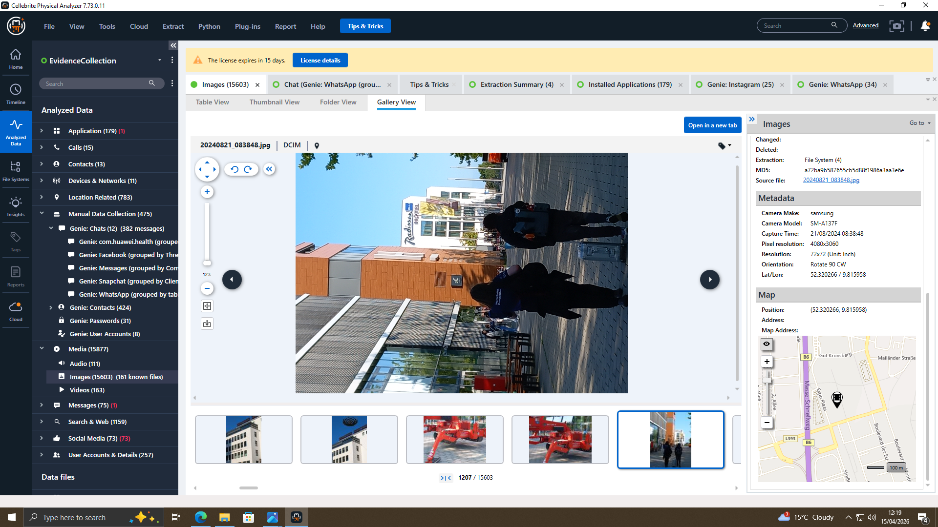
TRAVELLING
The location‑tagged photos backed up the claims about where the individuals travelled.
The travel records also lined up with the timeline of the negotiations.

Slide 9
Emma was the one who initially contacted Joe privately.
Their conversations showed she had access to valuable AI‑related information.
Joe then steered the discussion toward arranging a purchase.
Norman eventually appeared in the communication chain on the buyer’s side.
FINDINGS

Slide 10


CONCLUSION
All the information strongly supports the conclusion that an attempt at corporate espionage took place.
Emma acted as the internal source who initiated the leak.
Joe functioned as the broker who managed the communication and deal‑making.
Norman served as the intended buyer on the receiving end of the transaction

