Slide 1
ESDGC
Practice within the Youth Work Sector

Slide 2
Aims of Session
Explore the role of ESDGC practice within Youth Work
Identify own knowledge and experience
ESDGC activities for practice

Slide 3
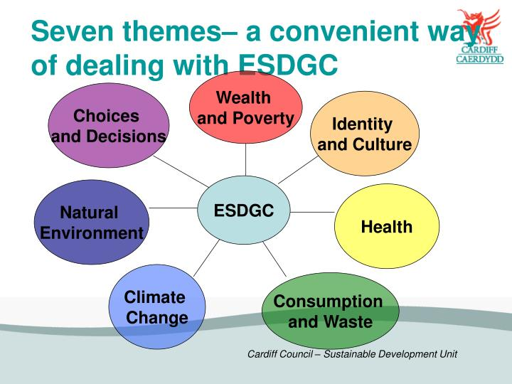
ESDGC
EDUCTION FOR SUSTAINBLE DEVELOPMENT AND GLOBAL CITEZENSHIP

Slide 4
Why ESDGC?
Youth work plays a crucial role in supporting young people through a significant time in their lives.
It enables them to explore important issues and develop opinions about them, and maybe even do something.
ESDGC can support young people to develop an understanding of the world around them.
It does this by developing their knowledge of some of the key local and global issues they face in the world today, and supporting them to explore their attitudes and values

Slide 5
Activity
In small groups outline what a sustainable youth club might look like?

Slide 6
Why ESDGC
Why do we need to change education (formal , non-formal, Informal?
What are the challenges young people are faced with today?
From your own perspective think about : What are the Most Important Issues Facing the World and its Inhabitants
https://sustainabledevelopment.un.org/?menu=1300

Slide 7

ESDGC
ESDGC in work context starts from the young people’s experiences:
  encourages a critical understanding of the links between their lives and histories with those in their community and others throughout the world,
  making the connections between society, economy, the environment and politics.
  It reflects on attitudes and values, and develops skills to enable active participation in creating a more just and sustainable world.
Welsh Government (2008)
This document will be really helpful for your discussion.

Slide 8

Is education responding?
Education as the answer or the problem?
‘The destruction of the planet is not the work of ignorant people. Rather it is largely the result of work by people with BAs, BScs, LLBs, MBAs and PhDs.’
David Orr (1994) ‘What is education for’? Earth in Mind, Island Press

Slide 9
“Education is the most powerful weapon you can use to change the world”
  Nelson Mandela

Slide 10
Reorienting Education
Important to consider HOW we educate:
Rather than Transmissive education Transformational Education e.g:
Problem solving
Critical thinking
A say in decisions
Examine values and cultural perspectives
Empowering learners to take appropriate action

Slide 11
ESDGC and Youth Work
So what is the difference between ESDGC in youth work and good youth work?
The answer for many is not much:
  “ Youth work has a long tradition of supporting young people’s understanding of the world around them, and the values that youth work promotes such as justice and equality link strongly with the introduction of global themes. Therefore ESDGC in a youth work context is entirely consistent, and many are engaging in ESDGC in youth work, even if they’re not giving it that name”.
(Welsh Government 2008)

Slide 12
Principles and purposes of Youth Work
Educative
Expressive,
Participative,
Inclusive
Empowering
ESDGC in youth work settings is distinct because it follows the same principles as youth work practice;
What are the purposes and principles of youth work practice?

Slide 13
promote and actively encourage opportunities for all young people in order that they may fulfil their potential as empowered individuals and as members of groups and communities;
support young people through significant changes in their lives and assist them to understand their responsibilities;
support young people to be able to understand and exercise their rights;
encourage young people to gain and develop knowledge, understanding, attitudes and values and to make constructive use of their skills, resources and time;
promote opportunities and access for all young people whatever their race, gender, sexual identity, language, religion, disability, age, background or personal circumstances;
challenge oppression and inequality;
support and enable young people in keeping themselves safe.
recognises the importance and value of the Welsh language and the need to promote its use;
recognises that Wales is a country with a diversity of languages and cultures;
recognises the importance of sustainable development and equips young people with the knowledge and skills to play their part in shaping the future;
encourages young people as local, national and global citizens to exercise their responsibilities;
encourages young people to protect their own rights and those of others.

Slide 14
ESDGC in youth work:
Recognises the links between our own lives and those of people throughout the world
Recognises histories, both our own and those of others throughout the world
Seeks to include black and minority ethnic (BME) perspectives locally and throughout the world
Is concerned with needs and rights of both the present and future generations
Addresses the relationship between power, resources and human rights
Enables young people to understand the global forces which shape their lives
Equips young people to participate in decision making and take action for change
Enables young people to question, to think critically, and to empathise

Slide 15
ESDGC is not:
  Confined to project work
  A series of discrete concepts or themes
  The responsibility of one or two people in the service or organisation
  About transmitting a set of answers to learners
  Separate from core youth work practice

Slide 16
ESDGC concepts
Concepts | Themes
1. Quality of life 2. Sustainable change 3. Diversity 4. Interdependence 5. Citizenship and stewardship 6. Conflict resolution 7. Need and rights 8. Values and perceptions 9. Uncertainty and precaution | 1.Identity and culture 2. Choices and decisions 3. Health 4. Natural environment 5. Consumption and waste 6. Climate change 7. Wealth and poverty

Slide 18
How can we link themes when working with Young People?

Slide 19
In pairs choose one jigsaw theme, and consider an activity you may undertake in your youth work practice.

Slide 20

The Story of Stuff
Look at the movie,
The Story of Electronics:
https://storyofstuff.org/movies/story-of-electronics/

Slide 21
Your own experiences?
Have you experience of working with the themes identified?
How can we embed ESDGC in to practice? What needs to happen?

Slide 22
Examples of embedding ESDGC into practice
1. Review your sustainable youth club, what would you do differently now?

Slide 23
Key References (available on Moodle)
CLD Standards Council Scotland, (2018) Youth Work NOS.
CWVYS, (2018) Youth Work in Wales: Principles and Purposes
CWVYS, (N.D) Working Together for the Good of Each Other The Education for Sustainable Development and Global Citizenship Youth Work Handbook
Council of Europe and European Commsion, (2018) T_Kit 13 Sustainability and Youth Work. EU
McKeown R (2002). ESDGC Toolkit Available from http://www.esdtoolkit.org/esd_toolkit_v2.pdf link to open resource
Welsh Government (2008 ). Education for Sustainable Development and Global Citizenship: A Common Understanding for the Youth Work Sector. Cardiff: Welsh Government

