Slide 1
The Impact of Artificial Intelligence on Employee Productivity in Small and Medium-Sized Businesses (SMEs)
Business Research Proposal
Student Name; Rafael-Petrut Florescu
Student ID; 2325179
Module: Research Methods for Business

Slide 2

Introduction
Research Topic
The Impact of Artificial Intelligence on Employee Productivity in SMEs
Business Context
AI is changing the way business is done.
SMEs are using AI technologies more and more.
Sage plc offers AI-driven solutions.
There is a lack of studies on the influence of AI on employee productivity in SMEs.
Notes:
My research is on the effects of Artificial Intelligence on employee productivity in SMEs. I chose this topic because AI usage is skyrocketing yet a lot of SMEs are still unsure if AI actually boosts productivity. The existing research is mostly related to large enterprises and this study seeks to fill the gap.

Slide 3
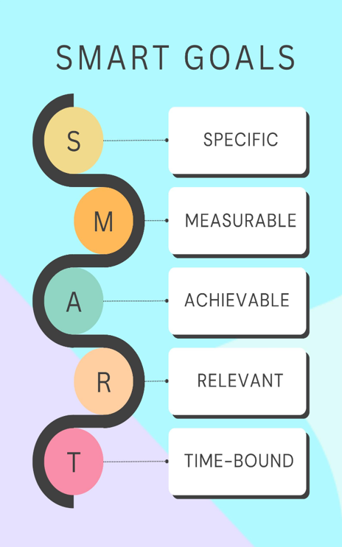
Research Objectives and Questions
Question 1
Are your research objectives aligned with the SMART criteria? Which part of your research do you find hardest to make specific, measurable, or time-bound?
Answer
Specific: Focuses on AI's impact on employee productivity in SMEs.
Measurable: Data collected through surveys and interviews.
Achievable: Research focuses on SMEs using Sage plc's AI solutions.
Relevant: Addresses a current business challenge.
Time-bound: Conducted within the module timeframe.
Most challenging aspect:
In an effort to objectively measure employee productivity, a mixed-methods approach is needed since it involves both quantitative outcomes and employee perspectives.
Notes:
My aims are SMART as they state exactly what will be examined, how data will be obtained and why the study is vital. The hardest part is to measure productivity, because it is a function of both objective performance metrics, and the personal experiences of the personnel. The difficulty can be addressed by combining surveys with interviews.

Slide 4

Research Objectives and Questions
Question 2
How do your research questions focus on solving the identified dilemma while advancing
knowledge in your chosen field?
Answer
The research questions explore:
Current artificial intelligence technology for SMEs.
Effect of AI on employee productivity
Perceptions of AI by employees.
Organisational hurdles to implementation of AI.
Practical tips for SMEs.
These questions address the business challenge by providing an indication of whether AI
actually does increase productivity and also adds to academic understanding of AI adoption in SMEs.
Notes:
The research questions are closely related to the business challenge. But they are not only questioning whether AI is good, they are also looking at how it impacts employes, the issues companies confront and how it might be applied more successfully. This would allow the businesses and researchers to have better understanding of AI adoption in SMEs.

Slide 5
Research Objectives and Questions
Question 3
Are your research objectives and questions sufficiently specific, measurable, achievable, relevant, and time-bound (SMART)? How do they directly address the identified problem?
Answer
Yes.
The objectives are directly related to the stated business challenge thru:
Looking at AI adoption in SMEs.
How to Measure Employee Productivity
Research on employee attitudes.
Identifying barriers to implementation.
Providing evidence-based advice.
This provides a clear connection between the business challenge, research objectives and expected outcomes.
Notes:
All the objectives are within the main research goal. They guarantee that the research covers not just the advantages of AI but also the problems businesses have in using artificial intelligence (AI) technology. This congruence adds to the overall design of the investigation.

Slide 6
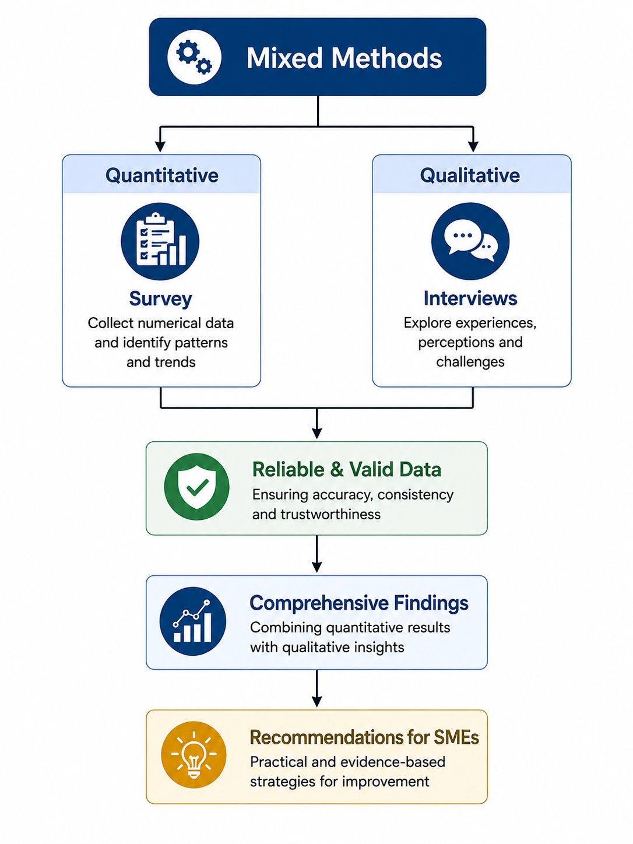
Methodology
Question 1
Why do you believe your selected data collection methods are the most appropriate for answering your research questions?
Answer
I chose a mixed-methods approach since it combines:
Surveys
Measures the perception of employees.
Gathers quantifiable productivity statistics.
Allows analysis of multiple people.
Interviews
Explore experiences more deeply.
Identify barriers to implementation.
Results of the survey. Discussion.
Using both methodologies gives a fuller picture of the influence of AI on employee productivity.
Notes:
This research is suitable for a mixed methods approach since it tries to explore productivity outcomes that are quantifiable as well as experiences of employees on a personal level. Surveys give statistical data, interviews provide more in-depth explanations and combined they allow for more complete conclusions.

Slide 7

Methodology
Question 2
How do you plan to handle ethical considerations, and are there any limitations you anticipate in your methodology?
Answer
Moral considerations
Informed consent.
Privacy.
Participation is voluntary.
Compliance with GDPR.
Research security of data storage.
Restrictions
Small sample size
Self-reported answers using questionnaires.
Cross-sectional studies.
Limited generalisability.
Notes:
Ethics considerations are important in all phases of the study. The participants will be fully informed about the study and will have the choice to withdraw at any time. The key limitations are that the sample size is quite small and that the study gathers data at one moment in time.

Slide 8
Methodology
Question 3
Why have you chosen the specific research methods, and how do they ensure the reliability and validity of your study? What are the potential limitations of your chosen methodology?
Answer
Why these methods?
Mixed methods provide richer evidence.
Surveys produce measurable data.
Interviews provide detailed explanations.
Reliability
Pilot testing.
Standardised questionnaire.
Consistent interview questions.
Validity
Based on established theories.
Triangulation.
Multiple data sources.
Limitations
Time constraints.
Participant bias.
Limited sample.
Notes:
Standardised research tools and pilot testing increase reliability. Triangulation, which involves comparing findings from surveys and interviews, enhances validity. Although the sample size may restrict the generalisation, the mixed-methods approach gives a holistic view of the study subject.

Slide 9

Practical Implications
Question 1
What practical recommendations do you foresee arising from your research, and how can they be applied in real-world business contexts?
Answer
Some recommendations:
AI training courses.
Change management methods
Slow AI implementation.
Performance checking periodically.
Ongoing staff assistance.
These tips can assist SMEs in improving efficiency and minimising opposition to the implementation of AI.
Notes:
I anticipate the findings will show that effective AI deployment is as much about investing in workers as it is technology. "Training and communication will assist businesses to get the best out of AI.

Slide 10

Practical Implications
Question 2
What challenges do you predict businesses might face when implementing your findings, and how would you propose mitigating those?
Answer
Challenges
Employee resistance.
Lack of digital skills.
Financial costs.
Data privacy concerns.
Mitigation
Staff training.
Leadership support.
Phased implementation.
Clear AI policies.
Ongoing evaluation.
Notes:
AI provides numerous benefits, but companies may confront problems during deployment. Strong leadership, employe involvement and continual training may solve this.

Slide 11

Practical Implications
Question 3
How can your anticipated findings influence current business practices or management strategies? What are the potential challenges in implementing these findings in a real-world setting?
Answer
Influence on business
Improve employee productivity.
Support evidence-based AI investment.
Enhance digital transformation.
Improve organisational performance.
Challenges
Budget constraints.
Employee acceptance.
Skills shortages.
Maintaining ethical AI use.
Notes:
"Managers will get practical recommendations on how to apply AI efficiently from the results. However, companies have problems such as cost and employee acceptability, but these challenges may be solved via strategic planning, training and continual review.

Slide 12

Conclusion
Key Findings
✔ AI has significant productivity potential.
✔ Success depends on employee acceptance.
✔ Leadership and training are essential.
✔ SMEs require evidence-based implementation strategies.
✔ My research addresses a gap in current literature.
Notes:
To summarise, artificial intelligence can boost staff productivity, but technology is not adequate by itself. Successful implementation is dependent on personnel, leadership and organisational preparation. My study is intended to give practical advice for SMEs and to contribute to current academic knowledge.

Slide 13
References
Sage plc (2024) Annual Report and Accounts 2024. Newcastle upon Tyne: Sage plc.
Creswell, J.W. and Creswell, J.D. (2018) Research Design: Qualitative, Quantitative and Mixed Methods Approaches. 5th edn. Thousand Oaks, CA: Sage Publications.
Brynjolfsson, E. and McAfee, A. (2017) Machine, Platform, Crowd: Harnessing Our Digital Future. New York: W.W. Norton & Company.
Davis, F.D. (1989) ‘Perceived usefulness, perceived ease of use, and user acceptance of information technology’, MIS Quarterly, 13(3), pp. 319–340.

Slide 14
Questions?

