Slide 1

A Review of Article
Machine behaviour
Written Rahwan, I., Cebrian, M., Obradovich, N., et al.
By Solomon Simukoko MBCS, MSc, MA

Slide 2
The premise of this paper
New Field Proposed: The paper calls for an interdisciplinary science of machine behaviour to study AI systems as behavioural entities, not just engineering artefacts.
Ontological basis: The authors conceptualise AI systems as behavioural entities, not mere artefacts. They argue machines form “a class of actors with particular behavioural patterns and ecology”
The epistemology: is empirical and interdisciplinary. The authors argue knowledge must come from observation of machines “in the wild,” integrating computer science with social sciences and behavioural sciences.
Written Rahwan, I., Cebrian, M., Obradovich, N., et al.
N A T U RE
2 5 A P RI L 2 0 1 9 | V O L 5 6 8

Slide 3
Methodology
The methodology recommended by the paper is comparable to ethology, behavioural ecology, and empirical behavioural science observing machine actions in natural contexts, understanding constraints, and analysing interactions between algorithms and environments.
The authors emphasise:
Empirical study
Interdisciplinary frameworks
Examination of technical, legal, and institutional constraints

Slide 4
Area of Research and Target Audience
This paper introduces and defines the field of Machine Behaviour, proposing that AI systems must be studied like biological agents and establishing a research agenda that spans behavioural science, computer science, social sciences, and ecology.
Based on the paper, the target audience includes:
AI researchers and computer scientists
(because the paper critiques engineering‑only perspectives)
Behavioural scientists, psychologists, economists, sociologists
(because it argues for behavioural-level study)
Policy makers, regulators, and institutions
(because of the focus on constraints, accountability, social impact)

Slide 5

Rational For Selection
The paper traces the beginnings of AI agents as a concept.
1
It discusses the evolution of artificial intelligence.
2
It considers the role of humans in this change.
3
It addresses ethical considerations related to AI.
4
It emphasises that many AI systems operate as “black boxes”.
5

Slide 6
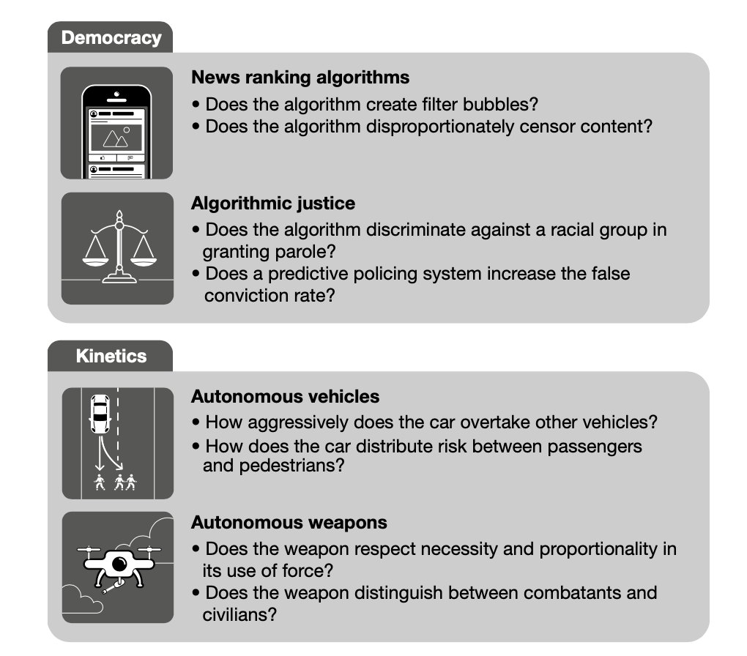
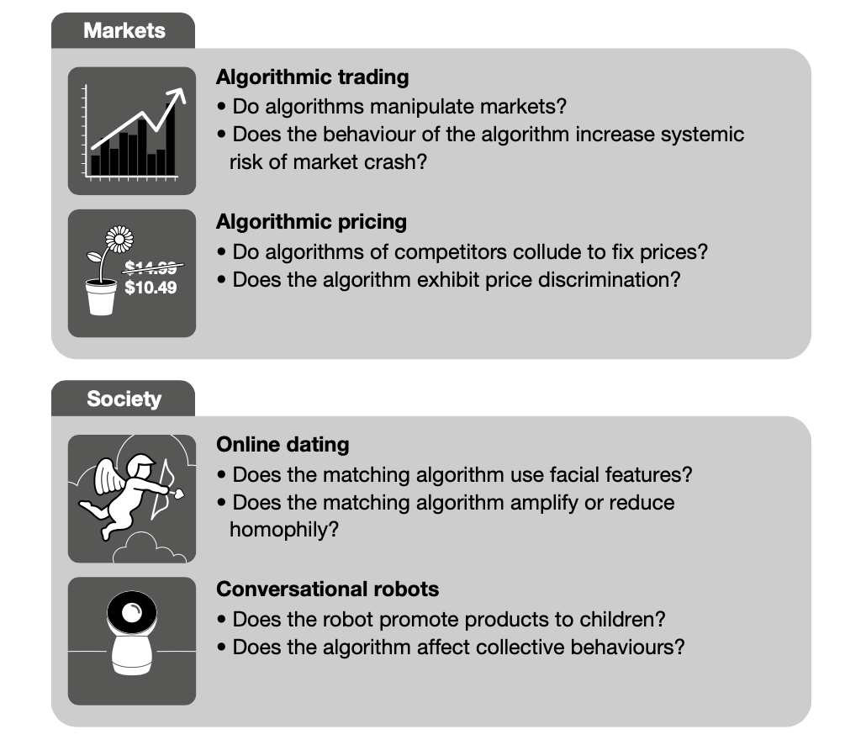
LLMs were on the horizon but were not yet a reality.

Slide 7
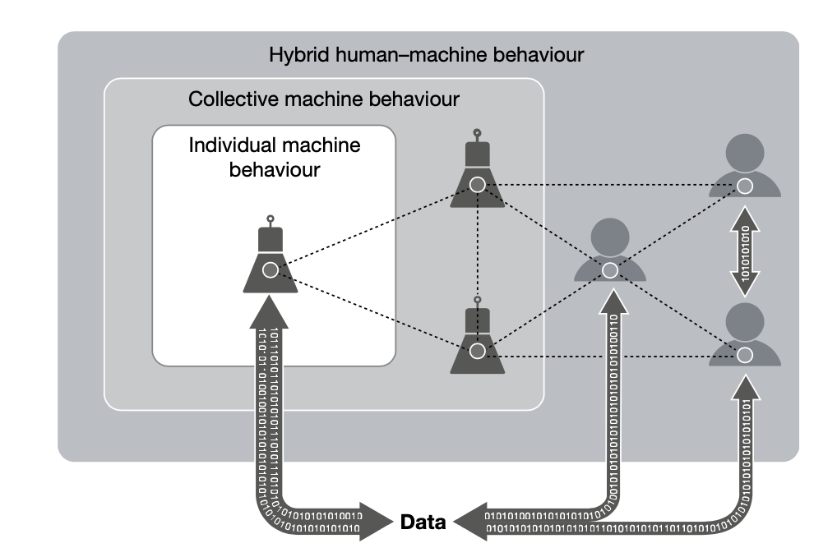
Hybrid Systems and Programming
“Examining how altering the parameters of the engineering process can alter the subsequent behaviours of intelligent machines as they interact with other machines and with humans in natural settings is central to a holistic understanding of machine behaviour.”

Slide 8
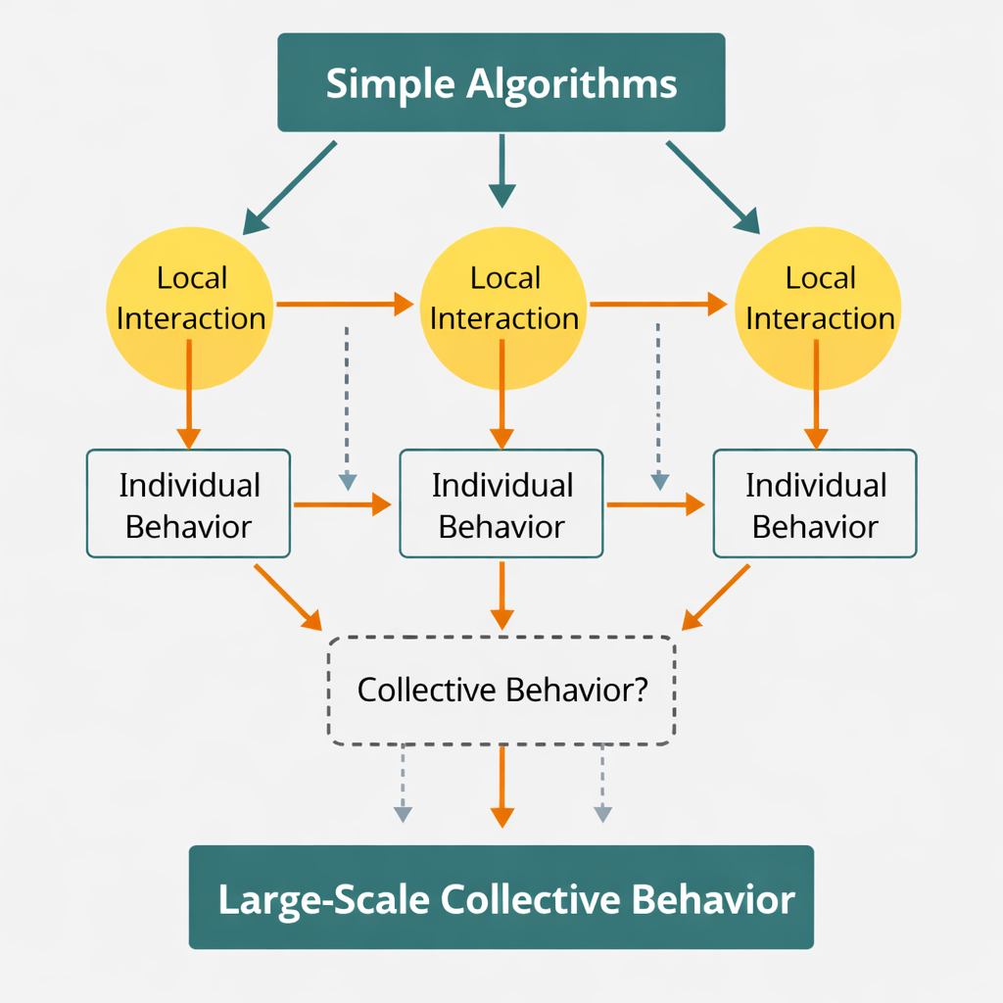
Collective Behaviour via simple Rules
Collective Behaviour
“Robots that use simple algorithms for local interactions between bots can nevertheless produce interesting behaviour once aggregated into large collectives.”
Reinforcement Learning and Programming
“A reinforcement learning agent trained to maximize long-term profit can learn peculiar short-term trading strategies based on its own past actions and concomitant feedback from the market.”

Slide 9
AI agents are created and shaped by human engineers:
“Architectural design choices made by the programmer… determine or influence the kinds of behaviours that the algorithm exhibits.”
AI systems evolve through human-driven processes: “AI replication behaviour may be facilitated through a culture of open source sharing… However, other institutions apply limits as well.”

Slide 10
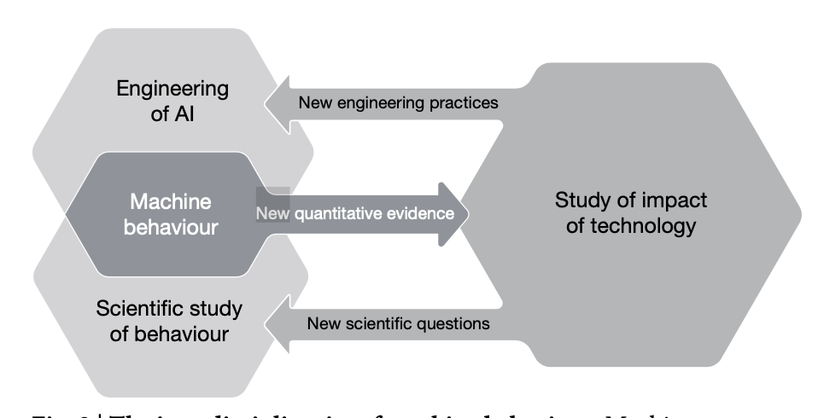
Evolution Through Code Reuse
“At each step, aspects of the algorithms are reused in new contexts, both constraining future behaviour and making possible additional innovations

Slide 11
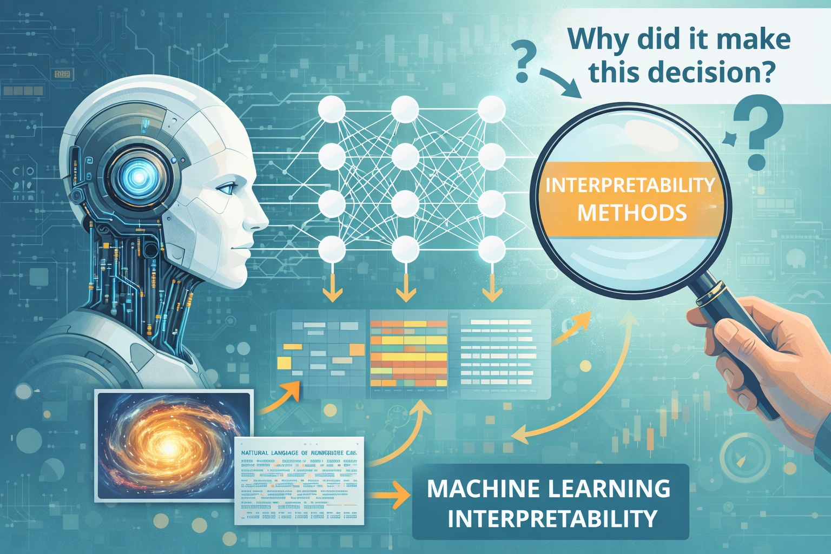
Interpretability Challenges
“Because many current AI systems are derived from machine learning methods that are applied to increasingly complex data, the study of the mechanism behind a machine’s behaviour… will require continued work on interpretability methods for machine learning.”

Slide 12

Human oversight remains critical:
“At present, the scientists who study the behaviours of these virtual and embodied artificial intelligence (AI) agents are predominantly the same scientists who have created the agents themselves.”

Slide 13
Conclusion
Machine behaviour emerges from design + environment: AI systems act as behavioural entities whose actions arise from architecture, data, training processes, and real‑world interactions.
Simple rules → complex outcomes: Even basic local algorithms can produce surprising collective behaviours when scaled, showing the need for behavioural‑level study.
Human decisions shape machine evolution: Programming choices, code reuse, open‑source culture, and institutional constraints all influence how AI agents develop and propagate.
Opacity remains a major challenge: Many systems operate as black boxes, making interpretability essential for understanding and governing behaviour.
Oversight and accountability are essential: As AI systems grow in complexity and autonomy, human governance, ethics, and transparency must remain central.

