Slide 1
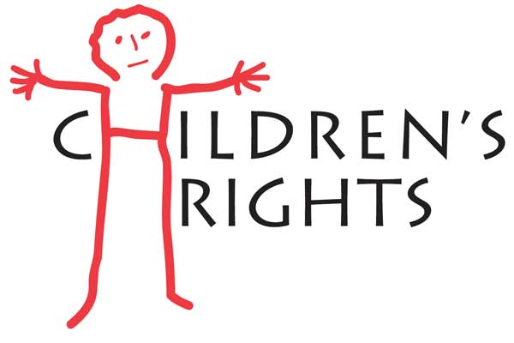

Children’s rights and why their voices are important
WHAT IS THE UNCRC?
WHY ARE THEY SO IMPORTANT?
The rights are important for many reasons, the main ones being that children feel happy, safe, protected and feel as though they have a voice. No child should have to sit in silence. They are important as they can lead to children living better lives. The rights are also to do with safeguarding children. Safeguarding is important to protect children from any harm that can affect them physically, mentally, intellectually or emotionally. In 1924 the need for the special safeguarding of children was expressed in the Geneva Declaration of the rights of the child.
The UNCRC consists of 41 articles that apply to all children and young people up to 18 years of age. The articles states children’s rights and how the government can help parents/ carers carry out the rights to ensure children are living safe and happy lives. It includes basic rights which are the right to life, to food, to shelter and to medical care. It also includes the right to develop within education, play and recreation, freedom of thought, religion, culture and language (Unicef, 2016).
Save the children was founded by Elgantyne Jebb in April 1945 after the second world war. Jebb was an extraordinary lady to fought for children’s rights which lead to the UNCRC which came in to action in the UK on the 15th of January 1992.
194 Countries have signed up to the UNCRC since 1989. America and Somalia are yet to sign. America didn’t want to sign as they felt they didn’t need to prove that American children were having their needs met.
In 2011, Wales became the first country in the UK to make the UNCRC part of it’s domestic law.
‘’The child must be the first to receive relief in times of destress’’ – Elgantyne Jebb
WHERE DID IT ALL BEGIN?
Urie Bronfenbrenner(1927-2005) developed the ecological systems theory to explain how a child’s environment affects their development, his theory links highlights why it is so important to ensure children have rights and how it can affect them if they do not.
He labelled different aspects or levels of the environment that influence children's development, including the:
Microsystem
Mesosystem
Exosystem
Macrosystem
‘’Every child needs at least one adult who is irrationally crazy about him or her’’ – Urie Bronfenbrenner
WHO DO THE RIGHTS APPLY TO?
The rights apply to all children and young people under the age of 18 regardless of their nationality, race, family background, gender, etc. Every child deserves to be treated as an individual and deserves to be treated equally. Everyone that comes in to contact with children and young people is responsible for protecting them from harm.
Important legislation regarding children and young people
The 'Rights of Children and Young Persons (Wales) Measure' 2011
The 'Rights of Children and Young Persons (Wales) Measure' 2011, received unanimous cross party support when it was passed at the National Assembly for Wales in January 2011.
Children acts 1989 and 2004
Childcare act 2006
Equalities act 2010
The social services and well being (Wales) act 2014
This image shows Maslow’s Hierarchy of needs
SURVIVAL
DEVELOPMENT
PROTECTION
PARTICIPATION

Slide 2
Article 12
Article 27
‘Children have the right to say what they think should happen, when adults are making decisions that affect them and have their opinions taken in to account’
This is highly important as children need to feel they have a voice and feel entitled to speak up when they have an opinion, this can lead to children having a better self esteem and confidence within people and can lead to better outcomes in certain situations. Children should feel they can speak up if they are unhappy with certain decisions being made and can ask for advice to understand decisions fully before speaking their opinion.
‘Children have a right to a standard of living that is good enough to meet their physical and mental needs. The government should help families who cant afford to provide this’ Children have needs that enables them to develop effectively. Children need a home, food and water to physically and mentally develop. The government should have strategies put in place to help families that can’t afford basic needs. There are places that have food banks to help families that can’t do a weekly shop.
Article 39
Article 29
Article 19
‘Children who have been neglected or abused should receive special help to restore their self respect’ Governments should ensure help is available in settings for children to build their confidence and self respect to recover from abuse/neglect. The help should be adapted to the child’s individual needs and take place in an environment that promotes their health, dignity and self-respect.
‘Education should develop each child’s personality and talents to the full. It should encourage children to respect their parents, and their own and other cultures’
Education should be about looking at each child as an individual, recognising their preferences and letting them have enjoyment out of their education. Education should promote ways of helping children respect themselves and the people around them as well as teaching them the academic basics such as maths and language.
‘Governments should ensure that children are properly cared for, and protect them from violence, abuse and neglect by their parents and anyone else who looks after them’ Children who suffer from abuse are more than likely to suffer from mental health issues through out their childhood and adulthood, it is the governments duty to ensure there are laws in place to protect children from abuse. They should ensure that cases are investigated to protect children and if they find that a child is suffering, to get them out of the situation as quickly as possible to prevent further harm.

Slide 3
Reference List for briefing paper
Children and young people’s commissioner Scotland (2018) ‘The UNCRC’ Available at: https://www.cypcs.org.uk/rights/uncrc (Accessed at: 10 October 2018)
‘Children’s rights’ [Online Image] http://www.wccc.ie/wp-content/uploads/2012/11/Childrenrights.jpg (Accessed: 18 October 2018)
Child rights International Network (2018) ‘Child’s rights convention’ . Available at: https://www.crin.org/en/home/rights/convention/articles/article-29-aims-education (Accessed: 17 October 2018)
‘Maslow’s Triangle’ [Online Image] https://datadesign.files.wordpress.com/2011/01/maslows-hierarchy-of-needs1.jpg (Accessed: 10 October 2018)
Save the children (2018) ‘Our Founder: Eglantyne Jebb The Woman Who Started Save the Children’ Available at: https://www.savethechildren.org/us/about-us/why-save-the-children/eglantyne-jebb (Accessed: 17 October 2018)
Sincero, S. (2012). ‘Ecological Systems Theory’. Available at: https://explorable.com/ecological-systems-theory (Accessed: 18 October 2018)
UK Government (2010) ‘United Nations Convention on the Rights of the Child (UNCRC): how legislation underpins implementation in England’ Available at: https://www.gov.uk/government/publications/united-nations-convention-on-the-rights-of-the-child-uncrc-how-legislation-underpins-implementation-in-england (Accessed: 12 October 2018)
UNICEF (no date) ‘FACT SHEET: A summary of the rights under the Convention on the Rights of the Child’ Available at: https://www.unicef.org/crc/files/Rights_overview.pdf (Accessed at: October 10 2018)
Veale, F. (2016) Early Years for levels 4&5 and the Foundation Degree London: Hodder & Stoughton Ltd
Welsh Government (2015) ‘United Nations Convention on the Rights of the Child’ (UNCRC) Available at: https://gov.wales/topics/people-and-communities/people/children-and-young-people/rights/uncrc/?lang=en (Accessed: 10 October 2018)

Slide 4
References for presentation

