Slide 1
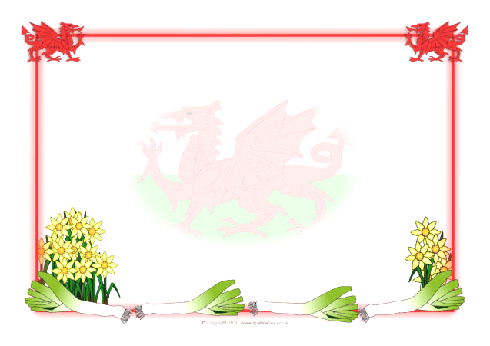

2300218
Ellie Kelman
Historic Welsh Event And The Impact On The Role Of Welsh Language In Education
ECIE5004

Slide 2

Why the S4C is important
How old is the Welsh language?
What S4C brings to us:
Culture and traditions
Language
Culture
Belonging
Notes:
The Welsh language evolved from Brythonic or Common Brittonic, a Celtic language spoken by the Ancient Britons beginning sometime between the Bronze Age and the Iron Age. Making it one of oldest language in what we now call the British Isles.
This is where we get our strong links to culture and traditions.
Welsh is not just a language it's our culture, and sense of belonging. It is that fuzzy warm feeling you get when your all 'cwtched' up at home with your family. Its home, happiness and pride for our culture and traditions.
Such traditions as our wooden spoons, traditionally given as wedding gifts with signs and symbols on that signify, love, happiness, togetherness, loyalty and protection. Symbols & Meanings :
Our leeks. These came from a battle in St. Davids, where the soldiers were told to attach them to their helmets to help camouflage them. The battle took place in a field where leeks were growing. A battle they won.
From this, the tradition of the daffodil appeared, in Welsh they sound very similar and its thought the confusion of the 2 words is where it started from. They are also one of the only flowers, at the time, that were in Wales in full bloom on St Davids Day. (don’t eat daffodil they are poisonous to people and dogs)
Our Castles. We have so many castles in Wales, each one unique withs its own fascinating story to tell, a true sign of how our love, protection and loyalty for our counrty.
The harp, originally from Italy. The harp was introduced to Britain in the court of King Charles the 1st. The 3 string harp was loved by the Welsh in London at the time and brought back to our home land. The 3 string harp quickly fell our of fashion, in other countries but not in Wales, where it is still played today. In England, and many parts of the world now, they only play a 1 string lined harp.
Our world famous rugby. We are a nation that wears our heart on our sleeve, especially when it comes to rugby. We may not be playing our best game at the minute, however fans as still as passionate when we score a try when loosing as they are when we win the world cup, the signing of the national anthem in the stadium is one of the loudest and proudest anthems you will ever hear. It’s the power of our culture, passion and traditions that makes our country so strong.
This shows the passion, culture and strong sense of belonging that Wales has , as a nation for the Welsh language.

Slide 3
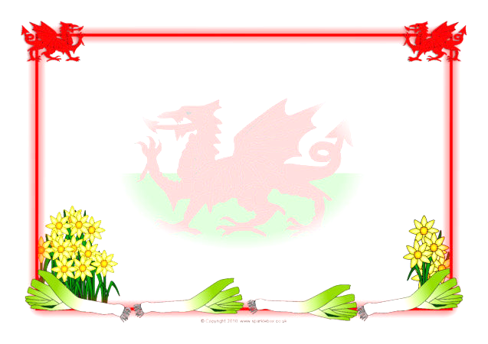
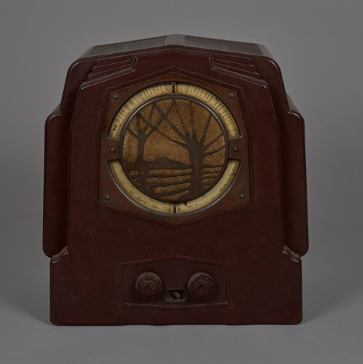
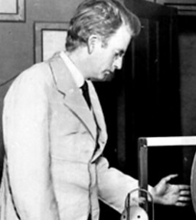

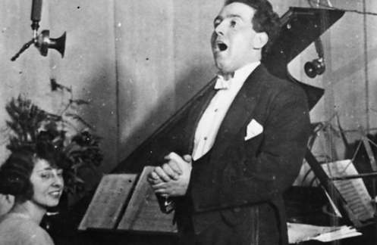
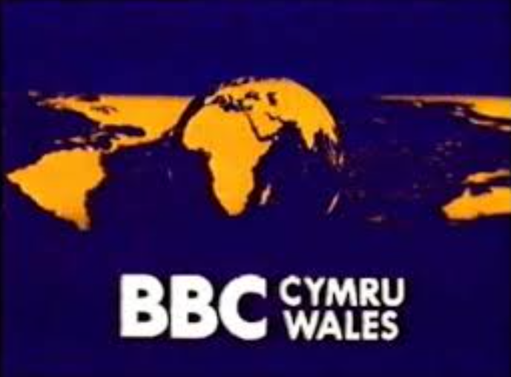

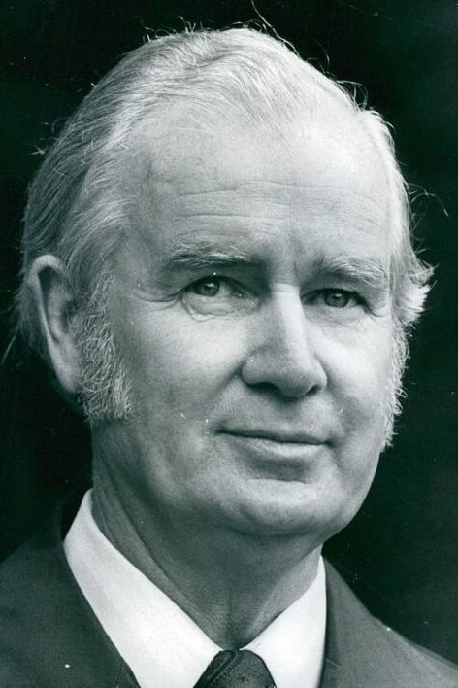


Where it began
1952
Cylch Dewi
1920
1930s
1929- the start of television
1923 –BBC’s first broadcast from Wales
1964
1990s
2050
1980's
1982
100 years of the BBC in Wales: an u neasy start and unclear future​
​
Notes:
1920 A group of Welsh nationalist called Cylch Dewi, were campaigning for Wales, to have our language and culture acknowledged. That Wales is a stand alone country, not part of England.
1923 3months after the first radio broadcast, Wales had their language heard on the radio for the very first time. At 9pm on 13th Feburary 1923, the first welsh language song was sung on the radio by Mostyn Thomas from a newly opened sation in Cardiff. Just over a year later a Swansea station was opened. However, these were still classed as the west reigion. History of the BBC in Wales .
John Logie Baird , done wonders with the radio station in London. Transmissions from London town to nation wide radio. He then moved from radio station to broadcasting images. He started the very first transmissions on Television in 1929. 1920s
1930, Wales wanted to see a separate Welsh Region, providing programmes in both English and Welsh languages for the Welsh audience. After a lengthy campaign, the transmitter in Penmon was opened in February 1937, signaling the beginning of the Welsh Region History of the BBC in Wales
1952- Wales had its own Radio station thanks to the support from John Davies, this radio station is still going strong today and helped pave the way for our own television region. Since 1952 "the BBC have played a major part in Welsh life, where it informed, educated and entertained in Welsh and English initially on the radio but also television from 1952."100 years of the BBC in Wales: an u neasy start and unclear future
1964, BBC Wales was born, no longer being part of BBC west region, Wales now has its own region. However it was only allowed 7 hours a day of Welsh language and 5 hours of English. Although this is a great start to the Welsh langauge change over, it was still not enough...
1980s, Gwynfor Evans, a patriot politician who famously became the first MP for Plaid Cymru back in 1962, He won the election, in Carmarthenshire, where the famous photo of the day he won, is still outside the old court house in Carmarthen. In 1980, Gwynfor Evans, went on a hunger strike due to the government not holding up their side of the bargain with Wales having their own TV channel. This is the man, who managed to get the Iron lady herself to change her mind, and give Wales their own channel, not sharing one with channel 4.
On the 1st of November 1982, at 6pm, S4C was born. S4C broadcasted 22 hours of Welsh progrmms a week, alongside English programs from Channel 4. Introducing S4C | S4C Wales finally has its own Welsh language television channel.
1990s 2nds Welsh language soap Rownd a rownd started, anlogng with Clwb Rugbi a welsh language rugby union program, and in 1999 the S4c Broadcast the national Eisteddod of Wales, the Urdd and the Royal welsh show. Timeline of S4C - Wikipedia
2020-2050 Now, S4C has more than 115 hours of Welsh programs a week and is working along side the Welsh government to reach the million Welsh speakers by 2050.

Slide 4

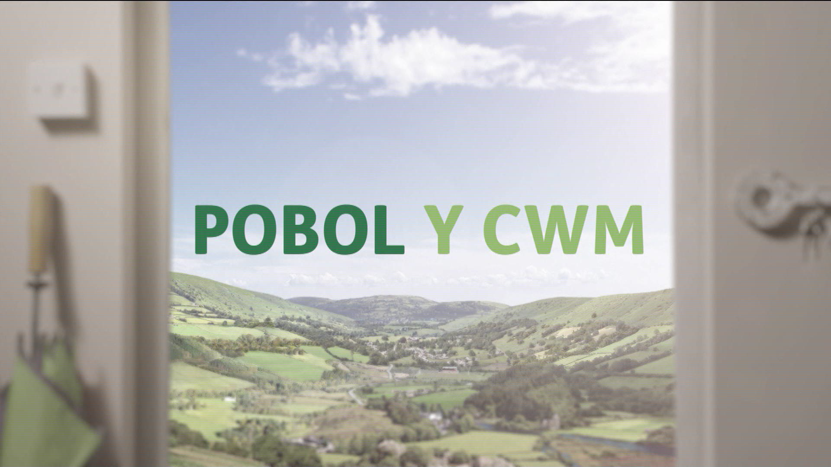

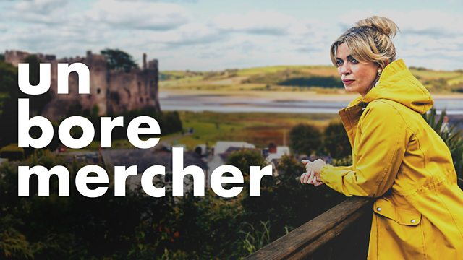
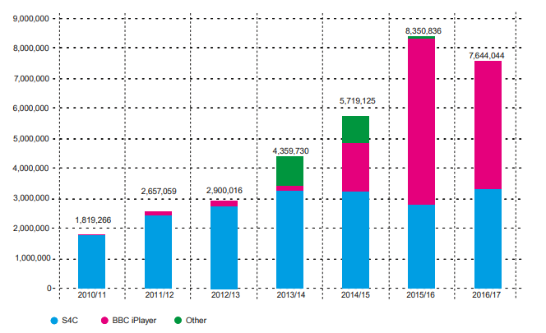


S4C's links BBC
BBC provide a minimum of 520 hours of programming a year.
Notes:
Since the launch of S4C in 1982, BBC Cymru has provided a wide range of programs and content for transmission on S4C, including news, and Pobol y Cwm. The current arrangements are for the BBC to provide a minimum of 520 hours of programs per year.
Since 2013, the BBC has been responsible for providing funding, from the licence fee, to support the public funding for S4C. This arrangement will continue until the end of the current Royal Charter in 2028. This funding and sharing broadcasting sites through out Wales is really supporting not only our Welsh language but the economy as well. The BBC uses our Cardiff Roath studios, putting more money into Wales, this highlights that the BBC are more inclusive of our work, heritage and lifestyle, with more nation wide TV programs being based in Wales such as ‘the way’ Hinterland, originally in Welsh then dubbed over in English. Keeping Faith, again an original for S4C which was then re filmed with the same actors in English. Not forgetting our most famous of all Gavin and Stacey. Although this is not in the Welsh language, the show put Barry Island back on the map.
The BBC also support with interactive viewing through BBC I player, as you can see on the graph. S4C is blue, Iplayer is pink, green is other sources, this graph shows data from 2010 to 2017 to show viewing sessions of S4C. You can clearly see an increase of volume over time where I player, known all of the world, suddenly has an influx in those accessing S4C through it. Although clic is still popular only decreasing to just under 3 million on 2016. The use of welsh langauage online and stream programs online has increased overall by 6 million viewers in 6 years. 14% of all S4C viewing hours comes from BBC I player S4C clic and you tube this is increasing annually. This is a of people aged 16-44 already wsatchign S4C through digital platforms. S4C launches new strategy with the first Welsh-language vertical TikTok drama broadcast | Press | S4C
19 TV Shows and Movies Filmed in Wales
Unbroe mercher S4C - Un Bore Mercher, Cyfres 2020, Pennod 1
From 2019, the BBC and S4C have also colate and share techinal broadcasting equipmwentr from the broadcasting Center in Cardiff. BBC/S4C strategic agreement

Slide 5
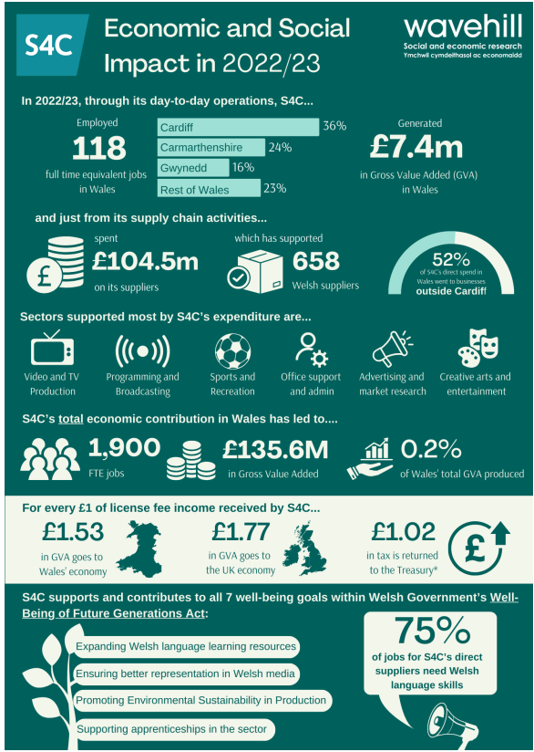

Economy
S4C contributed £150.3 million to the Welsh economy last year
(Nation Cymru 2025)
Notes:
Report_-_Assessment_of_S4Cs_Economic_and_Social_Impact_2022-23.pdfReport_-_Assessment_of_S4Cs_Economic_and_Social_Impact_2022-23.pdf
The S4C supports the Welsh economy in many different ways, as you can see from this graphic of the Econimical and Social impact of 2022/23 by Wavenhill.
S4C supports local jobs within Wales, with 118 full time positions in 2022/23/ They also try and support everything local using 658 Welsh suppliers within the same year. Of this 52% was outside of the Cardiff area. This has the added value of over £135.6 million economic contribution to Wales.
S4c is not only supporting the economy but our local culture too. Supporting creative arts and entertainment, sports and recreation, and working very closely with the WRU, our world famous rugby team. Helping and supporting them, with their website to ensure bilingualism, giving staff free welsh lessons as well as supporting the lower level clubs to ensure the welsh language, culture, and tradition is not forgotten.
Within the Ravenhill report on Econmic and Social impact, it states that "A survey conducted among S4C's direct suppliers revealed that Welsh language skills are essential for 75% of their workforce", showing how vital the welsh language is to their local business, how the bond of the historical Welsh language is what is still keeping the country strong, building up the economy to this day.
including help with their website. Encouraging that the Welsh language section is accessible and up to date. S4C are also supporting them with Welsh lessons and ensuring that all games have a welsh language option commentary.

Slide 6
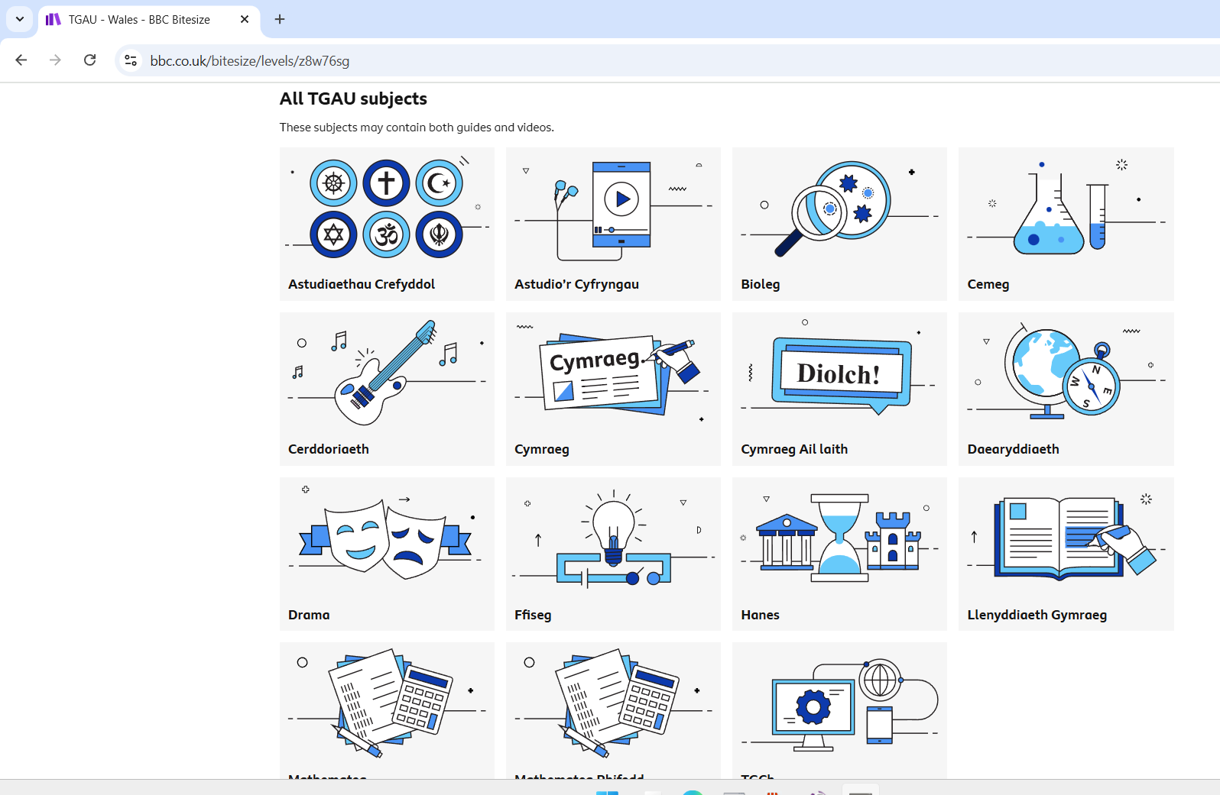


S4C links with Education
100 teaching hours on Welsh culture and history
2050
Notes:
Here you can see a screen shot from the BBC bitesize page, where S4C and BBC are working together on ensuring an inclusive education for all. All GCSE subjects can be accessed through the medium of Welsh. This is over seen by the S4C to ensure that all language and information is correct. Following in line with Curriculum Cymreag.
S4C have also created a number of their own teaching materials including over 100 hours of history of Wales. The online education pack, is based on the history series Amser Maith, Maith yn Ôl contains 100 teaching hours for children aged 5 to 9. Supporting the existing curriculum and the new educational curriculum that was formally introduced to classes in 2022. This is the first time that such an education pack has been produced in Welsh with support from Canolfan Peniarth. working alsong side the S4C. Education pack which includes 100 teaching hours is launched to accompany S4C children’s history series | Press | S4C
Adnodd is another goverement run activity, that focuses on the Welsh language in education and for supporting ALN. HIt works on how to integrate the Welsh language and has three key focus areas that guide Adnodd’s work: Literacy, Equality & Anti-racism, and Well-being. These focus areas are designed to ensure that every resource commissioned makes a meaningful, lasting contribution to addressing the biggest challenges facing learners and educators today — from falling literacy levels to entrenched inequalities and the mental health crisis affecting children and young people in Welas. New Strategy from Adnodd Sets Out Vision for Educational Resource Development
Our new generation needs a new way of learning and with this new bilingual resources created by Adnodd, Welsh education and bilingulaism will no longer be held back, creating a new, fun, up to date, technology based learning tool. Finally bringing Welsh learning into the 21st century.
Hwb have also done some creative work with S4C, WJEC and the Welsh Government, working together on a streaming channel that hosts over 80 hours of programms on hwb. You must be able to long onto hwb to access these. There are two different areas of lez\arning here. One for Secondary school and another for post 16 learners only. This is continuously being updated by S4C on Hwb. S4C streaming channel - Hwb

Slide 7



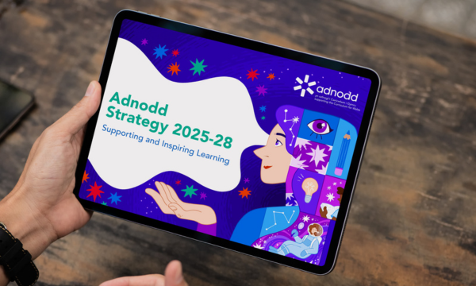


S4C and generations
Adnodd- working with WG, Hwb , and a focus on ALN
Notes:
Adnodd is another goverement run actiovity that focuses on the welsh language in education and ALN. How to intergrate the welsh language.
three key focus areas that will guide Adnodd’s work: Literacy, Equity & Anti-racism, and Well-being. These focus areas are designed to ensure that every resource commissioned makes a meaningful, lasting contribution to addressing the biggest challenges facing learners and educators today — from falling literacy levels to entrenched inequalities and the mental health crisis affecting children and young people. New Strategy from Adnodd Sets Out Vision for Educational Resource Development
Our new generation need a new way of learning and with this new bilingual resources created by Adnodd, Welsh education and bilingulaism will no longer be held back, creating a new, fun, up to date, technology based learning tool. This is the way most pupils now like to learn and communicate with others. Finally bringing Welsh learning into the 21st century.
Cyw, is designed for babies up to the age of 7. This is not just TV shows but also an interactive website, where they have songs, games, a creative tab where you can colour and draw out your thoughts and feelings as well as a a very important birthdays page, where you can upload a photo and message for a little ones special day that may then be shown on TV. Gwefan Cyw | S4C
Stwnsh, shown as the S and plus sign, is designed for children ageed between 7 to 14. Again not just Tv progamms they also have their very own you tube channel, something the new generation are fascinated with! Along with this, they have online with games, competeions and such a verity of programs all based in Wales, covering everything from the daily news to the most extreme challenges in Wild Wales! Very enterating with this age group, almopst like a welsh verson if Im a celebruity get ee out of here. Stwnsh | S4C
Hansh is designed for our teenagers and young adults. Again available online, but also tictock, Instagram and facebook to name a few. Here you have your more grown up programs such as reality shows, or celebrity ones, even with bar Hansh, which on a first look seems to be a Welsh version of Beindorm. Everything is available to access online as well as on S4C channel itself. Hansh | S4C S4C also use you tube to target the teenage audience, with exclusive shows on you tube as well as tick tok, which are not available anywhere else.
S4C is also available through its very own app, which ahs had over 250,000 subscriptions since it started. “S4C Clic is the place to watch S4C's programmes on demand and since developing its subscription model in May 2019, the service has considerably enhanced its provision.
In addition to streaming new and classic drama series, S4C Clic now offers exclusive live sport, including rugby from the Indigo Group Premiership and Welsh Schools and Colleges League, as well as dedicated content for children, young people and Welsh learners” S4C Clic reaches 250,000 registrations | Press | S4C
Thanks to the links S4C has with the BBC, you can also access S4C through BBC Iplayer.
S4C launches three teen-focused YouTube channels | Press | S4C

Slide 8

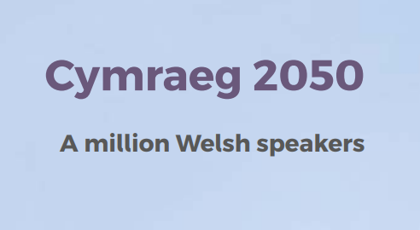
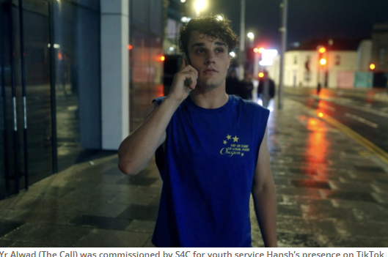

S4C's Future…
Memorandum of understanding
between Cymraeg 2050 and S4C
Notes:
S4c will be hosted the Semi-final round of judging the 2025 international Emey awards in our iconic Cardiff Castle on the 30th June 2025. An international celebration of the televison Arts and Science in Animantion, celebrating the greatest of the fim and televsoin industry outside of the US. The final of this event will be in in New York on the 24th of November 2025.
As the only Welsh language telvsion breadcaster, BBC and the government is working inpartnership with S4C with annual funding of £6.72 million. The secatary of state for wales Alun Cairns stated " S4C undeniably makes an enormous contribution towards the creative industries in Wales, and crucially, to promoting the Welsh language and our culture around the world." This how s how important the channel is, and how the channel can be seen all over the world as it is now. The future of S4C - GOV.UK
This shows how the channel has eveolved and moving forward with the 21st century. Having the channel digitalised, making it more than just a welsh channel is really pushing the S4C forward. As stated by Gariant Evans, chief executive of S4C. As part of this, Yr Alwad (The Call) was commissioned by S4C for youth service Hansh’s presence on TikTok. Produced by Mojo Productions, the drama about homophobic bullying also highlights the dangers faced by young people when out socialising. It launched on TikTok on September 8, with all seven episodes now available on S4C’s TikTok playlist. Welsh pubcaster S4C reveals new digital-first five-year vision | News | C21Media This new way of broadcasting is not only supprotin g mental health and wellbeing by theses shows but also the promotion of the welsh language in the world of the newst generation, in a supprotive way dealthing with current issues that many teenagerswe will be struggling with. Thaving this on Tictok, on of the newest and well known social media platorms, sows how they push forward into the new digiatal eria, not being just a televison program. Welsh pubcaster S4C reveals new digital-first five-year vision | News | C21Media
The S4C memorandum shows upport to the Welsh governemnt and how they are looking at working together to help create 1 million welsh speakers by 2025. S4C, have changed the way we look at the welsh language, making it fun, accessable and easy to learn at any time. Bringing in the use of pccaional Welsh, bringing welsh back out into the communities, just a few words to start a converstion and then change toenglish, encouarging this s a great start to building up the confidence in new welsh learners to try and speak welsh. S4C aslo have so many new interactive programs where you can opt for English subtitiles, to interactive on line ready to learn welsh lessons that you can aceess fo free at any time. This memonrandum is working well by increasing the infrastrucutre aond context of the welsh language, which in turn increases the use of the welsh langaugae to a way that views want.
Memorandum of Understanding between S4C and Cymraeg 2050
With most of the funding coming from the BBSC this has helped secure the future for the broadcasting channel.
WG million welsh speakers by 2050 Cymraeg 2050: A million Welsh speakers
Working with sports and welsh language
BBC Tv licencing
Welsh lessons online for free
Adnodd supporting mental health and wellbeing as well as education
working with education system supporting primary schools with programs and activities all based around the curriculum
Not just a tv channel… it's our history, our culture, our language, our future, its ours.

Slide 9
Reference - pictures
BBC logo (2025) slide 4 available at: BBC - Home accessed on 26/11/2025
Back ground picture frame. Welsh flag clipart. Available at: https://animalia-life.club/qa/pictures/welsh-flag-clipart-borders Accessed on 19 November 2925
Bbc Iplayer (2025) available at: BBC iPlayer - Home Accessed on : 2/12/2025
Clwb Rybi (2025) available at: https://www.s4c.cymru/clic/programme/895509537 Accessed on 24/11/2025
1995 S4C logo Available at: S4c Logo PNG Vectors Free Download Accessed on 19/11/2025
Gwynfor Evans Photo Available at: Gwynfor Evans | famouspeople.wales Accessed on 19/11/2025
BBC 1930s available at: Introduction: Broadcasting House in the 1930s accessed on 20/11/2025
1964 bbc wales logo On this day 1964, BBC Cymru Wales... - The History of Wales | Facebook
Pobol y Cwm picture (2021) Available at: Pobol y Cwm spoilers: Monday 15 February 2021 | Eastieoaks Accessed on 24/11/2025
Ruby ball Available at : Welsh Rugby G-TR3000 Training Ball Accessed on: 28/11/2025
Un bore Mercher (2020) Availabel at: S4C - Un Bore Mercher, Cyfres 2020, Pennod 1 accessed on: 29/11/2025
2025 Semi final round of judging Emmy Awards Available at: Wales' S4C to host 2025 International Emmy Semi-Finals in Animation - Señal News Accessed on 26/11/2025

Slide 10
Reference - pictures
1964 BBC Wales logo Available at: On this day 1964, BBC Cymru Wales... - The History of Wales | Facebook​ Accessed on: 19/11/2025​
1995 S4C logo Available at: S4c Logo PNG Vectors Free Download Accessed on: 19/11/2025​
2025 Semifinal Round Judging Emmy Awards Available at: Wales' S4C to host 2025 International Emmy Semi-Finals in Animation - Señal News Accessed on 26/11/2025
BBC 1930s Available at: Introduction: Broadcasting House in the 1930s Accessed on 20/11/2025​
Back ground picture frame. Welsh flag clipart. Available at: https://animalia-life.club/qa/pictures/welsh-flag-clipart-borders Accessed on: 19 November 2925 ​
BBC Iplayer (2025) BBC Iplayer logo Available at: BBC iPlayer - Home Accessed on : 2/12/2025​
BBC logo (2025) Available at: BBC - Home accessed on 26/11/2025​
Clwb Rygbi (2025) available at: https://www.s4c.cymru/clic/programme/895509537 Accessed on 24/11/2025
Gwynfor Evans Photo Available at: Gwynfor Evans | famouspeople.wales Accessed on 19/11/2025​​
Pobol y Cwm picture (2021) Available at: Pobol y Cwm spoilers: Monday 15 February 2021 | Eastieoaks Accessed on 24/11/2025​
Ruby ball Available at : Welsh Rugby G-TR3000 Training Ball Accessed on: 28/11/2025​
Un bore Mercher (2020) Available at: S4C - Un Bore Mercher, Cyfres 2020, Pennod 1 accessed on: 29/11/2025​

Slide 11
References
Akyuz G. (2025) Welsh pubcaster s4C revelas new digital first five year vison. Available at: Welsh pubcaster S4C reveals new digital-first five-year vision | News | C21Media Accessed on 2/12/2025​
BBC (2023) BBC/S4C strategic agreement available at: BBC/S4C strategic agreement Accessed on 24/11/2025​
Davies J. 1952 Available at:100 years of the BBC in Wales: an uneasy start and unclear future Accessed on 24/11/2025​
Department for digital, meida, culture and sport. (2017) Building S4C for the future Available at: Building an S4C for the future Accessed on:3/12/2025​
BBC Available at: The BBC Story accessed on 23\11\2025​
Nation cymru (2025) available at: S4C contributed £150.3 million to the Welsh economy last year - new report accessed on:17/11/2025 ​
S4C (2025) Introducing S4C avilabale at:https://www.s4c.cymru/en/about-us/introducing-s4c/page/17280/introducing-s4c/ Accessed on: 12/12/2025
S4C Clic (2025) available at: S4C Clic reaches 250,000 registrations | Press | S4C Accessed on: 29/11/2025​
S4C Cyw (2025) available at: Gwefan Cyw | S4C accessed on 29/11/2025​
S4C Hansh (2025) Abvailable at: Hansh | S4C accessed on 29/11/2025​
S4C Stwnsh (2025) available at: Stwnsh | S4C Accessed on 29/11/2025​

Slide 12
References
The future of S4c (2018) Gov.uk available at: The future of S4C - GOV.UK accessed on : 2/12/2025​
The future of S4c (2018) Gov.uk available at: The future of S4C - GOV.UK accessed on : 2/12/2025​
The strings of our nations heart – slide 2 (2025) available at: The Welsh harp: our national instrument | Wales.com Accessed on 17/11/2025​
​Thomas M. 1923 available at: Amgueddfa Cymru | Museum Wales on X: "At 5pm on 13 February 1923, the first ever first radio broadcast in Wales was made from a tiny studio at 19 Castle Street, Cardiff 📻🏴󠁧󠁢󠁷󠁬󠁳󠁿 Then at 9.30pm, Mostyn Thomas sang ‘Dafydd y Garreg Wen’, the first Welsh language song on air 📰 https://t.co/PUkILkA2b5 #WorldRadioDay2023 https://t.co/SBhHOuGNhT" / XAccessed on 24/11/2025​
Twinkl (2025) 10 fascinating Welsh language facts. Available at: 10 Fascinating Welsh Language Facts - Twinkl blog -Twinkl Accessed on 17/11/2025​
Welsh language (2025) Available at: Is Welsh the Oldest Language in Europe?​ Accessed on 24/11/2025​
Welsh love spoons (2025) available at:Symbols & Meanings : accessed on:29/11/2025
Wavehill 2023 Economic and social impact 2022/23 Available at: Report_-_Assessment_of_S4Cs_Economic_and_Social_Impact_2022-23.pdf Acessed on 27/11/2025

Slide 13
References
BBC (2023) BBC/S4C startegic agreement available at: BBC/S4C strategic agreement Accessed on 24/11/2025
S4C Clic (2025) available at: S4C Clic reaches 250,000 registrations | Press | S4C Accessed on: 29/11/2025
S4C Cyw (2025) available at: Gwefan Cyw | S4C accessed on 29/11/2025
S4C Hansh (2025) Abvailable at: Hansh | S4C accessed on 29/11/2025
S4C Stwnsh (2025) available at: Stwnsh | S4C Accessed on 29/11/2025
Wavehill 2023 Economic and social impact 2022/23 Available at: Report_-_Assessment_of_S4Cs_Economic_and_Social_Impact_2022-23.pdf Acessed on 27/11/2025

Slide 14
References
Akyuz G. (2025) Welsh pubcaster s4C revelas new digital first five year vison. Available at: Welsh pubcaster S4C reveals new digital-first five-year vision | News | C21Media Accessed on 2/12/2025
Department for digital, meida, culture and sport. (2017) Building S4C for the future Available at: Building an S4C for the future Accessed on:3/12/2025
BBC Available at: The BBC Story accessed on 23\11\2025
Is Welsh the Oldest Language in Europe?
Twinkl (2025) 10 fascinating Welsh language facts. Available at: 10 Fascinating Welsh Language Facts - Twinkl blog -Twinkl Accessed on 17/11/2025
Davies J. 1952 Available at:100 years of the BBC in Wales: an uneasy start and unclear future Accessed on 24/11/2025
Thomas M. 1923 available at: Amgueddfa Cymru | Museum Wales on X: "At 5pm on 13 February 1923, the first ever first radio broadcast in Wales was made from a tiny studio at 19 Castle Street, Cardiff 📻🏴󠁧󠁢󠁷󠁬󠁳󠁿 Then at 9.30pm, Mostyn Thomas sang ‘Dafydd y Garreg Wen’, the first Welsh language song on air 📰 https://t.co/PUkILkA2b5 #WorldRadioDay2023 https://t.co/SBhHOuGNhT" / XAccessed on 24/11/2025
Slide 2 photo ThePhoto by PhotoAuthor is licensed under CCYYSA.
The Welsh harp: our national instrument | Wales.comSlide 2
nation cymru (2025) available at: S4C contributed £150.3 million to the Welsh economy last year - new report accessed on:17/11/2025
available at:

Slide 15
Welsh love spoons (2025) available at:Symbols & Meanings : accessed on:29/11/2025
The future of S4c (2018) Gov.uk available at: The future of S4C - GOV.UK accessed on : 2/12/2025
S4C (2025) Introducing S4C avilabale at:https://www.s4c.cymru/en/about-us/introducing-s4c/page/17280/introducing-s4c/ Accessed on: 12/12/2025

Slide 16
Historic Welsh Event
ECIE 5004
2300218 - Ellie Kelman

Slide 17
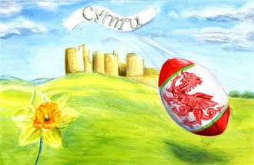
Why S4C is an important?
How old is the Welsh language?
Language
Culture
Belonging
Income
The Photo by Photo Author is licensed under CCYYSA.
Notes:
The Welsh language evolved from Brythonic or Common Brittonic, a Celtic language spoken by the Ancient Britons beginning sometime between the Bronze Age and the Iron Age. Making it the oldest language in what we now call the British Isles.
This is where we get our strong links to culture and traditions.

Slide 18
Why S4C is an important????
How old is the Welsh language?
Culture and traditions
What S4C brings to us:
Language
Culture
Belonging
Income
Notes:
The Welsh language evolved from Brythonic or Common Brittonic, a Celtic language spoken by the Ancient Britons beginning sometime between the Bronze Age and the Iron Age. Making it the oldest language in what we now call the British Isles.
This is where we get our strong links to culture and traditions.
Such as our language, our history of our Prices in their castles, our mountains and agriculture historic presence of farming.
The welsh leek, is know in history from a battle against the Saxons where St David ordered them to wear them on their helmets. This battle took place in a field full of leeks. Shakespeare also mentions the 'Ancient tradtion' , and his character Henry V tells Fluellen that he is wearing a leek “for I am Welsh, you know, good countryman.”
Since the 19th century the daffodil has been a national symbol, the Welsh word for daffodil is ‘Cenhinen Bedr’. The literal translation of this is ‘Peter’s Leek’ which relates to one of the other emblems of Wales, the leek. Some suggest that this closely related name could have caused confusion and led to the use of a daffodil instead of a leek.
Our music and song, with our Welsh harp. Originated from Italy, the 3 string harp wqas brought over for a performance for King Charles the first. This was then adopted by the Welsh who live in Londan and quickly spread as a favorite through Welsh culture. The 3 stringed harp is now imbedded within the culture of Wales.
So what dose this have incommon with S4C? This is the reason for S4C, what it stands for and its heratige, all based on the welsh language and culture of wales the feeling og belonoing. The S4c also brought itn
Food with our leeks, cawl and our world famous Welsh lamb.
Our national flower of the daffodil and our beautiful Celtic welsh love spoons

Slide 19

Why S4C is an important????
How old is the Welsh language?
Language
Culture
Belonging
Income
The Photo by Photo Author is licensed under CCYYSA.
Notes:
The Welsh language evolved from Brythonic or Common Brittonic, a Celtic language spoken by the Ancient Britons beginning sometime between the Bronze Age and the Iron Age. Making it the oldest language in what we now call the British Isles.
This is where we get our strong links to culture and traditions.

Slide 20
Where it began
1952
Cylch Dewi
1920
1930
1929- the start of television
1923 –BBC’s first broadcast from Wales
1964
1990s
1980
2050
1982
Notes:
1920 A group of Welsh nationalist called Cylch Dewi, were campaigning for Welsh language to have its onen broadcasting service.
1923 3months after the first radio broadcast, Wales had their very own. 13th February 1923 a Sation in Cardiff was opened. Just over a year later a Swansea station was opened. However, these were still classed as the west reigion. History of the BBC in Wales . At 9pm on 13th Feburary 1923, the first welsh language song was sung on the radio by Mostyn Thomas
1927 John Logie Baird , done wonders with the radio station in London. Transporting got form London town to nation wide. He then moved from radio station to broadcasting images. He stared the very first transmisstion on Telision. 1920s
1930, 3months after tv had started welsh lanuage was on TV
1952- Wales had its own Radion station thanks to the support form John Davies, this radio station is still going strong today and helped pave the way for our own telisivion region. As Davies states that wghat was being broadcast was alien to our trations, language and culture"100 years of the BBC in Wales: an uneasy start and unclear future
1964, BBC Wales was born, however it was only allowed 7 hours a day of welsh language and 5 hours of English. We are now do not share a regeion with England. Where we used to be part of BBC West, Wales not has its own channel. Although this is a great start to the welsh langauge.
1980, Gwynfor Evans, a patriot politician who famously became the first MP for Plaid Cymru back in 1962, HE was voted on, in Carmarthenshire, where the famous photo of the day he won, is still outside the court house in Carmarthen. In 1980, Gwynfor Evans, went on a hunger strike die to the government not holding up their side of the bargain with Wales having their own TV channel. The man who managed to get the Iron lady herself to change her mind, and give Wales their own channel, not sharing one with channel 4.
1990s 2nd welsh langauge soap, kids tv rebrandinf
2020-2050

Slide 21
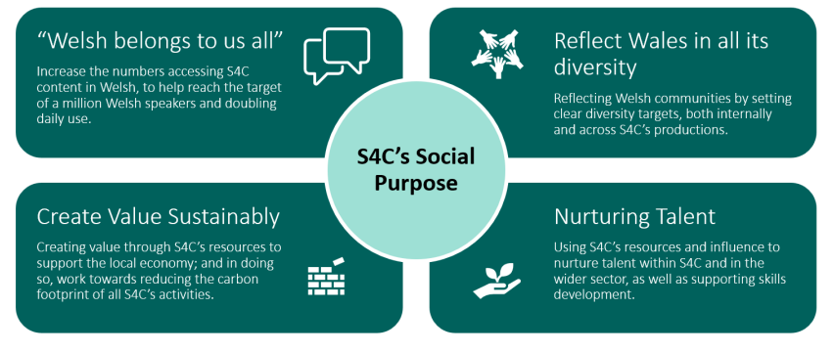
Social and Culture

