Slide 1
MRSA
THE AFFECTS THIS HAS ON PUBLIC HEALTH IN WALES
By Stacey Williams

Slide 2
Contents Page
Introduction
Signs, Symptoms, Causes and Treatment for MRSA
Health Trends and Evaluation
The Impact on Health and Social Care in Wales
Preventative Methods
Infection Control
Statistics in Wales
Conclusion
Reference List

Slide 3
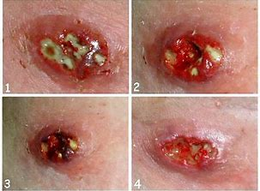
Introduction
Welcome to this presentation of communicable disease, the chosen area of interest is MRSA, this presentation revels the reality of MRSA and the potential implication, it has on public health in Wales.
(wales.nhs.uk, 2016)
(ottawaecopro)

Slide 4
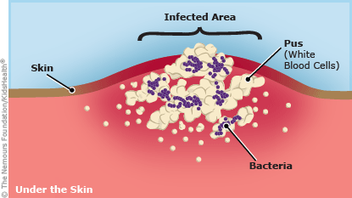
What are the Signs, Symptoms, Causes and Treatment for MRSA
There are several signs and symptoms for MRSA.
The NHS Wales, recognise that the cause of MRSA is.
To treat MRSA, it is important that people diagnosed with it, follow the correct medical assistance.
(www2.nphs.wales.nhs.uk)
Freeman-Cook, et al, 2006)
(mrsmrsa.blogspot, 2015)

Slide 5
Health Trends and Evaluation
Looking at the different trends in Wales, it has become clear that certain types of groups, in Wales are at a higher risk of getting MRSA. These groups are identified as.
People who have had trauma to the skin. for example case study.
Physical contact with someone who is carrying or has MRSA.
Living in crowded or unsanitary places.
(Young et al, 2006)
Chang et al, 2006)
Aiello et al, 2006)

Slide 6


The Impact MRSA has on Health and Social Care in Wales
MRSA can be costly to the public health in Wales.
The impact MRSA can have on professionals.
(Goetghebeur et al, 2007)
(www.alamy.com/stock-photo)
(www.wales.nhs.uk)

Slide 7
Preventative Methods
Wash your hands often.
Follow the advice from health prerational about wound care and looking after equipment that could lead to infection.
Report any unclean facilities to appropriate person.
Try to put a dressing over open areas like cuts or sores to prevent MRSA entering the body.
Use correct personal protective equipment. (PPE)
(Vandenesch et al, 2004)

Slide 8
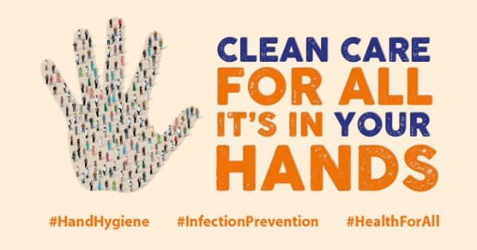
Infection Control Guidance within Health and Social Care
Effective hand washing.
Use of personal protective clothing. (PPE)
Safe management and disposal of waste.
Safe handling of laundry.
Decontamination: Maintain high standards of cleaning.
Correct management of spillages of blood and body fluids.
(Humphreys, 2007)
(www.infectionpreventioncontrol.co.uk,2017)
(www.who.int)

Slide 9
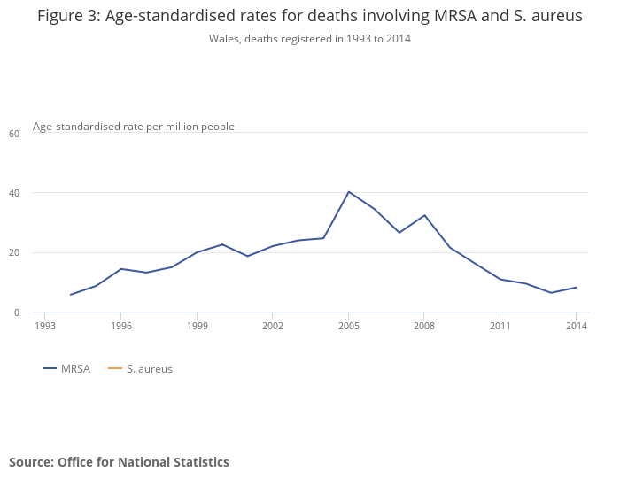
Statistics in Wales
More than 90,000 people in Britain will die over the next three decades unless action is taken to halt the rise in antibiotic-resistant superbug infections says the Organisation for Economic Co-operation and Development (OECD).
Here is a graph showing the age rates for deaths involving MRSA in Wales between, 1993 to 2014.
(www.theguardian.com/society/2018)
(https://www.ons.gov.uk/peoplepopulationandcommunity, 2013)

Slide 10
Conclusion
Using the information that has been gathered, this presentation clearly identifies what MRSA is. As well as the signs, symptoms and causes. This will help to educate others who like me, was unaware of the impactions MRSA can have on the public health. There is evidence of MRSA trends and what types of groups MRSA affects. There are clear guidelines that people must follow, in order to treat and prevent MRSA. It is crucial that good infection control is embedded in others regardless of their status, because this is what will help prevent and keep the number of MRSA cases low.

Slide 11
Reference List
http://www.wales.nhs.uk/sites3/page.cfm?orgid=379&pid=67899
https://ottawaecopro.com/mrsa-decontamination/
http://www2.nphs.wales.nhs.uk:8080/WHAIPDocs.nsf/3dc04669c9e1eaa880257062003b246b/24cf7af1a131dd6f80257abd0048f3a1/$FILE/SICPS_FinalV2_Aug_14.pdf
https://www.infectionpreventioncontrol.co.uk/content/uploads/2017/09/16-MRSA-August-2017-Version-1.02.pdfhttps://gov.wales/topics/health/protection/infections/?lang=en
Freeman-Cook, L., Freeman-Cook, K.D. and Alcamo, I.E., 2006. Staphylococcus aureus infections. Infobase publishing.
Sheen, B., 2009. Mrsa. Greenhaven Publishing LLC.
Young, D.M., Harris, H.W., Charlebois, E.D., Chambers, H., Campbell, A., Perdreau-Remington, F., Lee, C., Mankani, M., Mackersie, R. and Schecter, W.P., 2004. An epidemic of methicillin-resistant Staphylococcus aureus soft tissue infections among medically underserved patients. Archives of Surgery, 139(9), pp.947-953.
Chang, H.R. and Chang, M.H., 2006. MRSA and staphylococcal infections. Lulu. com.
Aiello, A.E., Lowy, F.D., Wright, L.N. and Larson, E.L., 2006. Meticillin-resistant Staphylococcus aureus among US prisoners and military personnel: review and recommendations for future studies. The Lancet infectious diseases, 6(6), pp.335-341.
Goetghebeur, M., Landry, P.A., Han, D. and Vicente, C., 2007. Methicillin-resistant Staphylococcus aureus: a public health issue with economic consequences. Canadian Journal of Infectious Diseases and Medical Microbiology, 18(1), pp.27-34.
Humphreys, H., 2007. National guidelines for the control and prevention of methicillin-resistant Staphylococcus aureus—what do they tell us?. Clinical Microbiology and Infection, 13(9), pp.846-853.
Burnett, E., Kearney, N., Johnston, B., Corlett, J. and MacGillivray, S., 2013. Understanding factors that impact on health care professionals’ risk perceptions and responses toward Clostridium difficile and meticillin-resistant Staphylococcus aureus: A structured literature review. American journal of infection control, 41(5), pp.394-400.
https://www.alamy.com/stock-photo-nurse-sitting-on-the-floor-with-her-head-on-her-hands-in-hospital-143806817.html
http://www.wales.nhs.uk/sitesplus/documents/862/ANNUAL%20REPORT%20%26%20ACCOUNTS%202017-18%20BILINGUAL.pdf
Vandenesch, F. and Etienne, J., 2004. How to prevent transmission of MRSA in the open community?. Euro surveillance: bulletin Europeen sur les maladies transmissibles= European communicable disease bulletin, 9(11), pp.1-2.
https://www.who.int/gpsc/5may/en/
https://www.theguardian.com/society/2018/nov/07/antibiotic-resistant-superbugs-will-kill-90000-britons-by-2050
//www.ons.gov.uk/peoplepopulationandcommunity/birthsdeathsandmarriages/deaths/bulletins/deathsinvolvingmrsa/2013-08-22
http://mrsmrsa.blogspot.com/2015/04/signs-and-symptoms.html

