Slide 1



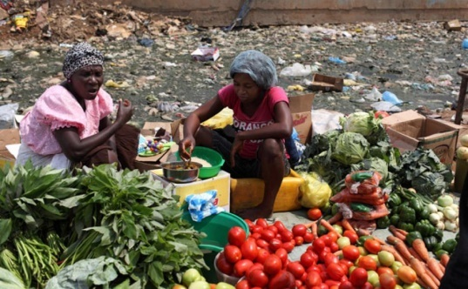
ECSO6004: Sustainable Communities & Global Development
Theme 3: Exploring Environmental Theory + Reflective Activity
Ken Dicks ken.dicks@uwtsd.ac.uk

Slide 2

The Story of Stuff
Time Cue 16:55
If you have not yet had the chance please take a look at this video and take notes of any key points or questions.

Slide 3
The Main Issue
Sustainable development means different things to different people
Can we have all three elements of sustainable development at the same time?
Economic Growth (Profit)
Environmental Protection
(Planet)
Social Justice (People)

Slide 4

Who says this is important?
“Effects of climate change on health will effect most populations in the next decades and put lives and wellbeing of billions of people at increased risk”
Who do you think made this statement?
Costello, Prof. A. (2007) ‘Managing the health effects of climate change - The Lancet’ The Lancet Volume 373 (No. 9676, May 2009) p. 1693

Slide 5

Environmental Inequality in the UK
Environmental inequality has been defined as:
  “Environmental inequality refers to the unequal
  social distribution of environmental risks and
  hazards and access to environmental goods and
  services, and is closely related to the concept of
  environmental justice”.
(Sustainable Development Research Network, 2004)
Discuss what you consider to be environmental inequalities

Slide 6
Measures of environmental inequalities include:
Air pollution
Industrial pollution
Flooding
Access to food and water
Transport and public transport access
Access to natural green spaces and biodiversity
Access to employment
Noise
Housing
Safety
Race and equality issues
Based on (London Sustainability Exchange, no date)

Slide 7


Group Activity
Read the two articles on the decision of the Dyson company to move production from Wiltshire to Malaysia.
Identify whether the articles approve or disapprove of this decision.
Using the Conceptual Tools of Scale and Elements of Sustainability, Decision Making and Ideology evaluate the issue using the worksheets provided.
Discuss this with the group

Slide 8
Four key areas of environmental inequality
Immediate locality or ‘front door’ issues such as litter, neighbourhood noise and the accessibility to and condition of open and green spaces.
Wider service issues such as access to environmental services, local transport facilities, healthy food and fuel poverty.
Planning, infrastructure and development issues such as air and water quality, environmental noise, road traffic accidents and flood risk.
Multiple environmental deprivation, considering the ways in which environmental problems accumulate and have combined effects on an area and people’s health.
(London Sustainability Exchange, no date)

Slide 9
‘Weak’ or ‘Strong’
Sustainable Development
Weak focuses on;
Strong focuses on;
Prevention of catastrophe for human society
Acceptance of science and modern technology
Anthropocentric-Human centred
Intergenerational distribution treated separately
Lower environmental risk aversion
Promotion of society in harmony with supporting ecosystems
Questions science & seeks alternative technology
Ecocentric- Values nature
Intergenerational distribution central to sustainable development
High environmental risk aversion

Slide 10
‘Weak’ & ‘Strong’ views of Sustainable Development
Technocentric versus Ecocentric
These terms were defined by Timothy O’Riordan in his 1989 work ‘The Challenge for Environmentalism’
Seen by O’Riordan and others as being in opposition to each other
One focuses on technology and the other on ecology

Slide 11
Techno-Centric Viewpoints
Interventionists
Have complete faith in human ingenuity, science, and the market to solve all problems and ‘improve’ the quality of the environment
It is argued that this is the view of those who control industry and commerce
Sees the natural world as a means to the end of human well-being (also known as androcentric/anthropocentric)
Examples would be GM crops (i.e. change nature for the good of humankind)

Slide 12
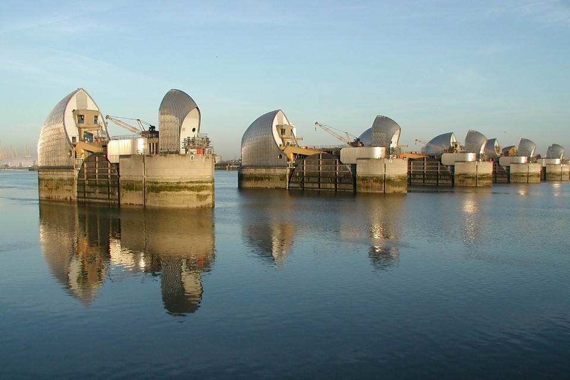


Theories of Sustainability
Technocentric Approaches
Interventionists

Slide 13
Techno-Centric Viewpoints
Accomodationists
Largely follow this view but are more moderate and express a note of caution
They believe some accommodations are needed to mitigate the impact of humans on the environment
Believe that technology and institutions can adapt to deal with resource scarcity or environmental problems

Slide 14
Techno-Centric Viewpoints
Accomodationists
At the most moderate end of the ‘accomodationist’ spectrum are those accused of wishing for the ‘status quo’
i.e. when asked they want an undisturbed environment
But also want a house, car, luxury goods and overseas holidays
An example of cognitive dissonance?

Slide 15


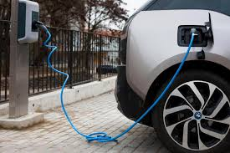

Theories of Sustainability
Technocentric Approaches
Accommodationists
What issues can you see with this approach?

Slide 16
Eco-Centric Viewpoints
‘Environmentalism’
Environmentalist noun – a person who is concerned with or seeks to protect the environment, especially from pollution [OED]
Often seen as concerned with conservationism and preservation (e.g. national parks)
Can be seen as being technocratic (i.e. try to win arguments on the terms of governments and industry rather than being ‘radical’)

Slide 17
Eco-Centric Viewpoints
Deep Ecologists / Deep Greens
Phrase coined by Arne Naess in 1973 and expanded on in 1989
Must focus on what is good for the planet rather than what is good for humankind
Human society can only be understood from the viewpoint of ecology
Sees the connections between every organism as being important

Slide 18
Eco-Centric Viewpoints
Gaianists
Based on the Gaia hypothesis of James Lovelock
The planet is a huge inter-connected super-organism
Creates a self-regulating system focused on maintaining life on earth
Can see viruses such as Ebola as natures way of ‘fighting back’
Can even be quasi-religious where the earth is seen as an object of worship

Slide 19
‘Political’ views of Sustainable Development
Where technocentrics see humanity as the only priority and ecocentrics see ecology as the only priority other theories seek to bring the two together ideologically (i.e. based on a set of shared values)
Two examples of these are;
Eco-feminist viewpoints
Eco-socialist viewpoints

Slide 20
Eco-feminist Viewpoints
Eco-feminism
Phrase coined by Francoise D’eaubonne in her 1974 essay Le feminisme ou la mort (Feminism or Death)
A merging of ecological and feminist ideologies
Argues for a positive re-evaluation of the connection between women and nature that has been ‘forgotten’ in Western society
Stresses that social gender roles give women more of an affinity with nature

Slide 21
Eco-feminist Viewpoints
Eco-feminism
Can see both women and nature as being repressed by patriarchy
Argues that women living in developing nations tend to be managers of natural resources (firewood, water etc.)
Often criticised for being ‘essentialist’ (i.e. assuming all women are the same)
Different strands emphasise the ecological, the social and the female spiritual dimensions

Slide 22
Eco-feminist Viewpoints
Eco-feminism
Charlene Spretnak (1990) defines three main routes to eco-feminism
Radical/social feminism
Earth-based goddess religions & spirituality
Environmentalism
In the late 20th & 21st Century it has also developed animal rights strand, anti-cosmetics / toxics strand, anti-nuclear strand and others

Slide 23

Eco-socialist Viewpoints
Eco-socialism
Interested in the social inequalities that exist between humans and how this is reflected in the wider environment
Capitalism alienates us from our work, from nature, and from ourselves
Redistribution of wealth and natural resources would improve both society and the environment
Often criticised for being unrealistic in the same way that ‘environmentalists’ are
Argues that environmental inequality can lead to mass migration the short videos below illustrate this dynamic in action.
Migration: Why People Migrate
Why do people migrate away from their home?

Slide 24
Radical Viewpoints
Social Ecology
Created by the anarchist and libertarian socialist Murray Bookchin
Sees environmental abuse as a direct result of the domination of groups of humans by other humans
With the exception of natural disasters most major ecological disasters in the 20th and 21st centuries have been caused by ethnic, cultural or commercial conflict.
Argues that if humans can live in harmony with each other they will also live in harmony with nature

Slide 25
Social Ecology
Social
Bearable
Equitable
SUSTAINABLE
Viable
Environmental
Economic

Slide 26
Eco-socialist Viewpoints
Communalists
Often seen as a more radical form of eco-socialism and developed from Social Ecology
Focuses far more on local economies, self-sufficiency and sustainable lifestyles
Local communities are best placed to decide what is best for the environment and therefore themselves
More about producing less rather than redistributing what is produced

Slide 27


Group Task
Choose one of the ideologies that we are studying
Consider and discuss the positive and negative aspects of the ideology and should also make a judgement on whether it is practical.

Slide 28

Reflective Activity
Sustainability: A personal reflection
Using the reflective practice worksheet, consider the following:
How environmentally friendly you feel you are now?
What, if anything, you do that you feel is environmentally friendly?
How environmentally friendly you would like to be in the future?
Any changes you would like to make that you feel are possible?
Any changes you would like to make that you feel are not possible?
Reduce, Reuse, Recycle

Slide 29

Reflective Activity
Sustainability: A personal reflection
If you have thought of a change that you would like to make and are happy to share it with the group…..
The change I intend to make is………
I feel that this is environmentally friendly because………

Slide 30
References
Attfield, Robin, (2003). Environmental Ethics Oxford: Polity.
Adams W.M. Green Development (2001) (2nd edition) London: Routledge. Available at: Full details and actions for Green Development: Environment and Sustainability in a Developing World [Accessed 12/11/2024]
Bakker, K. (2007) ‘The Commons Versus the Commodity: Alter-globalization, Anti-privatization and the Human Right to Water in the Global South’, Antipode, 39(3), pp. 430–455. Available at: The “Commons” Versus the “Commodity”: Alter-globalization, Anti-privatization and the Human Right to Water in the Global South. - EBSCO[Accessed 12/11/2024]
Beder, Sharon, (1993) The Nature of Sustainable Development (Newham, Vic., Australia: Scribe Publications.
Best, J. (2007) ‘Legitimacy dilemmas: the IMF’s pursuit of country ownership’, Third world quarterly, 28(3), pp. 469–488. Available at: Legitimacy Dilemmas: The IMF's Pursuit of Country Ownership on JSTOR [Accessed 12/11/2024]
Biehl, J. (1992) ‘Perspectives on ecofeminism: viewpoint’, Environmental action (Washington, D.C.), 24(2), p. 19–. Available at: (PDF) Perspectives on Ecofeminism (1992) | Janet Biehl - Academia.edu [Accessed 12/11/2024]
Bookchin, M. (1993) What is Social Ecology? The Anarchist Library Available at: What is Social Ecology? | The Anarchist Library [Accessed 12/11/2024]
Bookchin, M. (2005) The Ecology of Freedom Stirling: AK Press
Brown, T. (1997) ‘Clearances and Clearings: Deforestation in Mesolithic/Neolithic Britain’, Oxford journal of archaeology, 16(2), pp. 133–146. Available at: Clearances and Clearings: Deforestation in Mesolithic/Neolithic Britain - Brown - 1997 - Oxford Journal of Archaeology - Wiley Online Library [Accessed 12/11/2024]

Slide 31
References
Buchanan, I. (2018) A Dictionary of Critical Theory (2 ed.)Oxford: OUP Available at: Complexity theory - Oxford Reference [Accessed 12/11/2024]
Colman, A. M. [ed] (2015) ‘Cognitive Dissonance’ in A Dictionary of Psychology Oxford: OUP Available at: Cognitive dissonance - Oxford Reference [Accessed 12/11/2024]
Costello, Prof. A. (2007) ‘Managing the health effects of climate change’ The Lancet Volume 373 (No. 9676, May 2009) p. 1693 Available at: Managing the health effects of climate change - The Lancet [Accessed 19/11/2024]
Cottrell, S. (2013) The Study Skills Handbook Basingstoke: Palgrave Macmillan
Cudworth E. Environment and Society London: Routledge.
D’Eaubonne, F. (1974 [2020]) Feminism or Death London: Verso Available at: Feminism Or Death - Google Books [Accessed 12/11/2024]
Dasgupta, P. (1998) ‘Population, consumption and resources: Ethical issues’, Ecological economics, 24(2-3), pp. 139–152. Available at: Population, consumption and resources: Ethical issues - ScienceDirect [Accessed 12/11/2024]
Dobscha, S. (1993) ‘Women and the Environment: Applying Ecofeminism to Environmentally-Related Consumption’, in Advances in consumer research. Urbana, Ill: Association for Consumer Research, p. 36–. Available at: Women and the Environment: Applying Ecofeminism to Environmentally-Related Consumption. – EBSCO [Accessed 12/11/2024]
Elkington, J. (1998). ‘Partnerships from cannibals with forks: The triple bottom line of 21st‐century business’. Environmental Quality Management, 8(1), 37-51. Available at; Partnerships from Cannibals with Forks: The Triple Bottom Line of 21st-Century Business. – EBSCO [Accessed 12/11/2024]
Esteva, Gustavo, (1992). ‘Development’, in Wolfgang Sachs (ed.), The Development Dictionary London and Atlantic Highlands, NJ; Zed Books, pp.6-25. Available at The Development Dictionary - Google Books [Accessed 12/11/2024]

Slide 32
References
Freyfogle, E.T. (2006) Why conservation is failing and how it can regain ground. New Haven: Yale University Press. Available at: Why Conservation Is Failing and How It Can Regain Ground | Yale Scholarship Online | Oxford Academic [Accessed 12/11/2024]
Gaard, G.C. (2019) Ecofeminism : women, animals, nature. Philadelphia: Temple University Press.
Gibbs, G (2002) Dyson, champion of British industry, switches production to far east The Guardian Available at https://www.theguardian.com/business/2002/feb/06/manufacturing.globalrecession [Accessed 06/09/2021]
Goldman, M. (2005) Imperial nature the World Bank and struggles for social justice in the age of globalization. New Haven, Conn. ;: Yale University Press. Available at: Imperial nature : the World Bank and struggles for social justice in the age of globalization : Goldman, Michael, 1960- : Free Download, Borrow, and Streaming : Internet Archive [Accessed 12/11/2024]
Gribbin, M. and Gribbin, J. (2021) James Lovelock: In Search of Gaia. Princeton University Press. Available at: James Lovelock [Accessed 12/11/2024]
Hashimzade, N., Myles, G.D. and Black, J. (2017) A dictionary of economics. 5 ed. Oxford, England: Oxford University Press. Available at: Dictionary of Economics - Oxford Reference [Accessed 12/11/2024]
Jacobs, Michael, (1999)‘Sustainable Development as a Contested Concept’, in Andrew Dobson (ed.), Fairness and Futurity: Essays on Environmental Sustainability and Social Justice Oxford: Oxford University Press. Available at: ‪Fairness and Futurity : Essays on Environmental Sustainability and Social Justice‬‎ - ‪Record details‬‎ - ‪EBSCOhost Research Databases‬‎ [Accessed 12/11/2024]
Jana, A. and Shekhar, C. (2022) ‘Female sterilisation in India: Examining the role of women’s own decision making and information given to client’, Journal of biosocial science, pp. 1–20. Available at: Female sterilisation in India: Examining the role of women’s own decision making and information given to client | Journal of Biosocial Science | Cambridge Core [Accessed 12/11/2024]

Slide 33
References
Johns, D. (1992) The Practical Relevance of Deep Ecology Portland: Portland Stat University Available at: The Practical Relevance of Deep Ecology [Accessed 12/11/2024]
Kakuba, S. J. (2016) ‘Foreign Aid to Africa: Conceptualising Socio-Economic and Political Development Applying Complexity Theory’ in Ercetin, S.S. and Bağcı, H. [Eds.] (2016) Handbook of research on chaos and complexity theory in the social sciences. Hershey, Pennsylvania: Information Science Reference. Available at: Handbook of Research on Chaos and Complexity Theory in the Social Sciences | IGI Global [Accessed 12/11/2024]
London Sustainability Exchange (No Date) Definitions of Environmental Justice and Environmental Inequalities Available at http://www.lsx.org.uk/resources/EJIDefinition_page3198.aspx [Accessed 06/09/2021]
Lovelock, James (2009). The Vanishing Face of Gaia: A Final Warning: Enjoy It While You Can. Allen Lane.
Lynch, C.L. & Wolcott, S.K. (2001) Helping Your Students Develop Critical Thinking Skills The IDEA Center
McKeown, R. (2002). The ESD Toolkit 2.0. Web-published document. Available at: http://www.esdtoolkit.org/ [Accessed 12/11/2024]
Max Ajl (2021) ‘Green Social Democracy or Eco-Socialism?’, in A People’s Green New Deal. Pluto Press, p. 75– Available at: 4 Green Social Democracy or Eco-Socialism? from A People's Green New Deal on JSTOR [Accessed 12/11/2024]
Meadows, D. et al (2005) The Limits to Growth: The 30-year Update London: Routledge Available at: Full details and actions for The Limits to Growth: The 30-year Update [Accessed 12/11/2024]
Mijač, S., Slivšek G. and Džajić A. (2022) ‘Deep Ecology: Contemporary Bioethical Trends’, Southeastern European medical journal (Online), 6(1), pp. 129–139. Available at: Deep Ecology: Contemporary Bioethical Trends | Southeastern European Medical Journal [Accessed 12/11/2024]
Millennium Alliance for Humanity and the Biosphere (2022) Solutions to overpopulation and what you can do Stanford University Available at: Solutions to overpopulation and what you can do – MAHB [Accessed 12/11/2024]

Slide 34
References
Næss, A. & Rothenberg, D. (1989) Ecology, Community and Lifestyle: Outline of an Ecosophy Translated by D. Rothenberg. Cambridge: Cambridge University Press Available at: Ecology, Community and Lifestyle - Google Books [Accessed 12/11/2024]
O'Riordan, T. (1999). Environment and environmentalism. In: Environmental Geology. Encyclopedia of Earth Science. Springer, Dordrecht. Environment and environmentalism | SpringerLink [Accessed 12/11/2024]
Park, C. & Allaby, M. [eds.] (2017) A Dictionary of Environment and Conservation (3 ed.) Oxford: OUP Available at: Environmentalism - Oxford Reference [Accessed 12/11/2024]
Paulson, N (2016) ‘Old Ideas, New Knowledge, Sustainable Communities’ TED Talks Available at: Old Ideas, New Knowledge, Sustainable Communities | Nels Paulson | TEDxUWStout [Accessed 12/11/2024]
Pelenc, J. (2015) Weak Sustainability versus Strong Sustainability: Brief for GDSR 2015 Available at: Microsoft Word - 122-Pelenc-Weak Sustainability versus Strong Sustainability [Accessed 12/11/2024]
Phillips, M. & Mighall, T (2013) Society and Exploitation Through Nature Abingdon: Routledge
Resurrección, B.P. and Elmhirst, R. (2021) ‘Negotiating gender expertise’ in Environment and development : voices from feminist political ecology. Edited by B.P. Resurrección and R. Elmhirst. Abingdon, Oxon ;: Routledge. Available at Negotiating Gender Expertise in Environment and Development | Voices f [Accessed 12/11/2024]
Royal Society (2022) Climate Change in the Critical Decade London: Royal Society Available at: Climate change in the critical decade: A summary of the IPCC Sixth Assessment Report and its implications for the UK. The Royal Society [Accessed 12/11/2024]
Scott W. and Gough S. (2003) Sustainable Development Framing the Issues. London: Routledge Falmer. Available at: Sustainable Development and Learning: Framing the Issues - Stephen Gough, William Scott - Google Books [Accessed 12/11/2024]

Slide 35
References
Schrems, I. and Upham, P. (2020) ‘Cognitive Dissonance in Sustainability Scientists Regarding Air Travel for Academic Purposes: A Qualitative Study’, Sustainability (Basel, Switzerland), 12(5), p. 1837–. Available at: Cognitive Dissonance in Sustainability Scientists Regarding Air Travel for Academic Purposes: A Qualitative Study [Accessed 12/11/2024]
Scriven, M., & Paul, R. (1987). Defining Critical Thinking. Available at: Defining Critical Thinking [Accessed 12/11/2024]
Shiva, V. (1988a) ‘Geopolitics of Food: America’s Use of Food as a Weapon’, Economic and political weekly, 23(18), pp. 881–882. Available at: Geopolitics of Food: America's Use of Food as a Weapon on JSTOR [Accessed 12/11/2024]
Shiva, V. (1988b) Staying Alive: Women, Ecology, and Survival in India London: Zed Books Available at: Staying Alive: Women, Ecology and Survival in India - Vandana Shiva - Google Books [Accessed 12/11/2024]
Social Development Research Network (2004) SDRN Briefing Two: Environment and Social Justice Available at http://www.sd-research.org.uk/sites/default/files/publications/Environment%20and%20Social%20Justice_0.pdf [Accessed 06/09/2021]
Sole, R. & levin, S.A (eds) (2022) ‘Ecological complexity and the biosphere: the next 30 years’ Philosophical Transactions of the Royal Society B Vol.377 Issue 1587 Available at: Philosophical Transactions of the Royal Society B: Biological Sciences: Vol 377, No 1857 [Accessed 12/11/2024]
Spretnak, C. (1990) ‘Ecofeminism: Our Roots and Flowering’ In Diamond, I & Orenstein, G. (ed) Reweaving the World: The Emergence of Ecofeminism San Francisco: Sierra Club Books Available at: Ecofeminism_-_1987.pdf [Accessed 12/11/2024]
Unger, C.R. (2014) ‘Family Planning – A Rational Choice?’ in Hartmann, H., Unger, C.R. and Dörnemann, M. (2014) A world of populations : transnational perspectives on demography in the twentieth century. Edited by H. Hartmann and C.R. Unger. (pp. 58-82) New York ;: Berghahn Books. Available at: (PDF) A world of populations: Transnational perspectives on demography in the twentieth century [Accessed 12/11/2024]

Slide 36
References
United Nations (No Date) The UN Campaign for Individual Action United Nations Available at: Act Now | United Nations [Accessed 12/11/2024]
University of Vermont (No Date) Types of Eco-feminism Available at: EFtypes.pdf [Accessed 12/11/2024]
Vitek, B. & Jackson, W. [Eds.] (2008) The Virtues of Ignorance: Complexity, Sustainability, and the Limits of Knowledge Available at: Project MUSE - The Virtues of Ignorance [Accessed 12/11/2024]
Vogel, Steven, (2016) 'Alienation, Nature, and the Environment’, in Thinking like a Mall: Environmental Philosophy after the End of Nature Cambridge, MA, 2015; online edn, MIT Press Scholarship Online Available at: https://doi.org/10.7551/mitpress/9780262029100.003.0003 [Accessed 11/03/2024] Unable to access 12/11/2024
White, D.F. (2008) Bookchin a critical appraisal. London: Pluto Press. Available at: Bookchin : a Critical Appraisal [Accessed 12/11/2024]
World Commission of Environment and Development, (1987) Our Common Future New York: United Nations Available at: Our Common Future: Report of the World Commission on Environment and Development [Accessed 12/11/2024]
Xiong, T. (2014) ‘Shallow Environmentalism: A Preliminary Eco-Critical Discourse Analysis of Secondary School English as a Foreign Language (EFL) Texts in China’, The Journal of environmental education, 45(4), pp. 232–242. Available at: Shallow Environmentalism: A Preliminary Eco-Critical Discourse Analysis of Secondary School English as a Foreign Language (EFL) Texts in China. – EBSCO [Accessed 12/11/2024]

