Slide 1
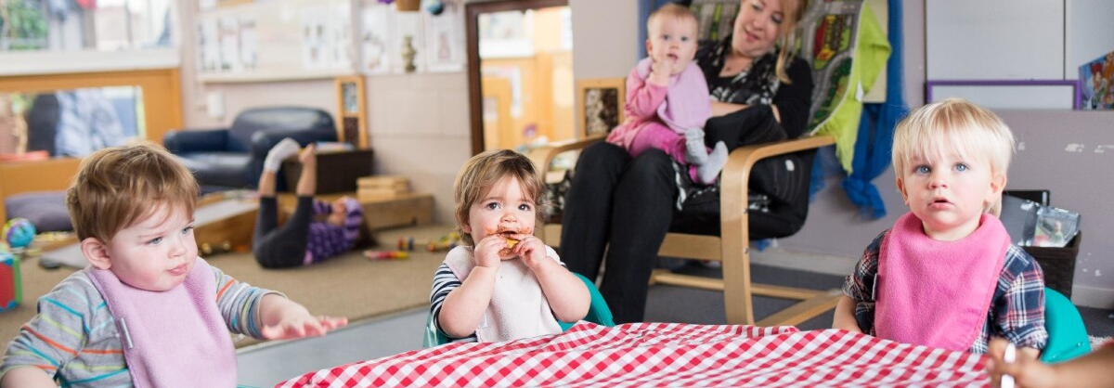
Psychology in Health and Social Care
Module Code:lchs4010
Mohammed Yasin
2411902
Individual Presentation
ThePhoto by PhotoAuthor is licensed under CCYYSA.
ThePhoto by PhotoAuthor is licensed under CCYYSA.

Slide 2

Introduction
Amira
Amira is aged 3 and is left in nursery by her carers
-showing signs of anxiety
Weak in verbal communication
Showing less social interaction amongst other children
-

Slide 3

A Plan
-As nursery practitioners recognizing this and the need to develop and build a plan for staff and Amira to help and build confidence between Amira and other children.
-Understand her background including her medical history and family background, cultural information.
Erikson lifespan theory to Support Amira's early stage development.
ThePhoto by PhotoAuthor is licensed under CCYYSA.

Slide 4
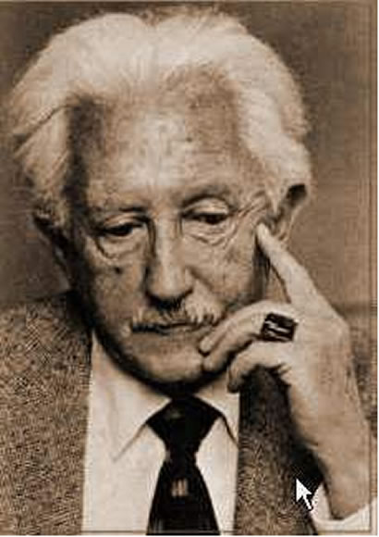
Eriksan's Lifespan Theory
Erik humburg erikson a german psychologist born in 1902 (The Harvard Gazette, 2002)
-Erikson suggested eight stages of early development which will support Amira to boost her confidence , trust and development.
Eriksan's theory suggests focusing on early development of life and how it will help to build a stronger and confident person later in life.
Recognizing the strengths and weaknesses
Each stage of life builds on the previous one (Healthline, 2024)
ThePhoto by PhotoAuthor is licensed under CCYYSA.

Slide 5
Importance of practical strategies
-Practical strategies will boost Amira's confidence
Reduce stress
Allow individuals working with Amira help understand her needs
Reduce anxiety
Improve skills and her social relationships
Foster emotional growth
Improves cognitive development
Improve Communication development
Help boost her confidence in later stages of life
Improve charecter

Slide 6
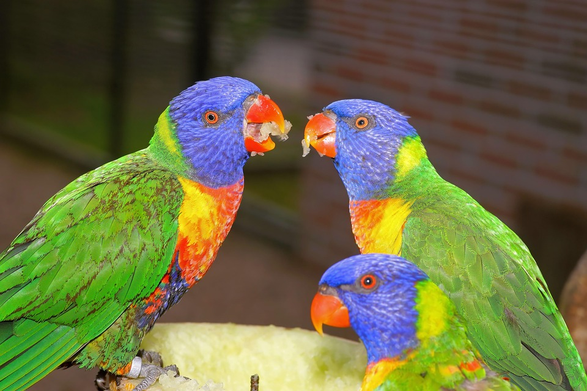
Biological and environmental influences
How humans are shaped in life
-nature nurture – genetics and environmental (Simply Psychology,2024)
Psychological development (Very well mind, 2024)

Slide 7
Usefullness and limitation of theories in health and social care
Theories Provide a guide and identify basic facts
Theories generate tested hypothesis and results
Theories can predict and explain outcomes
Theories simplify complex problems make more sense
(Psychology Today, 2022)
Limitations include over simplification - making things more complex to understand of reality
Assumptions
Limitations
Lack of practicality
Empirical limitation
Confining and limiting
Cultural factors
Religious factors
(Science Direct, 2024)
t
Title

Slide 8
Conclusion
All theories are theoretrical way of thinking , and facts have been tested and drawn from real modules by professional psychologist
Most of the theories formulate ideas in the development stages
But need to incorporate culture ,religious and diverse society's
Theories and life span do give a better prospective and understanding and planning to help and predict better outcomes to help with development stages and emphasize new ideas

Slide 9
Reference List
Erik Erikson (2002) Harvard Gazette. Available at: https://news.harvard.edu/gazette/story/2002/03/erik-erikson/
Psychology Today (2018) “Finding meaning through life’s stages,” 7 February. Available at: https://www.psychologytoday.com/gb/blog/counseling-keys/201802/finding-meaning-through-lifes-stages
Lewis, R. (2020) Erikson’s 8 stages of psychosocial development, explained for parents, Healthline. Healthline Media. Available at: https://www.healthline.com/health/parenting/erikson-stages
Erik Erikson (2022) Harvard.edu. Available at: https://psychology.fas.harvard.edu/people/erik-erikson
Verywellmind.com. (2024) Available at: https://www.verywellmind.com/erik-eriksons-stages-of-psychosocial-development-2

