Slide 2
Today’s Discussion
Active Directory – An overview
Domain Services
Domain Controller
Best Practices
During this week, we shall focus on Directory Services! we will delve into the Active Directory Infrastructure concepts, overviewing directory services, understand its environment and apply the learning to deploy and later manage network services and resources.
Before we dive into today's topics, let's briefly recap
what we covered so far.

Slide 3

Scan and Share!!!

Slide 4





Milestone
Coursework 1:
Choose your Hypervisor based on your research (Q.1, 2)
Download (use Evaluation Copy or From our Servers) and Setup your Virtual Machines – as per the topology (Q. 3, 4)
Research on IP Address (Based on the Group Discussion Last week)
Use Appropriate IP Addressing Scheme to configure your Network
Test and Troubleshoot (if required) your network.
Submit your Coursework 1 – next week – 23/02/2024

Slide 5

Action
As we conclude today's lecture on domain services, including Active Directory Domain Services, LDAP, and their physical and logical components such as domain controllers, I trust you now have a clearer understanding of the different services offered by Active Directory and their purposes in managing network resources. With this foundational knowledge in place, I encourage you to
take the initiative to conduct initial research on routing before our next lecture session.
Understanding routing protocols will be instrumental as we dive into our next group activity, which will focus on exploring various routing protocols used in networking.
By familiarizing yourself with routing protocols and how they function, you'll be better prepared to participate actively in our group discussions and engage in collaborative learning experiences.
Additionally, consider preparing a case study on how routing protocols work, as this will be invaluable for your upcoming presentation.
Remember, the more you engage with the material outside of class, the deeper your understanding will become. So, let's take this opportunity to delve into routing protocols and enhance our knowledge together.
Good luck!

Slide 6

Objectives
Understand the Active Directory Infrastructure
Continue with your Coursework 1, complete Task 6 and 7, prepare your report
Submit your report – 23rd February 2024 @ 1500
This Photo by Unknown Author is licensed under CC BY-NC

Slide 7
Introduction
  Network Operating Systems!!!
    Manage and facilitate communication, resource sharing across a network of interconnected devices.
    Offer services for network connected entities to effectively communicate, access shared resources, perform network related task efficiently.
  Features
    Resource Sharing
    User Authentication
    Access Control
    Centralized Management
    Scalability
    Reliability

Slide 8
Introduction
  Type in the Chat….
  What are the different types of Network Operating Systems you are aware of?
  Types of NOS
    Server-Centric
    Device Specific
    Hypervisor Based

Slide 9

Introduction
  Microsoft Windows Server is one of the most widely used network operating systems.
  Offers a range of features for:
    Managing network services.
    Facilitating file sharing.
    Handling user authentication.
    Providing directory services - Active Directory Domain Services
  Active Directory Domain Services
    enables centralized user and resource management.
    facilitates efficient administration of network resources.
    supports features such as group policy management and user access control.

Slide 10
Introduction
  Linux-based Servers (e.g., Ubuntu Server, CentOS, Red Hat Enterprise Linux) is known for stability, security, and flexibility.
  Provide a wide range of networking services including:
    DNS (Domain Name System).
    DHCP (Dynamic Host Configuration Protocol).
    File sharing (using protocols like Samba).
    Web hosting (using Apache or Nginx).
  FreeBSD, Unix-like operating system known for reliability and performance.
    Can be used as a network operating system to provide services such as
    DNS, DHCP, FTP.
    Firewalling.
    Supports advanced networking features like IPsec and virtualization.

Slide 11
Introduction
  Cisco IOS (Internetwork Operating System)
    Operating system used on Cisco networking devices (routers, switches).
    Features for:
    Configuring, managing, and securing network infrastructure.
    Including routing protocols, VLAN configuration, access control, and more.
  Juniper Junos:
    Operating system used on Juniper Networks devices (routers, switches, firewalls).
    Offers advanced networking features such as:
    MPLS (Multiprotocol Label Switching).
    BGP (Border Gateway Protocol).
    Firewall policies.
    Network virtualization.

Slide 12
Introduction
  Apple macOS Server:
    Network operating system developed by Apple for Macintosh computers.
    Provides services such as:
    File sharing.
    Centralized user authentication.
    DNS, DHCP.
    VPN (Virtual Private Network) services.
    Many server features have been deprecated in recent years.
  VMware ESXi:
    Hypervisor-based operating system used for virtualization.
    Primarily for virtualizing server infrastructure.
    Includes networking features such as:
    Virtual switches, VLAN support, Network traffic management.

Slide 13
Introduction
  NetWare:
    Legacy network operating system developed by Novell.
    Used for functions such as:
    File and print services.
    Directory services.
    Usage has declined over the years but may still be present in some organizations.???

Slide 14
Active Directory: Introduction
  Active Directory (AD) is a directory service developed by Microsoft for managing network resources in a Windows environment.
  It provides a centralized repository for storing information about objects such as users, computers, groups, and resources within a network.
  AD uses a hierarchical structure called a domain, which organizes objects into logical containers for easier management.
  Domains can be further organized into trees and forests, forming a hierarchical namespace that reflects the organization's structure.
  The primary function of AD is to authenticate and authorize users and computers to access network resources.
  AD integrates with other Windows services such as DNS (Domain Name System) and DHCP (Dynamic Host Configuration Protocol) to provide a comprehensive networking solution.

Slide 15
Active Directory: Introduction
  It supports features such as group policy management, which allows administrators to enforce security settings and configurations across multiple devices.
  AD enables single sign-on (SSO), allowing users to access multiple resources with a single set of credentials.
  Overall, there are three main operations
    One is to manage identity of the resources on the network.
    Two is to facilitate access to and for the resources on a network.
    The Third is to Centrally manage the network.

Slide 16

Active Directory: Introduction
Certificate Services
Federation Services
Rights Management Services
Identity
Non-Repudiation
  Maintain security of data
Network Access for External Resources
  Service,
  Client, Server
  User identification
Content Security and Control
Kerberos securely authenticates and proves the identity between users and servers on the network
  Resource access across traditional boundaries
Lightweight Directory Services
Domain Services
Active Directory
Internal Accounts
Authorization
Authentication
Application Templates
  Access the directory services data
Identity
Access
Centralized Management
Users, Computers, Policies

Slide 17
Active Directory: Domain Services
Active Directory Domain Services: A directory service is the combination of the directory information source & the service that the information offers.
    which in turn makes the resources available and usable
    Typical/ Old School Example: A phone book…
The Network Management (for managing user and group accounts) could be achieved
    in a Single location
    With a set of tools
Capable of
    assigning access to shared network resources
    Directory service for AD DS enabled applications
    Configuring security policies to all users and computers
    Group policies to manage user desktops and security settings

Slide 18
Active Directory: Domain Services
Centralized directory
Windows User
Windows Server
Mgmt Profile
Network Info
Printers
Shares
Applications
Single sign-on access
Server Config
SSO
App-Specific Directory Info
Integrated security
Account Information
Privileges
Profiles
Policies
Active Directory Domain Services
Manageability
Security
Interoperability
Windows Client
Email Servers
Network Devices
Config
QoS Policy
Security Policy
Mgmt Profile
Network Info
Policies
Mailbox Information
Address Book
Scalability
Common management interface

Slide 19
Active Directory: Domain Services
Scalable, secure, and manageable infrastructure for user and resource management
    stores and manages information about network resources
    provides support for directory-enabled applications such as Microsoft® Exchange Server
    allows for centralized management
LDAP is used to access the directory services data (like Active Directory, OpenLDAP etc)
Kerberos securely authenticates and proves the identity between users and servers on the network
DNS translates the Domain names into IP Addresses.

Slide 20


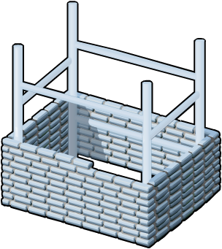




Active Directory: Domain Services
AD DS requires a DNS infrastructure
AD DS domain names must be DNS domain names
DNS Domain Name
DNS
AD DS domain controller records must be registered in DNS to enable other domain controllers and client computers to locate the domain controllers
DNS zones can be stored in AD DS as Active Directory integrated zones
DNS Zone

Slide 21
Active Directory: Domain Services
Physical Components
    Data store
    Domain controllers
    Global catalog server
    Read-Only Domain Controller (RODC)
Logical Components
    Partitions and Schema
    Domains and Domain trees
    Forests and Sites
    Organizational units (OUs)

Slide 22
Active Directory: Domain Services
Domain Controller A domain controller is a server with the AD DS server role installed that has specifically been promoted to a domain controller
    Host a copy of the AD DS directory store
    Provide authentication and authorization services
    Replicate updates to other domain controllers in the domain and forest
    Allow administrative access to manage user accounts and network resources
    The AD DS data store contains the database files and processes that store and manage directory information for users, services, and applications

Slide 23
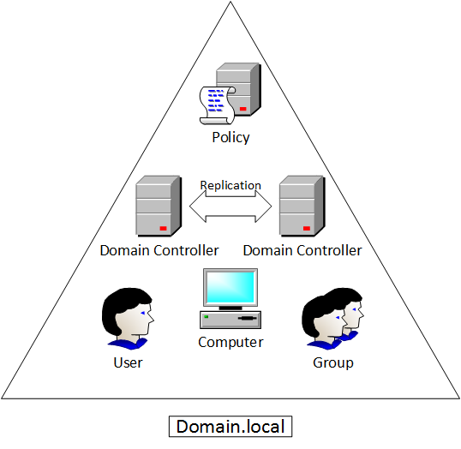
Active Directory: Domain Services
Domains are used to group and manage objects in an organization
    An administrative boundary for applying policies to groups of objects
    A replication boundary for replicating data between domain controllers
    An authentication and authorization boundary that provides a way to limit the scope of access to resources
DOMAIN

Slide 24
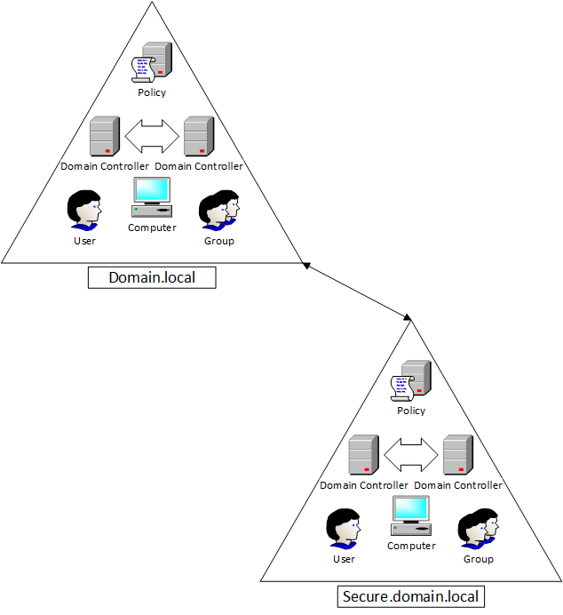
Active Directory: Domain Services
A domain tree is a hierarchy of domains in AD DS
    Share a contiguous namespace with the parent domain
    Can have additional child domains
    By default, create a two-way transitive trust with other domains
A forest is a collection of one or more domain trees
    Share a common schema
    Share a common configuration partition
    Share a common global catalog to enable searching
    Enable trusts between all domains in the forest
    Share the Enterprise Admins and Schema Admins groups
TREE

Slide 25
AD-DS: Lightweight Directory Services
Application
Server Config
SSO
App-Specific Directory Info
Windows User
Account Information
Privileges
Profiles
Policies
Active Directory LD Services
Manageability
Security
Interoperability
Network Devices
Config
QoS Policy
Security Policy
Email Servers
Mailbox Information
Address Book
AD LDS is a hierarchical file-based directory store
AD LDS is both the directory information source and the service that makes the information available and usable

Slide 26
Active Directory: Authentication & Authorization
Authentication: Verification – Local vs Network
Authorization: The authenticated user’s permission to execute the required task.
  SECURITY IDENTIFIER (SID)
  ACCESS CONTROL LIST (ACL)
    A discretionary access control list (DACL) identifies the security principals that are allowed or denied access to an object.
    When a person or process tries to access an object, the system checks the ACEs in the object's DACL to determine whether to grant access to it.
    If the object does not have a DACL, the system grants full access to everyone.
    If the object's DACL has no ACEs, the system denies all attempts to access the object because the DACL does not allow any access rights.

Slide 27
Active Directory: Authentication & Authorization
Authentication: Verification – Local vs Network
Authorization: The authenticated user’s permission to execute the required task.
  SECURITY IDENTIFIER (SID)
  ACCESS CONTROL LIST (ACL)
    A system access control list (SACL) enables administrators to log attempts to access a secured object.
    Each ACE specifies the types of access attempts by a specified principal that cause the system to generate a record in the security event log. An ACE in a SACL can generate audit records when an access attempt fails, when it succeeds, or both.

Slide 28
Active Directory: Domain Services
OUs are Active Directory containers that can contain users, groups, computers, and other OU’s
    Represent your organization hierarchically and logically
    Manage a collection of objects in a consistent way
    Delegate permissions to administer groups of objects
    Apply policies
Active Directory is managed by the Microsoft Management Console (mmc.exe)
    Active Directory Administrative Center (dsac.exe)
    Active Directory Users and Computers (dsa.msc)
    Active Directory Domains and Trusts (domain.msc)
    Active Directory Sites and Services (dssite.msc)
    Active Directory module for Windows Powershell

Slide 29
Active Directory: Certificate Services
AD CS is the Microsoft implementation of Public Key Infrastructure (PKI)
PKI is a set of hardware, software, people, policies, and procedures needed to create, manage, distribute, use, store, and revoke digital certificates
AD CS provides customizable services for issuing and managing digital certificates
    Certification authorities (CAs) CAs issue certificates to users, computers, and services, and manage certificate validity
    CA Web enrollment Web enrollment allows users to connect to a CA by means of a Web browser in order to request certificates and retrieve certificate revocation lists (CRLs)
    Online Responder The Online Responder service sends a signed response containing requested certificate status information to clients
Certificate Signing Request
2
Enrollment
Certificate Repository
3
x.509 Certificate Chain
End-Entities (users or computers)
Certification Revocation Repository
Certificate Retrieval
4
1
CRL Retrieval
Certificate Revocation List
5
Revocation Request

Slide 30
Active Directory: Certificate Services
AD CS is the Microsoft implementation of Public Key Infrastructure (PKI)
PKI is a set of hardware, software, people, policies, and procedures needed to create, manage, distribute, use, store, and revoke digital certificates
AD CS provides customizable services for issuing and managing digital certificates
    Network Device Enrollment Service The Network Device Enrollment Service allows network devices to obtain certificates when they don’t have domain accounts
    Certificate Enrollment Web Service The Certificate Enrollment Web Service allows for certificate enrollment by users and computers using SSL to enables policy-based certificate enrollment for disconnected or non-domain-joined computers and users
    Certificate Enrollment Policy Web Service Delivers certificate enrollment policy information to computers and users to enable the Certificate Enrollment Web Service
Certificate Signing Request
2
Enrollment
Certificate Repository
3
x.509 Certificate Chain
End-Entities (users or computers)
Certification Revocation Repository
Certificate Retrieval
4
1
CRL Retrieval
Certificate Revocation List
5
Revocation Request

Slide 31






Active Directory: Federation Services
Software Component that facilitates the cross-organizational access of systems and applications
The AD FS server role provides simplified, secured identity federation and Web single sign-on (SSO) capabilities.
    enables the creation of trust relationships between two organizations
    provides access to applications between organizations
    provides Single Sign-on (SSO) between two different directories for Web-based applications
AD DS
Web Server
Federation Trust
Account
Federation Server
Resource
Federation Server
Account Partner Organization
Resource Partner Organization

Slide 32












Active Directory: Rights Mgt Services
Active Directory Rights Management Services (AD RMS) is an information protection technology that works with applications to safeguard digital information
Allows individuals and administrators to specify access permissions to documents, workbooks, and presentations
    prevent sensitive information from being printed, forwarded, or copied by unauthorized people
    access and usage restrictions are enforced no matter where the information is located
RMS Server
Information Author
Recipient

Slide 33
Summary
Active Directory
  Rights Management Services, Certificate Services, Federation Services
  Lightweight Directory Services, Authentication & Authorization, DNS
  Domain Services
    Manageability
    Security
    Interoperability
    Physical and Logical Components
    Domain Controller
      DOMAINS
      TREE
      FOREST
      OUs are Active Directory containers that can contain users, groups, computers, and other Ous

Slide 34
References:
NOSS (ACCA5023)
Applied Computing - WISA
Yang, J., Li, C., Yang, Y., & Li, J. (2012). Research and Implementation of a Novel Network Operating System Based on Embedded Linux. International Journal of Computer Theory and Engineering, 4(6), 1026-1030.
Raghavendra, V., Shridhar, S. & Sunitha, K.V. (2013). A study of server operating systems: a comparative analysis. International Journal of Computer Science Issues, 10(5), 63-67.
Jin, D., Liu, Y., & Liu, C. (2013). A survey of hypervisor-based network virtualization. Tsinghua Science and Technology, 18(3), 235-249.
Any Questions?

