Slide 1
An investigation into chatbots for education
By Kyle Pixley
Notes:
This is my project viva

Slide 2
Introduction
What is my project?
  Investigation into chatbots
  More specifically within educational organisations
Why did I choose this topic?
  Personal experiences with information gathering
  Interesting topic
Notes:
To begin, I will talk about what my project actually is and why I chose the topic. Firstly, my project is an investigation into chatbots but more specifically chatbots for education such as chatbots that provide assistance or information. The reason I chose this topic is because of my own personal experiences with information gathering on this course and past courses, I feel as if the current methods used for providing information to students lack in some manner and make the process more difficult than it needs to be, I also decided on this topic as it seemed quite interesting to look into the various chatbots that exist and are used.

Slide 3
Aims & Objectives
Aim
  Investigate chatbots for various uses
  Develop a chatbot to help students with information gathering
Objectives
  Conduct a literature review on various types of chatbots and their uses in educational systems
  Design and develop an information chatbot for students
  Compare existing methods for information gathering in educational systems and information chatbots
  Gather primary research about how the chatbot impacts the users
  Evaluate the effectiveness of the chatbot based on primary research
Notes:
The aim for this project is to investigate chatbots that cover a wide range of uses and to then develop a chatbot to help students gather information they may need or want. To successfully complete this aim I have produced some objectives, these objectives are to conduct a literature review on the types of chatbots and how they are used in educational systems, this objective will ensure that secondary research on the topic is completed and knowledge of the types and uses of chatbots is gained for the second objective which is to design and develop an information chatbot for students, the third objective for this project is to compare the existing methods that exist for information gathering in educational systems and information chatbots, this objective will help ensure that an understanding of where current systems lack for information gathering is gained so that improvements can be made to the chatbot that will be developed for this project, the fourth objective for this project is to use the developed chatbot to gain information about how students feel the system impacts their ability to gather information, whether it is better or worse than current systems and why they think that, the final objective for this project is to evaluate the effectiveness of the chatbot based on the primary research that will have been conducted, this will look at any strengths or weaknesses that were mentioned by students in the primary research and provide information on why students may prefer the system, this objective will also ensure that a conclusion can be made about the use of an information gathering chatbot in educational systems.

Slide 4
Literature Review Findings
What is a chatbot?
  A machine that uses interfaces to communicate
  Originally developed to fool humans
  Now used to support users
    Simplify tasks
  Advancing technologies – more developed chatbots
Notes:
The definition of a chatbot varies slightly but the consensus is that a chatbot is a machine that uses natural language user interfaces to communicate with users. Originally chatbots were developed to try and “fool user’s that they were real humans” but now they are used in several ways to aid users in an effective and timely manner. Chatbots have become a method of simplifying tasks such as customer service, marketing, education, and support. Chatbots have been developed for years making them become more advanced and more implemented into the day-to-day lives of people some examples of chatbots that are more complex than just the original text-based interfaces would be Google Assistant, Siri, and Alexa, these are just chatbots which make use of the advancing digital technologies to provide useful functionality and information when needed. ^{[1-4]}
[1] Abu-Shawar B, Atwell E. (PDF) Chatbots: Are they Really Useful? [Internet]. ResearchGate. 2007 [cited 20 December 2020]. Available from: https://www.researchgate.net/publication/220046725_Chatbots_Are_they_Really_Useful
[2] Brandtzaeg P, Følstad A. Why people use chatbots [Internet]. SpringerLink. 2017 [cited 15 December 2020]. Available from: https://link.springer.com/chapter/10.1007/978-3-319-70284-1_30
[3] Smutny P, Schreiberova P. Chatbots for learning: A review of educational chatbots for the Facebook Messenger [Internet]. Science Direct. 2019 [cited 15 December 2020]. Available from: https://www.sciencedirect.com/science/article/pii/S0360131520300622
[4] Vaidyam A, Wisniewski H, Halamka J, Kashavan M, Torous J. Chatbots and Conversational Agents in Mental Health: A Review of the Psychiatric Landscape - Aditya Nrusimha Vaidyam, Hannah Wisniewski, John David Halamka, Matcheri S. Kashavan, John Blake Torous, 2019 [Internet]. SAGE Journals. 2019 [cited 15 December 2020]. Available from: https://journals.sagepub.com/doi/full/10.1177/0706743719828977

Slide 5
Literature Review Findings
What types of chatbots exist?
  Chatbots don’t fit into a single category
    Input
    Messaging Channels
  Examples of chatbots that are frequently used
    Alexa, Siri, Cortana
Notes:
Chatbots are not necessarily “associated as a single category but they fall along a wider spectrum.” Chatbots can be classified by their input or their messaging channels some examples of input-based chatbots would be chatbots that make use of buttons to follow a hierarchy of decisions, keyword input to present pre-generated responses, voice-enabled which works similarly to the keyword although it takes what the user is saying and then produces an outcome whether it is a task or answering a question or a contextual chatbot which makes use of machine learning to improve answers according to how a user asks for something. As mentioned previously chatbots can also be classified by their messaging channels, messaging channels that might be utilised by chatbots would include web services, standalone applications, and integrated. The most well know messaging channel for chatbots is likely web-based services as chatbots are commonly found on websites providing customer support or additional information through a text-based interface. ^{[3]}
Some examples of chatbots that exist and are frequently used today would be systems like Alexa, Siri, and Cortana which are not conventional text-based interfaces but are AI-based systems that use inputs made by users speaking to the system, chatbots are being consistently improved and produced to provide an easy to use and beneficial experience to its users, an example of this is the use of voice over text-based interfaces as several users would prefer this method of interaction as it is easier for them. These systems can also be referred to as voicebots or socialbots as stated by Amazon during their Alexa prize competition. ^{[14-15]}
[3] Smutny P, Schreiberova P. Chatbots for learning: A review of educational chatbots for the Facebook Messenger [Internet]. Science Direct. 2019 [cited 15 December 2020]. Available from: https://www.sciencedirect.com/science/article/pii/S0360131520300622
[14] Batish R. Voicebot and Chatbot Design [Internet]. Google Books. 2018 [cited 14 January 2021]. Available from: https://books.google.co.uk/books?hl=en&lr=&id=XSxxDwAAQBAJ&oi=fnd&pg=PP1&dq=AI+chatbot+alexa&ots=Ra5jty6Zc2&sig=B7IYg-q-75pxqjFpOUeMlko4jrA&redir_esc=y#v=onepage&q=AI%20chatbot%20alexa&f=false
[15] Ram A, Prasad R, Khatri C, Venkatesh A, Gabriel R, Liu Q et al. Conversational AI: The Science Behind the Alexa Prize [Internet]. arXiv.org. 2018 [cited 14 January 2021]. Available from: https://arxiv.org/abs/1801.03604

Slide 6
Literature Review Findings
How are chatbots currently used in educational systems?
  Effective Learning – Individual Assistance
    Several uses and types
    Growing number of students – struggling to provide individual support
    Restricted financially and organisationally
    Advantages that chatbots provide
      Cost
      Availability of resources
      Students take control
    Example – University of Georgia
Notes:
Chatbots are starting to be used in educational locations more and more, the types of chatbots and how they are used vary from each organisation, some educational institutes currently struggle to provide individualised support due to the ever-growing number of students on courses, this causes issues with providing effective learning to all students as ideally it would be one lecturer to one student but this is not possible due to restrictions both financially and organisationally. This is where chatbots come in as they can provide several advantages to organisations including being available 24 hours a day and cutting down costs caused by having several support personnel to handle issues that arise or provide information to people when they require it. The traditional systems that are used in educational institutes include intelligent learning systems that attempt to “provide immediate and customised instruction or feedback to the learner.” If chatbots were to be used over these traditional interfaces they would allow students to control their own learning process as “chatbots interact with students in a synchronous way”, this makes the chatbot able to react to individual intents. An example of a chatbot that was implemented into an educational institute includes the University of Georgia which “created a chatbot using IBM’s Watson platform, this chatbot was used to handle posts on forums from students that were enrolled on a computer science course”, the result of this chatbot was that students felt more engaged with their course. ^{[5-7]}
[5] Unleashing the Potential of Chatbots in Education: A State-Of-The-Art Analysis [Internet]. Alexandria.unisg.ch. 2018 [cited 15 December 2020]. Available from: https://www.alexandria.unisg.ch/254848/1/JML_699.pdf
[6] Wollny S, Schneider J, Rittberger M, Drachsier H. Chatbots -An Opportunity for Individual Assistance in Education [Internet]. Research Gate. 2020 [cited 15 December 2020]. Available from: https://www.researchgate.net/profile/Sebastian_Wollny2/publication/340314350_Chatbots_-An_Opportunity_for_Individual_Assistance_in_Education/links/5e837eb54585150839b2b018/Chatbots-An-Opportunity-for-Individual-Assistance-in-Education.pdf
[7] Hien H, Pham-Nguyen C, Hoai Nam L, Kim Nhung H. (PDF) Intelligent Assistants in Higher-Education Environments: The FIT-EBot, a Chatbot for Administrative and Learning Support [Internet]. ResearchGate. 2018 [cited 20 December 2020]. Available from: https://www.researchgate.net/publication/329634846_Intelligent_Assistants_in_Higher-Education_Environments_The_FIT-EBot_a_Chatbot_for_Administrative_and_Learning_Support

Slide 7
Literature Review Findings
How are chatbots currently used in educational systems?
  Information Sharing & Gathering
    Important information is easier to gather
    Example Bolton College – Ada
    Advantages of this type of chatbot
      Time reduced – students, administration
      Accessibility
      Support – Reduced workload
Notes:
Another use for chatbots in educational institutes is information sharing and gathering, an example of this is Bolton College’s chatbot named Ada which is a chatbot available to students to help with the gathering of information that may be important to the student such as information about attendance, or content within the curriculum along with personalised learning as mentioned previously, this chatbot uses IBM’s Watson platform which is an AI program. This type of chatbot cuts down the number of hours needed for administration within the college or even in their spare time. This chatbot is not limited use as it can be accessed from a mobile application which allows students to get the information they need when they need it as they can use it after college hours. Chatbots that are used in this way for education increase the support and engagement that students get while reducing the workload for administration within the organisation. ^{[8-10]}
[8] Education Secretary praises Ada, Bolton College's AI chatbot » Bolton College [Internet]. Boltoncollege.ac.uk. 2019 [cited 20 December 2020]. Available from: https://www.boltoncollege.ac.uk/latest-news/praise-for-ada-bolton-colleges-chatbot/
[9] Cunningham-Nelson S, Boles W, Trouton L, Margerison E. A Review of Chatbots in Education: Practical Steps Forward [Internet]. Queensland University of Technology. 2019 [cited 20 December 2020]. Available from: https://eprints.qut.edu.au/134323/1/AAEE2019_SCN_WB_LT_EM.pdf
[10] Mondal A, Dey M, Das D, Nagpal S, Garda K. Chatbot: An automated conversation system for the educational domain - PDF Free Download [Internet]. Docplayer.net. [cited 20 December 2020]. Available from: https://docplayer.net/122970896-Chatbot-an-automated-conversation-system-for-the-educational-domain.html

Slide 8
Literature Review Findings
Methods used for creating chatbots
  Development Methods
    Creation from scratch
    Use of existing tools
      Flow.ai
  Data Retrieval Methods
    Single Database
    Data Warehouse
    Unstructured Documents
Notes:
Development Methods
When creating a chatbot there are several different methods of doing so for example you can code it from scratch using the language of your choosing depending on the platform and method of implementation such as HTML with CSS, PHP, and AJAX or you can use languages such as C#, Java and JavaScript. The alternative method that can be used for creating chatbots would be to use a system that lays out the very basic information and allows you to code and implement the functionality of the chatbot an example of this is a system named Flow.ai which allows the user to determine the logic for the chatbot by laying out the flow of the chatbot using several inputs and outputs as well as actions to be completed when specific input is made by the user. “A flow is one specific part of the dialog you want to automate”, this refers to the basic structure that the developer creates for their chatbot. This system enables the creation of an artificial intelligence driven chatbot that follows a set of instructions that are implemented during the development through the user teaching the AI what it should be looking for, some examples of what the chatbot may look for would be keywords or phrases commonly used by users so that the correct information can be retrieved and output to the user, as stated within the documentation that Flow.ai provides “Flow.ai features a state-of-the-art NLP engine that can train or be trained to understand different types of user input within the context of a conversation.” Alongside being able to create a flow or logic system for the chatbot you can implement actions, these actions typically start as a blank action and require the input of code for the chatbot to understand what the action means and what the chatbot should do when it gets to said actions in its conversation flow as previously mentioned, an example of an action that can be created using this system would be identifying the user by taking the users input and verifying it against data in a database through the use of an API. The use of a flow system within chatbots enables the creation of dynamic chatbots that can produce a wide range of responses through several different methods such as API calls or processing of data for analytical requests. ^{[11,13]}
Methods for data retrieval
During the development of a data retrieval based chatbot a method must be chosen for collecting and presenting the data based on the user inputs, there are a few different methods for doing this which includes the use of single databases, a data warehouse, or unstructured documents. The first method for data-retrieval is a simple database, when using a single database system it will typically consist of set questions and responses which have been setup so that if a user inputs a specific question they will get a specific response back that is linked to the question they asked. The second method is using a data warehouse which takes the single database concept and expands upon it by having a database with queries that the user could input which then links to several other databases with information that the user may be looking for, this method of data collection enables the use of several databases and is beneficial to educational organisations as they will typically have several databases for information such as attendance and contact details. The last method that was stated in this section for data retrieval is unstructured documents, this method of data retrieval uses any type of document that may contain useful information to provide information to users, this method will typically use generation instead of direct retrieval as it will take the users input or queries and turns them into “vector representations” through the use of encoding, “then feed this representation into a decoder to generate a response.” This system is also based on questions but the responses that the chatbot provides are sentences that are generated as a response instead of directly taking information from a database. ^{[12-13]}
[11] Flow.ai | Chatbot design and management solution for professionals [Internet]. Flow.ai. 2021 [cited 14 January 2021]. Available from: https://flow.ai
[12] Yan Z, Duan N, Bao J, Chen P, Zhou M, Li Z et al. DocChat: An Information Retrieval Approach for Chatbot Engines Using Unstructured Documents [Internet]. Aclweb.org. [cited 14 January 2021]. Available from: https://www.aclweb.org/anthology/P16-1049.pdf
[13] Dynamic Chatbots [Internet]. Patentimages.storage.googleapis.com. 2014 [cited 14 January 2021]. Available from: https://patentimages.storage.googleapis.com/b5/e8/96/b70a898fdf8b37/US20140279050A1.pdf

Slide 9
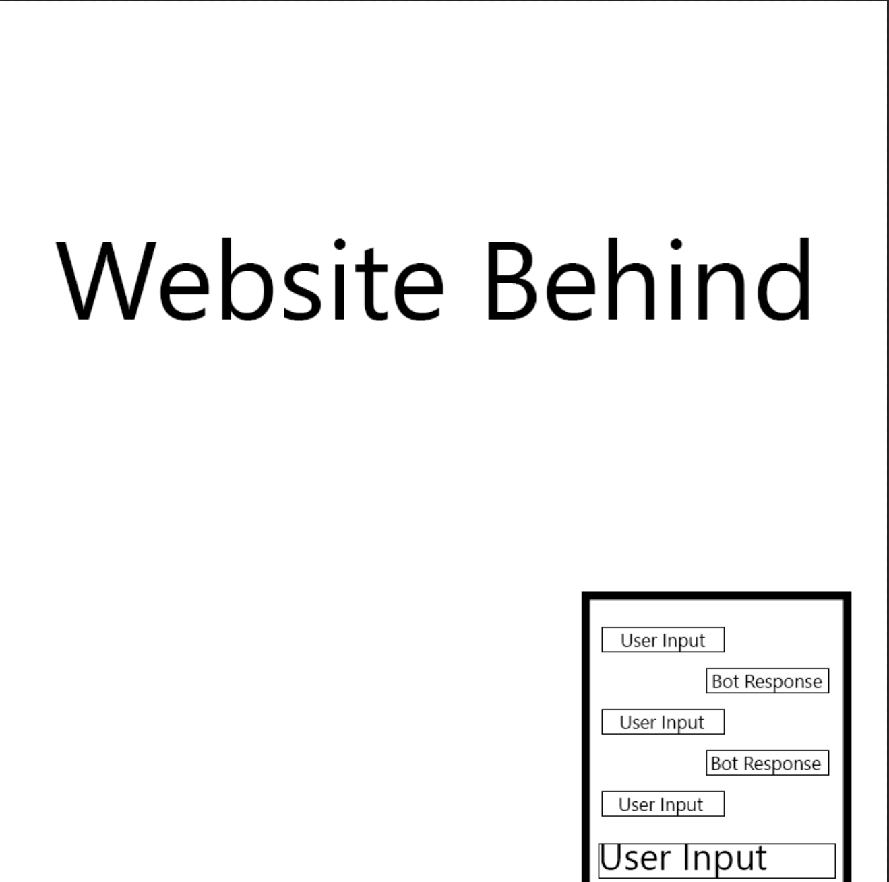
Designing the chatbot - Draft
Mock-ups – Method 1
  Uses a textbox for inputs
  Allows a wider range of questions
Notes:
This is the first design mockup I came up with for the chatbot within this project, this design will make use of a textbox for user inputs which will enable a wider range of questions that are available to the user. Each input from a user will have a response from the chatbot whether it be data they wanted or a simple answer to state that the chatbot does not understand with some choices for the user.

Slide 10
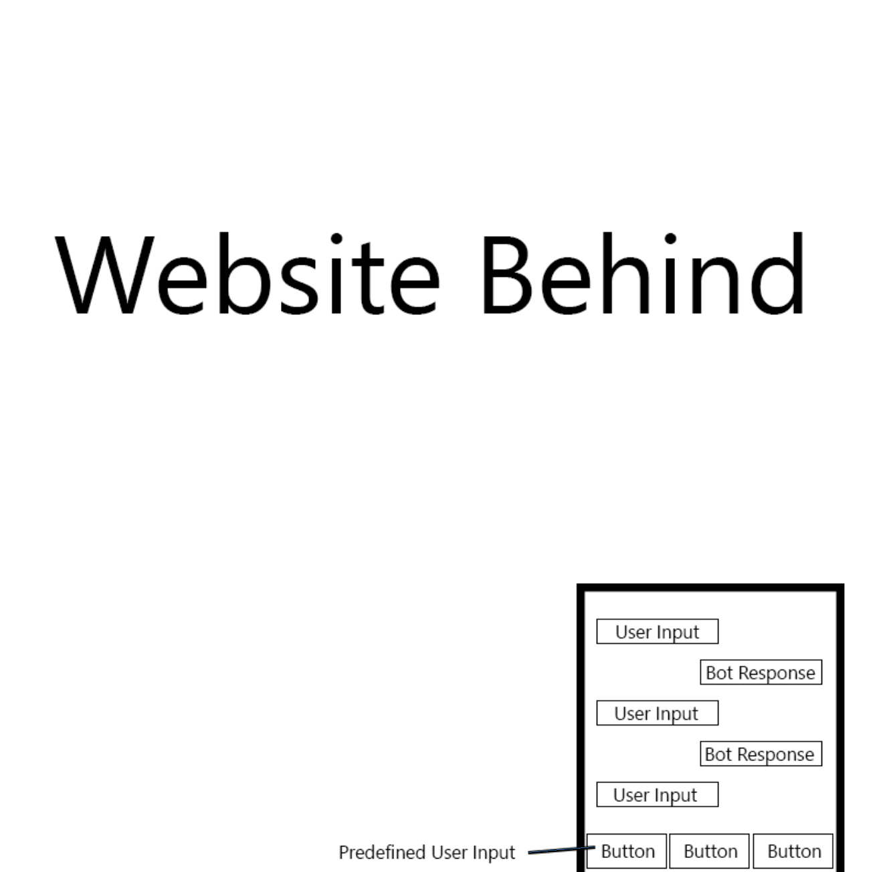
Designing the chatbot - Draft
Mock-ups – Method 2
  Use of buttons for input
  Predefined inputs
Notes:
The second design that I created as an alternative to the first was a chatbot that uses buttons to minimise the amount of inputs that the user could have making the chance for a valid response from the chatbot higher as it would make use of pre-defined inputs such as “what is my attendance”. I decided against this design as this restricts the users quite significantly and I would like the chatbot to have more depth and potentially make use of machine learning to understand what the user is looking for.

Slide 11
Designing the chatbot – Current progress
Prototype – Current progress with system
  Simple chatbot
  Connected to single database
    Plan to have it make use of a data warehouse with multiple databases
Notes:
I will now demonstrate a prototype that I have created so far for this project, this chatbot is quite simple at the moment as it only has one database connected at the moment but I aim to use a data warehouse as mentioned previously the reason for this is because a single database will only be able to provide general information but I aim to make the chatbot provide information specific to the user such as the students attendance or assignment dates based on the courses they are enrolled on.

Slide 12
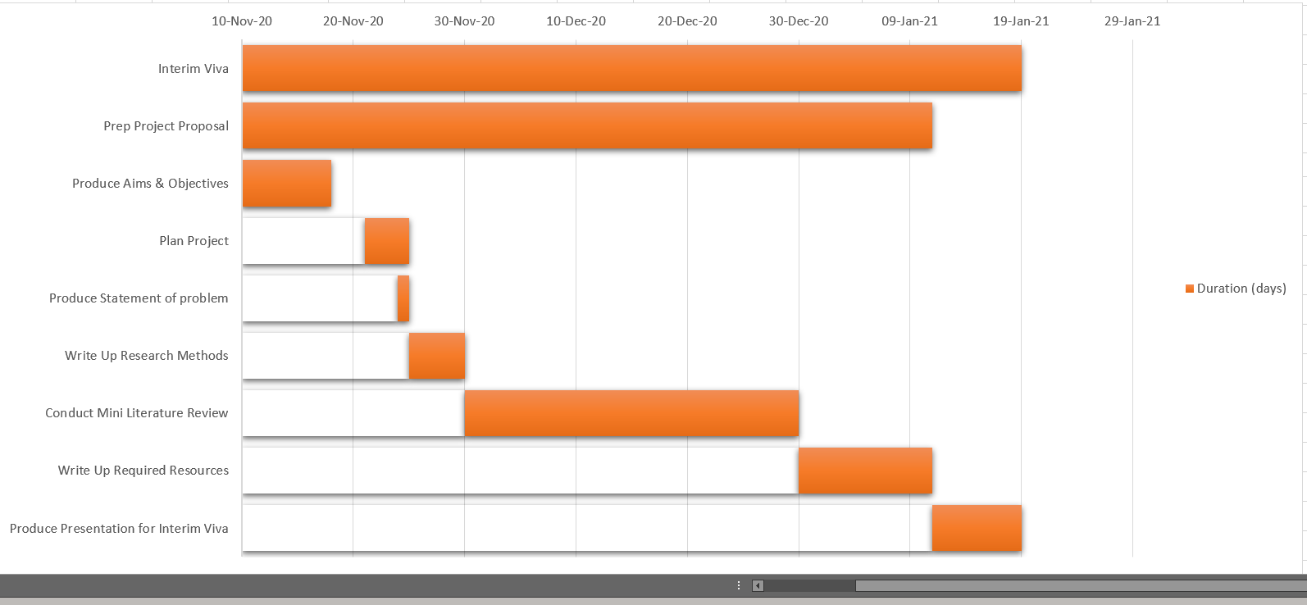
Project Plan – Interim Viva
Plan for the interim viva.
Notes:
This is my project plan for the entire project I decided to split the project plan up into the main sections with sub tasks for each section to make it easier for me to stay on track with this project. The next few slides will show each section of the project plan.

Slide 13
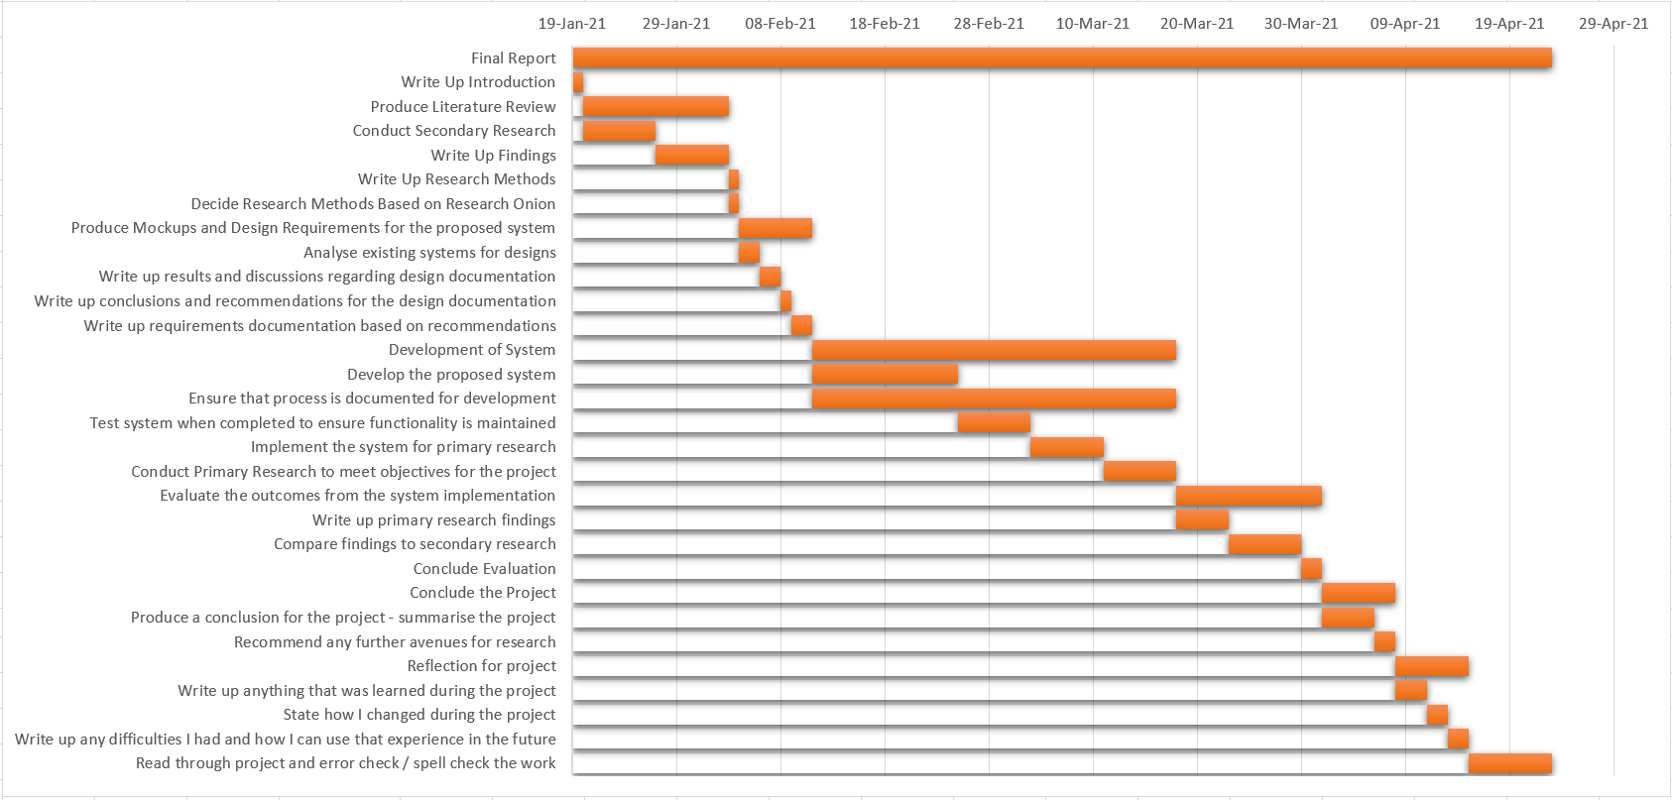
Project Plan – Final Report
Plan for the final report.

Slide 14
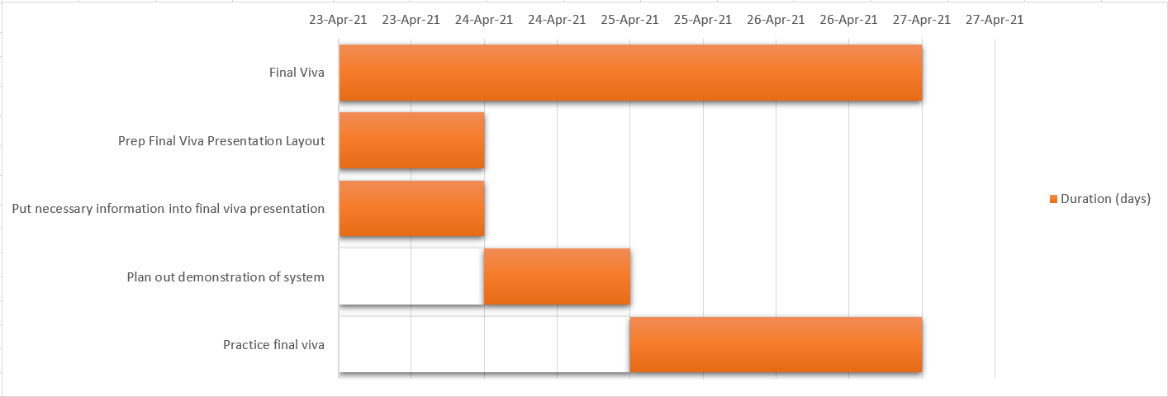
Project Plan – Final Viva
Plan for the final viva.

Slide 15
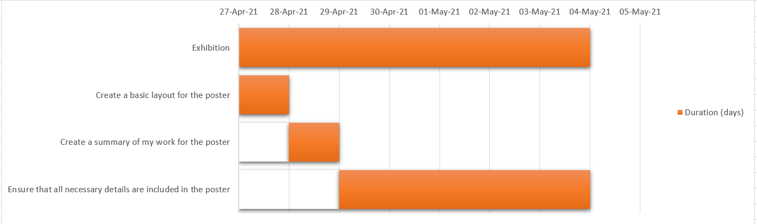
Project Plan – Exhibition
Plan for the exhibition.

Slide 16
Any questions?
Thank you for listening, any questions?
Notes:
Thank you for listening, any questions?

