Slide 1
Skills Agenda
PCET –Teaching Toolkit II

Slide 2

Skills Agenda
Essential and Employability Skills

Slide 3
Learning objectives
Discuss the transition from school to PCET
Examine Dewey’s 4 principles of learning
Explore education in the 21st C /4IR
Review the Welsh Government skills agenda /resources/effective pedagogy

Slide 4


Activity: PCET a step change?
- Does entering post-compulsory education represent a step change to the way we learn?
- Why?
Justify your view in terms of learning concepts
i.e. pedagogy/andragogy

Slide 5
John Dewey’s view of learning
John Dewey has had an impact on education thinking.
The American philosopher, psychologist and educator believed children to be active contributors and agents of their learning, and not just passive recipients of knowledge of previous generations.
He believed that for knowledge to be acquired successfully, learning should be an experience.
His Experiential Learning approach was based on four core principle
These are explained in the following video John Dewey’s 4 Principles of Education

Slide 6
Dewey’s 4 principles.
Experiential learning, learning by doing
Learning in a democratic society
Interactive learning – reflecting the nature of the worlds we live in
Interdisciplinary nature of learning – transfer of learning
‘Education is life itself ’

Slide 7
Activity: The 21st Century employment context
What sort of world is it that are we preparing our learners?
What sort of employability skills are desired?
What are the big changes that impact our learner's prospects?
  Political
  Economic
  Social
  Technological

Slide 8
The Fourth Industrial Revolution (4IR) and Education
Education is the primary tool for connecting people to the workplace. It is a building block that is used to aid employment. Employment, in turn, is the channel that allows people to be economically autonomous and to play an active role in the economy. (World Economic Forum , 2024)
Review this article and share your views
https://www.weforum.org/agenda/2019/08/fourth-industrial-revolution-education/
https://youtu.be/kpW9JcWxKq0

Slide 9
The Fourth Industrial Revolution (4IR) and Education
This video produced by the World Economic Forum provides and overview of how they see the Fourth Industrial Revolution (4IR)
Video : What is the Fourth Industrial Revolution?
What does this mean for us as educators?
What skills will we need as educators to remain relevant?
What skills will our students need to get employment and sustain careers?

Slide 10
What will work look like in the 21 C ?
The Futureist Yuval Noah Harari has written an article on what the year 2050 has in store for humankind
When you will be at the height of your careers !
Activity :
Let’s read the article together and make some notes/observations for discussion
https://www.wired.co.uk/article/yuval-noah-harari-extract-21-lessons-for-the-21st-century

Slide 11
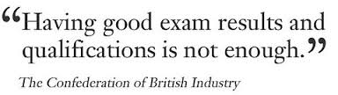
Soft /Hard Skills
Soft skills are general skills that most employers look for when recruiting and are needed for most jobs. They're sometimes called transferable skills or employability skills by employers.
Examples of soft skills
Soft skills are more likely to be the kind you pick up through life experience, like how you:
communicate and work with others
make decisions
organise yourself and work
adapt to difficult situations
UK Gov website
Video Heckman talks about soft skills : http://www.youtube.com/watch?v=yKzQYQNtYts

Slide 12

The Welsh Government view

Slide 13

Critical Thinking and Problem Solving
Digital Literacy
Planning and Organisation
Essential and Employability Skills
Personal Effectiveness
Creativity and Innovation
Essential and Employability Skills are used in an integrated, holistic and contextualised way
Therefore they must be developed, applied and assessed in the same way in order that they make sense and are transferrable to different contexts.

Slide 14
Typical Cluster of Essential Skills –Wales
Digital Literacy
Critical Thinking and Problem Solving
Planning and Organisation
Creativity and Innovation
Personal Effectiveness
https://qualificationswales.org/information-support/qualifications-available-in-wales/essential-skills-wales/

Slide 15
Digital Literacy
Comprised of 6 areas:
Digital Responsibility
Digital Productivity
Digital Creativity
Digital Collaboration
Digital Information Literacy
Digital Learning.

Slide 16
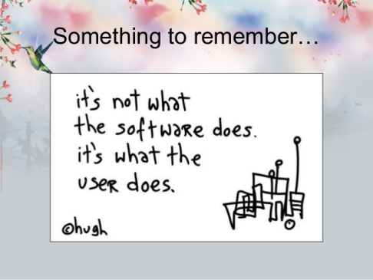
Digital Literacy
Respond to risks and problems to communicate safely
Social media
Digital footprint
Find, organise, store, manage, evaluate, share and protect digital information
Manipulate and create digital data
Use digital technologies in a range of contexts and to support other skills.

Slide 17

Critical Thinking and Problem Solving
Decision-making and problem-solving approaches and techniques
Potential solutions and reasons for different views
Justification of decisions made
Developing and assessing arguments and options – validity and reliability
Opposing views, alternative ideas
Reflection.
VIDEO RESOURCE
5 tips to improve your critical thinking - Samantha Agoos
https://www.youtube.com/watch?v=dItUGF8GdTw&t=4s

Slide 18

Planning and Organisation
Aims, objectives, targets and timescales
Responsibility and reliability
Plan, manage resources and allocate responsibilities
Select, organise and evaluate information
Implement, monitor, evaluate and adapt
Respond to risk
Reflection.
VIDEO RESOURCE: How to Manage Your Time Better
http://www.youtube.com/watch?v=VUk6LXRZMMk

Slide 19
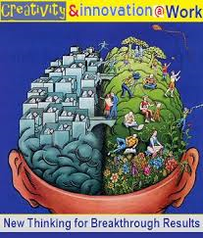
Creativity and Innovation
Generate ideas
Make the most of opportunities
Original thinking, imagination, initiative
Challenge assumptions
Assess, evaluate, combine and develop ideas
Reflection.

Slide 20
Creativity , Schools and PCET
Do schools kill creativity? Sir Ken Robinson
VIDEO- Sir Ken Robinson
https://www.youtube.com/watch?v=iG9CE55wbtY
What is creativity as a skill?
http://www.youtube.com/watch?v=FXJUDyqobbM

Slide 21
Resources- Creativity and innovation
Where do good ideas come from? Steven Johnson
https://www.youtube.com/watch?v=NugRZGDbPFU
Developing Creativity and Innovation through Education: Doireann O'Connor at TEDxCIT
http://www.youtube.com/watch?v=ozNo1tSARh8

Slide 22

Personal Effectiveness
Recognise strengths, weaknesses, talents and aptitudes
Manage and improve own behaviour and performance
Initiative and independence
Personal effectiveness
Time management
Manage conflict
Roles and teams
Respect for others
Reflection.
http://www.youtube.com/watch?v=kBcsqfwfGqw

Slide 23
Critical Thinking and Problem Solving
Digital Literacy
Planning and Organisation
Essential and Employability Skills
Personal Effectiveness
Creativity and Innovation
Essential and Employability Skills are used in an integrated, holistic and contextualised way
Therefore they must be developed, applied and assessed in the same way in order that they make sense and are transferrable to different contexts.

Slide 24
Effective Pedagogic Practice
Evidence-based approaches to effective differentiated pedagogic practice in the teaching of skills include:
teachers set high expectations for every student’s progress and ambitious targets for improving classroom performances
teachers implement teaching methods that have been shown to be effective in promoting successful learning for all
teachers create classroom learning environments in which all students are engaged, challenged, feel safe to take risks and are supported to learn
teachers work to build students’ beliefs in their own capacities to learn successfully and their understandings of the relationship between effort and success
teachers provide regular and timely feedback to students in forms that make it clear what actions individuals can take to make further learning progress.
Masters (2010)
- Hattie (2009:236) suggests “it is the differences in the teachers that make the difference in student learning.”

Slide 25

What about our gifted students?
Resources for parents fo gifted children http://www.teachthought.com/

Slide 26
Further reading /resources
Welsh Government
Plans and reviews about FE, HE and skills
https://gov.wales/plans-and-reviews-about-fe-he-and-skills

Slide 27
Business Wales
https://businesswales.gov.wales/skillsgateway/

Slide 28
EWC
https://educators.wales/

