Slide 1
Database Security
Lecture 14: Database Systems (DBS)
Dr Kemi Ademoye

Slide 2
Today’s Lecture
Database Security
Security Threats
Countermeasures

Slide 3
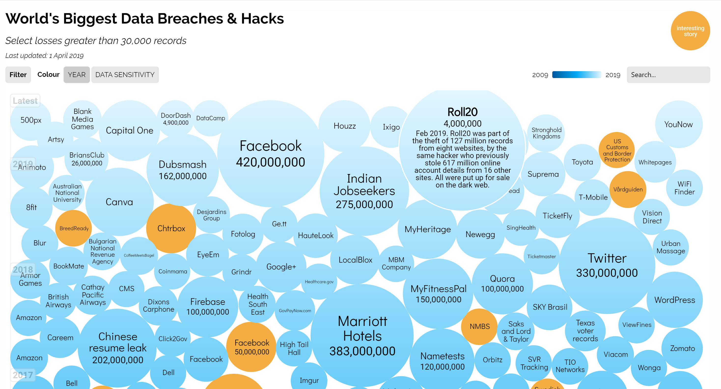
Data is Valuable!!
Recall from Lecture 1, Data is valuable and it must be strictly controlled and managed.
Notes:
Image source: https://informationisbeautiful.net/visualizations/worlds-biggest-data-breaches-hacks/ [accessed: 23-Nov-2019]

Slide 4
Data Security
Data is a valuable resource that must be strictly controlled and managed.
Corporate data typically has strategic importance and therefore it needs to be kept secure and confidential.

Slide 5
The CIA Model of Security
The CIA triad is a model designed to guide policies for information security within an organisation:
Confidentiality: only authorised users should have access to information to preserve privacy, intellectual property and national security efforts.
Integrity: ensuring that the consistency, trustworthiness and accuracy of data is maintained throughout its lifetime.
Availability: guarantee of reliable access to the information by authorised users when needed.
Notes:
See more: https://whatis.techtarget.com/definition/Confidentiality-integrity-and-availability-CIA

Slide 6
Database Security
Database Security: The mechanisms that protect the database against intentional or accidental threats.
Note:
  Security considerations do not only apply to the data stored in the database.
  Security breaches may affect other parts of the system, which may in turn affect the database.

Slide 7
Database Security
Involves measures to avoid:
Theft and fraud: intentional unauthorised access and/or unauthorised operations on data.
Loss of confidentiality: maintaining secrecy over data that is critical to the organisation.
Loss of privacy: protect data about individuals
Loss of integrity: operations resulting in invalid or corrupted data.
Loss of availability: data and/or the system, cannot be accessed, which can seriously affect financial performance.

Slide 8
Database Threats
Any situation or event, whether intentional or unintentional, that will adversely affect a system and consequently an organisation.
Threats may be caused by a situation or event that involves a person, action or circumstance that is likely to bring harm to an organisation.
An organisation needs to identify the types of threats it may be subjected to and to initiate appropriate plans and countermeasures, bearing in mind the costs of implementing them.
Exercise: Go to OneNote

Slide 9




Summary of Threats to Computer Systems
Hardware
Fire/flood/bombs
Data corruption due to power loss or surge
Failure of security mechanisms giving greater access
Theft of equipment
Physical damage to equipment
Electronic interference and radiation
DBMS and Application Software
Failure of security mechanism giving greater access
Program alteration
Theft of programs
Database
Unauthorised amendment or copying of data
Theft of data
Data corruption due to power loss or surge
Communication Networks
Breaking disconnection of cables
Electronic interference and radiation
Users
Using another person’s means of access
Viewing and disclosing unauthorised data
Illegal entry by hacker
Blackmail
Introduction of viruses
Programmers/Operators
Creating trapdoors
Program alteration (such as creating software that is insecure)
Inadequate staff training
Inadequate security policies and procedures
Staff shortages and strikes
Data/Database Administrator
Inadequate security policies and procedures
Notes:
Image from Database Systems: A Practical Approach to Design, Implementation and Management, 6th Edition, Addison Wesley (2015), By T. Connolly, C. Begg, pp. 611

Slide 10
Countermeasures: Computer-Based Security Controls
The security of a DBMS in the first instance is only as good as that of the operating system.
Additional countermeasures to threats on computer systems range from security controls to administrative procedures.
We will look at the following computer-based security controls for a multi-user environment:
  Authorisation
  Access controls
  Views
  Backup and recovery
  Integrity
  Encryption
  RAID technology

Slide 11
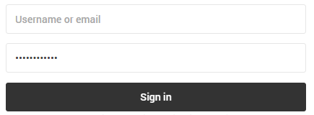
Countermeasures
Authentication and Authorisation
What is the difference between authorisation and authentication?
Authentication: Confirm that I am who I am claiming to be
Authorisation: Okay confirmed, know who you are, you can access …

Slide 12
Countermeasures
Authentication
Authentication: A mechanism that determines whether a user is who he or she claims to be.
Involves the use of logins, unique user identifiers associated with a password.

Slide 13
Countermeasures
Authorisation
Authorisation: The granting of a right or privilege, which enables a subject to legitimately have access to a system or a system’s object.
Involves authentication of subjects requesting access to objects.
  Subjects are user or programs
  Objects are tables, views, procedures, triggers, etc. in the Database
NO ISO Standard for authentication and authorisation – left for DBMSs to implement.

Slide 14
MS SQL Server
Authorisation and Authentication
Two levels of security: the server itself and the database(s).
Logins: access to the server is granted via logins and there are two main types:
  SQL Server authenticated logins
  Windows authenticated logins
Users: access to databases is granted via users.
  To get further access to a specific database, a login must be mapped to a database user.
  Therefore, a user mapped to a login must exist in the database.
Notes:
Permissions can be granted at both levels i.e. server and database.
Permissions inside the database are granted to database user accounts, not the logins.
See more: https://docs.microsoft.com/en-us/sql/relational-databases/security/authentication-access/create-a-login
MS SQL Server also supports contained databases: https://docs.microsoft.com/en-us/sql/relational-databases/security/contained-database-users-making-your-database-portable

Slide 15
MS SQL Server
Authorisation and Authentication
Permissions can be granted at both levels.
Permissions inside the database are granted to database user accounts, not the logins.

Slide 16
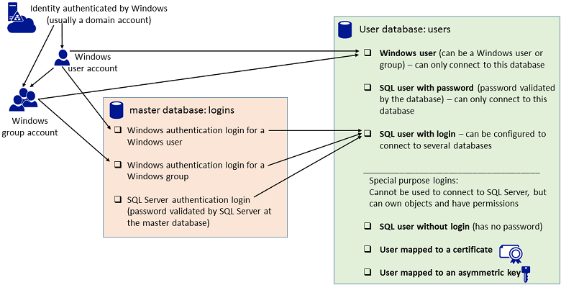
MS SQL Server Users and Logins
Notes:
Image source: https://docs.microsoft.com/en-us/sql/relational-databases/security/authentication-access/create-a-database-user

Slide 17
MS SQL dbo Schema
A core concept of SQL Server security is that owners of objects have irrevocable (impossible to change) permissions to administer them.
That is, you cannot :
  Remove privileges from an object owner.
  Drop users from a database if they own objects in it.
dbo is the default schema for a new database.
  The dbo schema is owned by the dbo (database owner) user account.
  So when you create a database, your login is mapped to the dbo user account by default – you own the database.
Let’s have a look …
Notes:
See more: https://docs.microsoft.com/en-us/dotnet/framework/data/adonet/sql/ownership-and-user-schema-separation-in-sql-server
Also see: https://docs.microsoft.com/en-us/dotnet/framework/data/adonet/sql/server-and-database-roles-in-sql-server

Slide 18
Creating Logins in SQL Server
Creating a login syntax (simplified):
    CREATE LOGIN login_name [WITH option_list1 | FROM source] [, option_list2 [, …]]
Examples:
  Create a login with a password:
    CREATE LOGIN P000001 WITH PASSWORD = 'dbms';
  Create a login requiring user to change password on first login:
    CREATE LOGIN P000001 WITH PASSWORD = 'dbms' MUST_CHANGE;
  Create a login from a Windows domain account:
    CREATE LOGIN Domain_Name\P000001 FROM WINDOWS;

Slide 19
Creating Logins in MS SQL Server
Note that, a new login can connect to the server, but only has the permissions granted to the public role.
You have to give permission to any additional roles that you want the login to have.

Slide 20
Creating Database Users in SQL Server
You use the CREATE USER command to add a user to the current database.
MS SQL Server supports different types of database users.
The most common is a user based on a login:
    CREATE USER user_name [FOR|FROM] LOGIN login_name[WITH limited_options_list [, …]]
Notes:
See more: https://docs.microsoft.com/en-us/sql/t-sql/statements/create-user-transact-sql

Slide 21
Creating Database Users in SQL Server
Domain Login Users
    CREATE USER [DomainName\P000001];
    CREATE USER [DomainName\P000001] FOR LOGIN DomainName\P000001;
User based on SQL Server Authentication Login
    CREATE USER P000001;
    CREATE USER P000002 FOR LOGIN P000001;
Your user accounts on the Sql Server we are using are domain login user accounts.
For the practical element of this module, we will use users based on SQL Server Authentication logins.
Let’s give it a go.

Slide 22
Countermeasures
Access Control
Based on granting and revoking privileges.
A privilege allows:
  a user to create or access (i.e. read, write or modify) some database object (table, view, index, etc.),
  or to run certain DBMS utilities.
Privileges are granted to users to accomplish the tasks required for their jobs.
  Excessive granting of unnecessary privileges can compromise security.

Slide 23
Two Types of Access Control
Discretionary Access Control (DAC)
  Privileges are managed through SQL.
  Users with appropriate authorisation can grant or revoke privileges to others.
  Has certain weaknesses, unauthorised uses can trick an authorised user into disclosing sensitive data.
Mandatory Access Control (MAC)
  Stricter than DAC
  Controlled by the operating system, under the control of a system administrator.
  Based on system-wide policies that cannot be changed by individual users.
We will, however, only look at DAC.

Slide 24
Discretionary Access Control (DAC)
Most DBMSs provided DAC.
The SQL standard supports DAC through the use of the GRANT and REVOKE commands.
  The GRANT command gives privileges to users.
  The REVOKE command takes away privileges.
The privileges are the actions that a user is permitted to carry out on a given base table or view.

Slide 25
Privileges defined by ISO Standard
Privilege | Description
SELECT | The privilege to retrieve data from a table.
INSERT | The privilege to insert new rows into a table.
UPDATE | The privilege to modify existing rows of data in a table.
DELETE | The privilege to delete rows of data in a table.
REFERENCES | The privilege to reference columns of a named table in integrity constraints. E.g. Permission to create a FOREIGN KEY constraint Permission to create a view referencing PRIMARY KEY columns. In other words, user is allowed to reference this column from another database object.

Slide 26
Specifying Privileges
The INSERT/UPDATE privilege
  can be restricted to specific columns,
  allowing changes only to these columns.
Owner of a table must explicitly grant other users the necessary privileges using GRANT statement.

Slide 27
Specifying Privileges
To create a view, the user must have SELECT privileges on all tables that make up the view and REFERENCES privileges on the named columns.
When a user creates a view, it does not necessarily grant the user full privileges on the view.
  This will depend on the privileges the user has on the base tables.

Slide 28
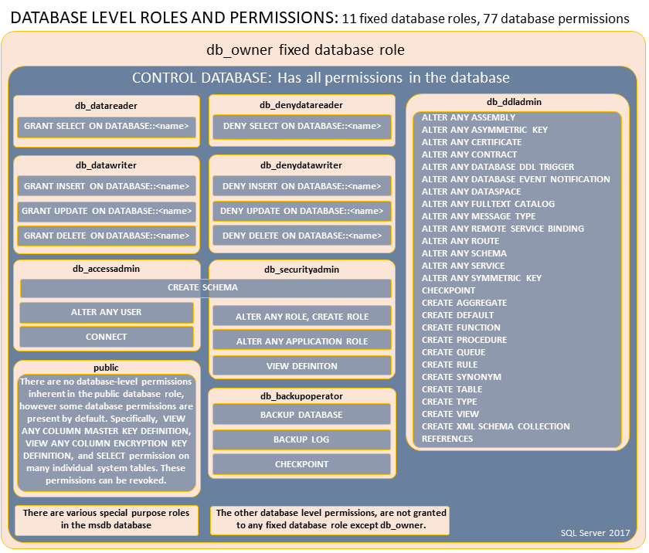
MS SQL Server Database Level Roles and Permissions
Notes:
https://docs.microsoft.com/en-us/sql/relational-databases/security/authentication-access/database-level-roles

Slide 29
The GRANT Statement
Syntax (simplified):
    GRANT { PrivilegeList | ALL [PRIVILEGES] }
    ON ObjectName
    TO { AuthorisationList | PUBLIC }
    [WITH GRANT OPTION]
PrivilegeList consists of one or more of the privileges to be granted separated by commas.
INSERT, UPDATE and REFERENCES also accept a column list e.g.
    GRANT INSERT ([columnName[, …]])
Notes:
https://docs.microsoft.com/en-us/sql/t-sql/statements/grant-object-permissions-transact-sql

Slide 30
The GRANT Statement
ALL PRIVILEGES grants all privileges to a user, e.g.:
    GRANT ALL PRIVILEGES ON Staff TO ...
However, MS SQL Server has deprecated the use of ALL and it does not necessarily grant all possible DATABASE privileges.
  You will get a warning message that using it does not grant all possible DATABASE permissions.
  For what we want to do, it is okay.
  On tables, ALL PRIVILEGES will grant INSERT, SELECT, UPDATE, DELETE and REFERENCES.

Slide 31
The GRANT Statement
Granting privileges to the PUBLIC role grants access to all present and future authorised users.
ObjectName can be a base table, view, domain, character set, collation or translation.
AuthorisationList is the user(s) to grant the privilege(s) to.
Using WITH GRANT OPTION allows privileges to be passed on.
  The user can pass the privileges they have been given for the named object to other users.
Notes:
See more on database roles: https://docs.microsoft.com/en-us/sql/relational-databases/security/authentication-access/database-level-roles

Slide 32
Granting Privileges: Examples
Give the user P000001 full access to the Branch table and let the user pass the privileges on.
    GRANT ALL PRIVILEGES ON Branch
    TO P000001 WITH GRANT OPTION;
Grant specific privileges:
    GRANT SELECT, UPDATE(Salary) ON Staff TO P000001;
If you want to set privileges for ALL Users (now and in the future), use the PUBLIC account. Give all users SELECT on Branch table.
    GRANT SELECT ON Branch TO PUBLIC;
Notes:
Please note the restrictions with using ALL on Microsoft SQL Server.

Slide 33
The REVOKE Statement
Syntax (simplified):
  REVOKE [GRANT OPTION FOR]
  { PrivilegeList | ALL [PRIVILEGES] } ON ObjectName
  FROM { AuthorisationList|PUBLIC } [RESTRICT|CASCADE]
ALL PRIVILEGES refers to revoking all privileges granted to a user and has again been deprecated in MS SQL server.
GRANT OPTION FOR revokes the option to grant the specified permission separately from the privileges themselves.
Notes:
https://docs.microsoft.com/en-us/sql/t-sql/statements/revoke-object-permissions-transact-sql

Slide 34
The REVOKE Statement
REVOKE fails if it results in an abandoned object, unless the CASCADE keyword has been specified.
  Abandoned means the authority that allowed the object to be created has been removed.
  If CASCADE is specified and REVOKE results in an abandoned object, the object is DROPPED.
Privileges granted to this user by other users are not affected.

Slide 35
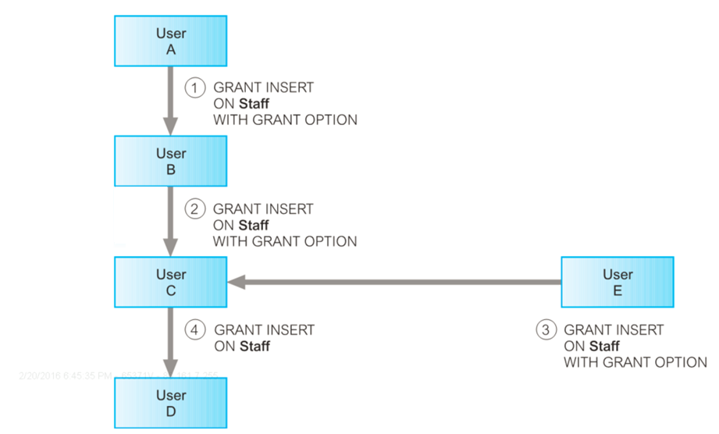
Effects of Revoke
User A grants User B INSERT with grant option
User B passes INSERT with grant to User C
User C receives same grants from User E too
User C passes only INSERT to User D, User D cannot grant other users privilege. Why?

Slide 36
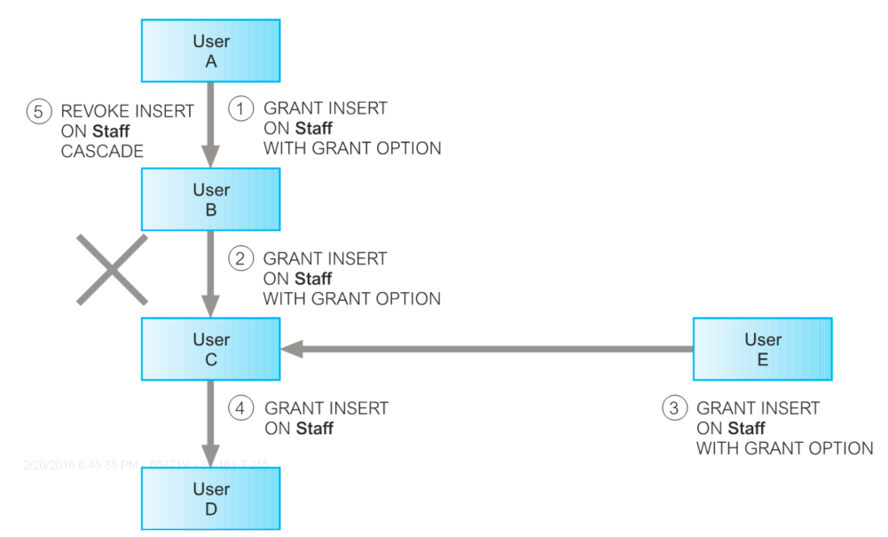
Effects of Revoke
User A revokes INSERT from User B, but …
Although CASCADE has been used, the privilege is not revoked from User C and User D, because User E also granted this privilege to User C.
If User E had not given the privileges, CASCADE will revoke the privileges from Users C & D too.

Slide 37
Revoking Privileges: Examples
Revoke the SELECT privilege on the Branch table from ALL Users.
    REVOKE SELECT ON Branch FROM PUBLIC;
Revoke ALL CRUD privileges you have given to P000001 on the Staff table.
    REVOKE SELECT, INSERT, UPDATE, DELETE ON Staff FROM P000001;
Revoke ALL privileges you have given to P000001 on the Staff table (but note MS SQL behaviour).
    REVOKE ALL PRIVILEGES ON Staff FROM P000001;

Slide 38
Revoking Privileges: Examples
Revoking just the GRANT OPTION from User C (in the Effects of Revoke example), without revoking the underlying privilege (INSERT in this case).
    REVOKE GRANT OPTION FOR INSERT ON Staff FROM UserC;

Slide 39
Countermeasures
Views
The view mechanism provides a powerful and flexible security mechanism by hiding parts of the database from certain users.
The user is not aware of any columns or rows that are missing from the view.
Users can also be granted appropriate privileges to use a view, but not its base relations (tables).
  Thus, providing greater restrictions than simply having certain privileges granted to a user on the base table(s).
Also views restrict the kinds of updates allowed.
Notes:
Recall that:
A view is a dynamic result of one or more relational operations (queries) operating on base tables to produce another relation.

Slide 40
Countermeasures
Backup and Recovery
Backup: process of periodically taking a copy of the database and log file (and programs) to offline storage media.
  In the event of a failure that renders the database unusable, the backup copy and details captured in log file are used to restore the database to the latest possible consistent state.
Journaling: process of keeping and maintaining a log file (or journal) of all changes made to database to enable effective recovery in event of failure.
  The log file is useful for determining the last known consistent state if the database needs restoring.

Slide 41
Countermeasures
Integrity
Integrity constraints also contribute to maintaining a secure database system.
They prevent data from becoming invalid, and hence giving misleading or incorrect results.

Slide 42
Countermeasures
RAID
RAID: Redundant Array of Independent Disks
Hardware that the DBMS is running on must be fault-tolerant.
This means that the DBMS should continue to operate even if one of the hardware components fails.
This suggests having redundant components that can be seamlessly integrated into the working system whenever there is one or more component failures.

Slide 43
Countermeasures
RAID
The main hardware components that should be fault-tolerant include disk drives, disk controllers, CPU, power supplies, and cooling fans.
Disk drives are the most vulnerable components with the shortest times between failure of any of the hardware components.
One solution to this problem is the use of RAID.
  Provides a large disk array comprising an arrangement of several independent disks that are organized to improve reliability and at the same time increase performance.

Slide 44
Countermeasures
Encryption
Encryption is the encoding of data by a special algorithm that renders the data unreadable by any program without the decryption key.
Requires a cipher system, consisting of:
  Encryption algorithm: converts plaintext to ciphertext.
  Encryption Key: part of the input for the encrypting algorithm from a very large set of possible keys.
  Decryption algorithm: reproduces plaintext from ciphertext.
  Decryption Key: part of the input for the decrypting algorithm from a very large set of possible keys.

Slide 45
Countermeasures
Encryption
Two main techniques:
Symmetric Key Encryption
  The encryption key is the same as the decryption key.
  Relies on safe communication lines for exchanging the key.
Asymmetric Key Encryption
  Uses different keys for encryption and decryption.

Slide 46
Question
What data should be encrypted?

Slide 47
Encrypting Data at Rest
Data at rest refers to inactive data stored in digital form (in our case in a database).
In MS SQL Server, and Oracle, Transparent Data Encryption (TDE) is used to encrypt data at rest.
  TDE performs real-time I/O encryption and decryption of the data and log files.
  It supports both symmetric and asymmetric keys.
Notes:
See more:
https://docs.microsoft.com/en-us/sql/relational-databases/security/encryption/always-encrypted-database-engine
https://docs.microsoft.com/en-us/sql/relational-databases/security/encryption/configure-always-encrypted-using-sql-server-management-studio

Slide 48
Review Questions
Explain the following in terms of providing security for a database:
Authorisation
Authentication
Access Controls
Views
Backup and Recovery
Integrity
Encryption
RAID Technology

Slide 49
Lab Exercise
Download Instructions from Moodle.

Slide 50
What Data Should be Encrypted?
Encrypt any personal information held electronically that would cause damage or distress if it were lost or stolen.
See what the UK government says about:
  Encryption
  Data Protection
  Personal Data

