Slide 1
Review of Database Concepts

Slide 2
Exercise- ERD
Construct an E-R diagram for a car-insurance company whose customers own one or more cars each. Each car has associated with it zero to any number of recorded accidents.

Slide 3
Exercise- Possible Solution
Construct an E-R diagram for a car-insurance company whose customers own one or more cars each. Each car has associated with it zero to any number of recorded accidents.
Entities:
Customer:
Attributes: CustomerID (Primary Key), First Name, Last Name, Address, Phone Number, Email, etc.
Car:
Attributes: CarID (Primary Key), Make, Model, Year, License Plate, VIN (Vehicle Identification Number), etc.
Accident:
Attributes: ReportId (Primary Key), Date, Location, Description, Damage Amount, etc.

Slide 4
Exercise- Possible Solution
Construct an E-R diagram for a car-insurance company whose customers own one or more cars each. Each car has associated with it zero to any number of recorded accidents.
Relationships:
Owns:
  Relationship between Customer and Car.
  One customer can own one or more cars.
  One car is owned by one and only one customer.
  Cardinality: One (Customer) to Many (Car).
Has:
  Relationship between Car and Accident.
  One car can be associated with zero to many accidents.
  One accident is associated with one and only one car.
  Cardinality: Zero or Many (Car) to One (Accident).

Slide 5
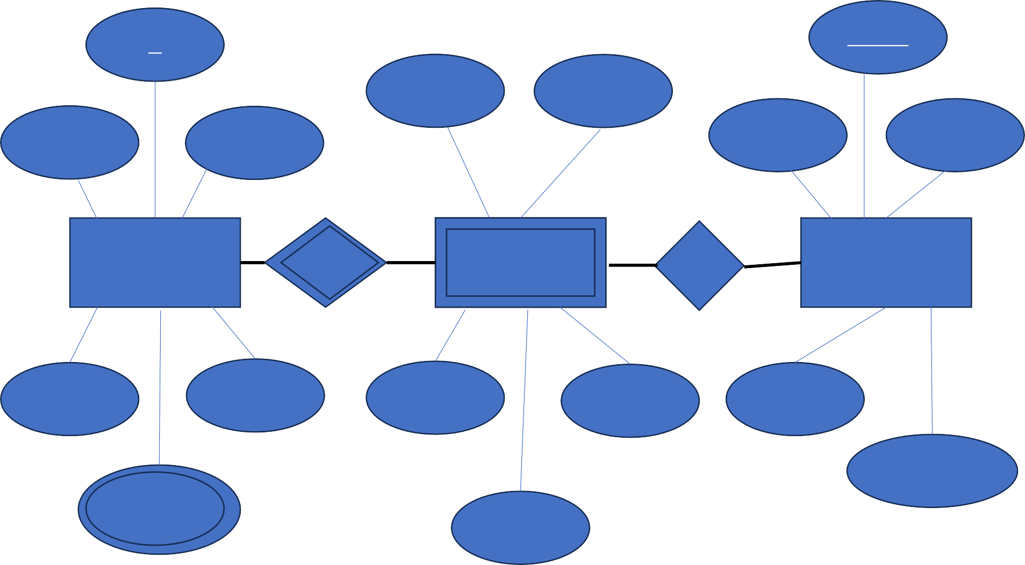
Exercise-Possible Solution
Id
ReportId
CarID
Make
FName
LName
Date
Location
Customer
owns
Car
has
Accident
Phone
Email
Model
Year
Desciption
Damage_Amount
<<Address>>
VIN

Slide 6
ERD to Relational Table Mapping Algorithm

Slide 7
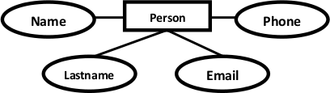
Mapping Algorithm - Entities and Simple
Attributes
Person( personid , name, lastname, email)
What happens to Phone-multivalued attribute?
PersonID

Slide 8
Mapping Algorithm – Multivalued attribute
Person( personid , name, lastname, email)
PersonID
1 person can have 0 or many phone numbers (1:N)
Phone ( phoneid , personid, phone )
Phone

Slide 9
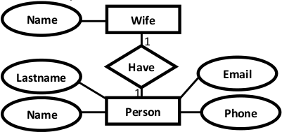
Mapping Algorithm – 1:1 Relationships
which will be the foreign key creating a reference between Persons and Spouse table?
Spouse

Slide 10
Mapping Algorithm – 1:1 Relationships
Spouse
Person( personid{PK}, name, lastname, email, spouseid{FK})
Spouse ( spouseid{PK}, name)
Can you think of an alternative approach?

Slide 11
Mapping Algorithm – 1:1 Relationships
Spouse
Persons( personid{PK}, name, lastname, email)
Spouse ( spouseid{PK}, name, personid{FK})

Slide 12
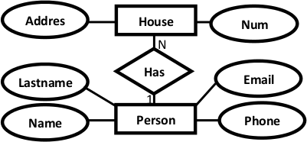
Mapping Algorithm – 1:N Relationships
How is this converted to?
Give a try…

Slide 13
Mapping Algorithm – 1:N Relationships
House
person
houseid | personid
H1 | 1
H2 | 2
H3 | 1
personid | houseid
1 | H1,H3
2 | H2
3 | <null>

Slide 14
Mapping Algorithm – 1:N Relationships
Person( personid , name, lastname, email ) House ( houseid , num , address, personid)

Slide 15

Mapping Algorithm – N:N Relationships
s
How is this converted?
Give a try…

Slide 16
Mapping Algorithm – N:N Relationships
Person
Country
personid | countryid
p1 | c1
p2 | c1
p3 | c1,c2
countryid | personid
c1 | p1,p2,p3
c2 | p3
c3 | -

Slide 17

Mapping Algorithm – N:N Relationships
countryid | personid
c1 | p1,p2,p3
c2 | p3
c3 | -
Composite key
hasrelationid | personid | countryid
has1 | P1 | C1
has2 | P2 | C1
has3 | p3 | C1
has4 | p3 | c2
personid | countryid
p1 | c1
p2 | c1
p3 | c1,c2

Slide 18
Mapping Algorithm – N:N Relationships
s
Persons( personid , name, lastname, email ) Countries ( countryid , name, code)
HasRelation ( hasrelationid , personid , countryid)

Slide 19
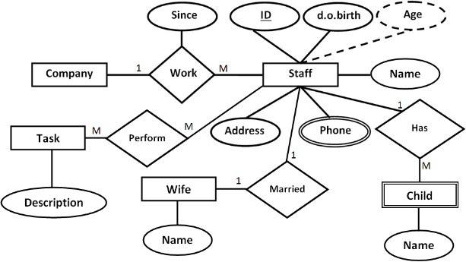

Mapping Algorithm – Activity 1
https://forms.office.com/e/3Dzw97CRvA

Slide 20
Mapping Algorithm – Activity 1
Company( CompanyID , name , address ) Staff( StaffID , dob , address , WifeID) Child( ChildID , name , StaffID )
Wife ( WifeID , name )
Phone(PhoneID , phoneNumber , StaffID) Task ( TaskID , description)
Work(WorkID , CompanyID , StaffID , since ) Perform(PerformID , StaffID , TaskID )
https://forms.office.com/e/3Dzw97CRvA

Slide 21
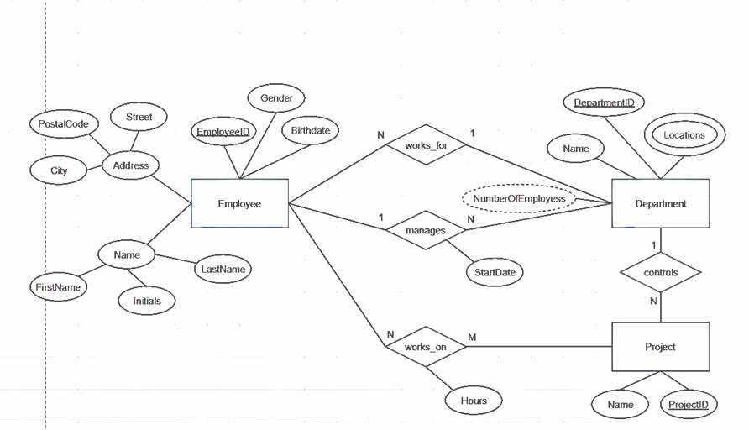

Mapping Algorithm – Activity 2
https://forms.office.com/e/nZnGcYpCEn

Slide 22
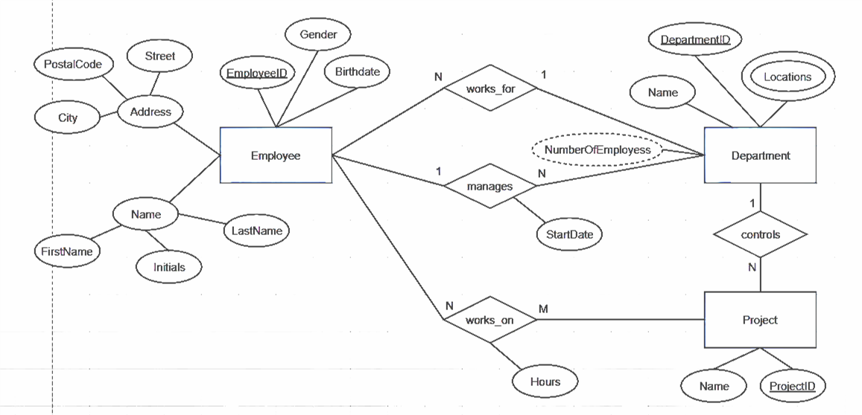
Mapping Algorithm – Activity 2
Employee(Employeeid,gender,birthdate,street,postalcode,city,Firstname,Initials,Lastname,Departmentid) Department(departmentID,name, LocationID,employeeid)
Location(LocationID,locationname) Project(Projectid,name,departmentid) Works_on(hours, employeeid, projectid)

Slide 23

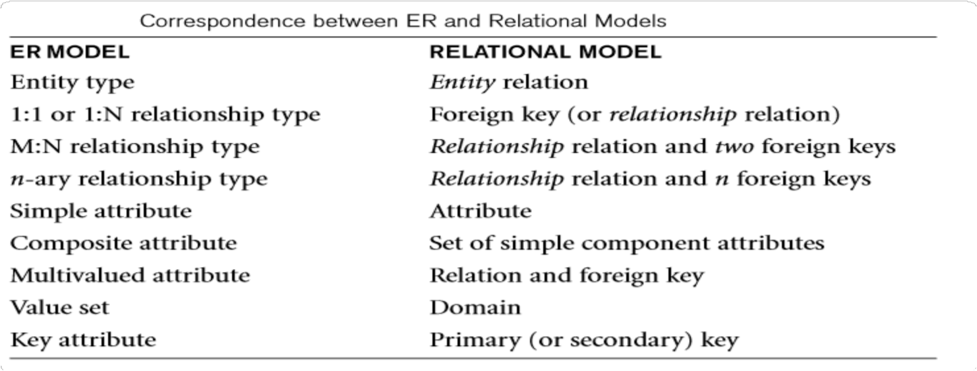
ERD to Relational Tables: Mapping Algorithm

Slide 24
Properties of Database Relations
Each relation name is distinct from all other relation names in the relational schema.
Each attribute has a distinct name.
Each cell of a relation contains exactly one atomic (single) value.
Values of an attribute all come from the same domain.
Each tuple is distinct, there are no duplicate tuples.
The order of attributes has no significance.
The order of tuples has no significance theoretically.

