Slide 1
Title
Effective Team Working and Communication
Team 1 Group presentation
BMSW 4002
Jabir Ahsan
Hafiz Rahmani

Slide 2
Table of content
Title | Slide 1
Table of content | Slide 2
Introduction | Slide 3
The benefits of effective communication to Tom, his project team and to Amazon | Slide 4
Models of Communication | Slide 5
What model or models of communication should Tom apply and why | Slide 6
Berlo’s Model | Slide 7
Which communication barriers have or can negatively impact the project team | Slide 8
Discuss the channels of communication to be used by Tom to improve communication | Slide 9
Conclusion | Slide 10
Reference | Slide 11
Evaluation | Slide 12

Slide 3
Introduction
Amazon opening 3 warehouses in major cities of Europe, Paris, London, and Berlin
Projects aim is to foster fast and reliable delivery across Europe
Tom Jackson is the project leader experiencing communication issue with his team
Two team members are not getting over their difference and settled on their own personal gains
This issue has the potential to jeopardise the entire project of achieving 3 warehouses across Europe.

Slide 4
The benefits of effective communication to Tom, his project team and to Amazon
A blog post from Nuclino claims that Jeff Bezos has offered a range of unorthodox business advice. When Jeff Bezos came up and declared, "No communication is awful," the subject of getting businesses to communicate more was under discussion. He concurs that effective communication is a key component of productive teamwork. Nuclino (2016) Two – pizza team: The science behind Jeff Bezos’ rule
A team's ability to work together more effectively is boosted by effective communication, which fosters loyalty and builds trust among team members.
The project won't stall out due to disagreement when there is effective communication because it increases productivity, encourages creativity, and helps to overcome problems.
Communication abilities will guarantee efficient team management and assist in coordinating efforts to achieve project success.
The success of the project will be positively impacted by effective communication, which will deliver the appropriate information in the proper manner at the appropriate time.
Improved employee relations and higher productivity will benefit Amazon.com. It will guarantee that Amazon opens distribution centres throughout Europe and reaches their goal.

Slide 5
Models of Communication
There are several communication theories and models. On this slide, we looked at the pyramid communication model and 4 functions of communication model. We decided to use a straightforward example to demonstrate how a communication model works, and we will recommend which model Tom should use to solve his issue on our next slide.
Pyramid communication, which puts the answer at the top and you’re reasoning and supporting augments at the bottom, helps corporate leaders quickly assimilate your information. Kuriyan, Ray, Toyama, (2008).
The goal behind the four functions of communicating models is to communicate in a way that you have control over the information presented, the information is true, reveal motive behind the speaking, and convey your emotion while communicating. Robbins, and Coulter (2017)
Functions of communication
Motivation
Emotional expressions
Information
Control

Slide 6
What model or models of communication should Tom apply and why
Additionally, we looked into the communication models proposed by Shannon & Weaver (1949) and Berlo (1960). In this slide, we will explain these models and their advantages.
The Sender, Encoder, Channel, Noise Decoder, Receiver, and Feedback components make up the Shannon and Weaver model. Finding and developing a common channel when there are problems with several channels helps all employees understand the chain of command. As the channels are broken down, it will be much easier to identify where the issues within the workforce are. Drew, Chris, (2022)
The Berlo Model of Communication extends from Shannon and Weaver's framework while delving further into the causes of communication problems at various stages.
More precise instructions are provided, and the professionalism and effective communication skills between the sender and receiver who will be exchanging communications are also encouraged. Andris and Khalimzoda, Ilkhom, (2016)

Slide 7
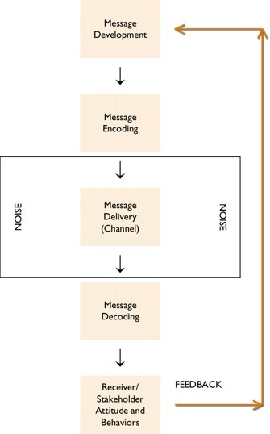
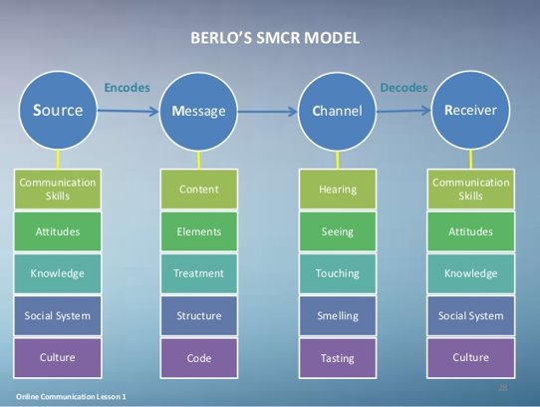
Berlo’s Model
Berlo's model of communication is preferable because it helps Tom Jackson and Amazon more effectively identify the sources of conflict. These sources of conflict are difficult to find because no effective model of communication has been set up for the affected stakeholders in the proposed project, and the project was planned in a very hasty manner.

Slide 8
Which communication barriers have or can negatively impact the project team?
According to Willkomm, A (2018), communication barriers that can negatively impact the project team are language barriers because if the team members are unable to communicate through the same language, then it creates misunderstandings between both parties.
Another communication barrier is the inability to listen to others, if the project team are not listening to what they each have to say and understand their point of view then it is likely that assumptions will be made based on their own perceptions rather than reality (Willkomm, A, 2018).
According to Martic, K (2022), communications barriers may also arise due to lack of trust between team members. If team members do not trust each other enough to share their views and ideas, then other members will not be aware of what may be going on leading to confusion due to not being on the same page.
Disengagement also leads to miscommunication which then negatively impacts the team project due to no engagement being made between parties and therefore initially ruining the purpose of effective communication between the project team members (Martic, K 2022).

Slide 9
Discuss the channels of communication to be used by Tom to improve communication
Whatever style of communication we employ, the information must be successfully conveyed. Communication can take many different forms, including written, spoken, and non-verbal. Digital technology can be used to facilitate communication in the workplace and connect workers worldwide using platforms like M S Teams. Stephens (2007).
Both the means of communication and the specific tools employed can be referred to as communication channels. One of the most popular methods of internal communication, along with email, staff newsletters, and video conferencing, is the intranet. Conversation and interaction between people happen through communication channels. These are the mediums that let you communicate with your target audience.
One of the most effective types of communication is face-to-face interaction. By utilising verbal and nonverbal indicators, face-to-face conversations provide you the ability to communicate your message more successfully. Digital communication can be confusing and lack tone and intent. Being able to disclose sensitive information makes in-person conversation productive. (Walther, J.B., et al 2005)

Slide 10
Conclusion
Tom should create effective channels of communication with his team, is our advice. For instance, he might organise frequent team meetings on MS Team in addition to monthly in-person sessions. Tom will also need to resolve the conflicts on his team and motivate everyone to think beyond their individual objectives.
To boost morale and to give awards and recognition when the project is over, engage in team-building activities. Maintain the current team structure with Spencer as project lead, Michaela as project manager, and him as managing director to promote trust. Once tasks are allocated, the team will feel more purposeful and gain personally.
If Tom uses the strategies and models outlined in our presentation, he will be able to execute his plan and launch three Amazon sites across Europe.

Slide 11
Reference
Drew, Chris (PhD), (2022) ‘Shannon Weaver Model Of Communication – 7 Key Concepts’ [ONLINE] Available at; https://helpfulprofessor.com/shannon-weaver-model/​ [Accessed 6th November 2022]
Kuriyan, R., Ray, I. and Toyama, K., (2008) Information and communication technologies for development: The bottom of the pyramid model in practice. The Information Society, 24(2), pp.93-104.
Martic, K. (2022) ‘Top 13 Communication Barriers and How to Tackle Them’, Haiilo. Accessed on: 13/11/2022. Available at: Top 13 Communication Barriers and How to Tackle Them (haiilo.com)
Nucclino (2016) Two-pizza teams: The science behind Jeff Bezos' rule, Available at Two-pizza teams: The science behind Jeff Bezos' rule | Inside Nuclino Available at: Two-pizza teams: The science behind Jeff Bezos' rule | Inside Nuclino [Accessed 13th November 2022]
Petersons, Andris and Khalimzoda, Ilkhom, (2016) ‘Communication Models And Common Basis For Multicultural Communication In Latvia’ Proceedings of the International Scientific Conference. Volume IV. 423-433 [ONLINE] Available at; http://journals.rta.lv/index.php/SIE/article/viewFile/1555/2164 ​[Accessed 6th November 2022]
Robbins, SP, & Coulter, MA (2017), Management, Global Edition, Pearson Education Limited, Harlow, United Kingdom. Available from: ProQuest Ebook Central. [7 May 2020].
Stephens, K.K., (2007) The successive use of information and communication technologies at work. Communication theory, 17(4), pp.486-507.
Walther, J.B., Loh, T. and Granka, L., (2005) Let me count the ways: The interchange of verbal and nonverbal cues in computer-mediated and face-to-face affinity. Journal of language and social psychology, 24(1), pp.36-65.
Willkomm, A. (2018) ‘6 Barriers to Effective Communication’, Drexel University Graduate College. Accessed on: 13/11/2022. Available at: 6 Barriers to Effective Communication | Graduate College | Drexel University

Slide 12
Evaluation
Teamwork Evaluation | Team responses
Who was in your team? | Ifzal Hussain, Boyd Malcolm and Mohammed Miah
What were the key strengths of your team? | In my opinion, I felt there was great chemistry within our team; everyone knew their roles and what they were doing.
What were the challenges that you overcame as a team? | Initially, I felt delegating roles and slides to the team would be difficult as we only met twice a week in university. To avoid any confusion, we held regular group calls to ensure everyone knew what to do in the presentation so it could be presented fluently.
What would you do differently if you worked as a team again? | Despite holding regular meetings, maybe stating our objectives a little more clearer would have been better. It would have helped build confidence when individually presenting.
How would you rate your team working? Out of 10? | Despite the strengths within our team and also during the presentation, there was also room for improvement; no one is perfect. Therefore, I would rate my team 8/10

