Slide 1

Planning and Designing A Project Management Process for The Workplace
By Lynzi-Kim Reed UWTSD – BMPF7018:.
Managing Work-based Projects

Slide 2

Agenda
INTRODUCTION
CURRENT ISSUES WITH THE LOCAL AUTHORITY THAT IMPACT THE PROCESS
OVERVIEW OF CURRENT PROCESS WITHIN LOCAL AUTHORITY
TOOLKIT
WHAT’S NEXT?
SUMMARY
CLOSE

Slide 3

INTRODUCTION
Throughout my role as a Digital Transformation Project Officer for the Local Authority, managing several different projects during this time, it has become apparent that there is no “one size fits all” approach to each Project I’ve undertaken. I have found that each project may often require a different or more tailored approach / methodology applied depending on the project goal.

Slide 4
Current Issues with LOCAL AUTHORITY That impact the process
When working in partnership with outside organisations, applied project methodologies / processes can sometimes clash
Skills gaps / lack of project management knowledge within other departments
Lack of accountability
Poor budgeting
Communication issues
Capacity within teams to see project through
Evolvement in the way that we work following the pandemic has changed the structure in which we now communicate – i.e MS Teams
Current toolkit does not allow for flexibility / creativity

Slide 5

Overview of current process within Local Authority
Let’s Dive In

Slide 6
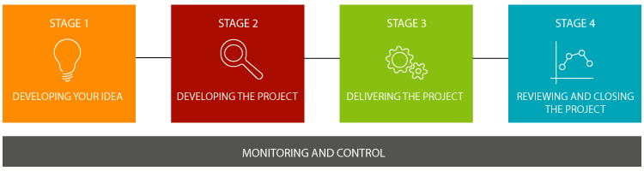
The Local Authority offers the following toolkit which can be accessed through Intranet Pages. Intended as no ‘one size’ fits all approach, but with a core set of principles which will always apply.
Projects will be required to:
Be linked to a corporate programme and / or the corporate Pillars.
Have a valid Business Case
Have clearly defined roles and responsibilities within the context of the project.
Clearly define a shared understanding of what the project is setting out to achieve, by when and with those resources.
Make efficient and effective use of the resources and funding.
Adhere to regular monitoring and control mechanisms
.

Slide 7

What’s next
LOOKING AHEAD

Slide 8
How can this be improved when planning and designing a project management process?
Start with a Project Design phase, after developing the idea. This will allow creativity and enable a more tailored project management process to each project
The Project Design Phase will help to define the overall project methodology that will be used for this project
Estimate and communicate what resources will be needed for the project
Structure the Project Strategy – resources, budget
Use analysis of similar projects to review what lessons were learnt and can be applied to the project (ie. SharePoint lists)
Contingency planning
Use tools available such as real time dashboards which can help keep track of costs, timescales and progress (ProjectManager is great example of this with beneficial features)

Slide 9
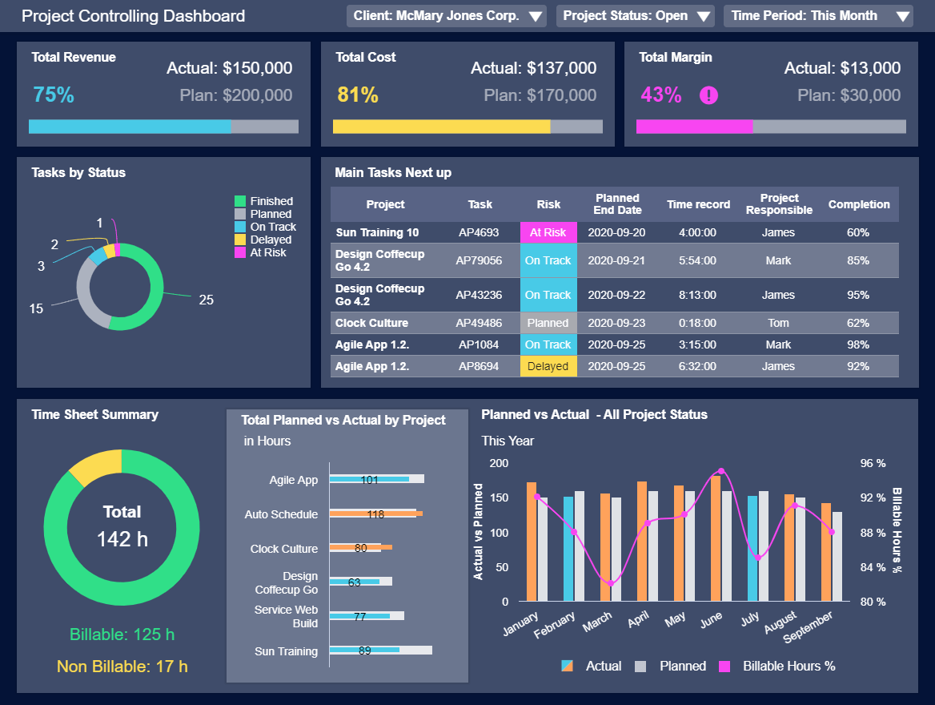
example of visual tools
ProjectManager Dashboard
Project Manager Dashboards such as this example offer a solution in providing more real-time data visualizations and automated reporting. These dashboards help to ensure that crucial project information is accessible 24/7, helping to empower teams to make informed decisions anytime and anywhere.

Slide 10
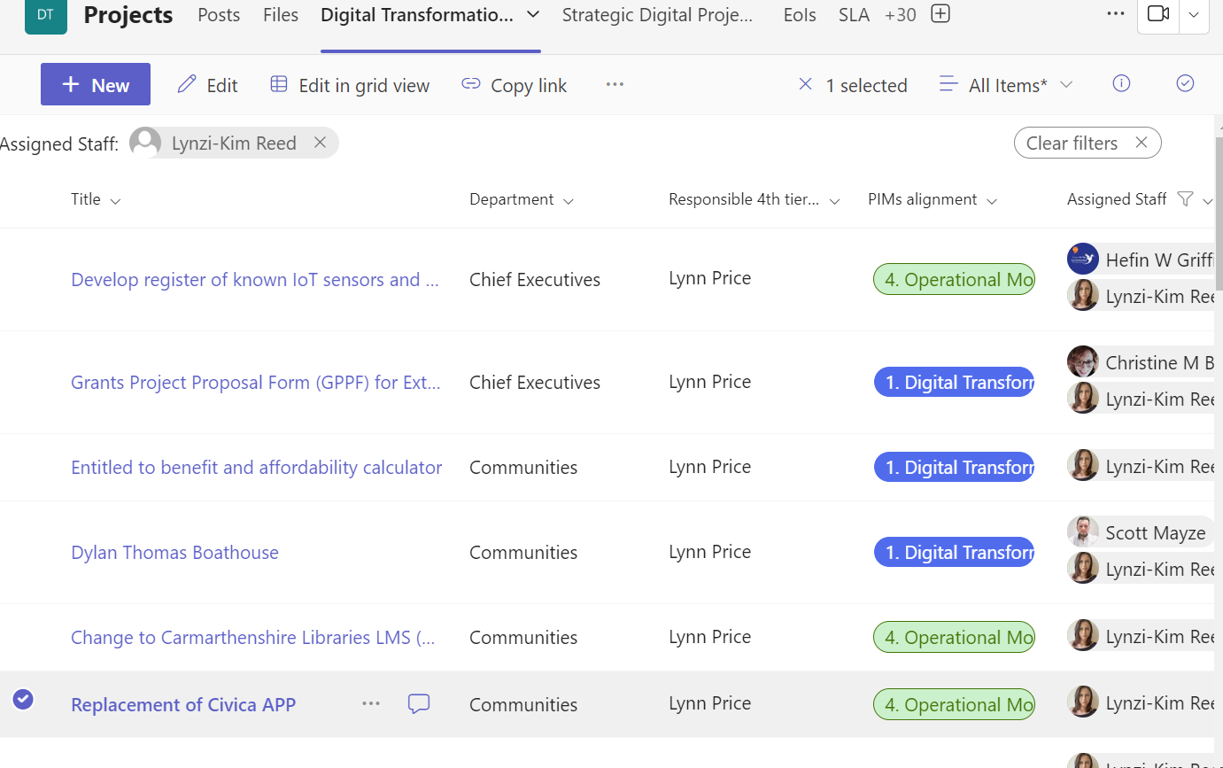
SharePoint List – Project Process Analysis
There are several free SharePoint Project management templates available that can help manage and re-plan projects using SharePoint On-premises. Templates come with lists, web parts and reports which can assist to streamline the project management and efforts.

Slide 11
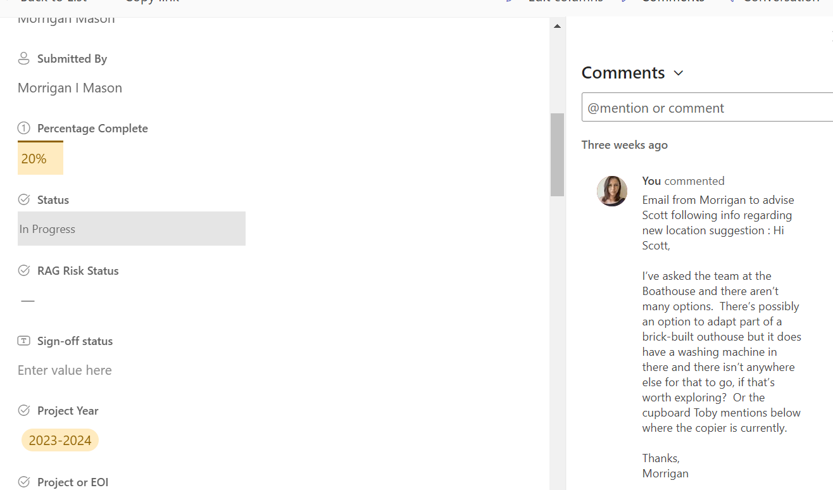
SharePoint List – Project Process Analysis
As Project Manager I have leveraged SharePoint lists extensively within our local authority for effective project management.

Slide 12

Summary
As a Project Manager operating in a dynamic environment within the local authority, I firmly believe that there is no need to re-invent the wheel when it comes to planning and designing project management processes.
Various methodologies exist to cater to different project types, sizes, and complexities. By meticulously assessing each individual project, considering its unique needs and goals, we can determine the most suitable methodology and apply an appropriate approach that yields optimal results.
I firmly believe from experience that project management success lies in recognizing the uniqueness of each project and adapting our practices accordingly.

Slide 13
THANK YOU
Any Questions?

