Slide 1
Social Cognition
Stuart Jones

Slide 2
Aims of the Lecture
To discuss how classic case studies have help neuroscientific research about identity, the self and personality
To explore neuroscience / biological basis of appropriate / inappropriate social behaviour.
To explore the links between Neuroscience and Developmental Psychology in relation to Identity.

Slide 3
Aims of the Lecture
To explore neuroscience research into the perception of other people.
To discuss Autism, some of the social and behavioural characteristics and neuroimaging people with Autism.
To explore mirror neurons and its impact in relation to empathy

Slide 4
The Story of Phineas Gage
One of the most famous case studies in Psychology.
June 1848
Accident in his work (Foreman of a railroad construction crew).
Explosion and a tamping iron shot out and passed through Gage’s skull.

Slide 5
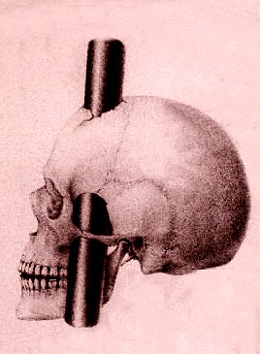
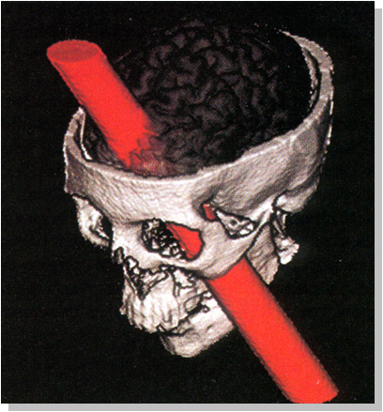
Amazingly Gage survived the accident
Never lost consciousness
Physical wounds generally healed
What about his personality?

Slide 6
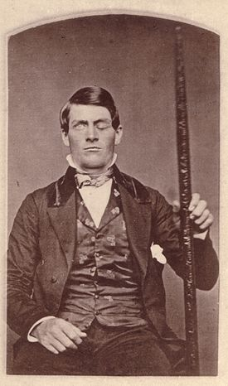
Gage’s physical wounds seemed to heal after a few months.
Gage personality POST accident described by his doctor as.
  “Irreverent, indulging in grossest profanity, manifesting in little deference to his fellows, impatient of restraint or advice when it conflicts with his desires”
    MacMilan (1986).

Slide 7
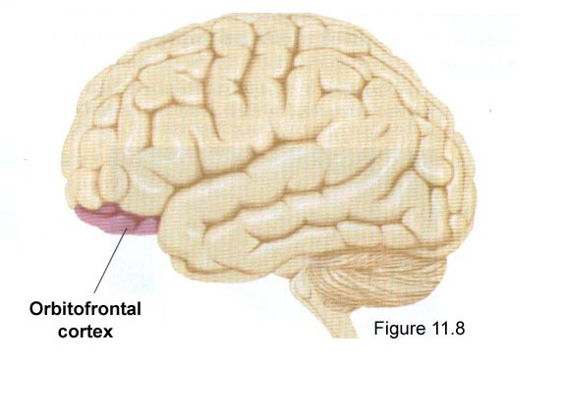
Gage suffered a massive lesion of the left orbitofrontal cortex (amongst other regions)
It is part of the Prefrontal Cortex.
Name based on its location –
  Located immediately above the orbits in which the eyes are located.

Slide 8
Brain damage and Social Behaviour
A very recent aspect of Neuroscientific Study (Gazzaniga et al 2009).
Why does some lesions impair social abilities but spare other complex (and simple) cognitive abilities.
2002 headline – “Man speared in head survives because spear passed through a place in the brain that is non functional”.
  Orbitofrontal Cortex pierced.

Slide 9
Social cognitive neuroscience
  New branch of Neuroscience
  How the Human Brain function supports the cognitive process underlying social behaviour.
  Remember back to the basic definition of what is Psychology
Social interactions essential aspect of human behaviour
Forming a sense of self, develop impressions of other people.

Slide 10
Self Perception and Self-Knowledge
Socrates
  Emphasised the importance of “knowing thyself”
Craik and Lockhart’s level of processing.
Information related to the self is processed at the deepest possible level
  Information relating to yourself most easily recalled
  (Markus 1977; Rogers et al, 1977)

Slide 11
Self Referent Effect
Memory related to the Self.
Why is it better?
Is it due to different processing system?
Is there a specific neural network relating the self?
  What can modern technology do in help answering these questions?

Slide 12
Kelley et al (2002)
FMRI study
Judged personality adjectives in one of three conditions.
  1) In relation to the self.
    Does this trait describe you?
  2) In relation to George W Bush (President at the time)
    Does this trait describe George W Bush
  3) In relation to its printed format
    Is this word presented in upper case letters.

Slide 13
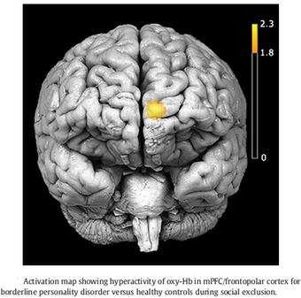
Kelley et al (2002)
After a delay participants were then asked to recall the personality adjectives that they had seen.
As predicted – able to recall more of the adjectives used when asked “if they describe you”.
Also, medial prefrontal cortex (MPFC) was activated in the self condition.

Slide 14
Issues with study?

Slide 15

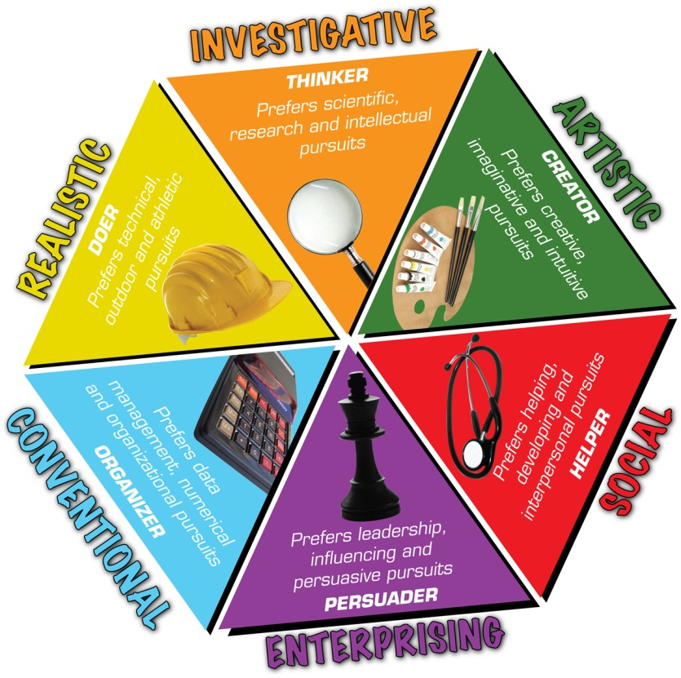
Does this highlight a specific neural network relating to the sense of self.
Or does this just highlight a specific network in relation to MEMORY Processing information about the self?

Slide 16
Think back to previous lectures!
Retrograde and Anterograde Amnesia Patients
R.B – Memory Loss as a Result of a heart attack
K.C. – Motorcycle Accident
Very limited Autobiographical Memory
  However, were able to describe their personality
  Consistent with judgements provided by their family.
  No damage to MPFC

Slide 17
However
Gazzaniga et al (2009) reports that Neuroscientific studies of patients with damage to the MPFC are rare.
Therefore, fairly difficult at this stage to state the impact that damage of this area has relating to personality judgements.
What studies have suggested is summaries about personality traits are supported by a distinct neural network – that differs from memories about specific life events (Gazzaniga et al, 2009).

Slide 18
But wait!!!
How often in an average day are you thinking about yourselves and your personality?
What YOU might be getting ready to do?
What is going on in YOUR Life (evaluating your current situation).
Even when daydreaming?

Slide 19
Medial Prefontal Cortex (MPFC) at rest.
Gusnard and Raichle (2001)
Researched the Resting Brain Activity Level using FMRI
Found even at Resting State the MPFC has higher activity rate at “rest” than when doing a number of cognitive tasks.
Why?

Slide 20
Gusnard and Raichle (2001) - Conclusions
Even when told rest we also have some idea, (or at least some desire to know) what is going on around US and how this might influence US.
When instructed to do a task that doesn’t involve the self – deactivates the MPFC.
  Have to consciously think away from Self.

Slide 21
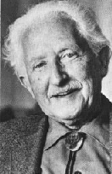
The Self and Developmental Psychology
Erik Erikson (1902-1994)
According to Erikson, to achieve a healthy personality an individual must successfully resolve a crisis at 8 stages of development.
Eight ages of Man.
Looking for a healthy resolution (positive).

Slide 22
Stage 5 Identity versus Role Confusion
(Early to Mid Adolescence)
Who am I and where am I going?
Conflict involves establishing a
consistent personal identity.
(“Who am I?” )
Stage 6 - Intimacy versus Isolation
Late Adolescence – Early Adulthood
Shall I share my life with another or live alone?
Conflict centered on establishing intimacy
with friends, family, a lover, or spouse.
(“We are what we love.” )

Slide 23
Identity vs Identity Confusion.
Finding their identity
Adjusting to New Roles.
Parents needs the adolescent to explore many different roles.
Positive Identity vs Identity Confusion related to the parental skills of parent.

Slide 24
Montemayor and Eisen, 1997.
Studied Self – Identity in Children across a variety of ages (9-18 years old).
20 answers to the question: ‘Who am I?’

Slide 25
9 year old response
My name is Bruce C. I have brown eyes. I have brown hair. I have brown eyebrows. I am nine years old. I love Sports. I have seven people in my family. I have great eye-site. I have lots of friends. I live on 1923 Pencrest Dr. I am going on 10 in September. I am a boy. I have an uncle that is almost 7 feet tall. My school is Pencrest. My teacher is Mrs V. I play Hockey! I am almost the smartest boy in my class. I love food. I love fresh air. I LOVE school.

Slide 26
11 year old Response.
My name is A. I’m a human being. I’m a girl. I’m a truthful person. I’m not very pretty. I do so-so in my studies. I’m a very good cellist. I’m a very good pianist. I’m a little bit tall for my age. I like several boys. I like several girls. I’m old fashioned. I play tennis. I am a very good swimmer. I try to be helpful. I’m always ready to be friends with anybody. Mosty I’m good but I lose my temper. I’m not well-liked by some girls and boys. I don’t know if I’m liked by boys or not.

Slide 27
17 year old response.
I am a human being. I am a girl. I am an individual. I don’t know who I am. I am Pisces. I am a moody person. I am an indecisive person. I am an ambitious person. I am a very curious person. I am not an individual. I am a loner. I am an American (God help me). I am a Democrat. I am a liberal person. I am radical. I am a Conservative. I am pseudoliberal.I am an atheist. I am not a classifiable person (i.e. I don’t want to be).

Slide 28
Findings
As the child matures – self concept is less to do with physical characteristics or even abilities.
17 year old describing abstract traits and characteristics.
Identity confusion appears to be apparent.

Slide 29
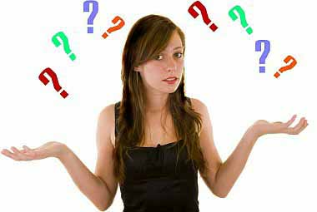
Neuroscience and the Adolescent
Neuroscience research using both structural and functional Neuroimaging have highlighted that the Brain is continually evolving.
The Prefrontal Cortex, including the MPFC, is being fine tuned during adolescence although NOT FULLY MATURED.
Is this part of the reason why Adolescents struggle with understanding with the self and engage in experimental /risk taking behaviour.

Slide 30
Going back to Phineas Gage
What about the orbitofrontal cortex.
  This was the part that Phineas Gage damaged not the MPFC.
Beer et al (2006)
Patients with Orbitofrontal Cortex damage were videotaped while being engaged in social interactions with a stranger.
Compared to healthy controls, and also patients with brain injury in other regions of the brain.

Slide 31
Beer et al (2006) findings
Orbitofrontal Cortex Damaged patients would perform badly in Social Interaction.
  Inappropriate topics and were often rude to the stranger.
Appeared unaware of Social Mistakes
  Felt they performed well in the social setting and behaved well.
However, deep regret and embarrassment when viewing the clip.
  So knew appropriate from inappropriate behaviour as an outsider.
  However, follow ups – still engaged in many social mistakes.

Slide 32
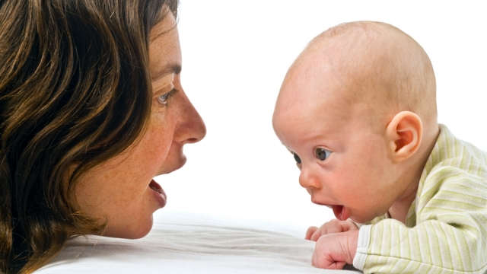
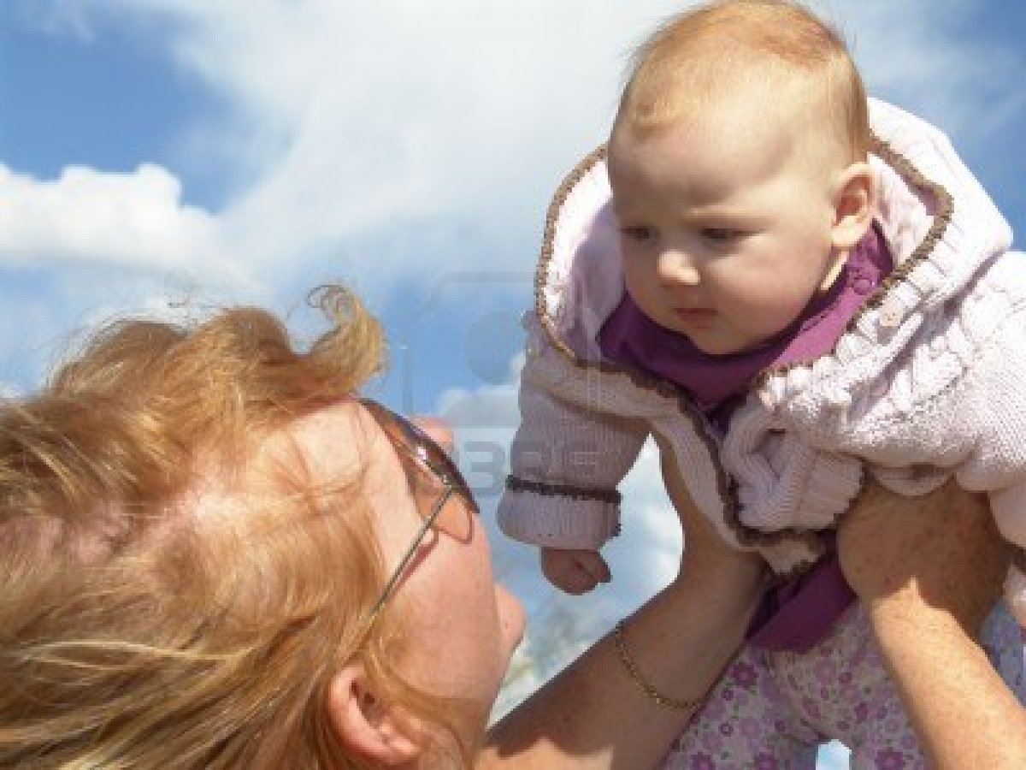
Perception of other People
Another important area of social cognition.
Curiosity appears at Birth
EEG’s of infants (4 months old) highlights Heightened activity in response to eye contact.
  Grossmann et al (2007).
Huge area of Social Psychology.
  E.g. Theory of Mind (Premack and Woodruff, 1978)

Slide 33
Theory of Mind
The ability to attribute mental states (beliefs, desires, intentions etc.) to oneself and to others.
Also to understand that others have beliefs, desires and intentions that are different from our own.

Slide 34
Impression Formation under FMRI
Mitchell et al (2005a)
Read about people and objects during FMRI scanning.
Given one of two tasks
  1) Impression Formation – judgement based on appearance and stories
  2) A sequential task – try and recall the order in which the information about each target appeared.

Slide 35
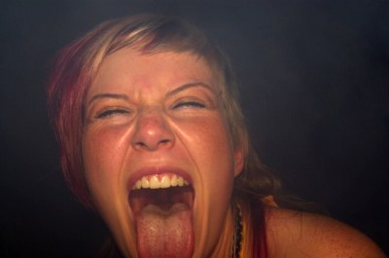
As an example
Gemma was the first to start dancing on the table
She was clearly now playing as hard as she worked
She suffered no ill effects from the night before and does not care that people were looking at her behaviour.
She was delighted in graduating

Slide 36
Group 1 – How would you describe this person
  Impression Formation
Group 2 – Recall the four points about this person in the order you read them.
  Sequential Task

Slide 37
As an example
Gemma was the first to start dancing on the table
She was clearly now playing as hard as she worked
She suffered no ill effects from the night before and does not care that people were looking at her behaviour.
She was delighted in graduating

Slide 38
Findings
Impression Formation group – activation of MPFC.
Sequential Group – deactivation of MPFC.
Subsequent studies have supported this (Amodio and Frith, 2006)
Also only with animate beings not with inanimate objects (Mitchel et al, 2005b).

