Slide 1

Student Name: Alexandru-Lavinel Gaiu
Student Number: 2332587
Module: Psychopathological Classifications and Provisions
Module Code: BMHP6029
Lecturer Name: Kennedy Obohwemu
(Pratt, 2025)

Slide 2

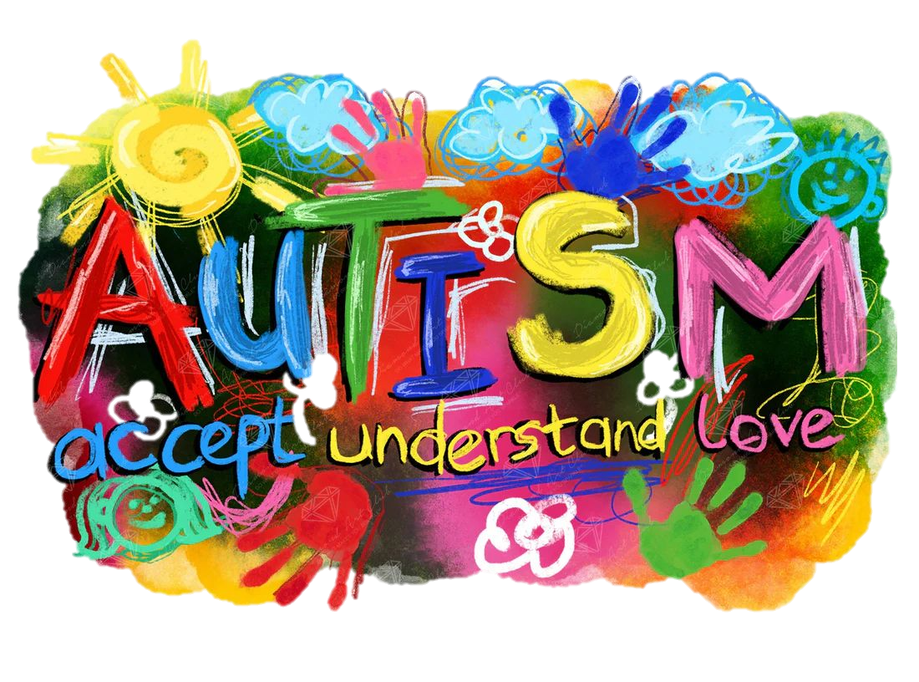
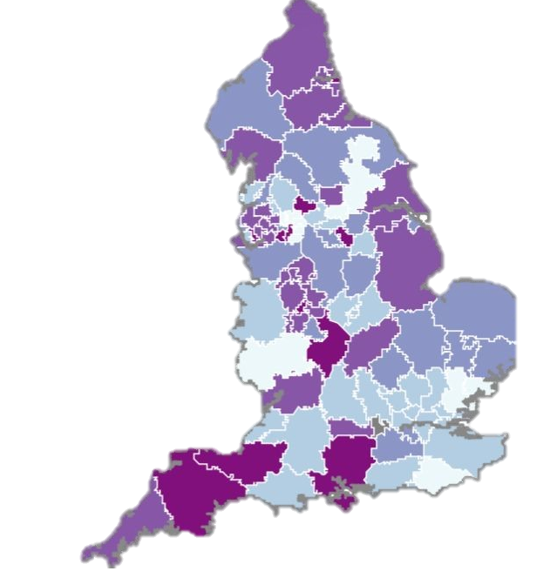
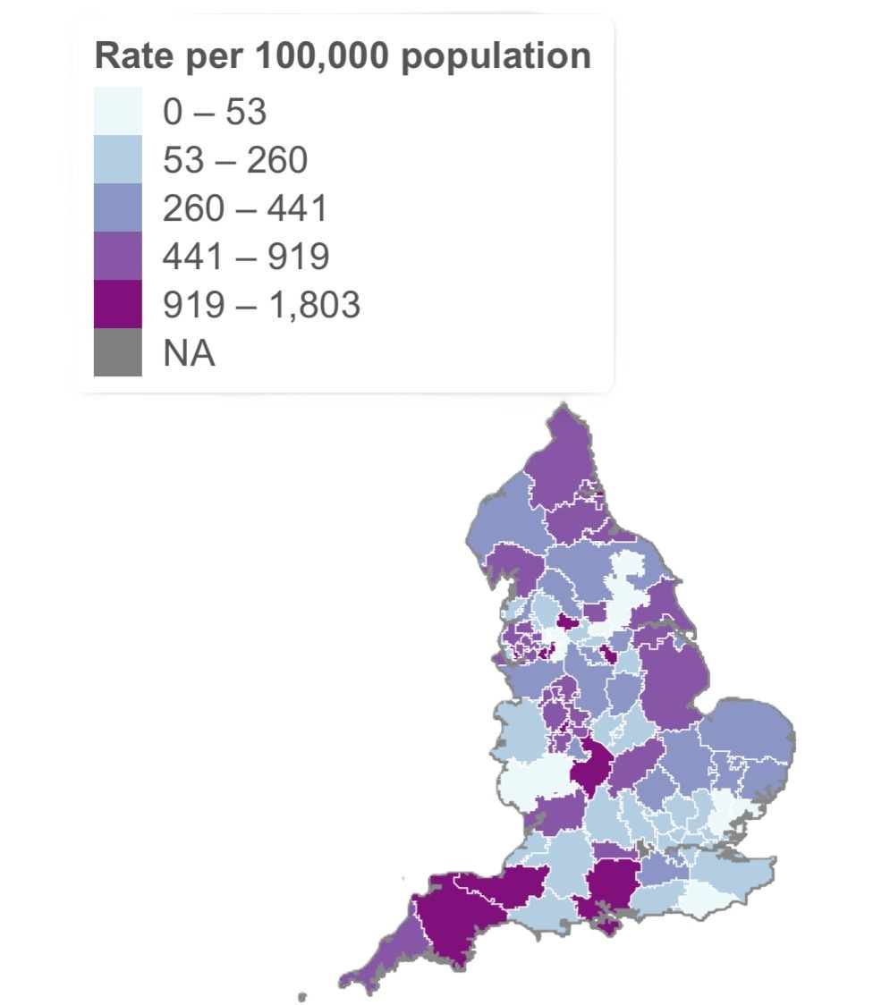
Autism Spectrum Disorder
1943
1995
2006
Kanner syndrome
Asperger Syndrome
Autism Spectrum
Classification (6A02.Z)
ICD-11 defines autism by a neurodevelopmental disorder characterised by differences in social communication, reciprocal interaction, sensory processing, routines and repetitive behaviours; however, it may not capture the diversity of ASD (WHO, 2026; D’Mello et al., 2022; O’Nions et al, 2023).
(NAS, 2026; Evans, 2013)
Legal safeguards
The Mental Capacity Act supports decision-making rights, while Mental Health Act reform aims to reduce inappropriate detention; however, reform may increase risk if community support is not strengthened (Mental Capacity Act 2005; Mental Health Act 2007; Beazley et al., 2026; Taylor et al., 2023).
Medical Model
Technology and future care
Telehealth, digital self-referral and AI may improve access and early identification, but they must support multidisciplinary assessment, not replace, due to risks around bias, validation and digital exclusion (Katakis et al., 2025; Guyatt et al., 2025; Mohammadi et al., 2025; Alberca-González and Fernández-Jiménez, 2026).
Biopsychological Model
(NHS England, 2026; Maciver et al., 2025)
(Evans, 2013; Engel, 1977; Turnock et al., 2022).
Inequalities and stigma
Autistic people experience delayed diagnosis, poor reasonable adjustments, health inequalities and stigma, with women and adults particularly affected by masking and under-recognition (O’Nions et al., 2023; O’Nions et al., 2024; D’Mello et al., 2022; Han et al., 2022; Women and Equalities Committee, 2024).
Policy in Practice
The Autism Act, Equality Act, NICE guidance and National Autism Strategy aim to improve rights and access; however, long waiting times show a continuing gap between policy and practice (Autism Act 2009; Equality Act 2010; DHSC and DfE, 2021; NICE, 2021; NHS England, 2026).
Waiting for assessment
(Stiebahl, 2026)

Slide 3
References
Alberca-González, A. and Fernández-Jiménez, E. (2026) ‘Artificial intelligence support for diagnosis of neurodevelopmental disorders during childhood: An umbrella review’, Frontiers in Psychiatry, 17. Available at: https://doi.org/10.3389/fpsyt.2026.1697185
American Psychiatric Association (2022) Diagnostic and Statistical Manual of Mental Disorders, Fifth Edition, Text Revision (DSM-5-TR). Arlington, VA: American Psychiatric Association Publishing. Available at: https://doi.org/10.1176/appi.books.9780890425787
Autism Act 2009. Available at: https://www.legislation.gov.uk/ukpga/2009/15/contents (Accessed: 6 July 2026).
Autism Alliance UK (2024) Doing the Right Thing: What the next government can do to drive real change for autistic people. Available at: https://www.autism-alliance.org.uk/doing-the-right-thing (Accessed: 6 July 2026).
Beazley, P., Alexander, R.T., Taylor, J.L., Velani, B., Dewson, H., Shankar, R., Tromans, S.J., Odiyoor, M.M., Hassiotis, A., Roy, A., McKinnon, I., Zia, A., Strydom, A., Keown, P., Perera, B., Khan, M., McCarthy, J., Butler, M., Chester, V., Chiu, K., Bew, A., Lane, T., Gay, T. and Gay, B. (2026) ‘The Mental Health Bill (2025) for England and Wales: professional and carer consensus statement summarising concerns and unintended consequences from proposed changes to autism and learning disability’, The British Journal of Psychiatry, 228(4), pp. 367–372. Available at: https://doi.org/10.1192/bjp.2025.10324
D’Mello, A.M., Frosch, I.R., Li, C.E., Cardinaux, A.L. and Gabrieli, J.D.E. (2022) ‘Exclusion of females in autism research: Empirical evidence for a “leaky” recruitment-to-research pipeline’, Autism Research, 15(10), pp. 1929–1940. Available at: https://doi.org/10.1002/aur.2795
Department of Health and Social Care (2025) 10 Year Health Plan for England: Fit for the future. Available at: https://www.gov.uk/government/publications/10-year-health-plan-for-england-fit-for-the-future (Accessed: 6 July 2026).
Department of Health and Social Care and Department for Education (2021) The national strategy for autistic children, young people and adults: 2021 to 2026. Available at: https://www.gov.uk/government/publications/national-strategy-for-autistic-children-young-people-and-adults-2021-to-2026/the-national-strategy-for-autistic-children-young-people-and-adults-2021-to-2026 (Accessed: 6 July 2026).
Disability Unit and Office for Equality and Opportunity (2026) Public perceptions and attitudes towards disabled people: A thematic report. Available at: https://www.gov.uk/government/publications/public-perceptions-and-attitudes-towards-disabled-people-in-the-uk/public-perceptions-and-attitudes-towards-disabled-people-a-thematic-report (Accessed: 6 July 2026).
Ellington, E., Parsons, S. and Kovshoff, H. (2026) ‘Bridging the gap: exploring shared decision-making with autistic young people within an NHS Learning Disability and Autism Keyworker Programme in England’, BMC Health Services Research, 26, Article 320. Available at: https://doi.org/10.1186/s12913-026-14025-z
Engel, G.L. (1977) ‘The need for a new medical model: A challenge for biomedicine’, Science, 196(4286), pp. 129–136. Available at: https://doi.org/10.1126/science.847460
Equality Act 2010. Available at: https://www.legislation.gov.uk/ukpga/2010/15/contents (Accessed: 6 July 2026).
Evans, B. (2013) ‘How autism became autism: The radical transformation of a central concept of child development in Britain’, History of the Human Sciences, 26(3), pp. 3–31. Available at: https://doi.org/10.1177/0952695113484320

Slide 4
Guyatt, H., Doherty, N., Limond, J., Swaine, Z. and Morpeth, L. (2025) ‘Digitally enabled, self-referral as an effective approach for young autistic people to access support: Pilot study’, BMC Digital Health, 3(9). Available at: https://doi.org/10.1186/s44247-025-00148-6
Han, E., Scior, K., Avramides, K. and Crane, L. (2022) ‘A systematic review on autistic people’s experiences of stigma and coping strategies’, Autism Research, 15(1), pp. 12–26. Available at: https://doi.org/10.1002/aur.2652
Han, E., Scior, K., Heath, E., Umagami, K. and Crane, L. (2023) ‘Development of stigma-related support for autistic adults: Insights from the autism community’, Autism, 27(6), pp. 1682–1694. Available at: https://doi.org/10.1177/13623613221143590
Hungerford, C., Kornhaber, R., West, S. and Cleary, M. (2025) ‘Autism, stereotypes, and stigma: The impact of media representations’, Issues in Mental Health Nursing, 46(3), pp. 254–260. Available at: https://doi.org/10.1080/01612840.2025.2456698
Katakis, P., Frankson, P., Lockwood Estrin, G., Wolstencroft, J., Mirzaei, V., Sayani, S., Skuse, D. and Heys, M. (2025) ‘Families’ and clinicians’ experiences with telehealth assessments for autism: A mixed-methods systematic review’, PLOS Digital Health, 4(7). Available at: https://doi.org/10.1371/journal.pdig.0000931
Kreative Kreations (no date) Diamond Art Club SQUARES Autism - Accept Understand Love. Available at: https://kreativekreations.me/products/diamond-art-club-squares-autism-accept-understand-love (Accessed: 6 July 2026).
Maciver, D., Roy, A.S., Johnston, L., Boilson, M., Curnow, E., Johnstone-Cooke, V. and Rutherford, M. (2025) ‘Waiting times and influencing factors in children and adults undergoing assessment for autism, ADHD, and other neurodevelopmental differences’, Autism Research, 18(4), pp. 788–801. Available at: https://doi.org/10.1002/aur.70011
Mental Capacity Act 2005. Available at: https://www.legislation.gov.uk/ukpga/2005/9/contents (Accessed: 6 July 2026).
Mental Health Act 2007. Available at: https://www.legislation.gov.uk/ukpga/2007/12/contents (Accessed: 6 July 2026).
Miot, S., Chancel, R., Peries, M., Crepiat, S., Couderc, S., Pernon, E., Picot, M.-C., Gonnier, V., Jeandel, C., Blain, H. and Baghdadli, A. (2023) ‘Multimorbidity patterns and subgroups among autistic adults with intellectual disability: Results from the EFAAR study’, Autism, 27(3). Available at: https://doi.org/10.1177/13623613221121623
Mohammadi, F., Shahrokhi, H., Asadzadeh, A., Pirmoradi, S., Moghtader, A. and Rezaei-Hachesu, P. (2025) ‘Artificial Intelligence in Autism Spectrum Disorder Diagnosis: A Scoping Review of Face, Voice, and Text Analysis Methods’, Health Science Reports, 8(11), e71476. Available at: https://doi.org/10.1002/hsr2.71476
National Autistic Society (2025) A Constant Fight: The reality of autistic people’s struggle for support across health and social care, education, employment and mental health. Available at: https://www.autism.org.uk/what-we-do/campaign/empowering-autistic-voices/a-constant-fight (Accessed: 6 July 2026).
National Autistic Society (2026) The history of autism. Available at: https://www.autism.org.uk/advice-and-guidance/what-is-autism/the-history-of-autism (Accessed: 6 July 2026).
National Institute for Health and Care Excellence (2021) Autism spectrum disorder in adults: Diagnosis and management (CG142). Available at: https://www.nice.org.uk/guidance/cg142 (Accessed: 6 July 2026).
NHS England (2019) The NHS Long Term Plan. Available at: https://webarchive.nationalarchives.gov.uk/ukgwa/20230418155402/https:/www.longtermplan.nhs.uk/publication/nhs-long-term-plan/ (Accessed: 6 July 2026).

Slide 5
NHS England (2021) Learning from lives and deaths – People with a learning disability and autistic people (LeDeR) policy 2021. Available at: https://www.england.nhs.uk/publication/learning-from-lives-and-deaths-people-with-a-learning-disability-and-autistic-people-leder-policy-2021/ (Accessed: 6 July 2026).
NHS England (2023) A national framework to deliver improved outcomes in all-age autism assessment pathways: Guidance for integrated care boards. Available at: https://www.england.nhs.uk/long-read/a-national-framework-to-deliver-improved-outcomes-in-all-age-autism-assessment-pathways-guidance-for-integrated-care-boards/ (Accessed: 6 July 2026).
NHS England (2023) Dynamic support register and Care (Education) and Treatment Review policy and guide. Available at: https://www.england.nhs.uk/publication/dynamic-support-register-and-care-education-and-treatment-review-policy-and-guide/ (Accessed: 6 July 2026).
NHS England (2024) National framework and operational guidance for autism assessment services. Available at: https://www.england.nhs.uk/publication/autism-diagnosis-and-operational-guidance/ (Accessed: 6 July 2026).
NHS England (2026) Autism Waiting Time Statistics. Available at: https://digital.nhs.uk/data-and-information/publications/statistical/autism-statistics (Accessed: 6 July 2026).
NHS England (2026) Building the right support. Available at: https://www.england.nhs.uk/publication/building-the-right-support/ (Accessed: 6 July 2026).
O’Nions, E., Brown, J., Buckman, J.E.J., Charlton, R., Cooper, C., El Baou, C., Happé, F., Hoare, S., Lewer, D., Manthorpe, J., McKechnie, D.G.J., Richards, M., Saunders, R., Mandy, W. and Stott, J. (2024) ‘Diagnosis of common health conditions among autistic adults in the UK: evidence from a matched cohort study’, The Lancet Regional Health – Europe, 41. Available at: https://doi.org/10.1016/j.lanepe.2024.100907
O’Nions, E., Petersen, I., Buckman, J.E.J., Charlton, R., Cooper, C., Corbett, A., Happé, F., Manthorpe, J., Richards, M., Saunders, R., Zanker, C., Mandy, W. and Stott, J. (2023) ‘Autism in England: assessing underdiagnosis in a population-based cohort study of prospectively collected primary care data’, The Lancet Regional Health – Europe, 29. Available at: https://doi.org/10.1016/j.lanepe.2023.100626
Pearson, A. and Rose, K. (2021) ‘A conceptual analysis of autistic masking: Understanding the narrative of stigma and the illusion of choice’, Autism in Adulthood, 3(1), pp. 52–60. Available at: https://doi.org/10.1089/aut.2020.0043
PNGAAA (no date) Autism Awareness Ribbon Rainbow - Autism Awareness Ribbon Png, Autism Awareness Png. Available at: https://www.pngaaa.com/detail/4424537 (Accessed: 6 July 2026).
Pratt, S.E. (2025) ‘April is Autism Acceptance Month: Supporting neurodiversity and the whole person’, Magellan Health Insights, 27 March. Available at: https://www.magellanhealthinsights.com/2025/03/27/april-is-autism-acceptance-month-supporting-neurodiversity-and-the-whole-person/ (Accessed: 6 July 2026).
Roman-Urrestarazu, A., Yang, J.C., van Kessel, R., Warrier, V., Dumas, G., Jongsma, H., Gatica-Bahamonde, G., Allison, C., Matthews, F.E., Baron-Cohen, S. and Brayne, C. (2022) ‘Autism incidence and spatial analysis in more than 7 million pupils in English schools: a retrospective, longitudinal, school registry study’, The Lancet Child & Adolescent Health, 6(12), pp. 857–868. Available at: https://doi.org/10.1016/S2352-4642(22)00247-4
Russell, G., Stapley, S., Newlove-Delgado, T., Salmon, A., White, R., Warren, F., Pearson, A. and Ford, T. (2022) ‘Time trends in autism diagnosis over 20 years: A UK population-based cohort study’, Journal of Child Psychology and Psychiatry, 63(6), pp. 674–682. Available at: https://doi.org/10.1111/jcpp.13505

Slide 6
Sharpe, R.A., Curry, W., Brown, R. and Shankar, R. (2019) ‘A public health approach to reducing health inequalities among adults with autism’, British Journal of General Practice, 69(688), pp. 534–535. doi:10.3399/bjgp19X706133.
Spain, D., Stewart, G.R., Mason, D., Milner, V., Fairhurst, B., Robinson, J., Gillan, N., Ensum, I., Stark, E. and Happé, F. (2022) ‘Telehealth autism diagnostic assessments with children, young people, and adults: Qualitative interview study with England-wide multidisciplinary health professionals’, JMIR Mental Health, 9(7), e37901. Available at: https://doi.org/10.2196/37901
Stiebahl, S. (2026) FAQ: Autism statistics (England). House of Commons Library Research Briefing, CBP-10923, 24 June. Available at: https://commonslibrary.parliament.uk/research-briefings/cbp-10923/ (Accessed: 6 July 2026).
Taylor, H., Ingham, B., Mason, D., Finch, T., Wilson, C., Scarlett, C., Moss, S., Buckley, C., Urbanowicz, A., Raymaker, D., Seiboth, C., Lees, R., Garland, D., Osbourne, M., Lennox, N., Cooper, S.-A., Nicolaidis, C. and Parr, J.R. (2023) ‘Co-design of an NHS primary care health check for autistic adults’, Autism, 27(4), pp. 1079–1091. Available at: https://doi.org/10.1177/13623613221132921
Turnock, A., Langley, K. and Jones, C.R.G. (2022) ‘Understanding stigma in autism: A narrative review and theoretical model’, Autism in Adulthood, 4(1), pp. 76–91. Available at: https://doi.org/10.1089/aut.2021.0005
Women and Equalities Committee (2024) Inequalities in healthcare and employment for people with a learning disability and autistic people. HC 134. London: House of Commons. Available at: https://publications.parliament.uk/pa/cm5804/cmselect/cmwomeq/134/report.html (Accessed: 6 July 2026).
World Health Organization (2026) 6A02 Autism spectrum disorder. ICD-11 for Mortality and Morbidity Statistics, 2026-01 version. Available at: https://icd.who.int/browse/2026-01/mms/en#437815624 (Accessed: 6 July 2026).

