Slide 1
Colin Crook
Student No: 1705826
Module Code: SBTY7004 AS2
Assignment Title: Individual Presentation
Assessment Type: PORTFOLIO
Module Tutor: John Zozzaro

Slide 2

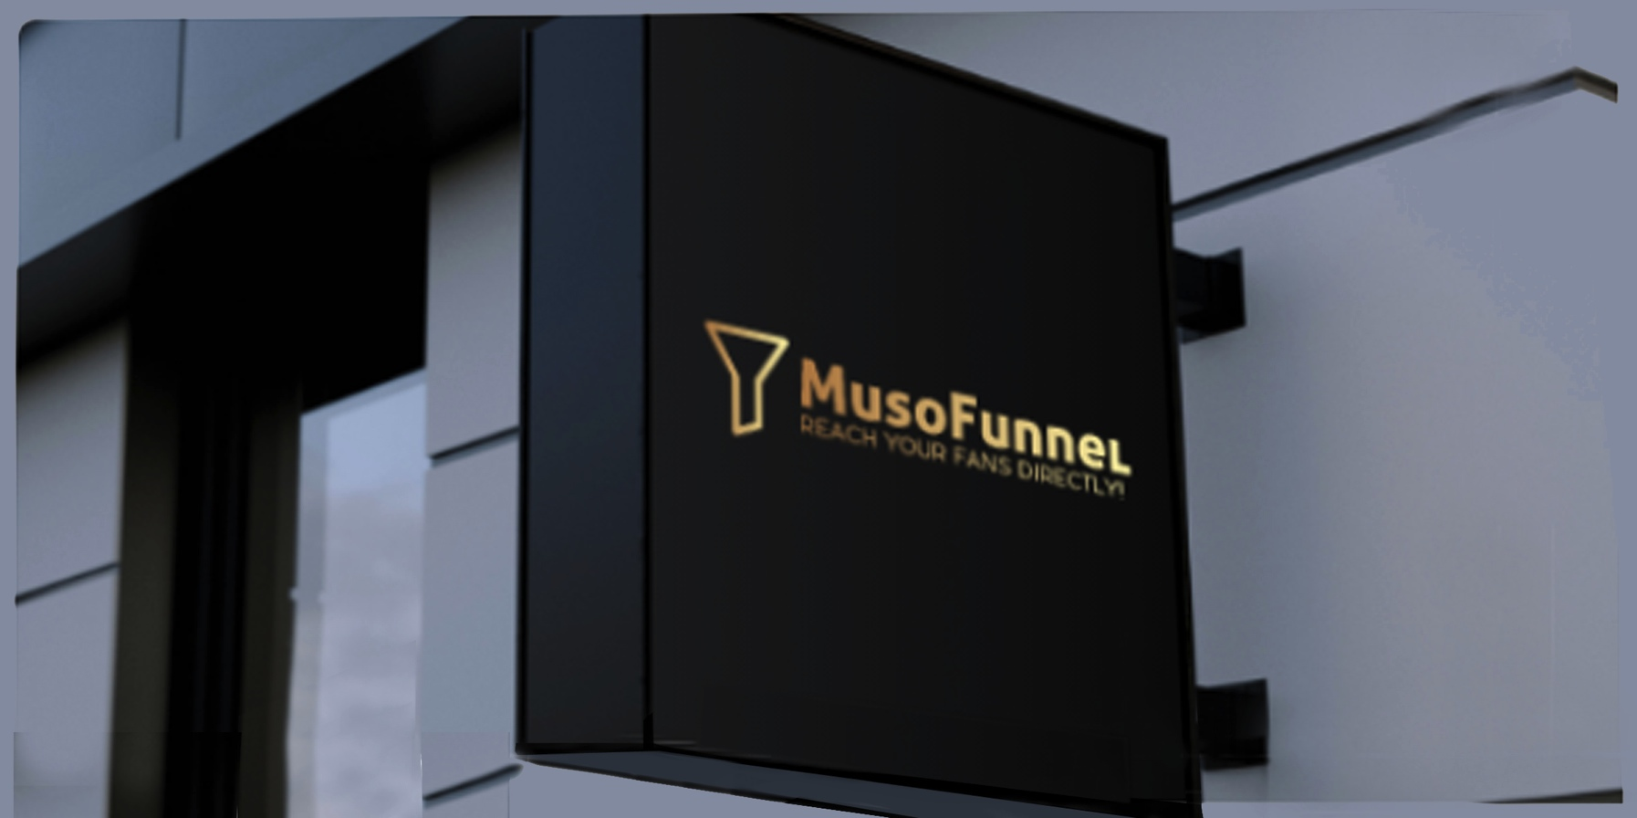
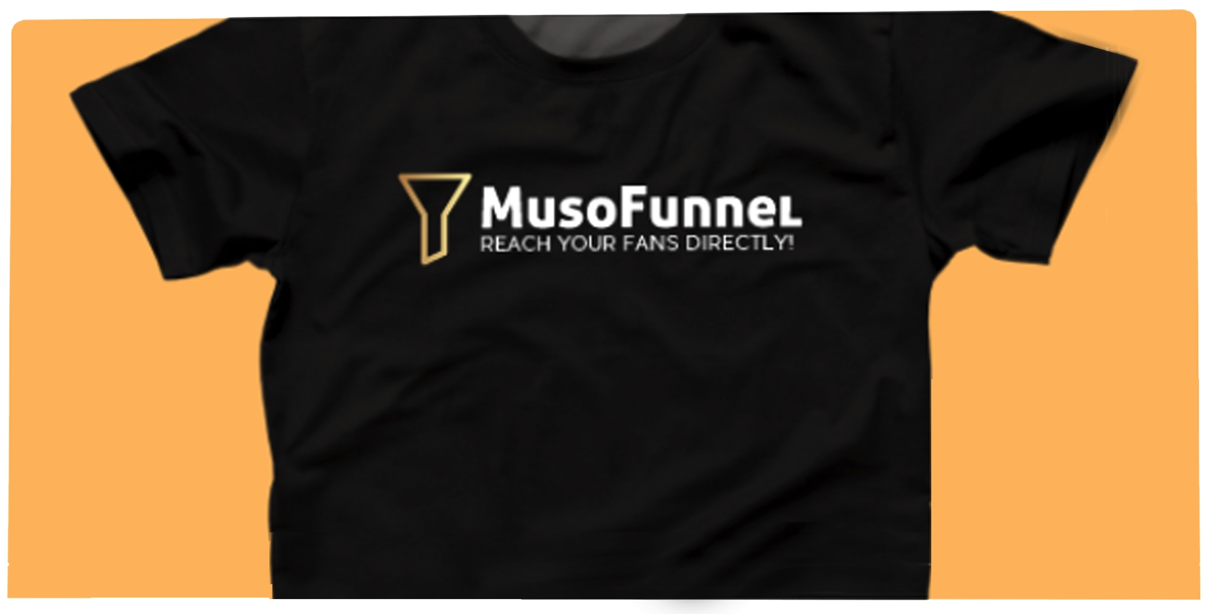
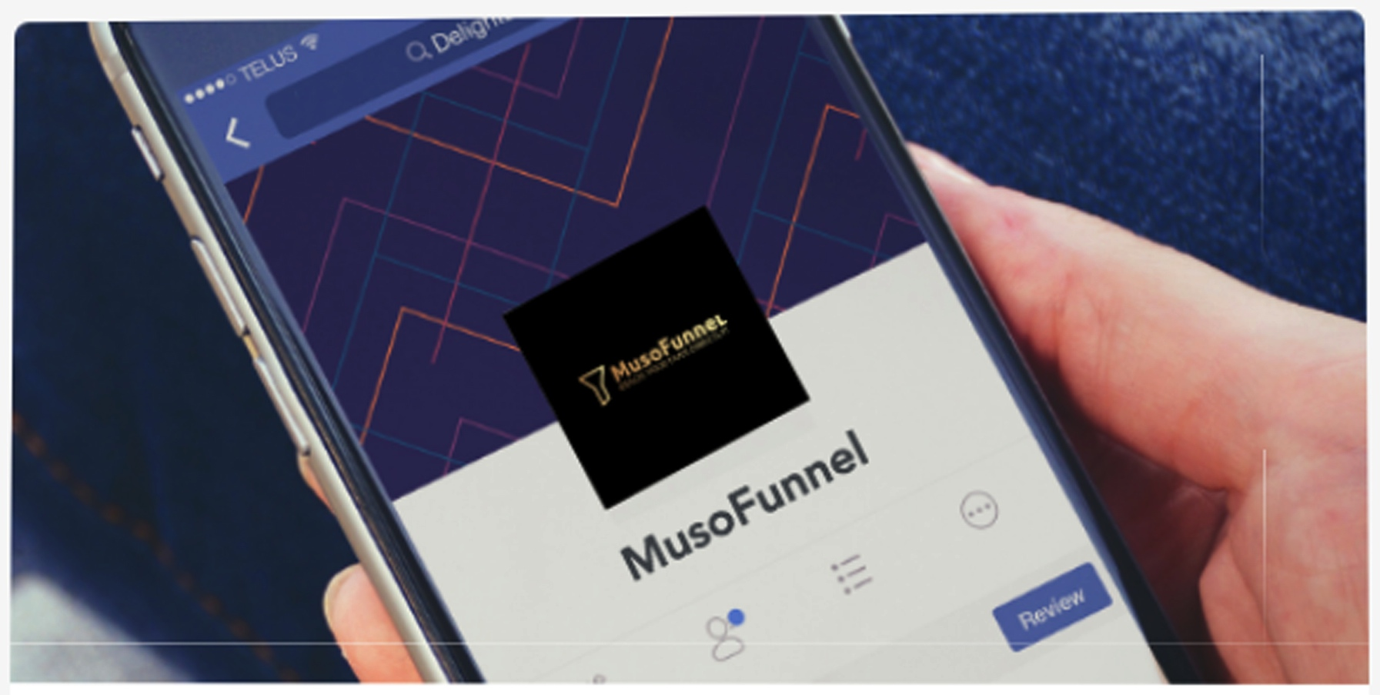

Slide 3
INTRODUCTION
MusoFunnel is a new Desktop and Mobile Application developed for Musicians,
Artists and Music Industry Entrepreneurs to create automated, targeted D2F marketing and advertising campaigns.
THE PROBLEM
The techniques used to reach defined, targeted audiences through Social Media advertising are closely guarded amongst Marketing and Advertising companies. Many charge excessive prices to set-up and run these campaigns.
For an independent musician or music industry entrepreneur, it is time consuming to learn how to set up Landing Pages, Social Media account Ad Sets and defined target audiences. This takes patience and time and an easier solution aimed at the Music Industry is required.
The solution is the MusoFunnel Software Application.

Slide 4
HISTORY
Internet marketers have been finding solutions for creating advertising campaigns for online stores since the start of the e-com revolution. One formula that has seen extensive growth is the use of Sales Funnel campaigns.
However, it is only in the last ten years that an independent group of music industry entrepreneurs have started to identify how this technology and methodology can be used to promote music products and services. A variety of online courses have been designed that teach the types of techniques, however this still requires time, patience and complimentary skills such as a good working knowledge of the internet, social media advertising and design.
Musicians and Music Industry Entrepreneurs have little time to stop and acquire this knowledge or skills, so a solution was needed to make the whole process quicker and easier.

Slide 5
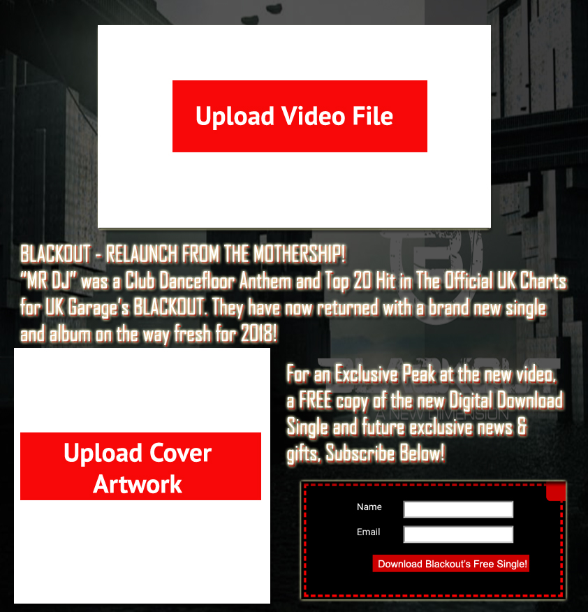
MUSOFUNNEL IN USE
By using the MusoFunnel App,
the user is presented with a
variety of types of advertising page
templates using a simple button or
drag-and-drop to upload images,
videos, audio and script.
Tips are also provided in effective
copywriting to create the right
script for each advert.
From Squeeze Pages to Landing
Pages, Thank you and Upsell Pages,
the user can decide which pages
they require and set up a sequence
of adverts within their Ad Set. These
can be automated to start and end
at specific times and dates.

Slide 6
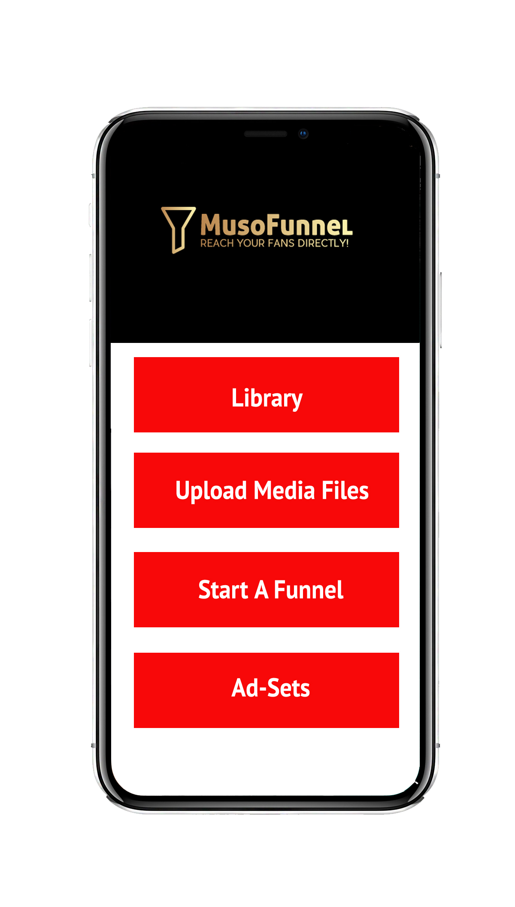
MAIN MENU
On opening the MusoFunnel App, users see the main menu which consists of four main buttons.
The Library
The Library is where all uploaded media files are stored, including some free background designs for those who do not have their own designs.
Upload Media Files
This is where users can upload their files ready to use on their projects. Files are stored in a cloud system within the App.
Start A Funnel
This is where users can set up their funnel through a easy guide that will prompt answers from the user to find the best solution.
Ad-Sets
Users can see their previously used or currently running Ad-Sets here, enabling them to see ROI results, split A/B testing results or which current Advert is running in their Ad-Set sequence.

Slide 7
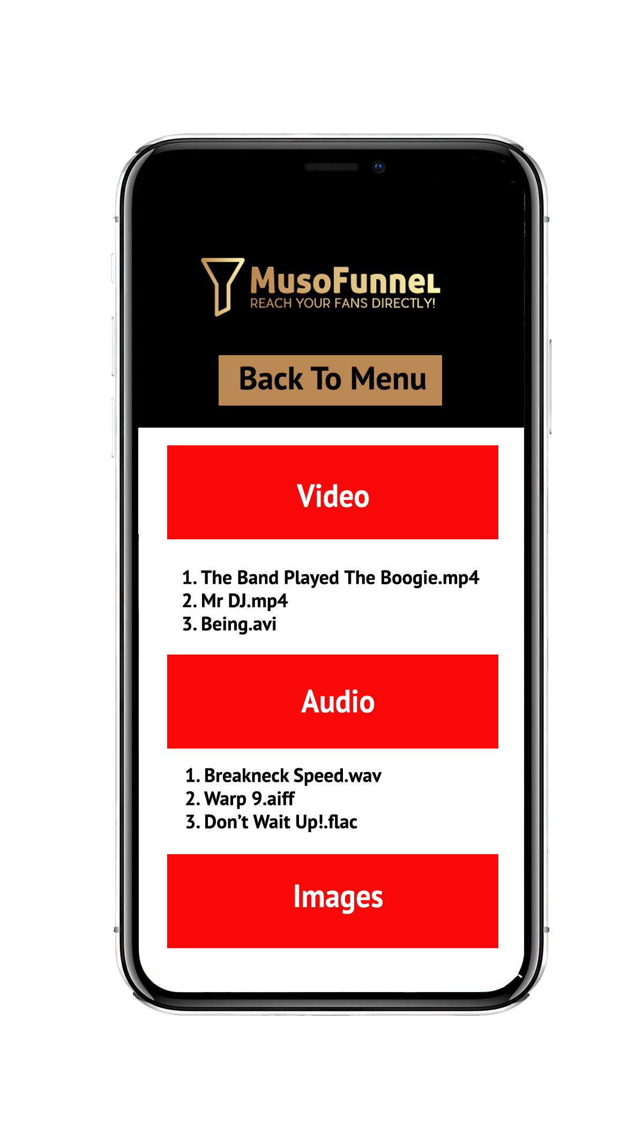
The Library
The Library enables users to peruse through their uploaded Video, Audio and Image files to ensure that they have the latest or correct edit stored for future Ad-Sets or page designs.

Slide 8
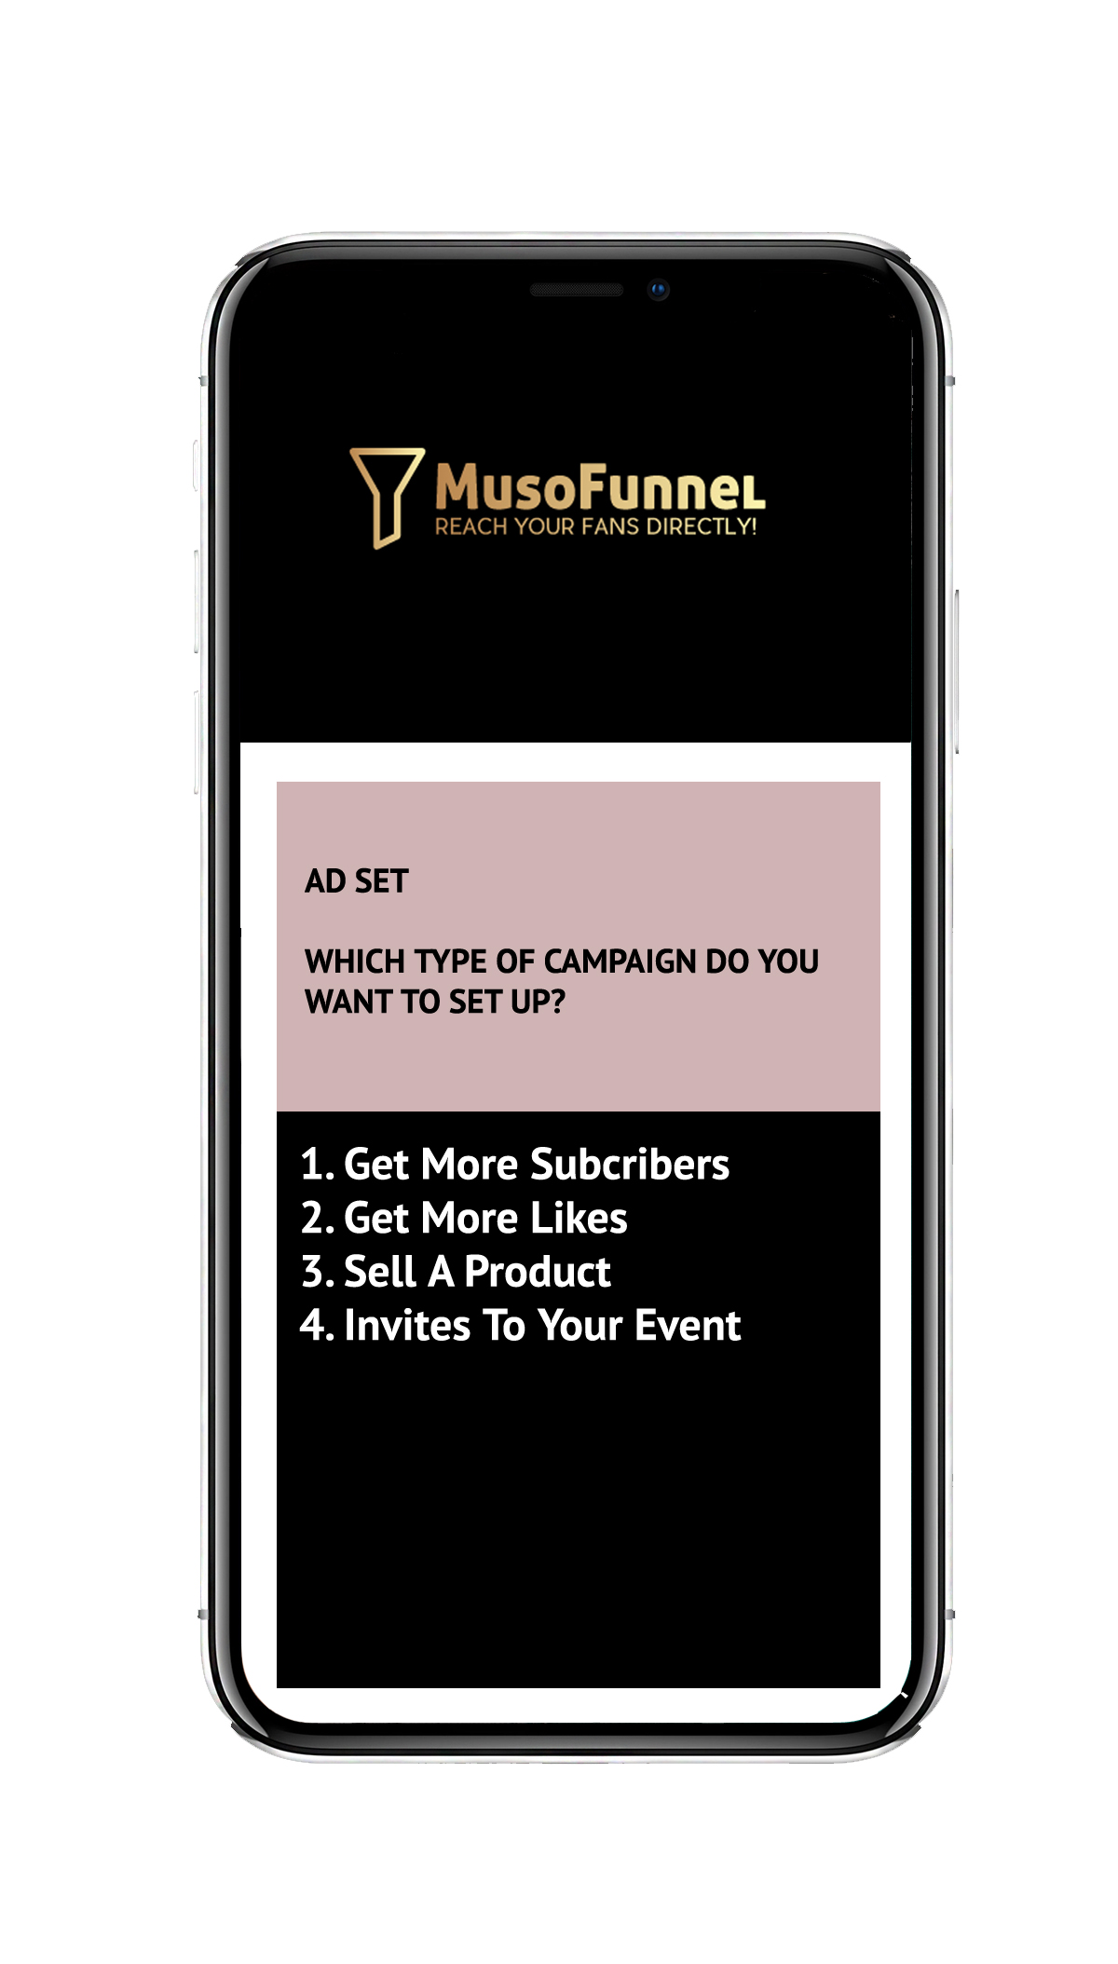
AD-SET
The user will be asked a series of questions and will
be able to select the correct answer from those provided
or will be required to type in their answer using the phone
keypad. This will assist in preparing the page template
types, sequence of adverts and setting up the audience
targeting.

Slide 9
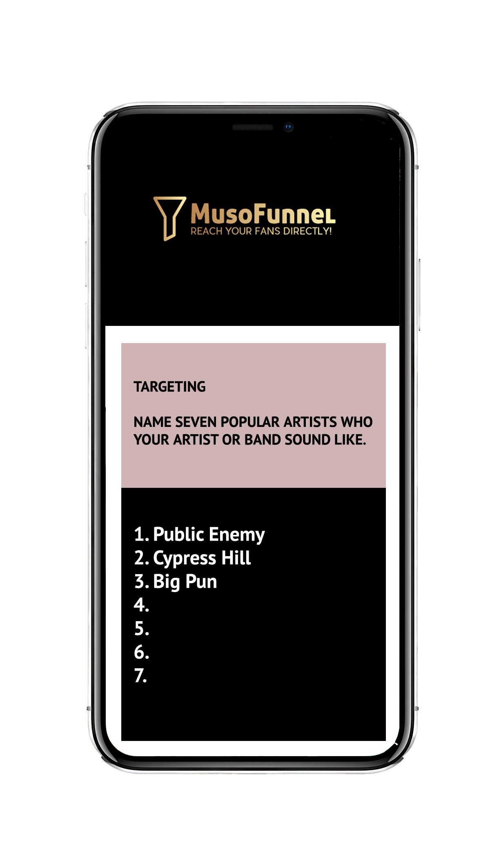
AUDIENCE TARGETTING
The user will be asked further questions about the
type of artist they are trying to promote, i.e.:
similar genres or artists.
This will ensure that the set-up target is specifically
defined to maximise clicks, likes or comments and
provide a strong ROI to the customer.

Slide 10
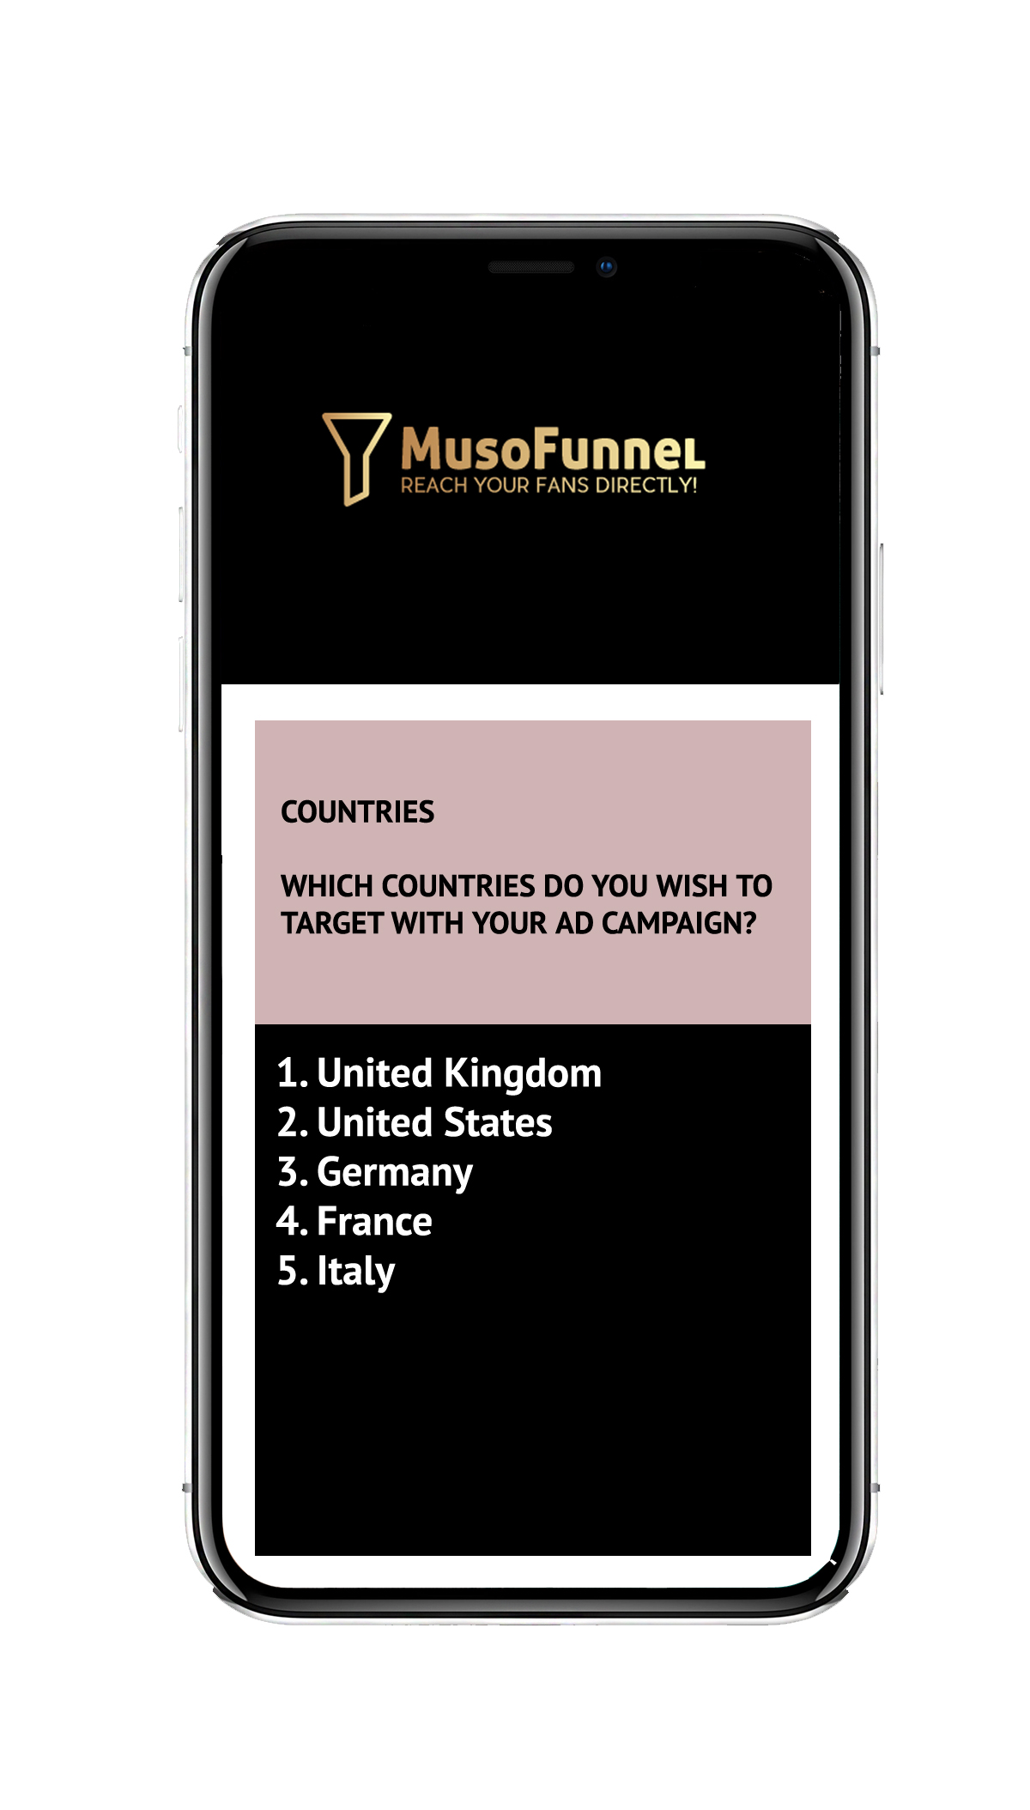
GEO-TARGETING
The user will be able to select which countries they
wish to target for their advert or Ad-Set.

Slide 11
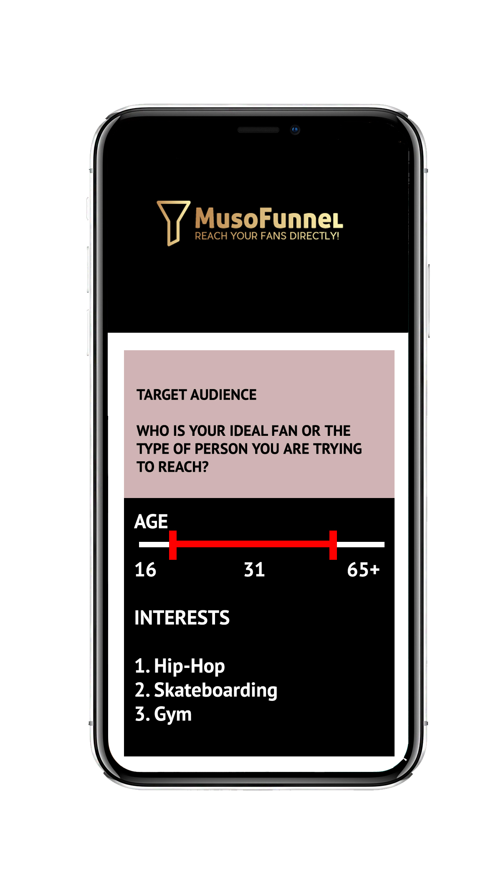
AGE RANGE, GENDER & INTERESTS
Users will choose further specific options for their
preferred target audience, such as age group, gender
and interests.
MusoFunnel will refine the audience target throughout
the campaign by deleting non-delivering targets and
moving the advertising spend to more target types who
are responding.
A report will be emailed to the user each week showing
which targets are delivering and those who are not.

Slide 12
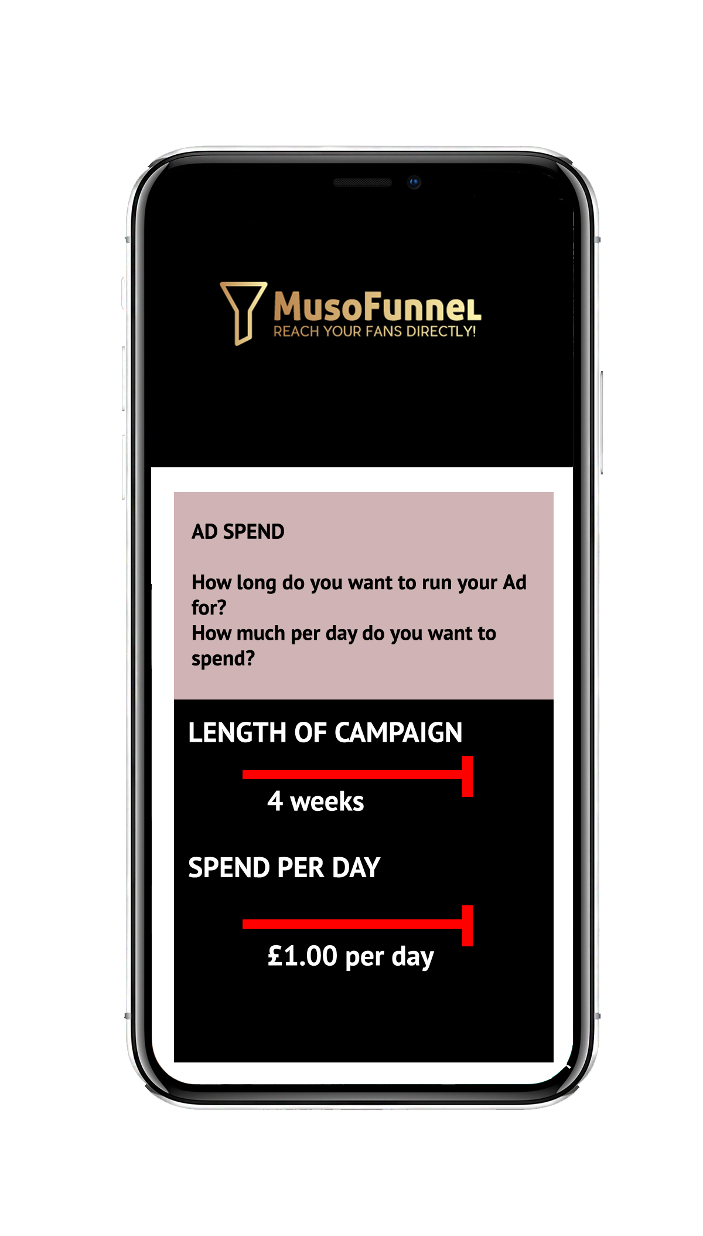
LENGTH OF CAMPAIGN AND AD-SPEND
The user will be required to enter the length of their
campaign and how much they wish to using the selector bars.

Slide 13
Music Sales Funnel
Opt-In
For Free Digital Download
Customer Receives Free Download & Exclusive Video Preview
A set of advert templates
are placed together in a sequence
within the users Ad-Set menu.
This is the basis for the user’s
Music Sales Funnel.
The App will go through each page,
allowing the user to refine the design
of each advert for their personal use.
Offer Of Discount On Early Influencer Up-Sell
Sale Of Album

Slide 14
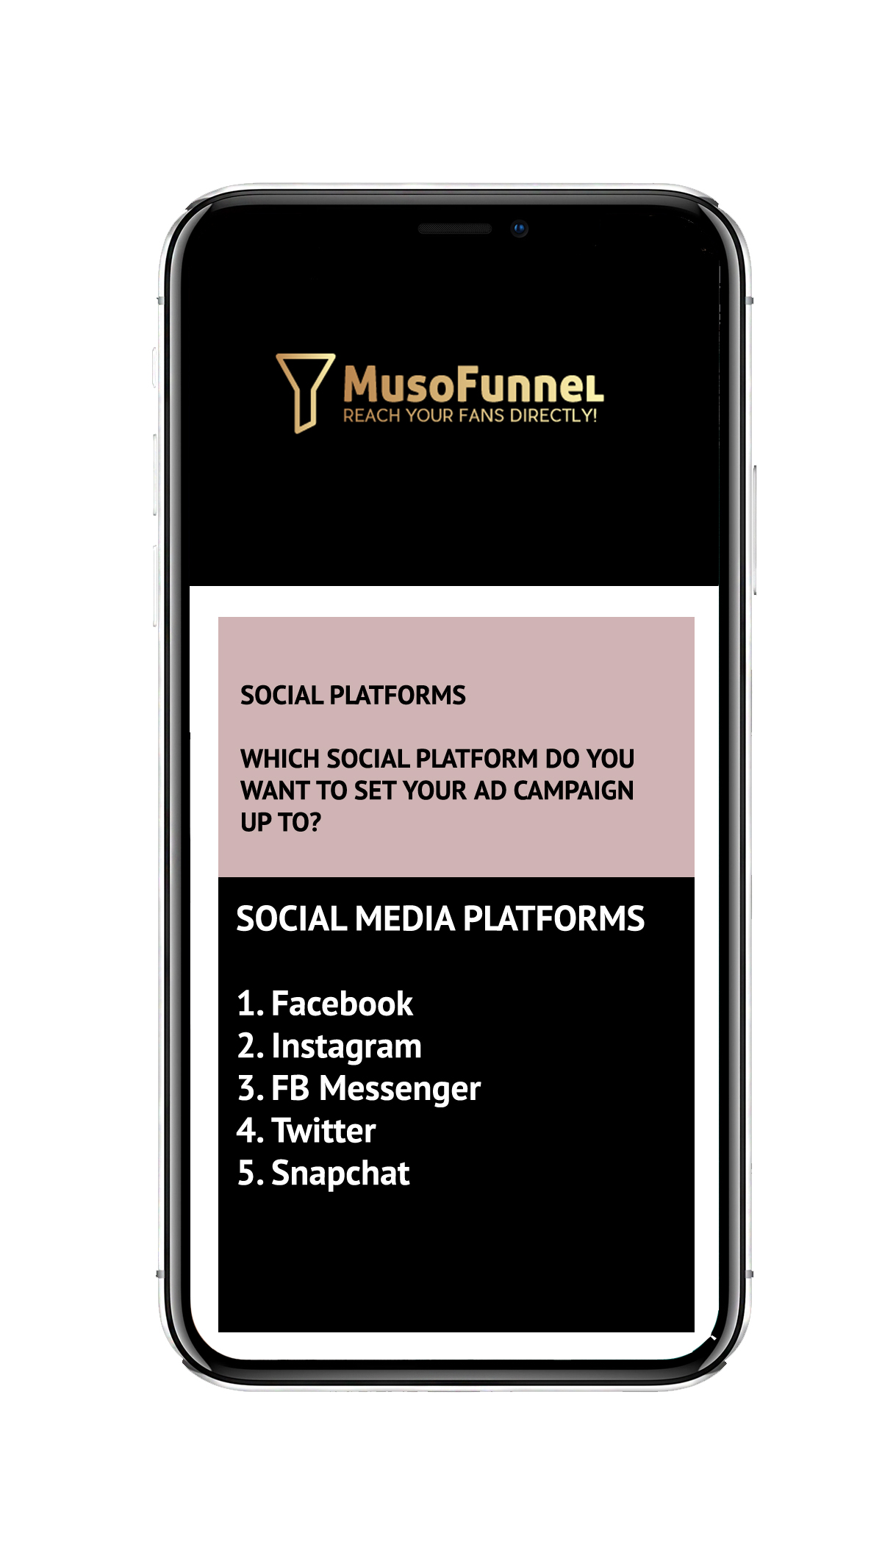
SOCIAL MEDIA PLATFORMS
The user will be asked which Social Media platforms they
wish to deliver their adverts to.
MusoFunnel will have individual business advertising
accounts with each platform and the app will
automatically transfer the information provided by
the user into its own advertising account on each
individual platform.

Slide 15
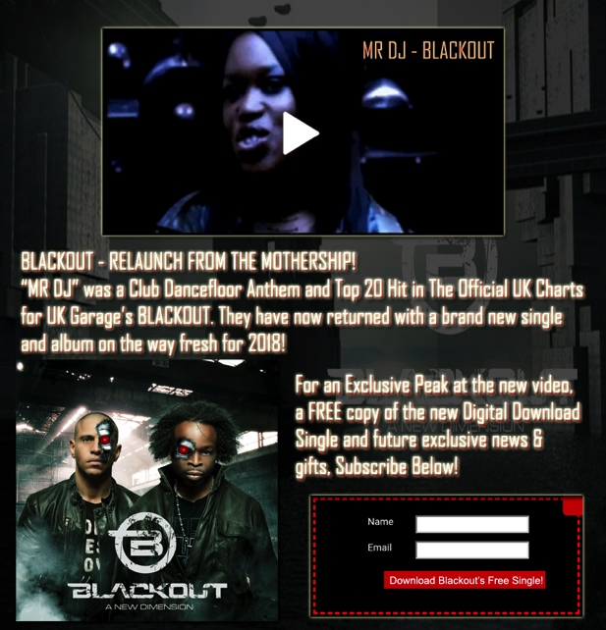
Using the upload buttons, the user
will be able to complete each
advert from their Ad-Set with ease.
Tips will be provided for any text copy
that is required.

Slide 16
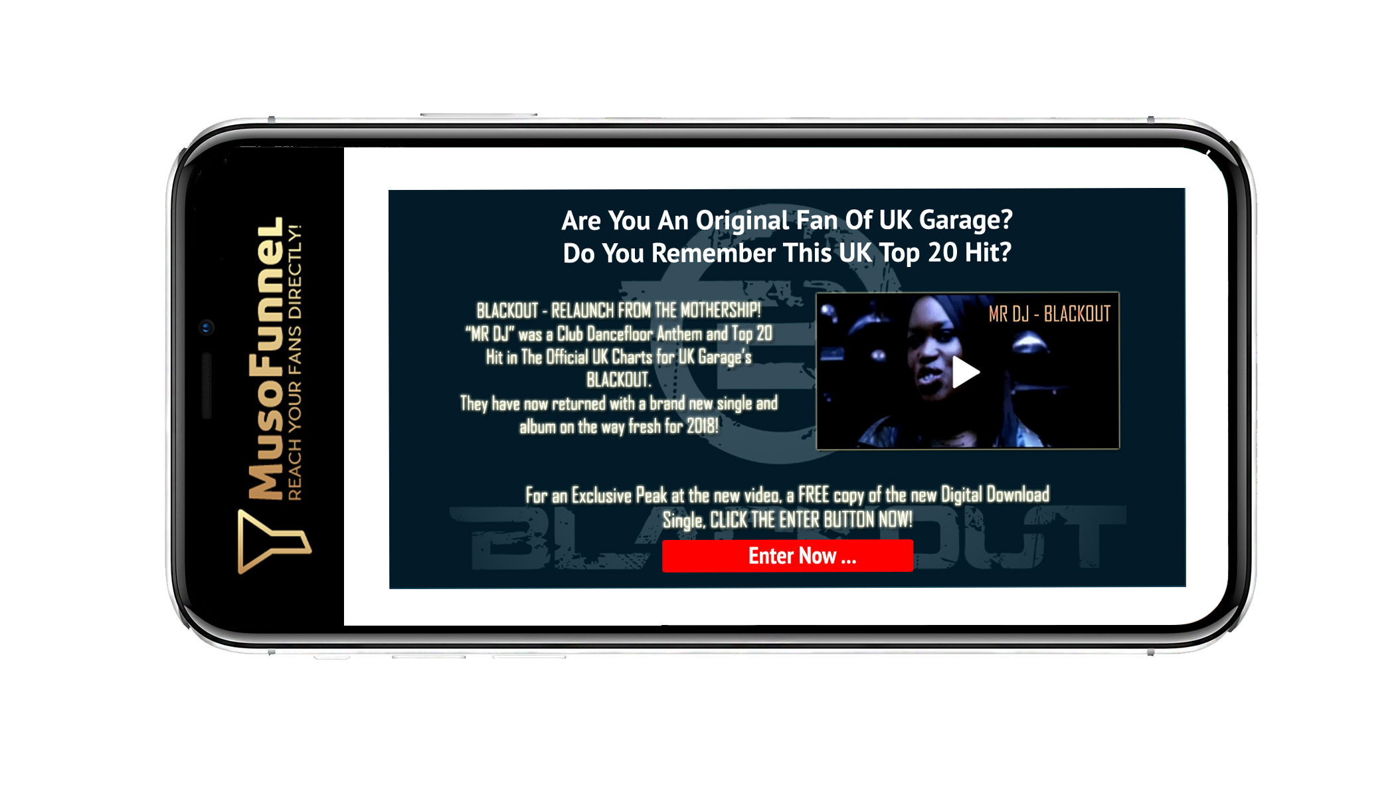
The MusoFunnel App can be operated from a desktop or mobile device

Slide 17
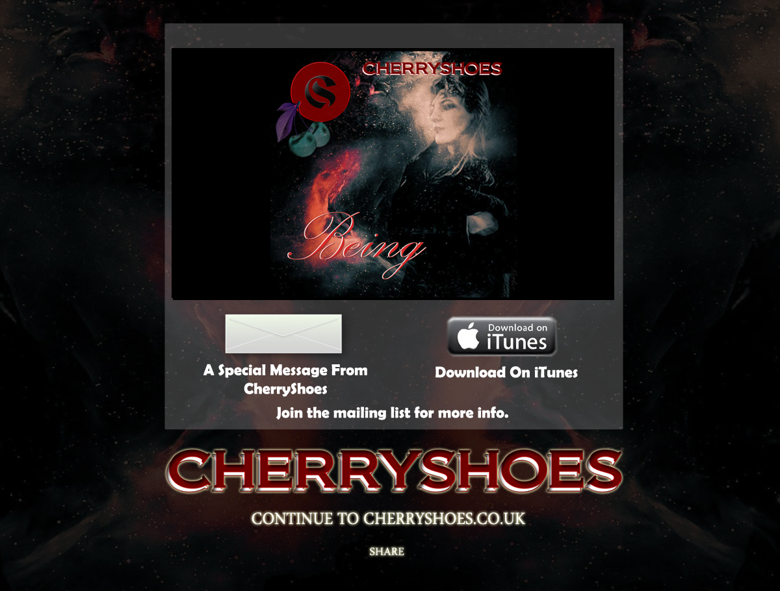
Example of a Sales Page designed to sell a specific product.

Slide 18
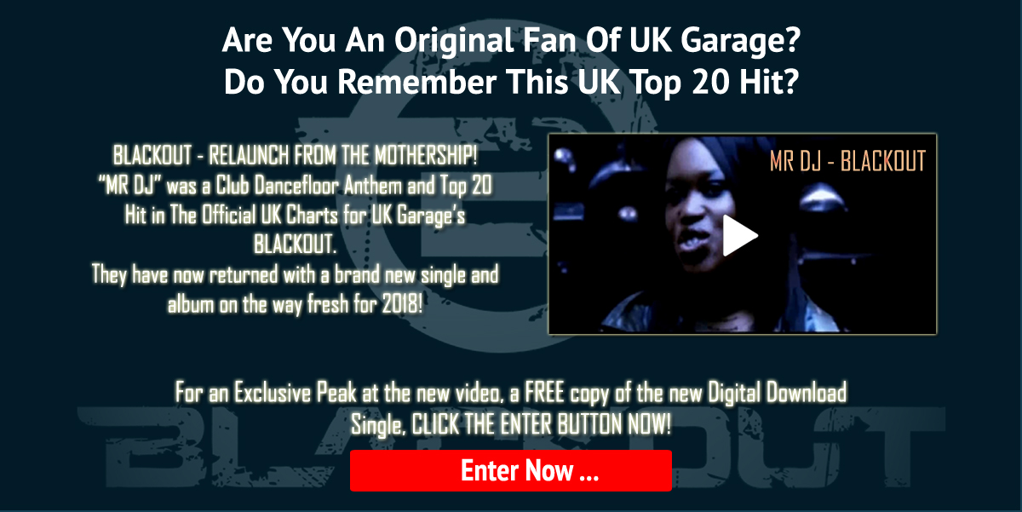
Example of an Opt-in Page designed to develop fanbase and subscribers

Slide 19
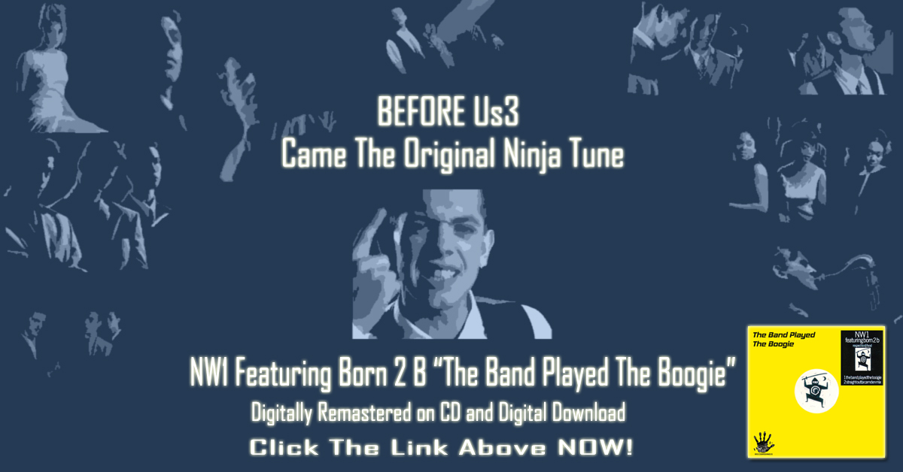
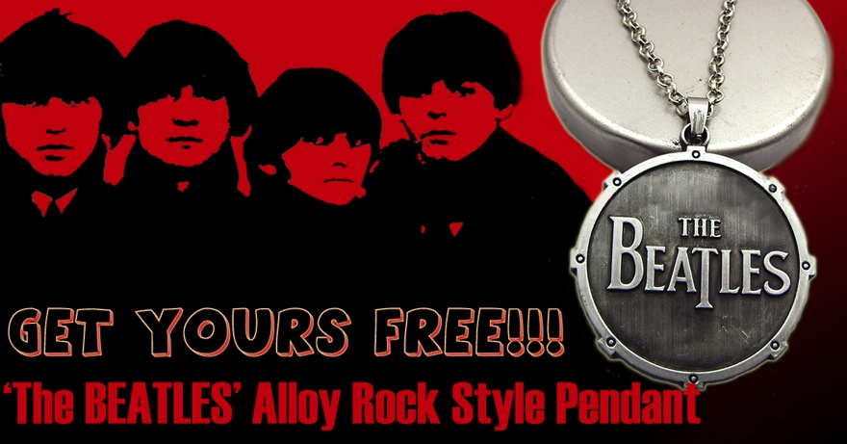
MusoFunnel can be used to
promote new music releases,
videos, ticketed events and
merchandise.
Whilst it can be used for most
business types, it is targeted
towards the music industry by
providing background images
and template designs that are
music specific.
All Landing Pages will be hosted
on the MusoFunnel Cloud drive
as long as the user has an
up-to-date subscription.

Slide 20
Pricing
The MusoFunnel will be a subscription based model, paid monthly or annually. Costs for advertising campaigns will be paid separately and at the time when making each order.
The proposed subscription price for the MusoFunnel App is
£10.00 per month or £100 per year if paid annually.

Slide 21
Product concept and design by Colin Crook © 2018

