Slide 1
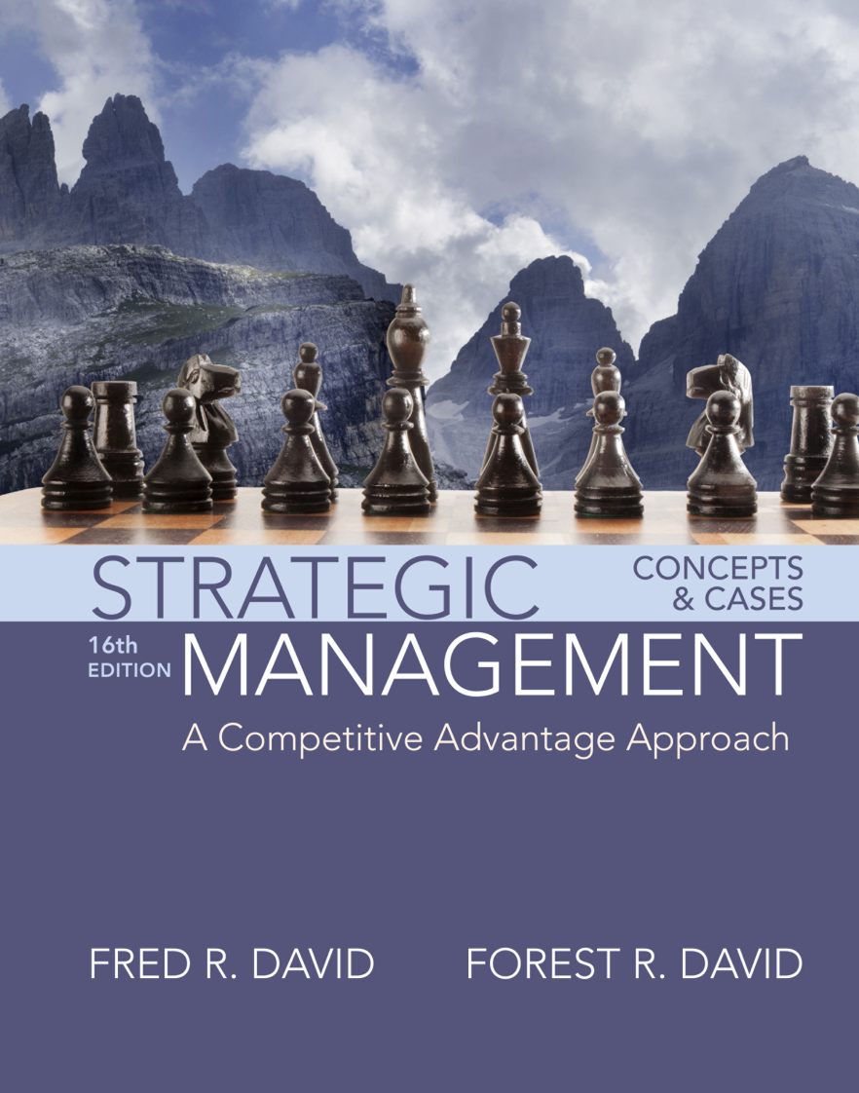
The External Assessment
Chapter Three

Slide 2
Learning Objectives
Describe the nature and purpose of an external assessment in formulating strategies.
Identify and discuss 10 external forces that must be examined in formulating strategies: economic, social, cultural, demographic, environmental, political, governmental, legal, technological, and competitive.
Explain Porter’s Five Forces Model and its relevance in formulating strategies.
Notes:
After studying this chapter, you should be able to do the following:
3-1. Describe the nature and purpose of an external assessment in formulating strategies.
3-2. Identify and discuss 10 external forces that must be examined in formulating strategies:
economic, social, cultural, demographic, environmental, political, governmental,
legal, technological, and competitive.
3-3. Explain Porter’s Five Forces Model and its relevance in formulating strategies.
3-4. Describe key sources of information used for locating vital external information.
3-5. Discuss forecasting tools and techniques.
3-6. Explain how to develop and use an External Factor Evaluation (EFE) Matrix.
3-7. Explain how to develop and use a Competitive Profile Matrix.

Slide 3
Learning Objectives (cont.)
Describe key sources of information used for locating vital external information.
Discuss forecasting tools and techniques.
Explain how to develop and use an External Factor Evaluation (EFE) Matrix.
Explain how to develop and use a Competitive Profile Matrix.

Slide 4
External Audit
External audit
  focuses on identifying and evaluating trends and events beyond the control of a single firm
  reveals key opportunities and threats confronting an organization so that managers can formulate strategies to take advantage of the opportunities and avoid or reduce the impact of threats
Notes:
This chapter examines the tools and concepts needed to conduct an external strategic management audit (sometimes called environmental scanning or industry analysis).

Slide 5
The Nature of an External Audit
The external audit is aimed at identifying key variables that offer actionable responses
Firms should be able to respond either offensively or defensively to the factors by formulating strategies that take advantage of external opportunities or that minimize the impact of potential threats.
Notes:
The purpose of an external audit is to develop a finite list of opportunities that could benefit a firm as well as threats that should be avoided. As the term finite suggests, the external audit is not aimed at developing an exhaustive list of every possible factor that could influence the business; rather, it is aimed at identifying key variables that offer actionable responses.

Slide 6
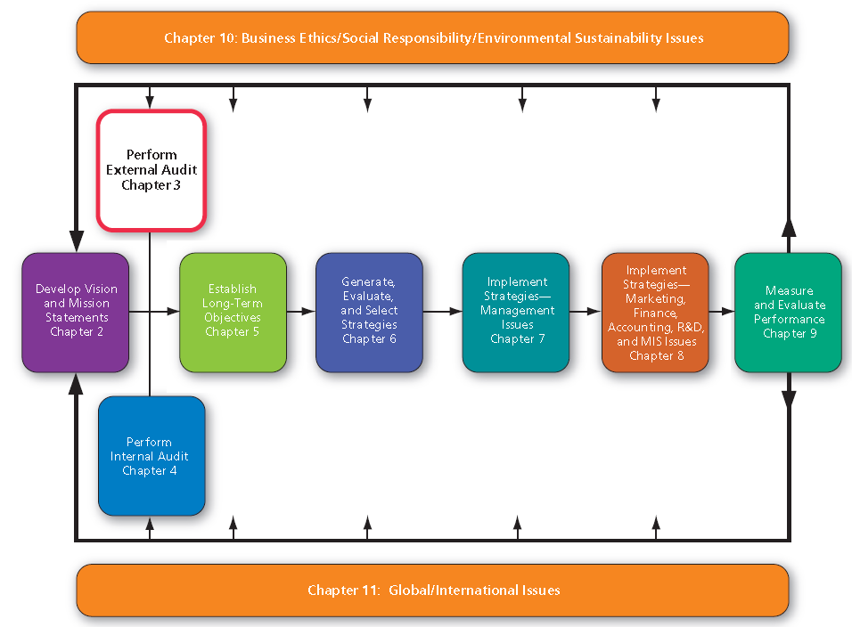
A Comprehensive Strategic-Management Model
Notes:
This figure illustrates with white shading how the external audit fits into the strategic-management process.

Slide 7
Key External Forces
External forces can be divided into five broad categories:
1. economic forces
2. social, cultural, demographic, and natural
environment forces
3. political, governmental, and legal forces
4. technological forces
5. competitive forces
Notes:
Important Note: When identifying and prioritizing key external factors in strategic planning, make sure the factors selected are (1) specific (i.e., quantified to the extent possible); (2) actionable (i.e., meaningful in terms of having strategic implications); and (3) stated as external trends, events, or facts rather than as strategies the firm could pursue.

Slide 8
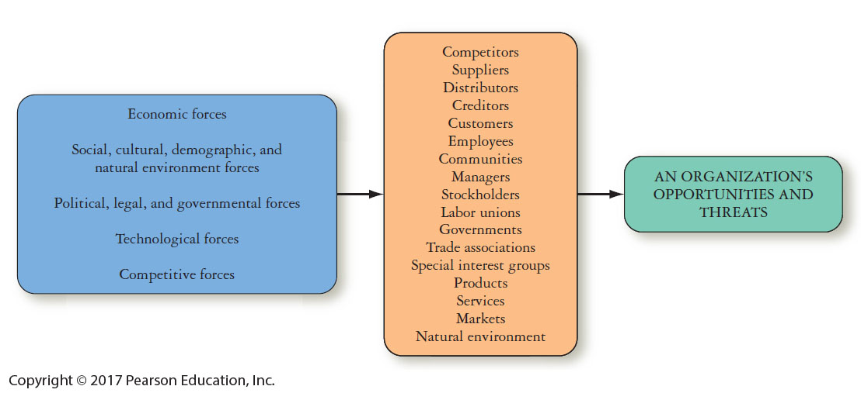
Relationships Between Key External Forces and an Organization
Notes:
Identifying and evaluating external opportunities and threats enables organizations to develop a clear mission, to design strategies to achieve long-term objectives, and to develop policies to achieve annual objectives.

Slide 9
The Process of Performing an External Audit
First, gather competitive intelligence and information about economic, social, cultural, demographic, environmental, political, governmental, legal, and technological trends.
Notes:
The process of performing an external audit must involve as many managers and employees as possible in order to lead to understanding and commitment from organizational members.
Individuals can be asked to monitor various sources of information, such as key magazines, trade journals, and newspapers—and use online sources.

Slide 10
The Process of Performing an External Audit
Information should be assimilated and evaluated
A final list of the most important key external factors should be communicated
Notes:
After information is gathered, it should be assimilated and evaluated. A meeting or series of meetings of managers is needed to collectively identify the most important opportunities and threats facing the firm. A prioritized list of these factors must be obtained by requesting that all managers individually rank the factors identified, from 1 (for the most important opportunity/threat) to 20 (for the least important opportunity/threat).

Slide 11
The Industrial Organization
(I/O) View
The Industrial Organization (I/O) approach to competitive advantage advocates that external (industry) factors are more important than internal factors in a firm for gaining and sustaining competitive advantage.
Notes:
Proponents of the I/O view, such as Michael Porter, contend that organizational performance will be primarily determined by industry forces, such as falling gas prices that no single firm can control.

Slide 12
Economic Forces
Shift to service economy
Availability of credit
Level of disposable income
Propensity of people to spend
Interest rates
Inflation rates
GDP trends
Consumption patterns
Unemployment trends
Value of the dollar
Import/Export factors
Demand shifts for different goods and services
Income differences by region and consumer group
Price fluctuations
Foreign countries’ economic conditions
Monetary and Fiscal policy
Stock market trends
Tax rate variation by country and state
European Economic Community (EEC) policies
Organization of Petroleum Exporting Countries (OPEC) policies
Notes:
Be mindful that in strategic planning and case analysis, relevant economic variables such as those listed must be quantified and actionable to be useful.

Slide 13
Advantages of a Strong Dollar
Leads to lower exports
Leads to higher imports
Makes U.S. goods expensive for foreign consumers
Helps keep inflation low
Allows U.S. firms to purchase raw materials cheaply from other countries
Allows U.S. to service its debt better
Spurs foreign investment
Encourages Americans to travel abroad
Leads to lower oil prices because oil globally is priced in U.S. dollars
Encourages Americans to spend money because they can buy more for their money
Notes:
Trends in the dollar’s value have significant and unequal effects on companies in different industries and in different locations. Agricultural and petroleum industries are hurt by the dollar’s rise against the currencies of Mexico, Brazil, Venezuela, and Australia. Generally, a strong or high dollar makes U.S. goods more expensive in overseas markets. This worsens the U.S. trade deficit.

Slide 14
Social, Cultural, Demographic, and Natural Environmental Forces
U.S. Facts
  Aging population
  Less white
  2050 = 20% population > 65 years
  2075 = no ethnic or racial majority
Notes:
Social, cultural, demographic, and environmental trends are shaping the way Americans live, work, produce, and consume. New trends are creating a different type of consumer and, consequently, a need for different products, new services, and updated strategies.

Slide 15
Key Social, Cultural, Demographic, and Natural Environmental Variables
Population changes by race, age, and geographic area
Regional changes in tastes and preferences
Number of marriages
Number of divorces
Number of births
Number of deaths
Immigration and emigration rates
Social Security programs
Life expectancy rates
Per capita income
Social media pervasiveness
Attitudes toward retirement
Energy conservation
Attitudes toward product quality
Attitudes toward customer service
Pollution control
Attitudes toward foreign peoples
Energy conservation
Social programs
Number of churches
Number of church members
Social responsibility issues
Notes:
Be mindful that in strategic planning and case analysis, relevant social, cultural, demographic, and natural environment factors for a particular business must be quantified and actionable to be useful.

Slide 16
Political, Governmental, and
Legal Forces
The increasing global interdependence among economies, markets, governments, and organizations makes it imperative that firms consider the possible impact of political variables on the formulation and implementation of competitive strategies.
Notes:
Federal, state, local, and foreign governments are major regulators, deregulators, subsidizers, employers, and customers of organizations. Political, governmental, and legal factors, therefore, can represent major opportunities or threats for both small and large organizations.

Slide 17
Political, Government, and
Legal Variables
Environmental regulations
Number of patents
Changes in patent laws
Equal employment laws
Level of defense expenditures
Unionization trends
Antitrust legislation
USA vs. other country relationships
Political conditions in foreign countries
Global price of oil changes
Local, state, and federal laws
Import–export regulations
Tariffs
Local, state, and national elections
Notes:
Some political, governmental, and legal variables that can represent key opportunities or threats to organizations are provided on this slide, but in stating these for a particular company, the factors should be both quantitative and actionable.

Slide 18
Technological Forces
New technologies such as:
the Internet of Things
3D printing
the cloud
mobile devices
biotech
analytics
autotech
robotics and
artificial intelligence
are fueling innovation in many industries, and impacting strategic-planning decisions.
Notes:
No company or industry today is insulated against emerging technological developments. In high-tech industries, identification and evaluation of key technological opportunities and threats can be the most important part of the external strategic-management audit.

Slide 19
Technological Forces
Many firms now have a Chief Information Officer (CIO) and a Chief Technology Officer (CTO) who work together to ensure that information needed to formulate, implement, and evaluate strategies is available where and when it is needed
Notes:
These individuals are responsible for developing, maintaining, and updating a company’s information database. The CIO is more a manager, managing the firm’s relationship with stakeholders; the CTO is more a technician, focusing on technical issues such as data acquisition, data processing, decision-support systems, and software and hardware acquisition.

Slide 20
Results of Technological Advances
Major opportunities and threats that must be considered in formulating strategies.
Can affect organizations’ products, services, markets, suppliers, distributors, competitors, customers, manufacturing processes, marketing practices, and competitive position.
Can create new markets, result in new and improved products, change the relative competitive cost positions, and render existing products and services obsolete.
Can reduce or eliminate cost barriers between businesses, create shorter production runs, create shortages in technical skills, and result in changing values and expectations of employees, managers, and customers.
Can create new competitive advantages that are more powerful than existing advantages.
Notes:
Results of technological advancements are varied, as shown on this slide.

Slide 21
Competitive Forces
An important part of an external audit is identifying rival firms and determining their strengths, weaknesses, capabilities, opportunities, threats, objectives, and strategies
Notes:
Collecting and evaluating information on competitors is essential for successful strategy formulation. Identifying major competitors is not always easy because many firms have divisions that compete in different industries.

Slide 22
Competitive Forces
Characteristics of the most competitive companies:
Strive to continually increase market share
Use the vision/mission as a guide for all decisions
Whether it's broke or not, fix it–make it better
Continually adapt, innovate, improve
Acquisition is essential to growth
Hire and retain the best employees and managers possible
Strive to stay cost-competitive on a global basis
Notes:
The seven characteristics on this slide describe the most competitive companies.

Slide 23
Key Questions About Competitors
What are the strengths of our major competitors?
What are the weaknesses of our major competitors?
What are the objectives and strategies of our major competitors?
How will our major competitors most likely respond to current economic, social, cultural, demographic, environmental, political, governmental, legal, technological, and competitive trends affecting our industry?
How vulnerable are the major competitors to our alternative company strategies?
How vulnerable are our alternative strategies to successful counterattack by our major competitors?
How are our products or services positioned relative to major competitors?
To what extent are new firms entering and old firms leaving this industry?
What key factors have resulted in our present competitive position in this industry?
How have the sales and profit rankings of our major competitors in the industry changed over recent years? Why have these rankings changed that way?
What is the nature of supplier and distributor relationships in this industry?
To what extent could substitute products or services be a threat to our competitors?
Notes:
Addressing questions about competitors, such as those presented on this slide, is important in performing an external audit.

Slide 24
Competitive Intelligence Programs
Competitive intelligence (CI)
  a systematic and ethical process for gathering and analyzing information about the competition's activities and general business trends to further a business's own goals
Notes:
Competitive intelligence (CI) is formally defined by the Society of Competitive Intelligence Professionals (SCIP). Competitive intelligence is not corporate espionage; after all, 95 percent of the information a company needs to make strategic decisions is available and accessible to the public.

Slide 25
Competitive Intelligence Programs
The three basic objectives of a CI program are:
To provide a general understanding of an industry and its competitors
To identify areas in which competitors are vulnerable and to assess the impact strategic actions would have on competitors
To identify potential moves that a competitor might make that would endanger a firm's position in the market
Notes:
Competitive information is equally applicable for strategy formulation, implementation, and evaluation decisions. An effective CI program allows all areas of a firm to access consistent and verifiable information in making decisions.

Slide 26
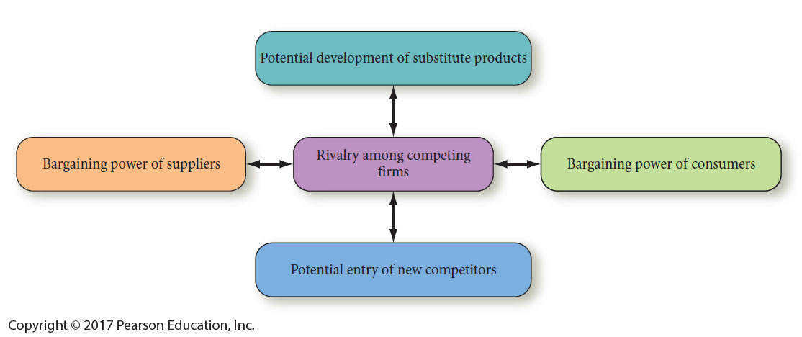
The Five-Forces Model of Competition
Notes:
Porter’s Five-Forces Model of competitive analysis is a widely used approach for developing strategies in many industries.

Slide 27
The Five-Forces Model of Competition
Identify key aspects or elements of each competitive force that impact the firm.
Evaluate how strong and important each element is for the firm.
Decide whether the collective strength of the elements is worth the firm entering or
staying in the industry.
Notes:
The intensity of competition among firms varies widely across industries.

Slide 28
The Five-Forces Model
Rivalry among competing firms
  Most powerful of the five forces
  Focus on competitive advantage of strategies over other firms
Notes:
The intensity of rivalry among competing firms tends to increase as the number of competitors increases, as competitors become more equal in size and capability, as demand for the industry’s products declines, and as price cutting becomes common.

Slide 29
The Five-Forces Model
TABLE 3-7 Conditions That Cause High Rivalry Among Competing Firms
▬▬▬▬▬▬▬▬▬▬▬▬▬▬▬▬▬▬▬▬▬▬▬▬▬▬▬▬▬▬▬▬▬▬▬▬▬▬
1. When the number of competing firms is high
2. When competing firms are of similar size
3. When competing firms have similar capabilities
4. When the demand for an industry’s products is falling
5. When the product or service prices in the industry are falling
6. When consumers can switch brands easily
7. When barriers to leaving the market are high
8. When barriers to entering the market are low
9. When fixed costs are high among competing firms
10. When the product is perishable
11. When rivals have excess capacity
12. When consumer demand is falling
13. When rivals have excess inventory
14. When rivals sell similar products/services
15. When mergers are common in the industry
Notes:
This slide summarizes conditions that cause high rivalry among competing firms.

Slide 30
The Five-Forces Model
Potential Entry of New Competitors
  Barriers to entry are important
  Quality, pricing, and marketing can overcome barriers
Notes:
Whenever new firms can easily enter a particular industry, the intensity of competitiveness among firms increases.

Slide 31
Barriers to Entry
Need to gain economies of scale quickly
Need to gain technology and specialized know-how
Lack of experience
Strong customer loyalty
Strong brand preferences
Large capital requirements
Lack of adequate distribution channels
Notes:
Barriers to entry, however, can include the need to gain economies of scale quickly, the need to gain technology and specialized know-how, the lack of experience, strong customer loyalty, strong brand preferences, large capital requirements, lack of adequate distribution channels, government regulatory policies, tariffs, lack of access to raw materials, possession of patents, undesirable locations, counterattack by entrenched firms, and potential saturation of the market.

Slide 32
Barriers to Entry
Government regulatory policies
Tariffs
Lack of access to raw materials
Possession of patents
Undesirable locations
Counterattack by entrenched firms
Potential saturation of the market
Notes:
Whenever new firms can easily enter a particular industry, the intensity of competitiveness among firms increases.

Slide 33
The Five-Forces Model
Potential development of substitute products
  Pressure increases when:
    Prices of substitutes decrease
    Consumers' switching costs decrease
Notes:
In many industries, firms are in close competition with producers of substitute products in other industries. The presence of substitute products puts a ceiling on the price that can be charged before consumers will switch to the substitute product.

Slide 34
The Five-Forces Model
Bargaining Power of Suppliers is increased when (there are):
  Few suppliers
  Few substitutes
  Costs of switching raw materials is high
Backward integration is gaining control or ownership of suppliers
Notes:
It is often in the best interest of both suppliers and producers to assist each other with reasonable prices, improved quality, development of new services, just-in-time deliveries, and reduced inventory costs, thus enhancing long-term profitability for all concerned.

Slide 35
The Five-Forces Model
Bargaining power of consumers
  Customers being concentrated or buying in volume affects intensity of competition
  Consumer power is higher where products are standard or undifferentiated
Notes:
When customers are concentrated or large in number or buy in volume, their bargaining power represents a major force affecting the intensity of competition in an industry.

Slide 36
Conditions Where Consumers Gain Bargaining Power
If buyers can inexpensively switch
If buyers are particularly important
If sellers are struggling in the face of falling consumer demand
If buyers are informed about sellers' products, prices, and costs
If buyers have discretion in whether and when they purchase the product
Notes:
The bargaining power of consumers can be the most important force affecting competitive advantage.

Slide 37
Sources of External Information
Unpublished sources include customer surveys, market research, speeches at professional and shareholders' meetings, television programs, interviews, and conversations with stakeholders.
Published sources of strategic information include periodicals, journals, reports, government documents, abstracts, books, directories, newspapers, and manuals.
Notes:
A wealth of strategic information is available to organizations from both published and unpublished sources.

Slide 38
Sources of External Information
http://finance.yahoo.com
www.hoovers.com
http://globaledge.msu.edu/industries/
Notes:
There are many excellent websites for gathering strategic information, but three that the authors use routinely are included on this slide.

Slide 39
Forecasting Tools and Techniques
Forecasts
  educated assumptions about future trends and events
  no forecast is perfect
Notes:
Forecasting is complex because of factors such as technological innovation, cultural changes, new products, improved services, stronger competitors, shifts in government priorities, changing social values, unstable economic conditions, and unforeseen events.

Slide 40
Making Assumptions
Assumptions
  Best present estimates of the impact of major external factors, over which the manager has little if any control, but which may exert a significant impact on performance or the ability to achieve desired results.
Notes:
Planning would be impossible without assumptions. McConkey defines assumptions as the “best present estimates of the impact of major external factors, over which the manager has little if any control, but which may exert a significant impact on performance or the ability to achieve desired results.”

Slide 41
Business Analytics
Using software to mine huge volumes of data
Helps executives make decisions
Notes:
Sometimes called predictive analytics, machine learning, or data mining, this software enables a researcher to assess and use the aggregate experience of an organization, which is a priceless strategic asset for a firm.

Slide 42
Industry Analysis: The External Factor Evaluation (EFE) Matrix
Summarize and evaluate these factors:
Economic
Social
Cultural
Demographic
Environmental
Political
Governmental
Legal
Technological
Competitive
Notes:
An External Factor Evaluation (EFE) Matrix allows strategists to summarize and evaluate economic, social, cultural, demographic, environmental, political, governmental, legal, technological, and competitive information

Slide 43
EFE Matrix Steps
List 20 key external factors
Weight from 0.0 to 1.0
Rate the effectiveness of current strategies from 1-4
Multiply weight * rating
Sum weighted scores
Notes:
The EFE matrix can be developed in five steps.

Slide 44
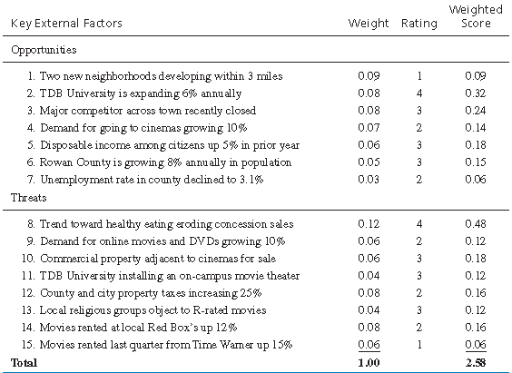
EFE Matrix for a Local Ten-Theater Cinema Complex
Notes:
The most important factor to being successful in this business is “Trend toward healthy eating eroding concession sales,” as indicated by the 0.12 weight. Also note that the local cinema is doing excellent in regard to handling two factors, “TDB University is expanding 6 percent annually” and “Trend toward healthy eating eroding concession sales.” Perhaps the cinema is placing flyers on campus and also adding yogurt and healthy drinks to its concession menu.

Slide 45
Industry Analysis: Competitive Profile Matrix (CPM)
Identifies firm's major competitors and their strengths & weaknesses in relation to a sample firm's strategic positions
Critical success factors include internal and external issues
Notes:
The ratings refer to strengths and weaknesses, where 4 = major strength, 3 = minor strength, 2 = minor weakness, and 1 = major weakness.

Slide 46
An Example Competitive
Profile Matrix
TABLE 3-12 An Example Competitive Profile Matrix
▬▬▬▬▬▬▬▬▬▬▬▬▬▬▬▬▬▬▬▬▬▬▬▬▬▬▬▬▬▬▬▬▬▬▬▬▬▬▬▬▬
Company 1 Company 2 Company 3____________
Critical Success
Factors_ ___ _ Weight Rating Score Rating Score Rating Score____ ____
Advertising 0.20 1 0.20 4 0.80 3 0.60
Product Quality 0.10 4 0.40 3 0.30 2 0.20
Price Competitiveness 0.10 3 0.30 2 0.20 1 0.10
Management 0.10 4 0.40 3 0.20 1 0.10
Financial Position 0.15 4 0.60 2 0.30 3 0.45
Customer Loyalty 0.10 4 0.40 3 0.30 2 0.20
Global Expansion 0.20 4 0.80 1 0.20 2 0.40
Market Share 0.05 1 0.05 4 0.20 3 0.15
Total 1.00 3.15 2.50 2.20
Note: The ratings values are as follows: 1 = major weakness, 2 = minor weakness, 3 = minor strength, 4 = major strength. As indicated by the total weighted score of 2.50, Competitor 2 is weakest. Only eight critical success factors are included for simplicity; this is too few in actuality.
Notes:
In this example, the two most important factors to being successful in the industry are “advertising” and “global expansion,” as indicated by weights of 0.20.

