Slide 1

Using case studies on your business & management programme
Stephen Griffiths,
University of Wales Moderator
Assistant Dean,
Swansea Business School,
Faculty of Business & Management

Slide 2
“Case studies focus on one instance (or a few instances) of a particular phenomenon with a view to providing an in-depth account of events, relationships, experiences or processes occurring in that particular instance.”
(Denscombe, 2002)

Slide 3
Cases studies have the following characteristics:
They are an empirical way of investigating a contemporary phenomenon within its real life context.
The boundaries between the phenomena and the context are not clearly evident.
They use multiple-methods of collecting data which may be both quantitative and qualitative.
They are particularly valuable in answering ‘Who?’, ‘Why?’ and ‘How?’ questions in management research.
(Yin, 2003)

Slide 4
Case studies can be:
Descriptive
Illustrative
Experimental
Exploratory
(Jankowicz, 2005)

Slide 5
Cases and other methods:
Cases can be used to follow up surveys to get deeper insight and depth of understanding. However they may precede surveys to identify key issues, which can be tested by surveys and quantitative methods.
Cases can be positivist, phenomenological or a mix of both research paradigms. The researcher should explain what his/her case is trying to achieve.
Can be explorative, informed by existing theory.
May be used to challenge existing theory and provide the base information for new hypotheses.

Slide 6
Advantages of case studies:
Focuses on detail and depth, to evaluate complexities and subtleties of organisations.
Holistic analysis- gives an overview, rather than a partial atomised perspective.
Allows a variety of research methods.
No pressure to control events.
(Adapted from Denscombe, 2002)

Slide 7
Disadvantages of case studies:
Difficult to generalise the findings of case study research or analysis.
Produces “safe data”, unchallenging, existing data, often gifted by organisations. Need for rigour and critical approach.
Difficult to define the boundaries of the case, here it begins and ends.
The “observer effect” can corrupt data, where the researcher causes unusual behaviours in those being observed or recorded.
(Adapted from Denscombe, 2002)

Slide 8
Case studies for teaching:
Good for applications.
Need for counter examples.
Short cases good for class work.
Case construction can be a course target for final delivery.

Slide 9
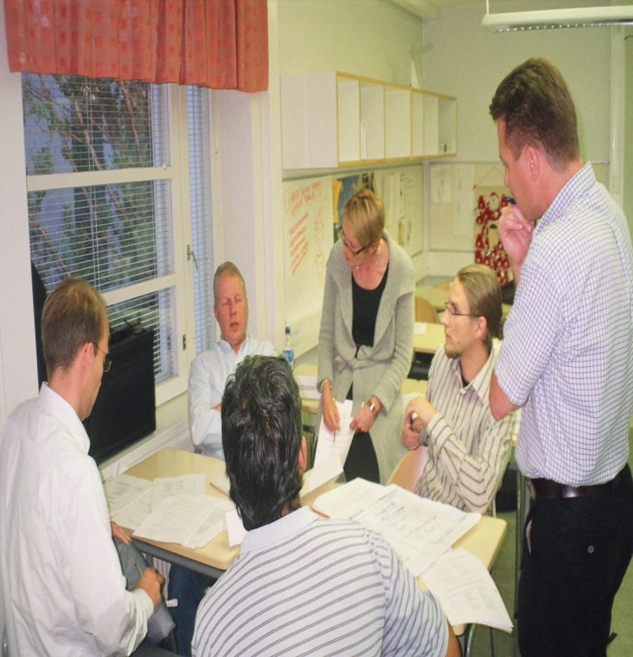
Students enjoy using cases and can relate them to real world experiences

Slide 10
Case studies for assessment
Providing a case makes application to an example neutral. Well-resourced students have no unfair advantage.
Using a case reduces temptation to plagiarise (which often happens when you say “apply this concept to an organisation you have studied”).
Using a case in an examination, allows a controlled experiment in testing all students using the same framework.
In examinations:
Short cases, must be read in exam time. Build this into your timings and the number of questions you require to be answered.
Long cases need to be issued before the exam to allow sufficient time for reading and research. Questions can be pre-release. You might add an unseen question in addition to any pre-release questions. However you need to cover the content of a possible answer in your teaching. Perhaps rehearsing some of the theories and analysis, in similar but not the same case material.

Slide 11
Case for dissertation and research:
This is the most popular methodology for practicing managers.
Key factors to review:
Access to data.
The ethics of case use.
The format for presentation.
Bias- impact on reliability and validity.
The need for triangulation of different data sets.

Slide 12
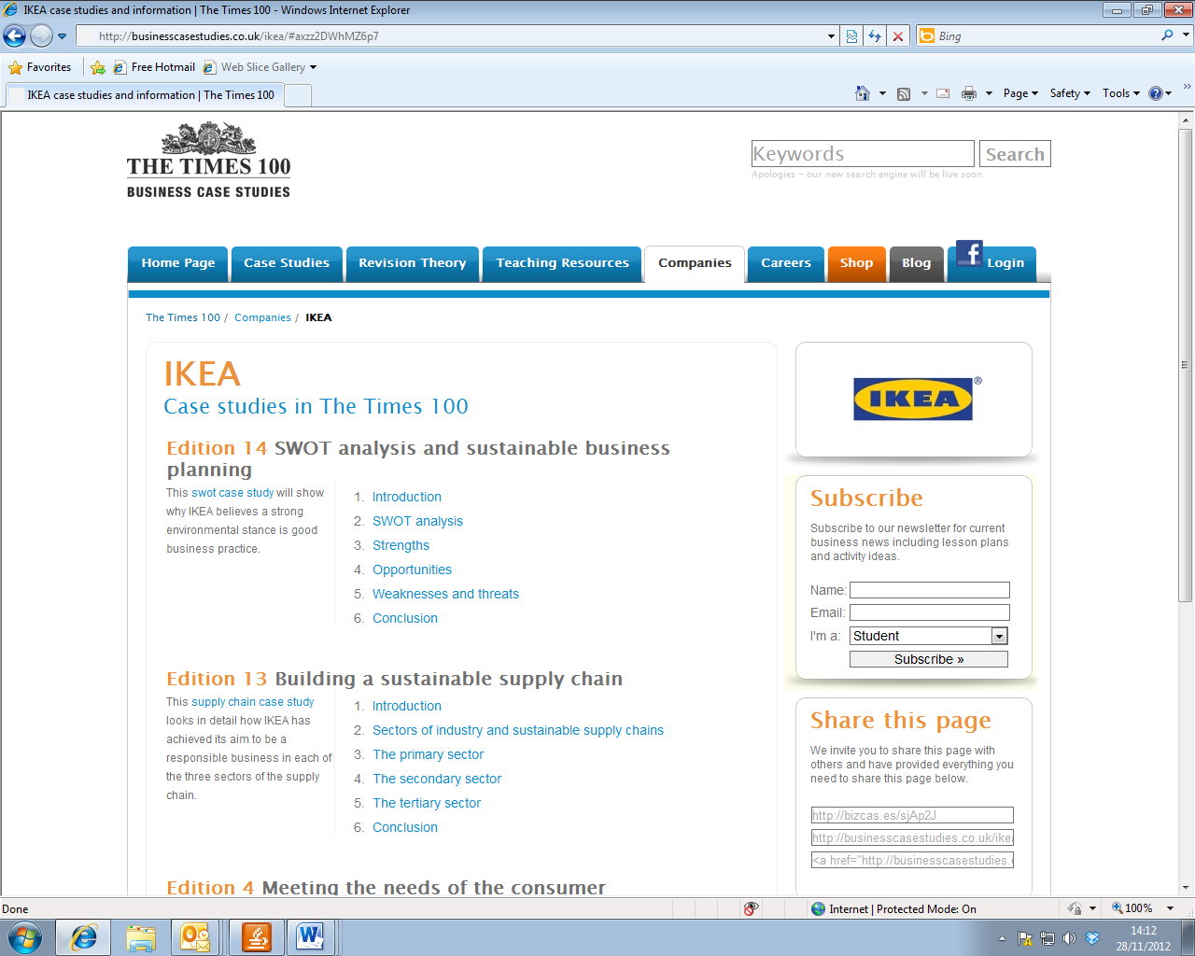

Slide 13
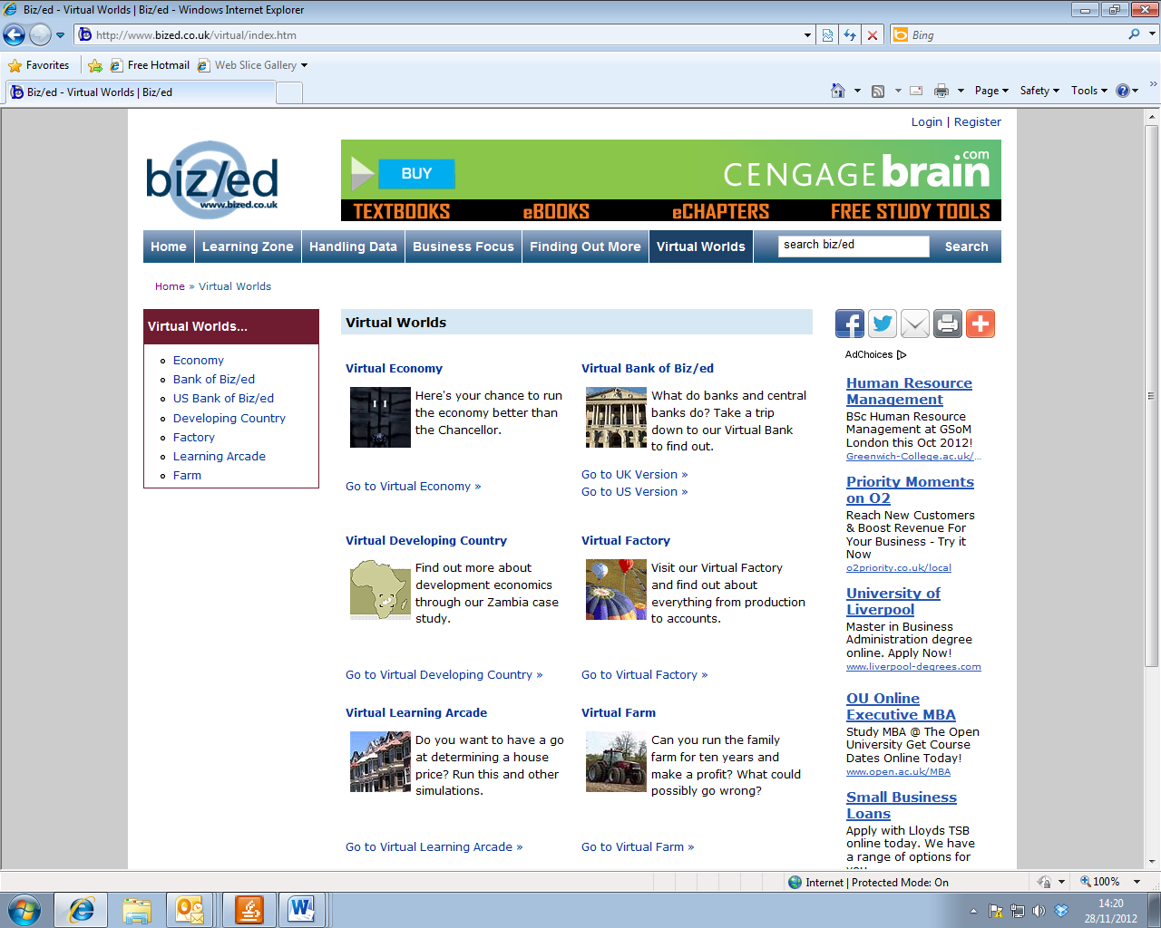

Slide 14
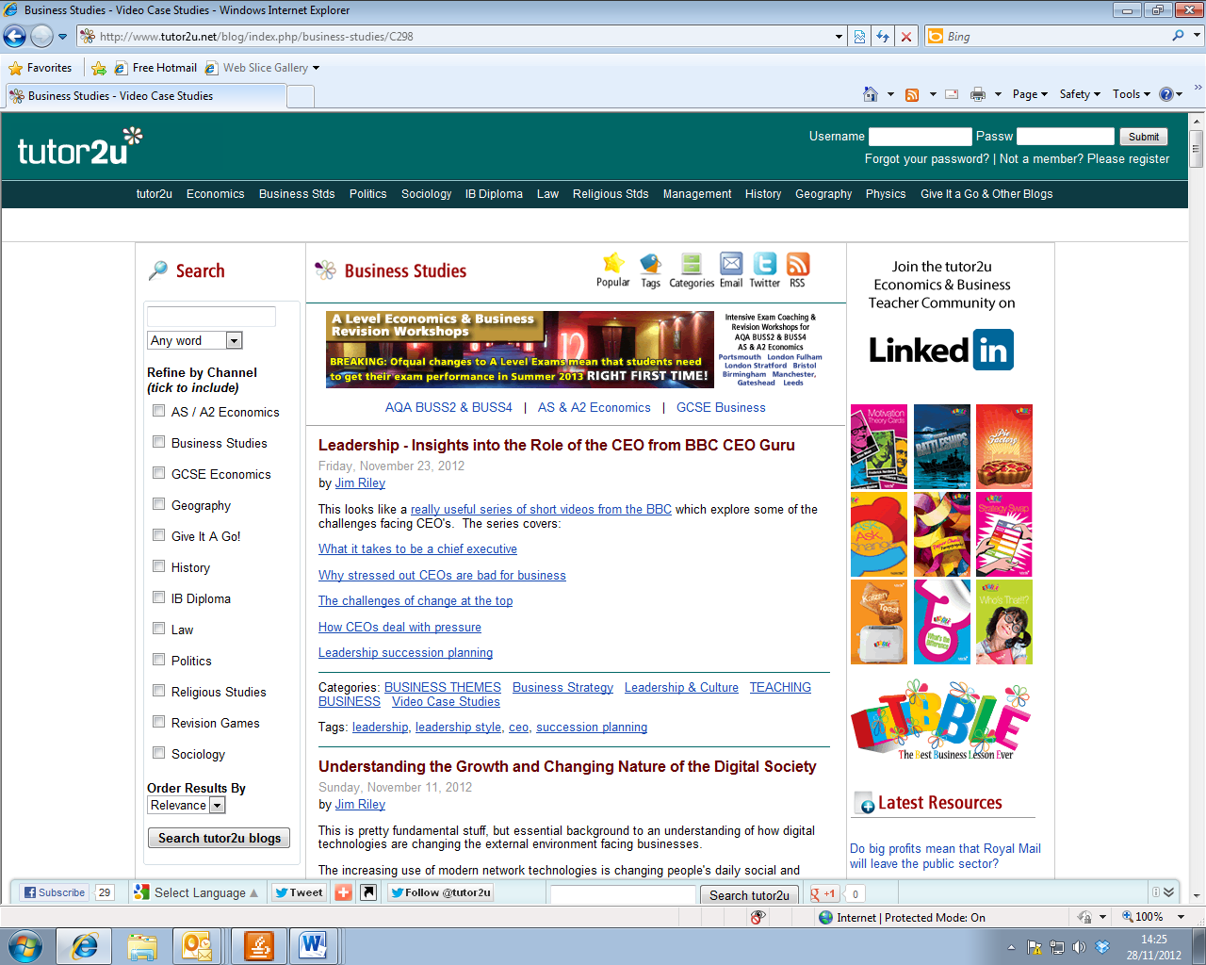

Slide 15
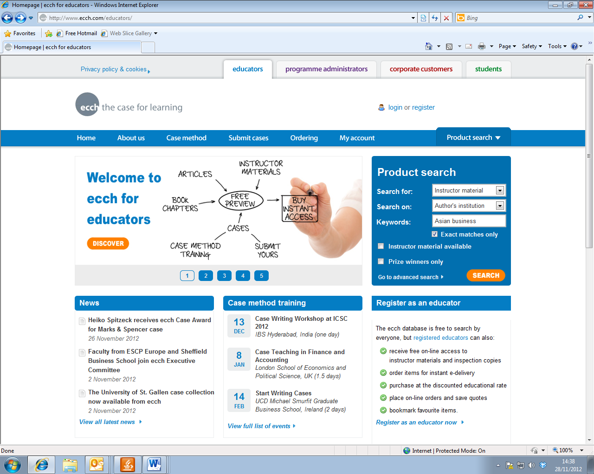

Slide 16
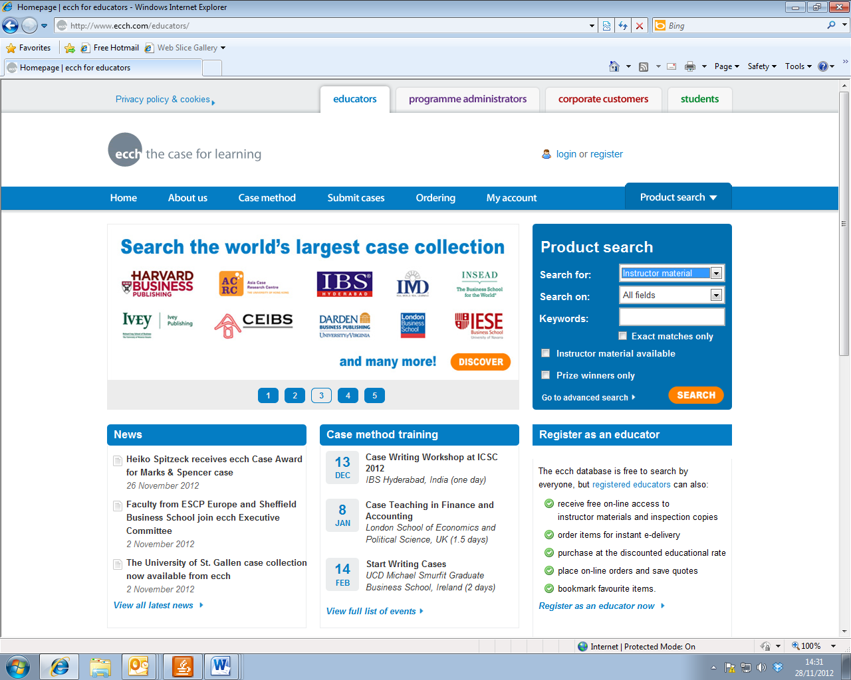

Slide 17

Develop your own, with colleagues or with the class.

Slide 18
Bibliography
Coghlan, D. & Brannick, T. (2005) Doing action research in your own organisation, London, Sage
Collis, J. & Hussey, R. (2009) Business Research, A Practical Guide for undergraduate and post graduate students, London, Palgrave
Denscombe, M. (2002) Ground Rules for Good Research, Buckingham, Open University Press (OUP)
Easterby-Smith, M., Thorpe, R. & Lowe, A. (2008) Management Research, London, Sage
Farquhar, J.D. (2012) Case Study Research for Business, London, Sage
Flick, U. (2011) An Introduction to Research Methods, London, Sage
Hair, J. F. Jr., Arthur H. Money, A.H., Samouel, P. & Page, M. (2007) Research Methods for Business, Chichester, John Wiley & Sons
Jankowicz, A.D. (2005) Business Research Projects, London, Thomson Learning
Mathews, R. & Ross, L. (2010) Research Methods: A Practical Guide for the Social Sciences, London, Pearson
Saunders, M. & Lewis, P. (2012) Doing Research in Business & Management, London, FT/Prentice Hall
Yin, R.K. (2003) Application of Case Study Methods, London, Sage

Slide 19
Web links
Beware of bias in organisations offering free case material
Educational sources are more reliable
Some commercial sites are expensive
Be careful of copyright use rules
http://archive.tlt.psu.edu/suggestions/cases/
http://hbsp.harvard.edu/product/cases
http://iteslj.org/Techniques/Daly-CaseStudies/
http://www.stanford.edu/dept/CTL/cgi-bin/docs/newsletter/case_studies.pdf
http://www.wri.org/publication/bell-teaching-case-studies/
http://www.bu.edu/ceit/teaching-resources/in-the-classroom/using-case-studies-to-teach/
http://www.pixel-online.net/edu_future/common/download/Paper_pdf/ITL33-Jendrych.pdf
http://www.materials.ac.uk/guides/casestudies.asp
http://www.caseplace.org/
http://www.netalogue.com/ecommerce-case-study-studies.aspx
http://www.bized.co.uk/search/node/case%20studies
http://businesscasestudies.co.uk/#axzz2DWhMZ6p7
http://www.tutor2u.net/revision_notes_strategy.asp
http://www.ecch.com/educators/casemethod/resources/freecases/ecchfreecases

