Slide 1
MODULE NAME: Managing Business Information
MODULE CODE: LCLM5004
STUDENT NAME: Tetiana Kovenia
STUDENR ID: 2422022
PRESENTATION TITLE: Ethical Considerations: Discuss data privacy, security, and ethical concerns, including AI decision-making, employee monitoring, and bias. Suggest ways to mitigate risks and ensure responsible use.
LECTURER: Dr Amitave Banik

Slide 2
Laudon's Moral Dimensions
Accountability & Quality of Life
Ensuring algorithmic fairness and mitigating psychological stresses of hyper-surveillance.
Definitive Liability: Robust legal models protect customers from automated or machine-driven errors.
Workplace Balance: Protecting employee mental health from toxic micromanagement stresses.
Invasive Impacts: Balancing system safety metrics against worker personal and professional dignity.
(Laodon and Laudon, 2012).
Information & Property Rights
Evaluating ethical rules protecting customer and worker assets in modern networks.
Ethical Standards: Clear rules must dictate how customer records are compiled, stored, and managed.
Legacy Modernization: Upgrading outdated systems secures enterprise trade secrets and private files.
Cloud Security: Structured governance models prevent continuous risks in cloud hosting (Laudon & Laudon, 2012).

Slide 3
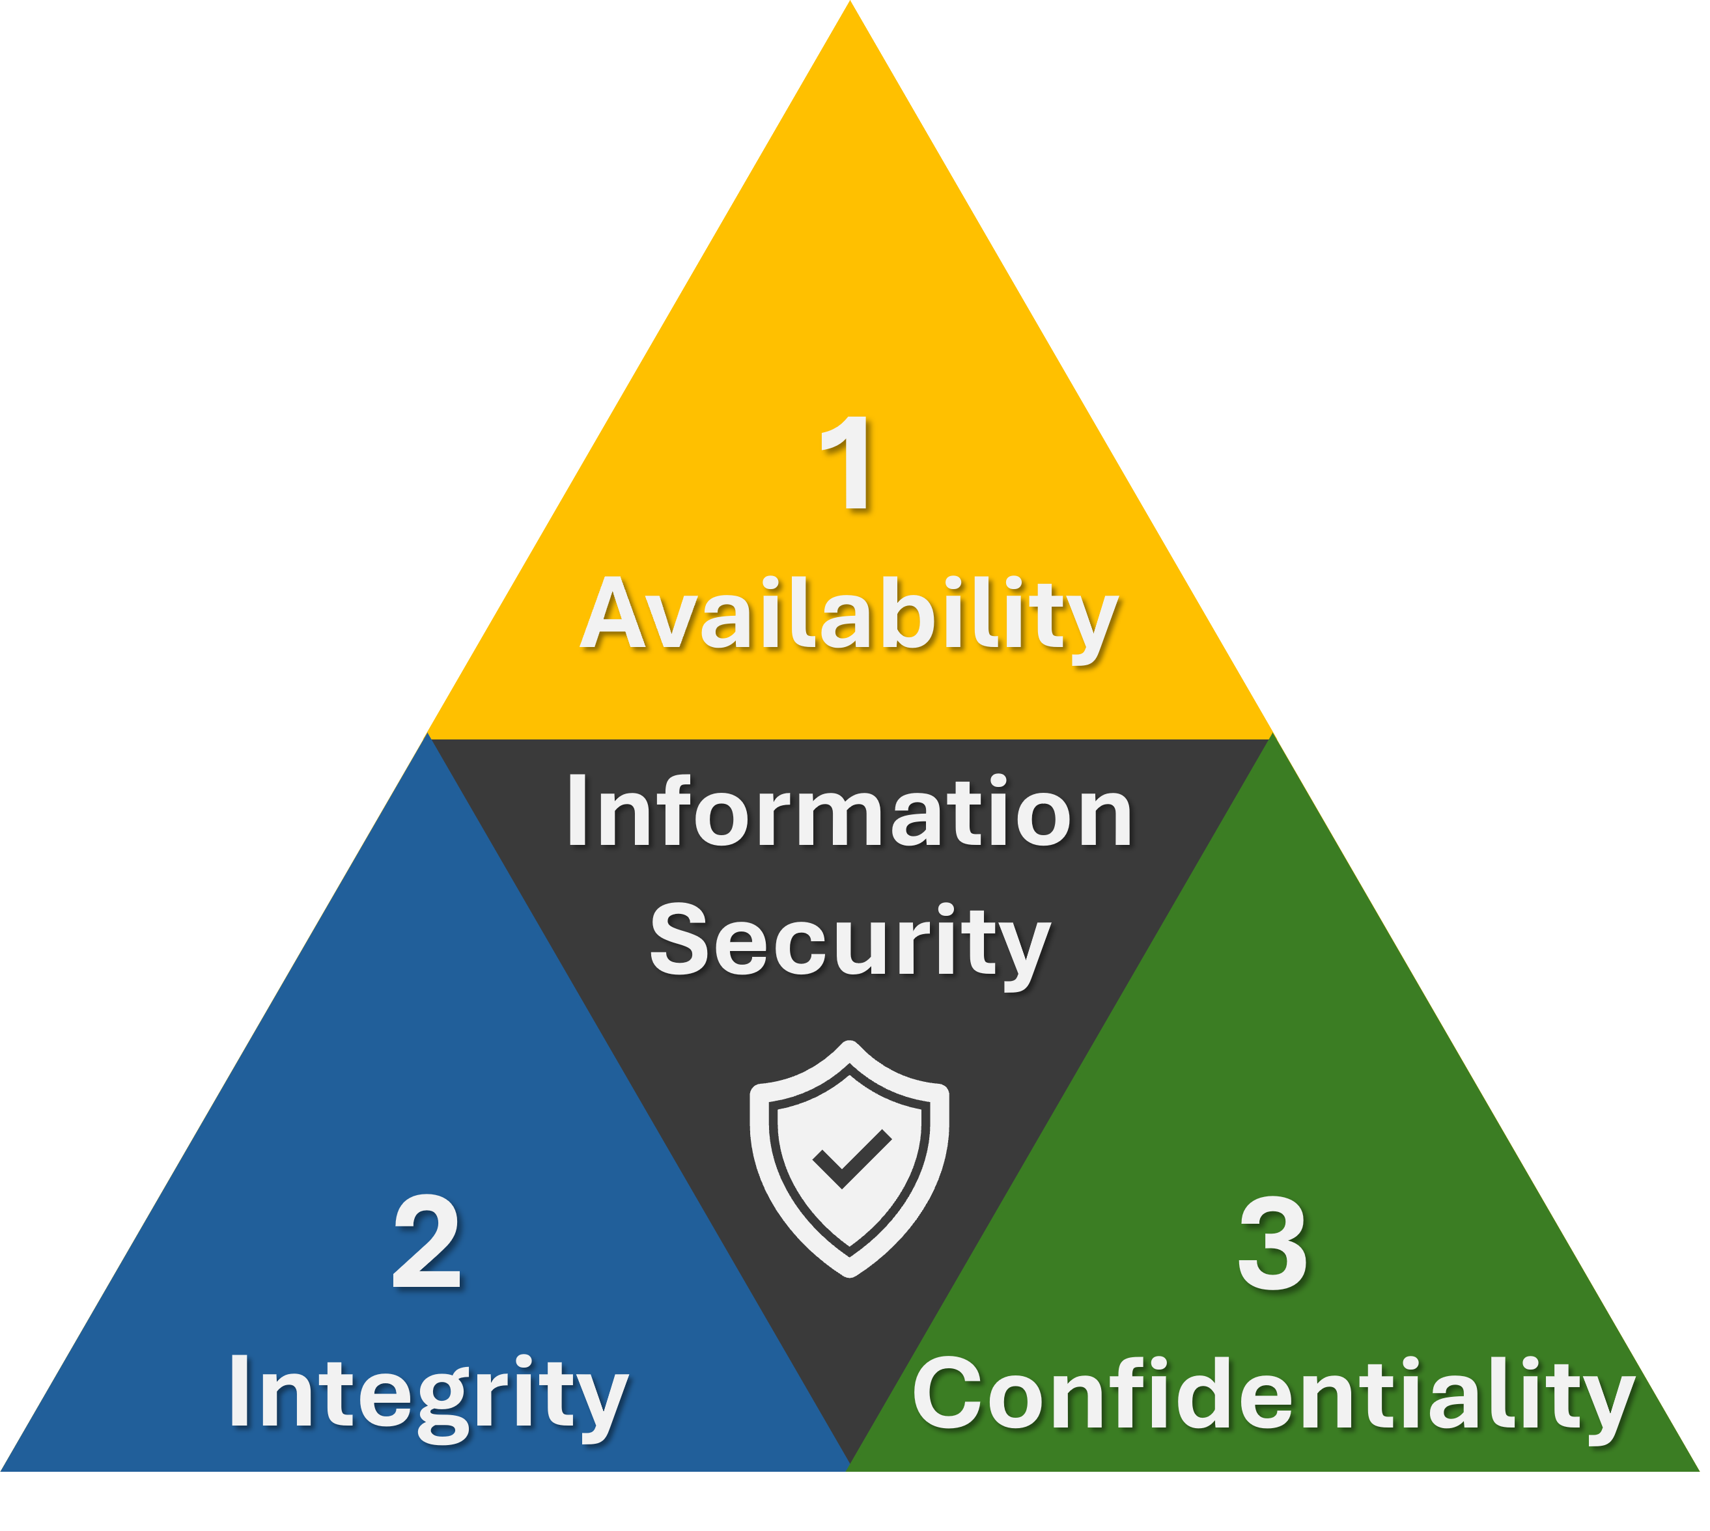
Data Privacy & Security
Securing critical infrastructure is not just a technological challenge, but a key business prerequisite.
Securing Trust & Loyalty: Maintaining strict protection over customer files serves as a brand differentiator.
Regulatory Compliance: Adapting database infrastructure to GDPR or CCPA standards protects against severe financial penalties.
Avoiding Damage: Robust cyber defense protocols prevent major financial loss, data theft, and brand ruin (Bourgeois et al., 2019).

Slide 4

AI Ethics & Algorithmic Bias
Understanding the risk of automated decision frameworks inheriting historical human prejudices.
Bias Propagation: Machine learning models frequently codify historical patterns of discrimination present in original training datasets (Mustafa et al., 2024).
Lack of Transparency: High-complexity models function as "black boxes", leaving automated choices hard to trace or audit.
Real-World recruitment Bias: An automated corporate hiring tool famously discriminated against female candidates because it was trained on historically male-dominated CV trends.

Slide 5
Ethical Risk, Impact & Strategy Mapping​
A simple, intuitive row-by-row flowchart mapping key organizational information system risks to their practical strategic resolutions.​
1. ETHICAL ISSUE (RISK)
2. BUSINESS IMPACT
3. MITIGATION STRATEGY
SECURITY RISK
Data Privacy Weakness
Unprotected database cloud storage & over-collection of records.
RISK EXPOSURE
Regulatory Fines
Severe financial loss, public trust deficit, GDPR/CCPA violations.
STRATEGIC RESOLUTION
Privacy-by-Design
Embed end-to-end encryption & data minimization protocols directly into data schemas.
ALGORITHMIC RISK
Algorithmic Bias
Skewed model training datasets leading to discriminatory algorithms.
RISK EXPOSURE
Unfair Decisions
Inaccurate brand reputation damaged & propagation of systemic inequalities.
STRATEGIC RESOLUTION
AI Audits & Testing
Regularly independent evaluation of outputs for balanced demographic parity.C
OPERATIONAL RISK
Invasive Monitoring
Intrusive constant webcam, micro-management & keystroke tracking.
RISK EXPOSURE
Employee Burnout
Severe workplace stress, ruined corporate morale, and high staff turnover.
STRATEGIC RESOLUTION
Transparent Policies
Adopt clear organizational ethics charters setting strictly recorded tracking limits.

Slide 6
References
Bourgeois, D., T., Smith, J., L., Wang, S., and Mortati, J., (2019). "Information Systems for Business and Beyond“, Open Textbooks. 1, available @: https://digitalcommons.biola.edu/open-textbooks/1 , (Accessed on 22/11/2023).
Coughlan, J., Lycett, M., and Macredie, R., D., (2005). Understanding the Business–IT Relationship, International Journal of Information Management, Vol. 25, pp.303–319.
Laudon, K.C. and Laudon, J. P. (2012). Management Information Systems, twelfth edition. Upper Saddle River, New Jersey: Prentice-Hall.
Mustafa, F., Ausat, A.M.A. and Kraugusteeliana, K., 2024. The Role of Business Information Systems in Strategic Decision-Making: Implications for Innovation and Market Adaptation. Jurnal Minfo Polgan, 13(2), pp. 1-8. Available at: https://doi.org/10.33395/jmp.v13i2.14099 [Accessed 7 July 2026].
Sengupta, S., (2015). Value Additive Activities in ERP Projects: A Consultant’s View, International Journal of Computer Applications, Vol. 121 (19).

