Slide 1
Structure of the Construction Industry
Faculty of Architecture, Computing and Engineering
School of The Built and Natural Environments
Allan Nantel
Room MA202
FACE South Building
January 2017

Slide 2
ASSIGNMENTS

Slide 3

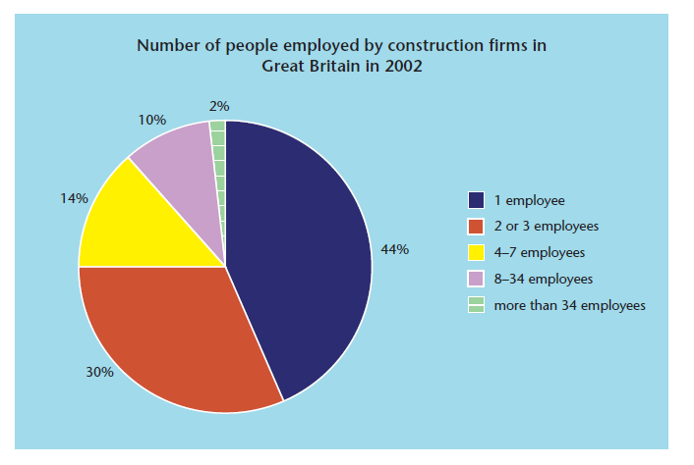
Number of people employed by construction firms in the UK in 2016

Slide 4
job roles - Exercise 1
Primary, secondary and tertiary job roles required for construction:
PRIMARY (management)
SECONDARY
(skilled operatives)
TERTIARY
Finance , admin and general
Primary
Secondary
Bricklayer
Tertiary
Design Office Administrator
Architect
BIM Modeller
Site Supervisor
Painter/Decorator
Structural Engineer
Roofer
Scheduler
Technician
Banker
Logistics Manager
Environmental Consultant
Estimator
Planner
Manufacturer
Quantity Surveyor
Project Manager
Supply Chain Manager
General Labourer
Insurer
Procurer
Masonry Worker
Insulation Installer
Heating, Ventilation, Air-Conditioning and Refrigeration Engineer
Glazer
Factory Worker
Electrician
Carpenter/Joiner
Plasterer
Plumber
Tiler
Welder
Contracts Manager
Buyer
Commercial Manager
10 minutes
Notes:
Modern Methods of Construction, including offsite construction, dictate a need for ‘core’ or primary job roles in addition to others at secondary and tertiary levels.
Primary job roles are essential for both design and delivery of offsite projects, whilst secondary job roles are required to contribute to delivery, for example by assembly offsite or onsite. Tertiary roles carry out a supporting or indirect function, for example through scheduling of component delivery in a logistics role, procuring the right types of materials or by supplying finance for the project.

Slide 5
Exercise 2:
Sketch out a organisational chart for a typical medium size Construction Company, using some of the relevant personnel from the list just completed….
Start with the ‘managing director’.
HANDOUT
20 minutes

Slide 6
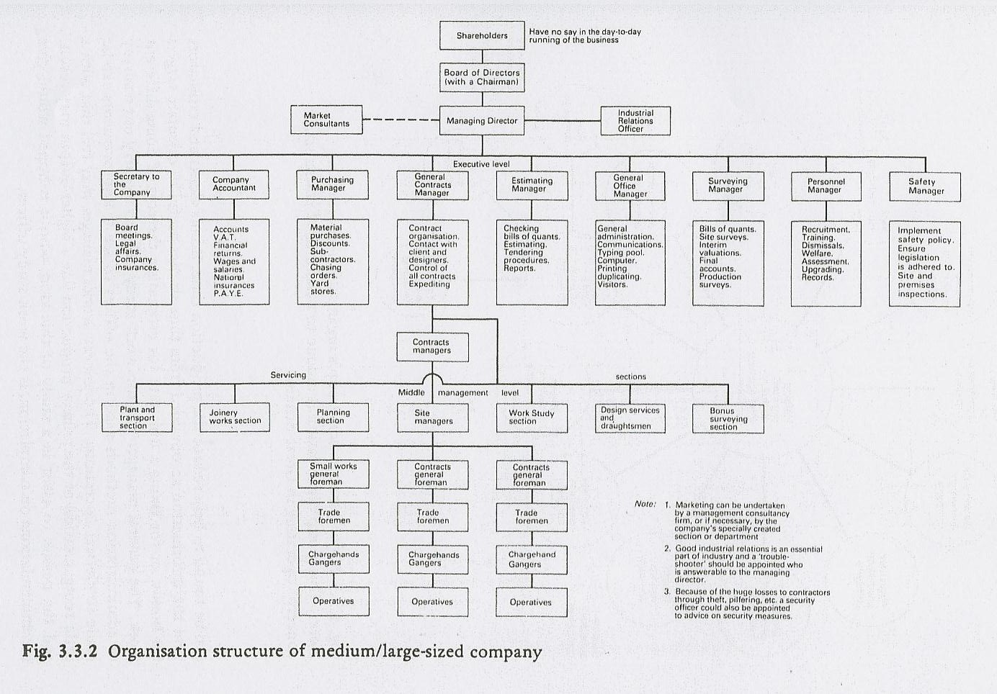
Plus ‘Security’
Plus ‘Q.A.’
Project
Manager
Quantity
Surveyor

Slide 7
Some company examples
from you….

Slide 8
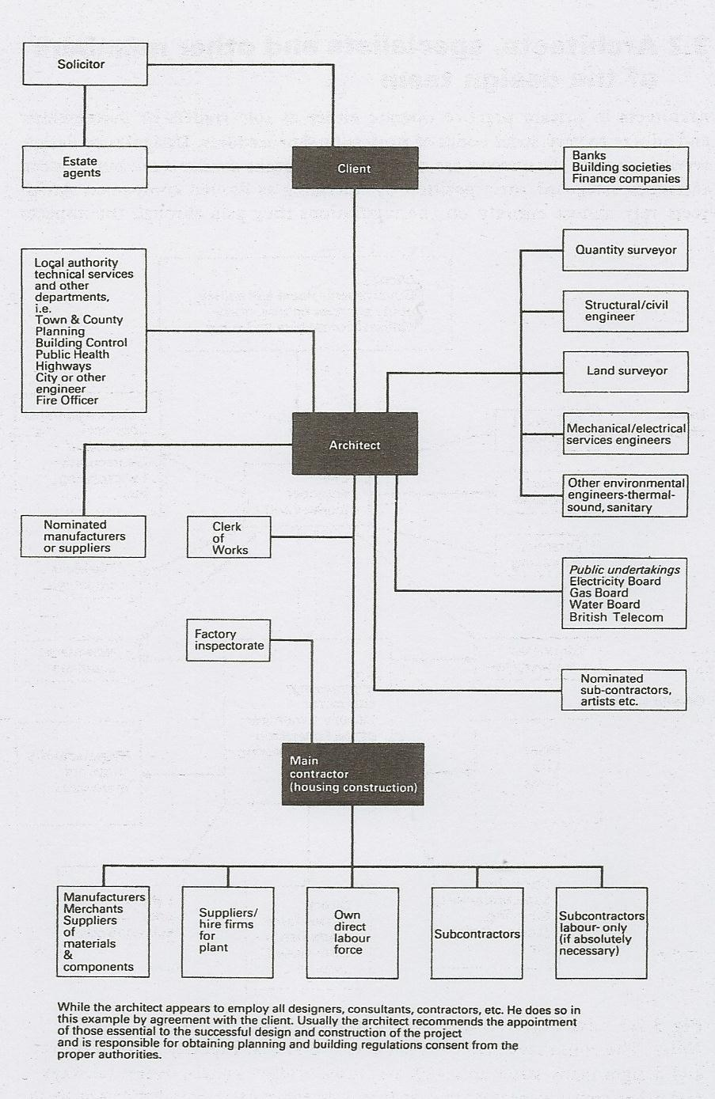
If the Client employs the services of an Architect in control of the build…
PROBLEMS?

Slide 9

The project
Defined as:
‘A unique undertaking composed of interrelated activities which has a well defined
beginning and end, often involving staff from cross-functional groups, that operates
under specific constraints of resources, schedules, times and requirements.’
Business Owner / Client
The executive customer of the project who initiates and sponsors the project, communicates the motivation of the project, and defines the project requirements on a high-level.
Project Team Members
Individual contributors to the project such as marketing specialists, Developers, Architects, Structural Engineers, Service interface specialists; these roles vary from project to project

Slide 10
PROJECT TEAM ROLE DETERMINATION EXERCISE

Slide 11
1.
Discuss the job description of the project team member assigned to your group and his/her full involvement in the project.
2.
What does your group feel are the professional and personal skills required for this particular job?

Slide 12
ARCHITECT
Job Description
1
2
3
4
5
6
7
8
Professional Skills Required
1
2
3
4
5
6
7
8
Personal Skills Required
1
2
3
4
5
6
7
8
Nominate a Group Leader ready to present your discussions to your peers

Slide 13
What are the principal stages of the development of the construction tender process to get our building built?
Sketch these in a flow diagram …start this from the decision to build by the client
10 minutes

Slide 14
YOUR FEEDBACK

Slide 15
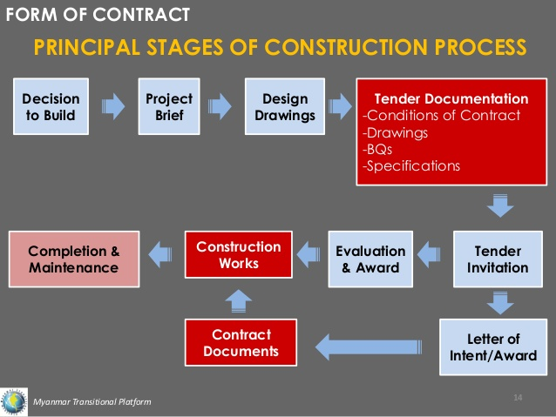
What is initiated at this stage of the process

Slide 16
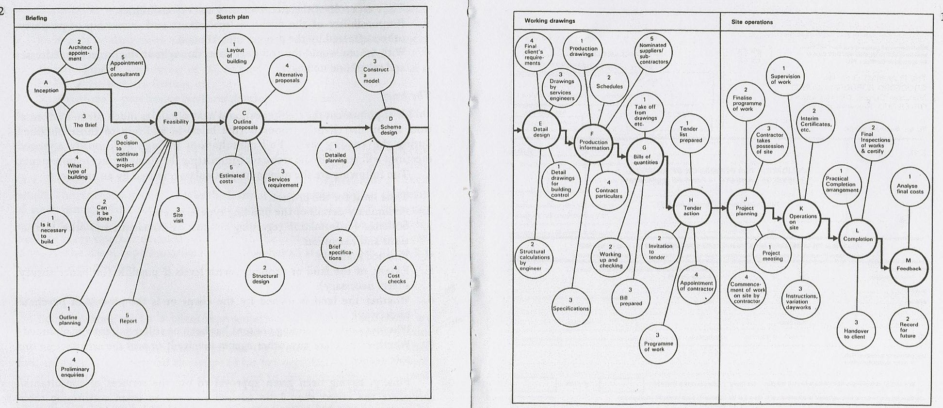
PROCESS FROM INCEPTION TO SITE OPERATION
EIA
H+sty.
Add in areas that you feel are missing from this flow diagram

Slide 17
Where do the Major Players have an input?
ARCHITECT
ENVIRONMENTAL CONSULTANT
PROJECT MANAGER
THE SITE ENGINEER
THE QUANTITY SURVEYOR
OPERATIVES
THE PLANNER
???

Slide 18
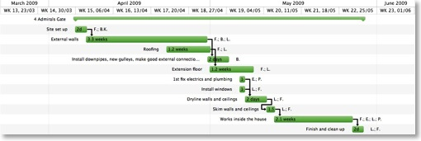
The Planner / Programmer ?
Assists the Project Manager to prepare weekly programmes of work for the main contractor and various sub-contractors, using the initial master programme as a guide.
Up-dates the master programme (bar chart and critical path) when required, to take into account 1. progress 2. time delay 3. variations.
Records and reports the various stages of work as they are completed so that progress can be monitored by the Project Manager.

Slide 19
The Architect ?
Operate as sole traders or partnerships, adhering to strict codes of professional practice.
Rely on the reputation gained through the impacts of their previous work.
Trained in all aspects of building design, they are artistically gifted ‘outside the box’ thinkers, that combine form (shape), new technologies, new materials and sustainability.
The Design of structure is so complex, advice may be sought by the Architect from a specialist Structural Engineer, who would assist with problems related to calculations of structural stability and soil bearing capacity.

Slide 20
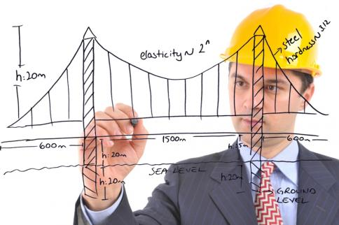
The Structural Engineer ?
Receives all structural queries and problems from the Architect.
Will advise on sizes of structural components and their orientation in the design to allow the safe transfer of loads from one member to another….. and into the foundations.
Skilled Mathematician
Generally, the stability of the
whole structure is his/her
responsibility !

Slide 21
The ENVIRONMENTAL CONSULTANT ?
Works with organisations on a range of environmental issues, offering expert advisory and assessment services to ensure that possible damaging effects are managed or eliminated.
Ensuring that the Client or employer complies with environmental regulations.
Address a variety of environmental issues such as:
Air, land and water contamination; environmental impact assessment and flood risk; waste management and recycling; renewable energy opportunities.
Advising on the suitability and sustainability of new developments, developing conceptual models and interpreting data to help ‘build out’ environmental impact.

Slide 22
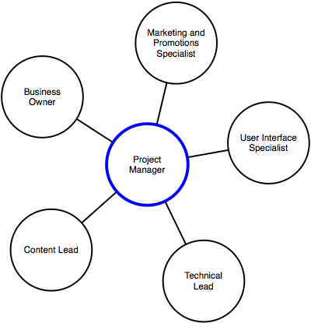
The Project
Manager ?
Is responsible for leading and coordinating the project effort from inception to its successful completion.
He is a manpower and situation manager
Control the site work in management of time, cost, quality and manpower.
Directs administration and communications.
Liaison point for Clients representatives and Contractor’s
head-office.
M+E etc.
Architect
Structural / Technical
lead

Slide 23

The Site Engineer ?
Permanently based on site operative
Takes instruction from the Project Manager.
Sets out the framework of the Build for all excavation, concrete, steelwork, brickwork and drainage ( and liaises with specialist sub-contractors (M+E.. etc.))
Assists in quality control, on site records and reporting on issues/progress.
Checks the work, levels, verticality and installation as the work proceeds.
Reports to Project Manager

Slide 24
The Quantity Surveyor ?
Is a sub-ordinate to the Project Manager, but more usually is directed by the Chief Surveyor (or Commercial Manager) at Head Office.
Measures the work done on site and agrees payment with the Client’s professional QS.
Records and prices variations to the work shown in the Bills of Quantity by the Architect, so that claims for payment may be made.
Prepares the ‘Final Account’, taking into consideration any overrun of work, which may lead to additional claim for preliminaries, price fluctuations….etc.
Records and agrees the work done monthly with the various sub-contractors.
Is responsible for the Cost-Control information reports being sent to the Head Office so that the progress can be monitored against the costs of the job.

Slide 25

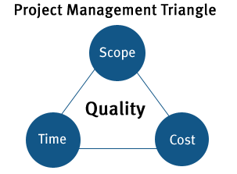
CONSIDERATIONS FOR OUR NEW PROJECT
What sort of questions need to be considered within each of these four parameters?

Slide 26

Project Management Logic
DELIVERABLES (Scope) of the project
  WHAT elements make up the total project?
  WHO will be responsible for each element?
  WHEN will each element be delivered?
  HOW will each element be delivered?
TIMING of the project
  WHEN is the deadline?
  In WHAT order do tasks need to be completed?
  WHAT needs to be done?
  Will the contract ‘run-on’
  What are the implications of this?
COST of the project
  HOW MUCH will it cost to bring this project up to that standard? This with profit added will form the Tender.
  WHAT choices cost more than others?
  Control and monitoring of costs during delivery.
QUALITY of the project
  WHAT standards must be
  met?
  WHY is that standard important?
  Delivery to the Client’s request and to required standard
Notes:
Let’s forget about our party for minute, and learn some basics of project management. You can clearly see the WHO WHAT WHERE WHEN WHY HOW incorporated into a logical plan. These are the first four ideas, but there is one more facet that we MUST acknowledge when planning a project.
Next slide

Slide 27
Why do Projects Fail?
Cost overruns
Unrealistic schedules (In time and Cost and Scope)
Does not meet expectations of the Client.
Project team is not clearly informed….communication….
Project Contract is ambiguous, and causes delay and dispute.
Project Manager has responsibility but not the authority !
Risks, that are apparent and that develop, are not properly managed
WHERE DO OUR RISKS LIE ??
10 minutes

Slide 28
Types of Risks
Other Risks : Resources, Politics, Contracts, Weather….

Slide 29
Name the various Categories of construction work and give examples of work included in each category ?
Private and Social Housing
Commercial
Industrial
Educational
Public buildings
Recreational
Utilities and services
Transport

Slide 30
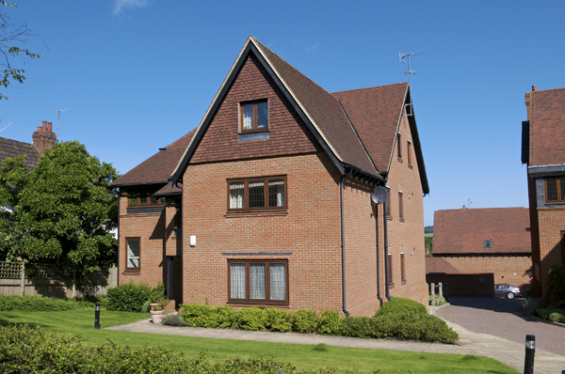
Private and Social Housing
• New Build
Green Field and Brown
Developer and Association
Existing
• Extensions
• Maintenance /
Refurbishment work
• Window replacement
• Driveways
• Energy Efficiency and
Insulation upgrades

Slide 31
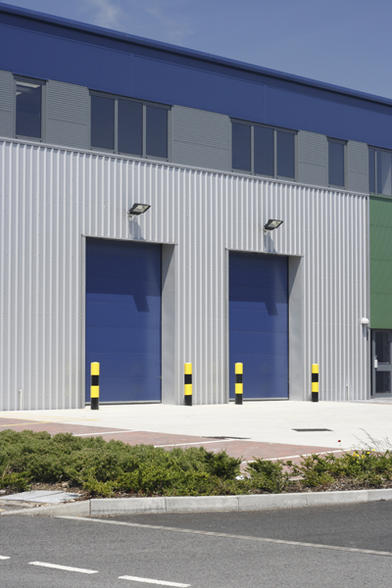
Commercial
• Factory units
• Storage facilities
• Distribution centres
• Warehouses
• Retail Outlets
• Call Centres

Slide 32

Industrial
• Power stations
• Refineries
• Processing plants
• Nuclear power
stations
• Large factories

Slide 33
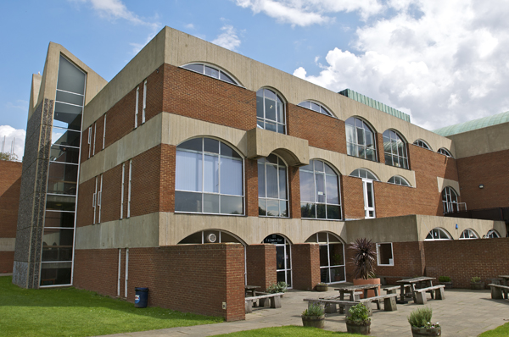
Educational
• Colleges
• Schools
• Universities
• Halls of residence
• Learning centres

Slide 34
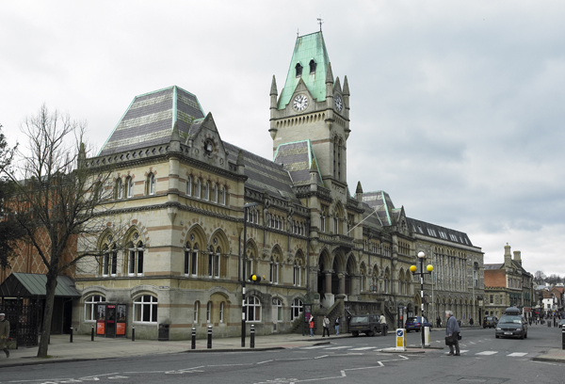
Public buildings
• Archives
• Libraries
• County Halls
• Community centres
• Hospitals
• Police / Fire stations

Slide 35
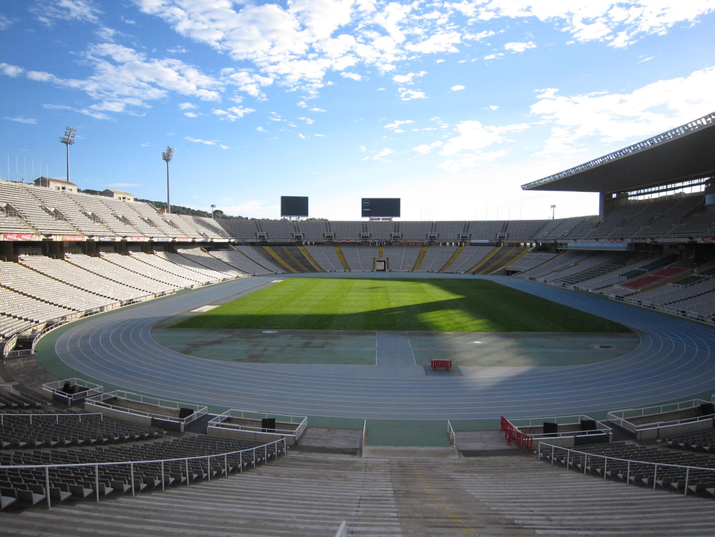
Recreational
• Sports Halls
• Running Tracks
• Stadiums

Slide 36
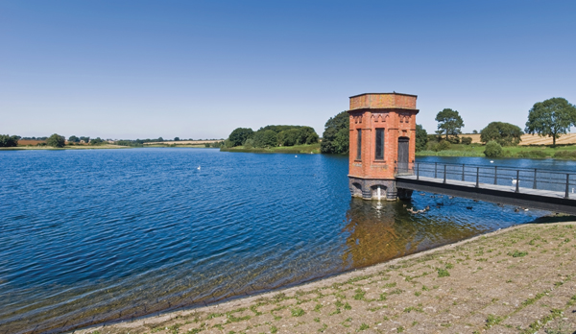
Utilities and services
• Electrical Substations
• Reservoirs
• Pumping stations
• Drainage structures
• Gas storage
• Water towers
• Dams

Slide 37

Transport
• Roads
• Rail Networks
• Tube Networks
• Airports
• Bridges

Slide 38
Possible Clients?
Central Government – and its various Ministries
National Industries – British Aerospace, (CAA) Airport and Port authorities, British Steel….etc.
Specialist Public Corporations – BBC, Water Boards…etc.
Housing Associations and their Trusts
Private Companies (PFI, PPP) (Severn Bridge)
Local Authorities – Housing, Highways etc.
Foreign Governments – Embassies and Overseas work (very lucrative!)
National Trusts

Slide 39
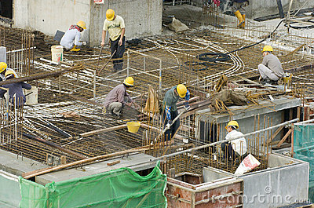
The construction industry is vital to the overall UK economy,
Construction is a major contributor to UK GDP
(directly around 8.5% in 2008, rising to around 11% overall by 2016. –
around 128 billion pounds)
It consists of 300,000 firms, including many small- and medium-sized family
and local businesses, as well as the ‘big boys’ of the industry.
It employs around 3.1 million people in a multitude of roles representing 9% of all UK employment
A significant proportion of construction
employees (60%) are labourers with
short term employment
opportunities with a specific
company – Agency Work

Slide 40

UK government investment has played an important role in growing the UK’s capital stock
Government investment in construction has historically focused on infrastructure, education, housing and health.
The UK had suffered from a more pronounced decline in construction
activity since the onset of the recession (2008-20012)
The impact on the construction sector was apparent through sharp
increases in company closures...
(there was an increase of over 40% between Q4 2008 and Q1 2009)
Individual bankruptcies and redundancies also increased...
(around 35% in bankruptcies between Q4 2008 and Q1 2009)
and a redundancy rate of 28 per 1,000
employees in Q1 2009
Q1 of 2012 employment drops to 2.2 M
– the highest amongst UK industries

Slide 41
Construction is one of the best ways of stimulating economic activity
Government investment in construction has historically focused on infrastructure, education, housing and health.
In the short term, construction is one of the most effective sectors in which the government could invest to stimulate economic activity.
£1 spent on construction output generates a total of around £3 in total economic activity.
Changing by what influences on the Industry ??

Slide 42


The UK construction industry today
The sector is dominated by high levels of self employment, with small and micro businesses accounting for around 75% of the sector, although large companies conduct a disproportionate proportion of the work by value.
The global construction market is forecast to grow by over 70% by 2025, with positive signs of growth for the industry in the UK.
A key challenge for the sector is to maintain its supply of engineering skills in areas of innovative sustainable Architecture and Construction Management, especially during periods of weak demand.
Notes:
Sources
Bullet one: www.gov.uk/government/uploads/system/uploads/attachment_data/file/229339/construction-sector-infographic.pdf
Bullet two: Gambin, L. et al. (2012) Sector Skills Insights: Construction. Evidence Report 50. UKCES, London. Breuer, Z (2012) Sector Skills Assessment: Construction, Building Services, Engineering and Planning. Evidence Report 65. UKCES, London.
Bullet three: HM Government (2013) Construction 2025 Industrial Strategy: government and industry in partnership. H M Government, London.

Slide 43
Technology in the construction industry ?
Technological change and the drive towards sustainable and low-carbon construction impacts on skills needs within the industry. High level skills will be needed to drive the development and use of innovative methods of building and the uptake of new technologies and materials.
Modern methods of construction have the potential to introduce greater efficiencies into the construction process, chiefly through innovations in building design and management – for example in adoption of Building Information Modelling (BIM) – and in offsite construction processes.
This presents a major opportunity to build quicker, to a higher quality, more sustainably, foster innovation and compete on the global market.
MMC and the implementation of low carbon systems will require new skills and the adaption and upgrading of the skills of people currently working in the sector.
Notes:
BIM Modelling is in its essence a coordinated set of processes that are supported by technology. Underpinned by ever evolving technology, BIM adds value to the entire life cycle of the construction process by creating, managing and sharing all of the critical elements that make up the design and construction progression from beginning to end. BIM incorporates data that is physical, commercial, environmental, and operational on every element of a development.

Slide 44
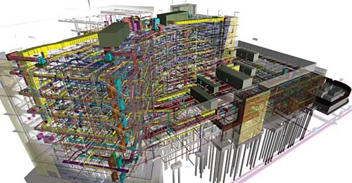
Building Information Modelling
BIM Modelling is in its essence a coordinated set of processes that are supported by new technology.
Underpinned by ever evolving technology, BIM adds value to the entire life cycle of the construction process by creating, managing and sharing all of the critical elements that make up the design and construction progression from beginning to end.
It incorporates data that is physical, commercial, environmental, and operational on every element of a development.
Public sector centrally procured construction projects will all eventually be delivered using BIM

Slide 45
KEY Skills REQUIRED FOR THE FUTURE
Core skills, knowledge and behaviours
Knowledge, mutual understanding and collaboration
Greater focus in future on a knowledge economy and increased interaction between Architecture, design, construction, engineering and environmental disciplines.
Marketing and business case development
Increasing importance of ‘selling’ the concept of new design requiring skills in negotiation and influencing, and technical understanding of the new technologies.
Project management
Management expertise of the interface between offsite and onsite, requiring skills in timing, sequencing and scheduling, costs , quality and man-management.
Information technology
Planning and design
A whole life approach
Developing the use of new technologies. (BIM requires well developed IT skills)
Requiring skills in phasing of the building and the environmental process: development, production, utilisation and disposal, all handled sustainably.
Designing to consider repair and maintenance requirements (such as air tightness) for the whole life cycle of the building, particularly critical to maintain energy efficiency.
Knowledge of CAD and automated tools for engineers.
Notes:
Onsite skills requirements are very different from conventional construction.

Slide 46



Future higher level job roles
Greatest impact for the need for specialists is expected for:
Design office staff, including BIM modellers and CAD specialists
Architects – with innovative new ideas
Environmental – Eco and Sustainability specialists
Engineers – with specialist engineering skills
Project managers – with Time / Cost / Logistic
management skills
Quantity Surveyors – to monitor finance
Planners and Schedulers – Logistic flow specialist

Slide 47
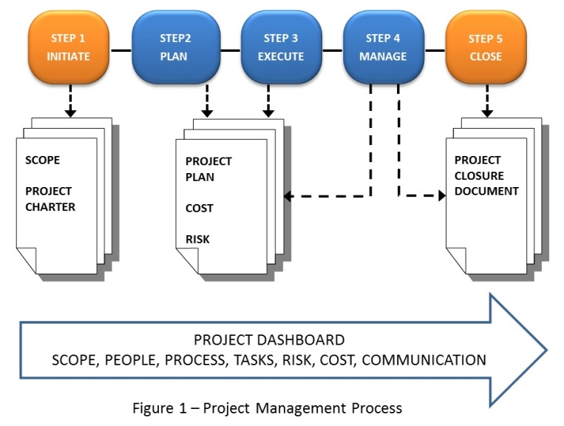
5 Project Steps
Project Management Logic
INITIATE
Establish requirements, goals & objectives
Establish Critical Success Factors & business case
Get approval
PLAN
Break down project into phases
Break down work
Develop a schedule & management
plans
EXECUTE
On approval of the plan, begin work
Acquire project team
Distribute work
MANAGE
Monitor your progress against the plan
Use the project dashboards to monitor
work, costs & risks
CLOSE
Transition to operations and close
Have you completed the plan as was requested?
Was the Business case of the project met?

Slide 48
THE DRIVERS OF CHANGE
Technological factors
Organisational factors
Economic factors
Governmental influences
Societal/cultural influences
Clients have changed!
Many overlaps and interactions

Slide 49
Technological Change
The industry and its buildings ?
Structure and fabric – since mid 19th C
Building services – especially last 50 years
Construction methods – mechanisation, industrialisation
Green buildings and SMART buildings
Society and industry generally?
Information technology – media, new approaches
Diverse Manufacturing, business processes etc.

Slide 50
Organisational Change
Increasing specialisation
Driven by technology and scientific breakthroughs,
changing business’s strategy, bringing new legislation
Less Separation of function
Especially design from construction
The professional “hierarchy” now more linked in
communication and co-operation

Slide 51
Economic factors
The importance of the industry
11% of all UK economic activity, >£ 130 billion p.a.
Representing 9% of UK employment
The economic cycle – “boom and bust”
Why construction suffers more and for longer
The industry as economic regulation
General economic controls affect industry hard

Slide 52
Governmental Influences
Control of economy
Infrastructure, education, housing, health
As client of the industry
Approx. 25% of output is commissioned by public sector
Changes in procurement methods – PPP & PFI
Legislation & taxation
Direct impact - Planning, building and environmental
regulations, safety - Pulling down the castle ?!
Indirect impact - Tax concessions, development areas etc…

Slide 53
Societal Influences
Greater influence of general public ?
Less accepting of “authority” – government, professions…
Environmental consciousness – protest, “NIMBY’s”
Broader cultural influences
Changing population, easier world travel, globalisation.
Entrepreneurial attitudes
Have varied with time
Increase in small businesses since late 70’s

Slide 54
Changing clients
Growth of the corporate client
Compare 19th C importance of individual & sole trader
Globalisation
Changing market for business & clients they generate
Business priorities
Increasing concentration on time & cost performance to
maximise profits….especially in inner cities.
Less tolerant of failings – more litigations
(contractual court cases)
Transfer of management methods
Project management, procurement of labour and materials
methods

Slide 55
The UK Housing Market
Globalisation, Pricing and the changing
Client in the inner city
https://www.youtube.com/watch?v=dINbQGgVEN8
20 minutes

