Slide 1
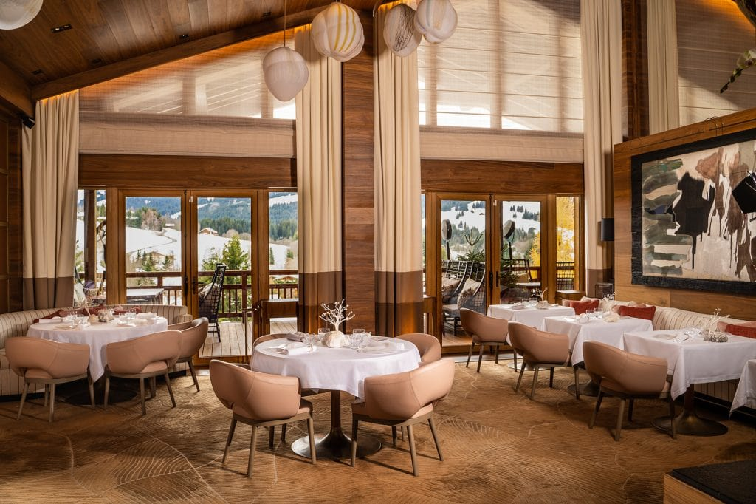
Module code/title: MG413 Data insights for business Decisions
Module title: Hospitality and Guest service
Module leader: Charlotte Joyner
Student Name and ID:Nicoleta Aurelia Monafu 2245344
Group Name:BMIH4003

Slide 2
Introduction
Hospitality and guest service are essential part of the tourism and hospitality management sector and it is related to restaurant industry development. Refreshment Bite Restaurant is a newly arrived restaurant in London that wants to improve business in this sector (Bagdan et al. 2019). The presentation is a discussion about Refreshment Bite Restaurant's development in the business sector and its related issues such as mission, warm welcoming message, staff training, personalized service, menu assistance, guest feedback, technology, sustainability, and so on.

Slide 3

Mission of Refreshment Bite Restaurant
Providing essential guest services
Promoting culture.
Committed to guest expectations
Promote a culture of warming and belonging
Notes:
There are some sets of the missions of Refreshment Bite Restaurant such as providing essential guest service which helps to make satisfied of the customers (Walker et al. 2021). Promoting cultural activities to travelers and tourists to increase curiosity about the organization. To maintain the commitment of the guest's expectations and demands. And promote cultural activities that help to improve warming and belonging in the restaurant business

Slide 4

Welcoming atmosphere of Refreshment Restaurant
Décor, ambiance, and lighting atmosphere
Comfortable seating,
Natural materials and ingredients
Smoothing background music
Notes:
Refreshment Bite is well-decorated, with ambiance, and a good lighting atmosphere for attracting customers. It also provides comfortable seating according to the demand for services (Solnet et al. 2019). It maintains natural ingredients to provide an authentic vibe. It uses smooth background music for the improvement of mental health.

Slide 5

Staff training of Refreshment Bite
Training and development programs
Maintain regular feedback and evaluation
Maintaining communication and collaboration.
Providing excellence services
Notes:
Refreshment Bite arranges staff training to provide effective services to the customers such as it uses training and development programs for increasing knowledge and experience in restaurant management. It helps in maintaining regular feedback and evaluation according to the customer's expectations (Naumov, 2019). The staff communicates and collaborates about the improvement of excellent services.

Slide 6

Personalized service of Refreshment Bite
Emphasize the commitment to personal service.
Showcase of guest database.
Discussing and remember guest
Showing respect for every guest
Notes:
The organization is exceptional because it provides personalized service to the customers. It emphasizes the commitment to personal service and it showcases the guest database which attracts the customers (Neuhofer et al. 2015). It is to tell and discuss past guests who enjoyed their service to the present guests. And it shows respect personally for every guest who takes services from the organization.

Slide 7
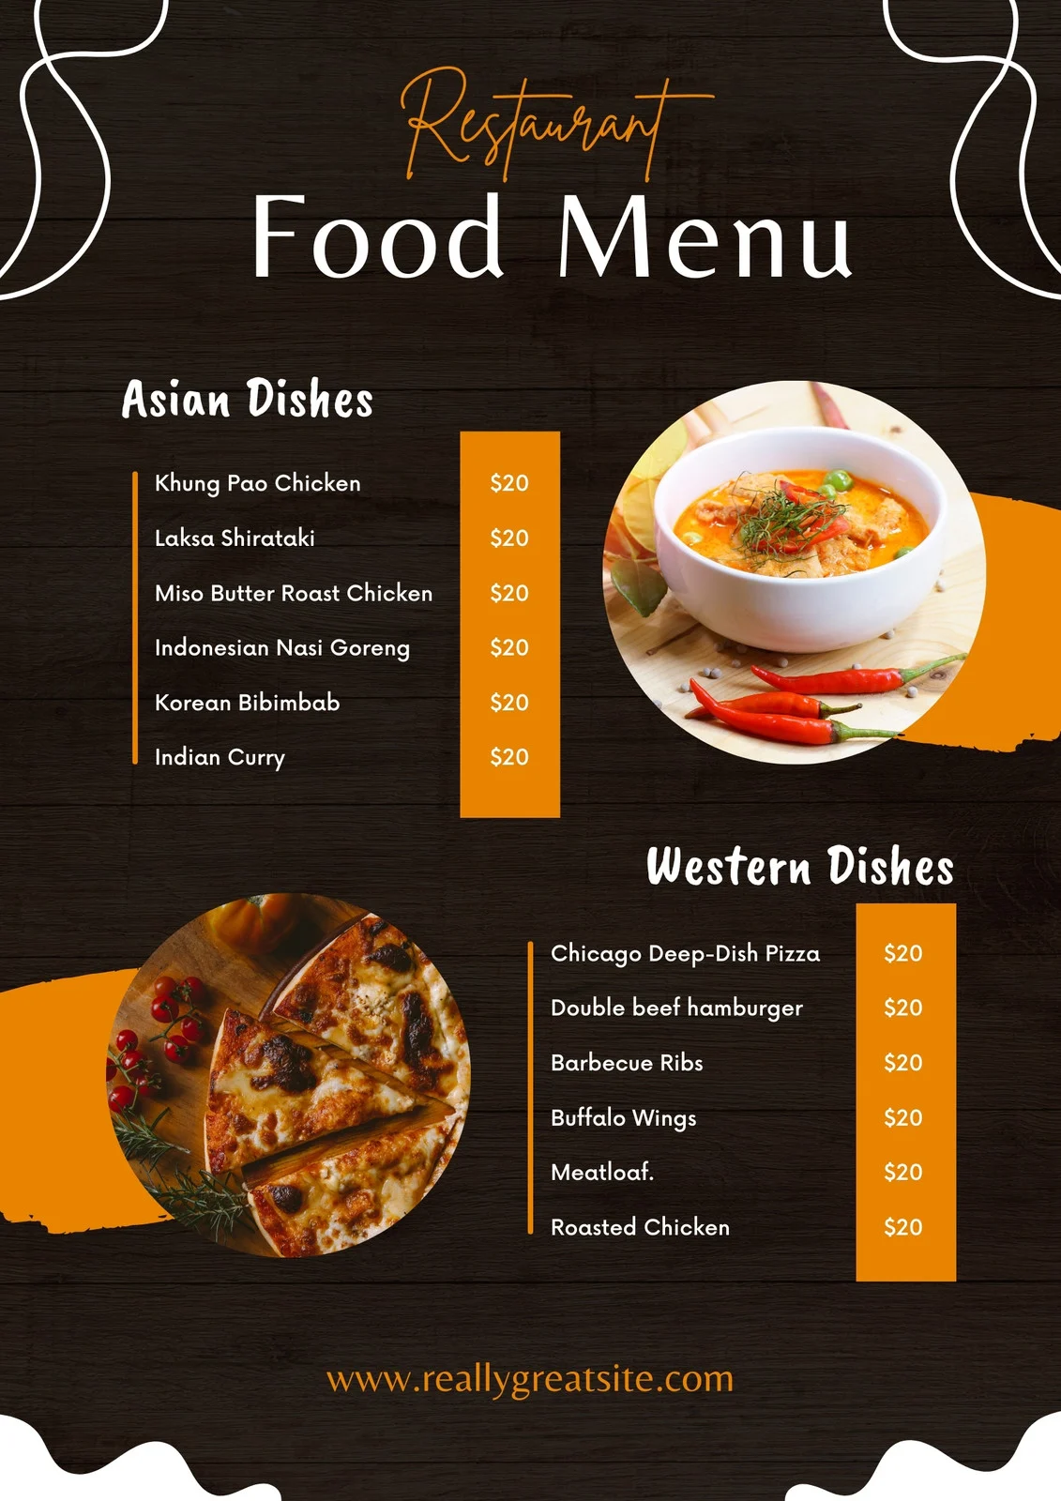
Menu assistance of Refreshment Bite
Explaining menu to the guest
Maintaining knowledge about menu.
Know about the tastes of the variant of the menu.
Recommended menu items.
Notes:
Refreshment Bite sets a lot of menu assistance to explain menu items to the guest (Dzhandzhugazova et al. 2016). The menu assistant has knowledge and experience about menu items. He knows every variant of the menu and he recommends the menu to the customers according to their demands.

Slide 8

Guest feedback of Refreshment Bite
Highlighting the guest feedback to others
Continuous improvement following commitment
Maintain feedback cards, online reviews, and social media interactions
Guest feedback led to positive change.
Notes:
Refreshment Bite Restaurant maintains proper guest feedback to highlight others. It helps to continuous improvement of the organization (Golubovskaya et al. 2017). This is why the organization maintains feedback cards, online reviews, and social media interactions to achieve its goals. The guest feedback led to positive change in the organization which is essential for development.

Slide 9

Technology integration of Refreshment Bite
Explain the technology used
Discussing about mobile app and website.
Online order receiving.
Mention loyalty programs
Notes:
Technology is essential for making the service effectiveness of Refreshment Bite Restaurant. This is why there needs to be an explanation of the technologies which are used by the organization (Pham et al. 2020). The staff discusses the mobile app and website to give orders from home. It also arranges loyalty programs for sharing information about the organization to achieve the marketing goals.

Slide 10

Sustainability of Refreshment Bite
Describing sustainability effort and commitment
Details sourcing of local and organic ingredients.
Describing partners and community
Eco-friendly activities.
Waste maintaining.
Notes:
Sustainability is another essential thing for the restaurant industry. This is why Refreshment Bite maintains sustainability rules such as it describes the sustainability effort and commitment to the customers for increasing awareness (Lashley et al. 2015). It maintains foods by sourcing local and organic ingredients. It provides information about partners and the community. It maintains eco-friendly activities and waste for an effective atmosphere.

Slide 11
Conclusion
Hospitality and guest service of Refreshment Bite Restaurant is essential for providing a message to other organizations that there needs to be careful and effective management of the organization which helps to improve the reputation of a country, organization, or region. On the other hand, people can get accurate service from the restaurant which makes the travelers and tourists attractive for taking service. In this way, the hospitality and guest service management sector or tourism and hospitality management sector can develop like Refreshment Bite Restaurant.

Slide 12
Reference
Bagdan, P., (2019). Guest service in the hospitality industry. Kendall Hunt Publishing Company.
Dzhandzhugazova, E.A., Blinova, E.A., Orlova, L.N. and Romanova, M.M., (2016). Innovations in hospitality industry. International Journal of Environmental and Science Education, 11(17), pp.10387-10400.
Golubovskaya, M., Robinson, R.N. and Solnet, D., (2017). The meaning of hospitality: do employees understand?. International Journal of Contemporary Hospitality Management, 29(5), pp.1282-1304.
Lashley, C., (2015). Hospitality and hospitableness. Research in hospitality Management, 5(1), pp.1-7.
Naumov, N., (2019). The impact of robots, artificial intelligence, and service automation on service quality and service experience in hospitality. In Robots, artificial intelligence, and service automation in travel, tourism and hospitality (pp. 123-133). emerald publishing limited.
Neuhofer, B., Buhalis, D. and Ladkin, A., (2015). Smart technologies for personalized experiences: a case study in the hospitality domain. Electronic Markets, 25, pp.243-254.
Pham, Q.V., Fang, F., Ha, V.N., Piran, M.J., Le, M., Le, L.B., Hwang, W.J. and Ding, Z., (2020). A survey of multi-access edge computing in 5G and beyond: Fundamentals, technology integration, and state-of-the-art. IEEE access, 8, pp.116974-117017.
Solnet, D., Subramony, M., Ford, R.C., Golubovskaya, M., Kang, H.J. and Hancer, M., (2019). Leveraging human touch in service interactions: lessons from hospitality. Journal of Service Management, 30(3), pp.392-409.
Walker, J.R., (2021). Introduction to hospitality. Pearson.

Slide 13


