Slide 1

THE
DRAMA
TRIANGLE

Slide 2

Application of counselling skills and reflexive practice
Have you ever walked away from an argument and suddenly thought of all the brilliant things you wish you'd said?
Then it’s time to consider your ‘self’ in times of disagreement

Slide 3
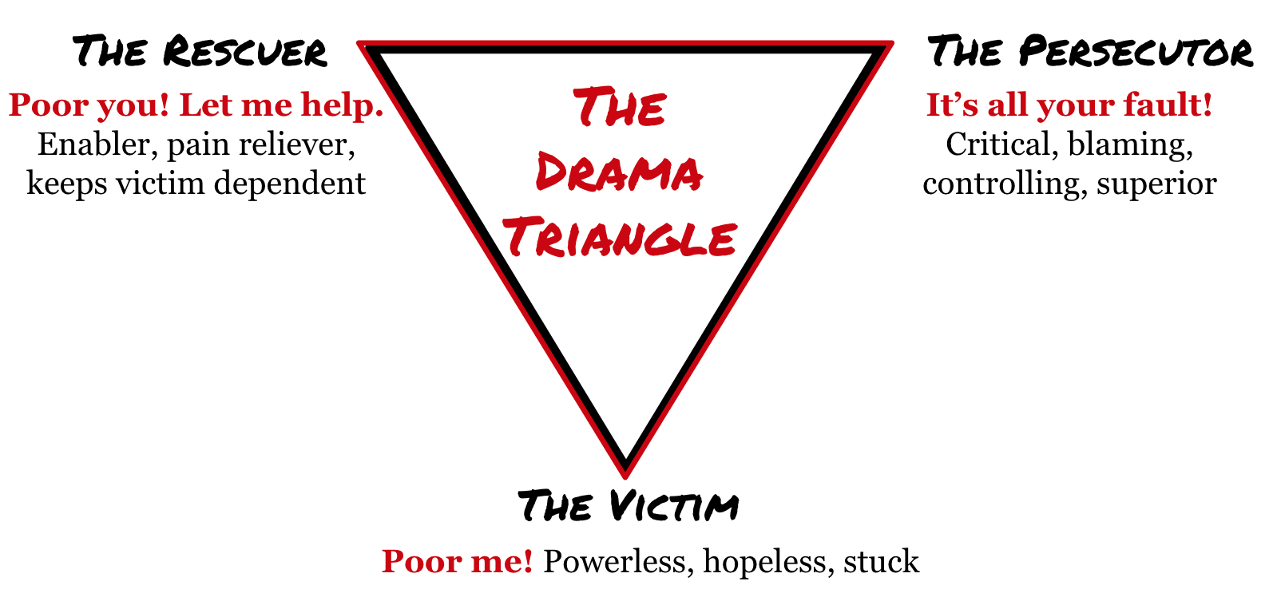
let’s look at ‘The Drama Triangle’
You will have learnt from the lessons on Transactional Analysis, that the Drama Triangle is a model to help us understand how conflict arises between people in dramatic or intense relationships or interactions. It was conceived by Steven Karpman in 1968 and it involves three different roles - the victim, the rescuer and the persecutor.

Slide 4
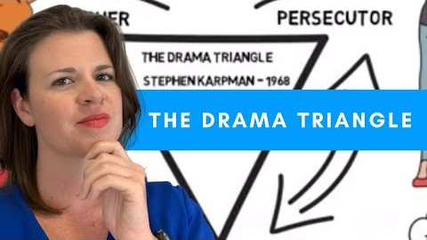
Watch the following video 'The Drama Triangle’ [5.33 minutes] and make notes on the different roles.

Slide 5
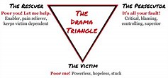
Consider the roles of the Drama Triangle
Think of an example when you’ve played out one of this roles and reflect on the experience of working through this.

