Slide 1

Hospitality management
Acqualina resort and residences.

Slide 2

Hello I am here today to train you in Hospitality Management.
Georgina miller.

Slide 3

Introducing hospitality.
Key statistics Scope of the hospitality industry

Slide 4
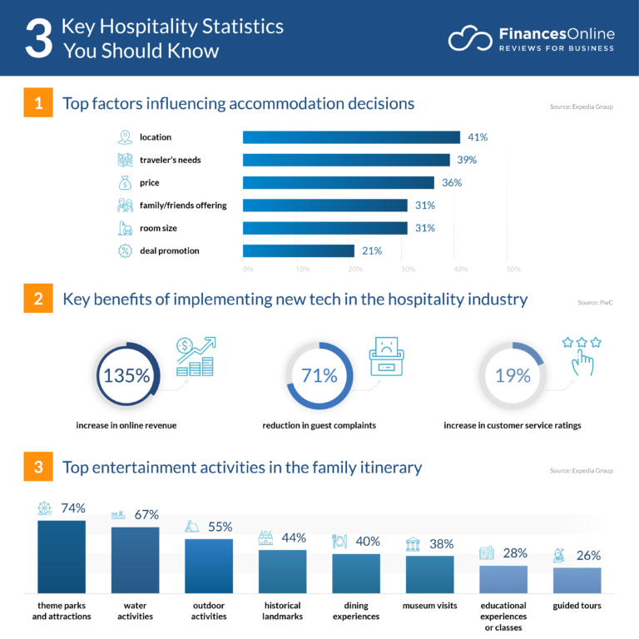
Key statistics

Slide 5




Accommodations & lodging
Hotels
Resorts
Motels
Airbnb?/HomeAway
Campgrounds/cabins
Recreation & entertainment management
Expositions
Meetings
Socials & special events
Conventions & event
Theme parks
Gaming
Adventure & outdoor
Recreation
Travel services
Eco tourism
Travel agents/OTA’S
Rail/Bus
Car
Cruise ships
Airlines

Slide 6
Key considerations Hotel business plan
Proximity
Potential customers
Customer type
Competitors
Tourists, business traveller's
Local up through international guests
Many hotels but only one with conferencing equal capacity
Visibility
From road
Appeal of exterior
Landscaping
Easy to see, signs with logo will be visible
Landscape area surrounding the hotel
Accessibility
close to major streets
Near main shopping centres
Open doors, easy to walk in
Easy entrance/exit
Traffic volume
Situations
Pedestrians
Periods
Patterns
Large intersection nearby
Easy access to main road
Low pedestrian area

