Slide 1
Creativity and Value Creation
Creadigrwydd a Chreu Gwerth
Level / Lefel 5
Research Methods / Dulliau Ymchwil
Kate Piper
Introduction and Experiences

Slide 2
Amlinelliad o'r sesiwn / Outline of the session
Literature Review Development
Example
Individual Task: Sources to show importance
Partner task: Discuss the importance of your hot topic
Recap: Quantitative and/or Qualitative methodology reasons
Datblygiad Adolygiad LLyfryddiaeth
Enghraifft
Tasg Unigol : Ffynonnellau i dangos pwysigrwydd
Tasg partner: Trafod pwysigrwydd eich pwnc llosg
Adolygu: Dulliau Meintiol ac/neu dulliau Ansoddol

Slide 3
Building the Rationale
Background and context: Why is it important/ interesting?
Literature review: what does the literature already tell us about the topic? Key findings? Further research suggested? Or gaps that you have identified? Why are these gaps important to consider further?
Cefndir a chynnwys : Pam mae e’n bwysig / diddorol?
Adolygiad llyfryddiaeth : beth mae’r llyfryddiaeth yn dweud wrthym yn barod am y maes o dan sylw? Beth ydy’r canfyddiadau allweddol? Cynnig ymchwil pellach sydd angen? Neu bylchau rydych wedi penodi? Pam mae’r bylchau yma’n bwysig i ystyried ymhellach?

Slide 4
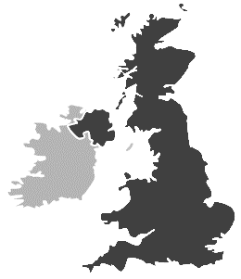

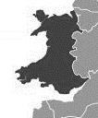
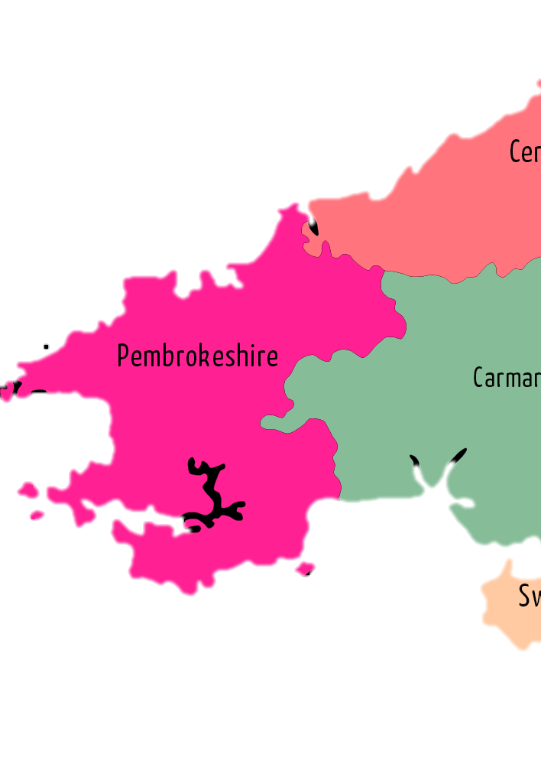



Importance and setting context/background
UK
Mass participation sports events around the UK are seeing record numbers of participants/ applicants (London Marathon, 2019; Fuller, 2017).
More memberships, permitted events and participants across the UK (British Triathlon, 2018).
7,500 places for Cardiff half marathon 2019 sold in the first 24hours of registration (Cardiff Half Marathon, 2018).
Number of permitted events has seen the same rise in Wales (Welsh Triathlon, 2018)
WALES
LCW has seen huge increases of all races across the weekend (Activity Wales Events, 2018)
191 Pembrokeshire athletes in 2014 Ironman Wales (Ironman, 2014)
PEMBROKESHIRE
Notes:
Anecdotally, Pembrokeshire has a huge number of people participating in mass participation sports events (such as triathlon, marathons,
These events have seen a huge rises across the UK in the last decade.
۞
British triathlon has seen an 86% increase of race starts since 2009.
۞۞
Wales has also seen similar growth in events numbers and starters. For example, the 2020 Cardiff half sold out in record time, however the race was cancelled due to the pandemic. ۞ The most recent ‘sport and active lifestyles -state of the nation report’ identified these types of sport as some of the most common activities for the welsh population. ۞
۞۞
Most importantly for this study Pembrokeshire has seen some extremely interesting growth especially for a rural community. This number from Ironman shows an average of 180 ironman athletes per 100,000 population. The UK average is 11 Ironman athletes per 100,000 population. Data received from the operations director, Rachel Jackson in 2019, identified 791 Pembrokeshire athletes registered for ironman events from 2012 to 2019. Using this data the county now boasts 632 ironman athletes per 100,000 population in addition to many hundreds of local people who take part in smaller scale events in the area.

Slide 5
What does the literature say about these events?
Motivation
Of athletes (Bennett et al., 2017; Funk et al., 2011; Coleman and Sebire, 2016)
Between types of events (Dopplemayr and Molkenthin, 2014; Bunning and Walker, 2016)
Differences between elite and non-elite athletes (Croft et al., 1999; LaChausse, 2006)
Gender focuses (Smith, 2010; Crofts et al., 2012)
Various motivations and goal choices
Many determinants around participation
Potential public health benefit
Notes:
As expected, within the last decade the literature and research covering these type of events have seen the same rise in interest.
Although research around MPSE have covered several areas including nutritional issues, injury concerns, performance levels and tourism interests.
Motivation has been the most common subject in the field of mass participation sports events.
However the findings have been complex,
Various motivations and goal choices have been linked to participation in events (triathlon and single discipline events being the most common)
Health benefits and personal goals often the most common, but competition and social reasons also scoring high across participants.
There are many determinants around participation and varying reasons for first time participants –such as new challenges, social, health and fitness improvements. These seem to change and develop as the athletes continue to take part and make lifestyle changes.
Finally, Funk et al., 2011 ( one of the most widely cited articles in the context of MPSE) discussed the motivation of first-timers suggesting the public health benefits of these events. Similarly, Coleman (2016) and Bennett et al (2017) made similar statements but all say more research is needed.

Slide 6
Beth mae’r llyfryddiaeth yn dweud am y digwyddiadau yma?
Cymhelliant
O’r athletwyr (Bennett et al., 2017; Funk et al., 2011; Coleman and Sebire, 2016)
Rhwng gwahanol mathau o ddigwyddiadau (Dopplemayr and Molkenthin, 2014; Bunning and Walker, 2016)
Gwahaniaethau rhwng athletwyr elitaidd a rhai sydd ddim yn elitaidd (Croft et al., 1999; LaChausse, 2006)
Ffocws rhyw (benywaidd a gwrywaidd) (Smith, 2010; Crofts et al., 2012)
Cymhelliant amrywiol a dewis uchelgeisiau
Sawl ffactor yn
dylanwadu cyfranogiad
Mantais i cyhoedd o ran iechyd
Notes:
As expected, within the last decade the literature and research covering these type of events have seen the same rise in interest.
Although research around MPSE have covered several areas including nutritional issues, injury concerns, performance levels and tourism interests.
Motivation has been the most common subject in the field of mass participation sports events.
However the findings have been complex,
Various motivations and goal choices have been linked to participation in events (triathlon and single discipline events being the most common)
Health benefits and personal goals often the most common, but competition and social reasons also scoring high across participants.
There are many determinants around participation and varying reasons for first time participants –such as new challenges, social, health and fitness improvements. These seem to change and develop as the athletes continue to take part and make lifestyle changes.
Finally, Funk et al., 2011 ( one of the most widely cited articles in the context of MPSE) discussed the motivation of first-timers suggesting the public health benefits of these events. Similarly, Coleman (2016) and Bennett et al (2017) made similar statements but all say more research is needed.

Slide 7
Why is the study needed?
Findings, gaps and limitations from literature
Anecdotal evidence from Pembrokeshire
Focus on the MPSE culture in Pembrokeshire
A different research perspective is needed
Create a wider picture of successful MPSE culture
Different focus on lifestyle changes and improved exercise behaviours
Focus in Wales
Notes:
These findings show that the literature at present is narrow and the research designs have limitations that do not take into consideration the complexity of individual or community collective experiences.
For example, with MPSE and public health benefits
Several studies have collected data from around the time of the event and up to three months after, although this shows drop-off or sustained physical activity levels it does not show lifestyle changes of these individuals.
Findings from Funk and colleagues also found participants in longer races such as half and full marathons “were more likely already exceeding the threshold for physical activity to receive health benefits… and already possess strong attitudes towards exercise”.
These findings (potentially due to the research design limitations) are just snap shots in time and capturing the athletes at the events does not tell the full story or show the big picture.
Therefore, a different perspective is needed that focuses not only on the individual but environments that surround and influence them. This will give a better understanding of the culture and phenomenon happening around these events in Pembrokeshire.

Slide 8
Pam mae angen yr astudiaeth?
Canfyddiadau, bylchau a rhwystrau o’r llyfryddiaeth
Tystiolaeth storïol ‘anecdotal’ o Sir Benfro
Ffocws ar y MPSE diwylliant yn Sir Benfro
Angen perbectif gwahanol i’r ymchwil
Creu llun ehangach o ddiwylliant llwyddiannus MPSE
Ffocws gwahanol - newid mewn ffordd o fyw a gwelliannau yn ymddygiad tuag at ymarfer corff
Ffocws yng Nhymru
Notes:
These findings show that the literature at present is narrow and the research designs have limitations that do not take into consideration the complexity of individual or community collective experiences.
For example, with MPSE and public health benefits
Several studies have collected data from around the time of the event and up to three months after, although this shows drop-off or sustained physical activity levels it does not show lifestyle changes of these individuals.
Findings from Funk and colleagues also found participants in longer races such as half and full marathons “were more likely already exceeding the threshold for physical activity to receive health benefits… and already possess strong attitudes towards exercise”.
These findings (potentially due to the research design limitations) are just snap shots in time and capturing the athletes at the events does not tell the full story or show the big picture.
Therefore, a different perspective is needed that focuses not only on the individual but environments that surround and influence them. This will give a better understanding of the culture and phenomenon happening around these events in Pembrokeshire.

Slide 9
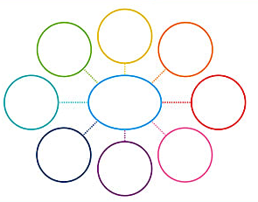
Planning your assessment
Cynllunio eich asesiad
Starting a BASIC plan
What do you already know about the topic? How do you know it?
What do you need to know about the topic?
Key inclusion criteria (demographics/ special populations etc)
  Your interests
  Public literature
  Research
  Specific topic and issues
  Directed by outside bodies / organisations
Think about clear searches
Notes:
Identify NO MORE than 3 key topics that will help you explain your hot topic. Spider diagram
Example: School support of mental health in adolescence
Mental health and adolescence (teenagers/ secondary schools) (facts, information, key ideas) School support (role of the school, very brief on outside of schools support, areas of school – curriculum; school additional support; wellbeing services within the school. Combined (what is happening at the moment – literature)

Slide 10
Task: Individual and Partner
Explain why your Hot Topic is important
Where do you find sources to help this argument?
15 mins – Prepare your argument
5 mins – explain to a partner
Partner task: What are the big take home messages? You are going to explain your partners HT to the group (less than 3mins).
Eglurwch pam mae'ch Pwnc Llosg yn bwysig
Ble dewch o hyd i lyfryddiaeth i gefnogi'r dadl?
15munud – paratoi dadl
5munud - egluro i bartner
Tasg partner : beth ydy'r negeseion mwyaf? Rydych yn mynd i egluro pwnc llosg eich partner i bawb (yn llai na 3munud).
Notes:
Give 5 mins for the person to make notes on confusion, understanding, anything else they have to add.

Slide 11
Task/Tasg: Individual / Unigol
Identify Consider the literature / Adnabod y llyfryddiaeth
Build your rationale / Adeiladu eich rhesymeg
What do you know? How do you know it?
Beth i chi'n gwybod? Sut i chi'n gwybod hyn?
Summarise each papers / Crynhoi pob papur
↓
Patterns between the papers / Patrymau rhwng y papurau
↓
Summarise your key point / Crynhoi prif bwyntiau
Notes:
Summarise each paper – what did they find/ were there any issues with the study/ anything else to take away
Next slide my help?
Patterns between the papers – Similarities or answers to further research questions, differences in methods but both support conclusions, further conclusions.
Summarise your key points

Slide 12


Slide 13
Task/Tasg: Pair / Pâr
Share with partner / Rhannwch gyda Phartner
What do you know? How do you know it?
Beth i chi'n gwybod? Sut i chi'n gwybod hyn?
Summarise each papers / Crynhoi pob papur
↓
Patterns between the papers /Patrymau rhwng y papurau
↓
Summarise your key point / Crynhoi prif bwyntiau

Slide 14
Planning your assessment
Cynllunio eich asesiad
Starting a BASIC plan
What do you already know about the topic? How do you know it?
What do you need to know about the topic?
Key inclusion criteria (demographics/ special populations etc)
Framing your final thoughts
Gaps
Critical Questions
Changing the perspectives
Think about clear searches
Notes:
Framing your own thoughts – Gaps (further research needed – guided by literature) Critical Questions (things you have thought while reading – teachers’ perspectives? Age ranges, gender differences, duration of intervention) Changing the perspectives (lots of quantitative but what about why or how?/ adding a topic (strength based intervention but what about motivation levels?)

Slide 15
Introduction for proposed study
Where your question has come from & Why?
Use relevant and appropriate evidence / literature to justify
What do you hope to fine out?
How is this information useful?

Slide 16
Rationale points
Is it clear why your project needs to be carried out?
Is it evident why it is important / will add to current research?
Who will the results of each study be useful for?
Can you think of anyone else who has not been considered that the results may be useful for?

Slide 17
Sut mae faint o amser treuliwyd ar Instagram yn perthyn i hunan-fry plentyn sy'n ei harddegau.
Pa bethau sy'n achosi plant sy'n ei harddegau i gael 'likes' sydd hefyd yn medru arwain at delwedd negyddol?
How does the amount of time spent on Instagram relate to a teen’s sense of self worth?
What factors make teens more likes to have a poor body image?
Notes:
Ethical issues?
How would you set out to research each question?

Slide 18
Morals and Ethics
Participants – who?
Design – what?
Procedures – how?
Ethics?
Notes:
Where do we get this information from?
What do we need to think about?

Slide 19
TASG:
Cwblhau eich adran Rhesymeg
Dulliau Allweddol defnyddiwyd
yn eich ymchwil am lyfryddiaeth
TASK:
Finalise your Rationale section
Key Methods
used in your literature searches

