Slide 1

Effective Team Working and Communication
BMSW4002

Slide 2

Group Members
Lecturer Name: Hafiz Rahmani
Name: Mariana Roman
Student ID: 2118893
Name: Buna Gianina Niculina Boldea
Student ID: 2123665
Ionut Marius Panait
Student ID: 2123949
Md Mahbub Alom
Student ID: 2121734

Slide 3

Introduction
The following presentation is based on these effective teams and how these can help an organisation enhance its business performance.
In a business organisation, the role of a leader in the development and learning of knowledge is to enhance communication skills and build teams more effective.
The organisation selected for the discussion is “Asda" which is one of the UK's leading supermarket businesses.
Notes:
Introduction
In a business organisation, the role of a leader in the development and learning of knowledge is to enhance communication skills and build teams more effective. An effective team will always help the organisation attain its goals and objectives. The effectiveness of teams is only possible through the communication skills and capabilities of the teams. The following presentation is based on these effective teams and how these can help an organisation enhance its business performance. The study will highlight the communication models and theories that can be applied by an organisation to better team performance and communication between members in the workplace. The presentation will also discuss the different barriers and provide an adequate solution for the organisation to adapt to reduce teamwork challenges. The organisation selected for the discussion is “Asda" which is one of the UK's leading supermarket businesses.

Slide 4

Overview of Chosen Organisation: ASDA
Asda is the UK’s 2nd largest grocery and supermarket chain which holds around 17% of the total market share in the country.
The company offers products such as clothes, food and drink, and general merchandise.
The company holds a reputation for being the “best-value” retailer in the UK by exceeding consumer expectations and needs.
Notes:
Overview of Chosen Organisation: Asda
Asda is the UK’s 2nd largest grocery and supermarket chain which holds around 17% of the total market share in the country. The company offers products such as clothes, food and drink, and general merchandise. The organisation also offers financial service that includes online and supermarket business (Lacerenza et al., 2018). The company is a private limited organisation that is a part of the UK's retail industry. It was established in 1949 but now holds more than 565 retail stores in various parts of the country. It was found to be the second most selling supermarket business in the UK. The company holds a reputation for being the “best-value” retailer in the UK by exceeding consumer expectations and needs.

Slide 5

Effective Communication Benefits to ASDA’s Business Processes
Boosting the Morale and Encouragement of Employees for Newer Ideas
Creating Team Cohesion
Increased Productivity
Trust Formation
Cease Confusion
Notes:
Effective Communication Benefits to ASDA’s Business Processes
ASDA utilises effective communication among its teams. These strategies provide them benefits such as the following:
Boosting the Morale and Encouragement of Employees for Newer Ideas
ASDA makes sure that employees are kept positive through active communication. This helps them in increasing their quality and work output for the finished product. Effective communication provides their employees better flow of ideas which allows them to operate more efficiently.
Creating Team Cohesion
Employees at ASDA work together in achieving common goals. These common targets provide them the opportunity to take the same path and support each other. It increases effective communication that provides employees a better understanding of situations and issues that occurs in their business. The cohesiveness among teams offers a better work experience.
Increased Productivity
ASDA makes sure that each employee is being communicated with their managers and leaders. The company forms a process of feedback in which employees discusses their duties and issues (Memon et al., 2018). Leaders resolve these issues and get back which results in better productivity of employees for the company.
Trust Formation
The company keeps its information channel open to all individuals of the company. They have implemented an open appreciation tactic that allows leaders to give value to employees in front of other employees. When employees are offered worth, they gain trust in the company and become convicted to reach the organisational goals.
Cease Confusion If employees are not aware of the business situation. ASDA makes sure that work, assignments, duties, and issues are all discussed among employees of the company. The leader persuades them with exceptional communication skills which provide better understanding. It helps them in reducing workplace confusion (Syakur et al., 2020).

Slide 6
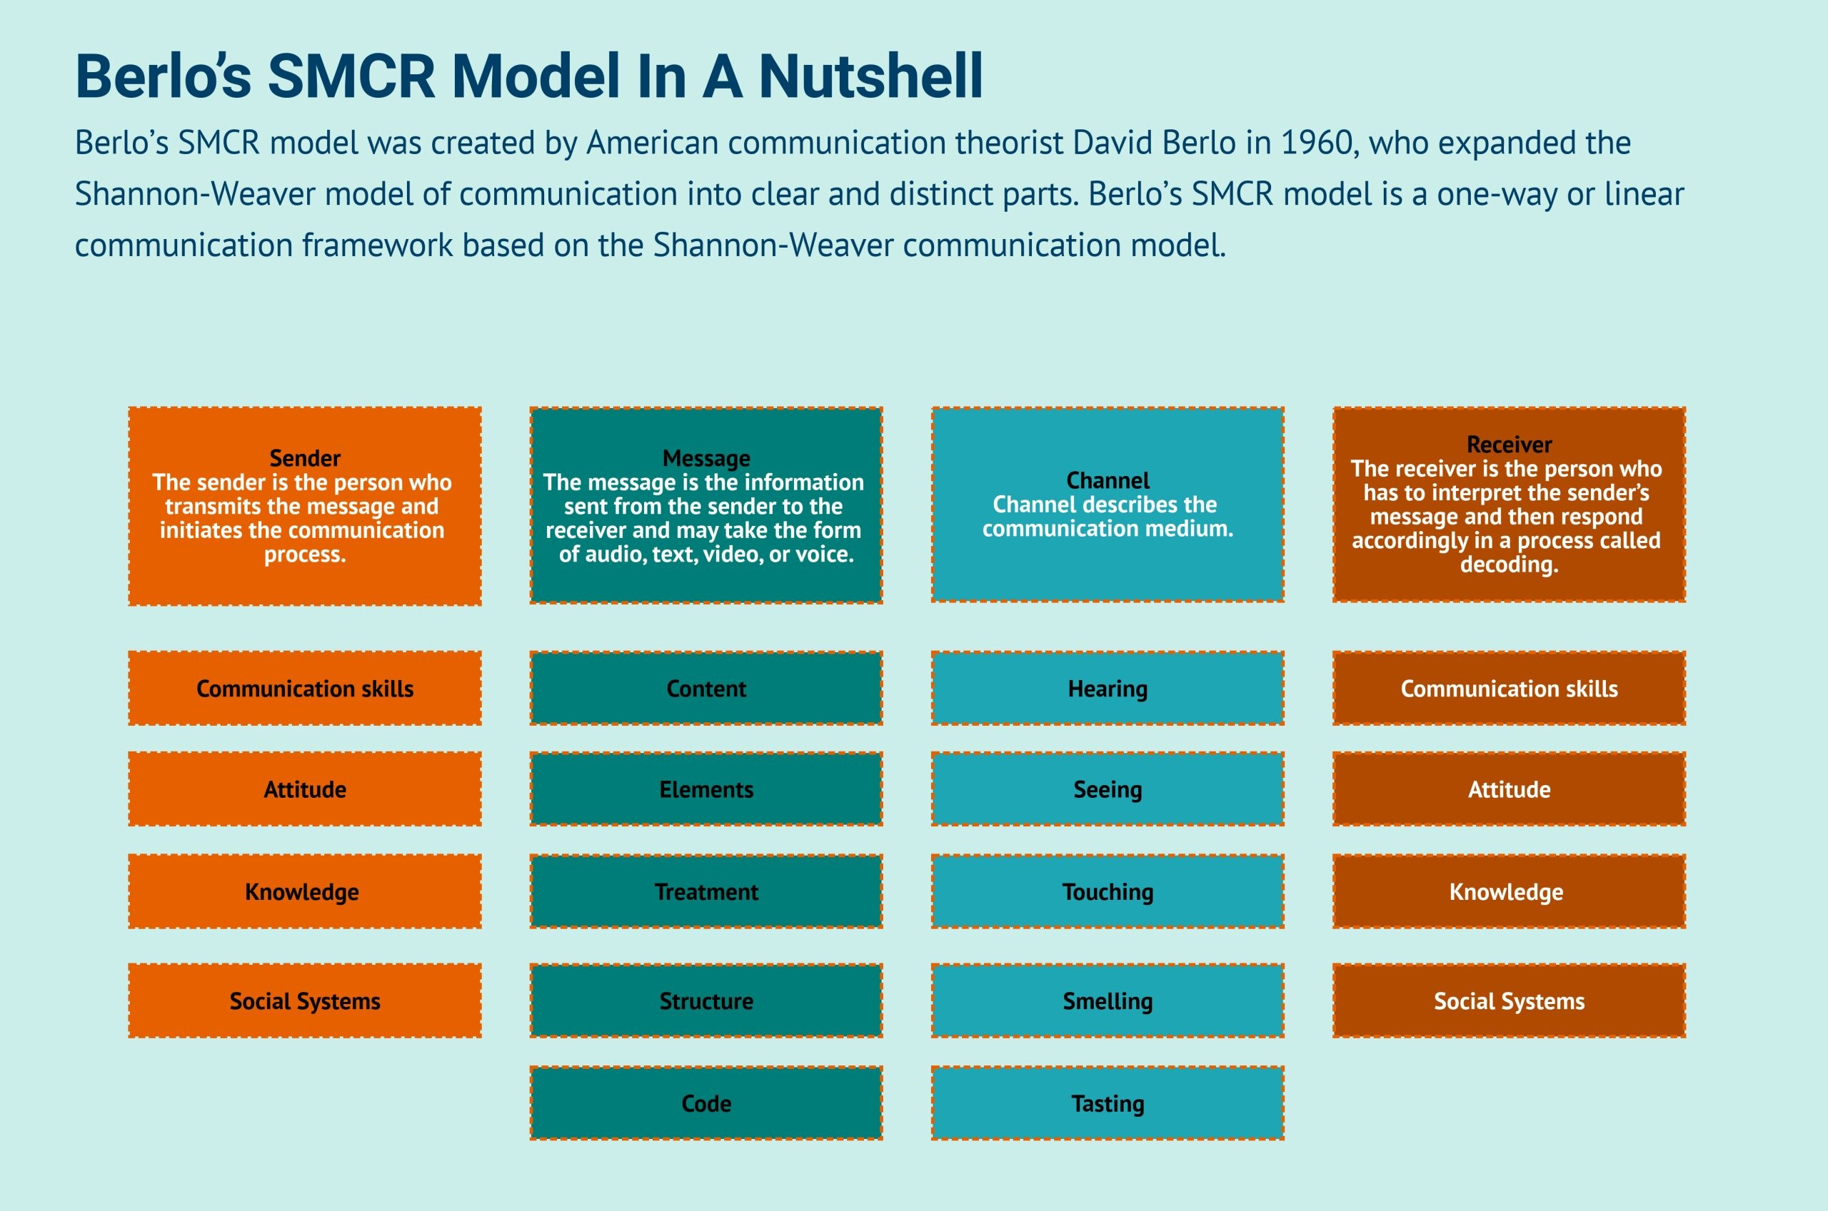
Effective Communication Model and how it can be used by ASDA
Berlo’s Model of Communication
Notes:
Effective Communication Model and how it can be used by ASDA
ASDA can implement "Berlo’s Model of Communication” to enhance their teamwork efficiency. This model will help them to encode and decode every piece of information before it is received back from the sender and employees receiving the message. Berlo’s Model will offer ASDA four components that are discussed below:
The Factors of Berlo’s Model of Communication
Sender
According to (Antony and Gupta, 2018), the message is sent through a specific source and where it is generated is the sender. The managers of ASDA can play the role of the sender. The sender will require to have a different skill set as per the model. These factors and skills of the sender include:
Communication Skills – The managers and leaders of ASDA must have communication skills for discussing their processes. Having good skills in communication will allow the sender to send messages more clearly and can help the receiver to understand them better (Chanana, 2021). When the information is not grasped by the reserved, the communication will not be effective. These leaders must have good listening, writing, reading, presenting, or speaking skills.
Attitude - The sender's attitude also has a great impact on the message sent to the receiver. It can change the meaning and environment of the message which can impact the understanding of the receiver.
Knowledge - The receiver must be familiarised with the message and its context making it essential for the sender to know the level of understanding of the receiver to decode the message.
Social System - The way of messaging through communication can also be affected by the religion, rules, beliefs, values, and other social factors of the sender in the company. The generation difference will be created. The situation and place will also be falling under the social system.
Culture - The managers of ASDA can implement cultural differences in sending information. Having a diversified communication channel can make it easier for all individuals of the company to understand.
Message
Berlo’s model explains a message to be a substance that a sender sends to the receiver. This message can be in the form of video, audio, text, voice, or other media. ASDA can use its factors that include:
Content - It is the topic or the point of the message. The content is the overall meaning or reason for sending the message.
Elements - The non-verbal things in the message are the elements that tag along in the content such as language, signs, or gestures.
Treatment - The method or approach of conveying the message from sender to receiver. This plays a major role in affecting the feedback from the receiver.
Structure - This is the overall presentation or arrangement of content and topics of the message. The effectiveness is based on this structure.
Code - The form on which the message is based is called code. It can be in the form of video, text, or language.
Channel
Berlo explains the channel as the medium which sends the message. ASDA is a company that holds mass communication and has implemented technologies such as the internet, telephones, etc. However, this model suggests that ASDA implement the five senses of a human being for creating an effective channel of communication in their teams.
Hearing – Receiving the messages through the hearing senses.
Seeing – Perceiving the message by observing. The non-verbal messages are usually seen.
Touching – Non-verbal communication such as shaking hands is a part of touching in effective communication.
Smelling – Using your nose to collect information.
Tasting – The taste refers to the interest or the type of message being sent to the receiver.
Receiver
The model's final factor is the receiver who usually attains the information or message. The model will provide an ASDA pattern of thinking on how to use the above-mentioned procedures or approaches for establishing effective communication to send and sync messages to all the receivers of the company who are the employees and staff (Fountaine et al., 2019). The skills required by the receiver are the same as the sender which are communication, attitude, culture, social system, and knowledge.

Slide 7

Effective Communication Barriers at ASDA between Organisation and External Stakeholders
Inability of Listening
Lack of Trust and Transparency
Style of Communication
Workplace Conflicts
Notes:
Effective Communication Barriers at ASDA between Organisation and External Stakeholders
Regardless of the communication type such as visual, listening, written, non-verbal, or verbal, ASDA has also been affected by the barriers to communication that happen in the workplace. These barriers can impact the company's performance and reduces employee relation. Some of these barriers to communication between the organisation and external stakeholders include:
Inability of Listening
The company faces issues of people not paying attention during conversations and communication. When external stakeholders are not paying attention, they will make assumptions which will lead to issues of clear communication.
Lack of Trust and Transparency
The company finds it difficult in communicating because of a lack of transparency in the workplace. Many times the employees believe that the company is keeping things to themselves which makes them anxious. This results in difficulty in communicating all employees to the same conclusions about the matters and issues (Guinan et al., 2019).
Style of Communication
Each person has their style of communication. The same goes for understanding. ASDA faces communication issues when a new leader or manager is hired. He might not be aware of the norms and might have adopted a different communication style that results in the unclear transfer of messages among the employees in the workplace.
Workplace Conflicts
Many incidents lead to conflicts in the workplace of ASDA. These conflicts occur because of different reasons but all end up disrupting the workplace environment of the organisation (Lacerenza et al., 2018). Conflicts reduce the performance of employees and affect the channels of information in the organisation. These conflicts cause negativity to occur in the workplace environment because of which the tendency to cooperate with employees is reduced.

Slide 8

Channel of Communication by ASDA
Empowering Employees using Information
Bottom-Up Communication Channel
Internal Communication Channel
Notes:
Channel of Communication by ASDA
Empowering Employees using Information
ASDA makes sure that all employees are considered while sharing information or decision-making. It helps them in creating a transparent channel where the company can discuss the services, products, and goals of the company with their employees. The company offers all employees to take part in discussions and give their opinions. It helps the company to empower their communication with the organisation and their staff.
Bottom-Up Communication Channel
ASDA is one of the few organisations that have implemented the "Bottom-Up" structure rather than the "Top-Bottom" structure. This channel allows ASDA to gain information and knowledge from the lower staff such as employees, workers, and staff members of the company (Memon et al., 2018). Since they are present directly to the consumers, they can help to give better decisions on enhancing their customer satisfaction.
Internal Communication Channel
According to (Rajhans, 2018), ASDA has performed much research to spend time studying the social network usage of their employees. The company has developed technological strategies which offer the ability to use social media sites as a platform for making business communications such as meetings, deadlines, assignments, and others. Using these strategies allows ASDA to interact directly with its employees using their social media accounts.

Slide 9

Methods to Improve Communication Channels at ASDA
Makes Plans and Stick to Them
Changing the Culture of the Company
Embracing Digital Communication
Notes:
Methods to Improve Communication Channels at ASDA
ASDA can follow the following strategies to improve its communication channels:
Makes Plans and Stick to Them
ASDA has to plan out a common structure and channel in the workplace that needs to be followed by all the members of the company regardless of its location or position. It will be acting as a road map that will be helping the organisation for enhancing its internal communication with its workers. The company will have to outline plans for establishing channels.
Changing the Culture of the Company
The retail business requires a company such as ASDA to keep every individual together to have an effective team. Since these employees are up front to the customers, these employees are required to have effective communication which ensures a better flow of information and knowledge. ASDA can change its company culture and implement a unified work culture (Syakur et al., 2020).
Embracing Digital Communication
Even though ASDA holds social media techniques for communication channels, their workplace still lacks advanced technologies and machinery. The company can provide each employee with their portal accounts where all their information and duties are kept updated by the managers of the company. This will allow the employees to keep track of their assignments and is also an easy way for leaders to assess employees.

Slide 10

Conclusion
The following presentation concludes with the importance of team communication which enhances performance and effectiveness in the workplace.
A good communication strategy can help a company to bring their people closer and creates a higher trust level between each individual.
Effective communication will allow a company to maintain a strong bond between the workforce of the company among all levels of the organisation.
Notes:
Conclusion
The following presentation concludes with the importance of team communication which enhances performance and effectiveness in the workplace. Workplace communication plays an essential role to maintain employee efforts in achieving the organisational goals and keeping everyone together while struggling to grow and develop. The presentation discussed the communication aspects of ASDA and how they establish their channels for effective teamwork in the company (Tien, 2019). A good communication strategy can help a company to bring their people closer and creates a higher trust level between each individual. If the company is unable to provide effective communication in the workplace, it tends to fail in motivating the employees and retaining them for the company. Effective communication will allow a company to maintain a strong bond between the workforce of the company among all levels of the organisation.

Slide 11

References
Antony, J. and Gupta, S., 2018. Top ten reasons for process improvement project failures. International Journal of Lean Six Sigma.
Chanana, N., 2021. Employee engagement practices during COVID‐19 lockdown. Journal of public affairs, 21(4), p.e2508.
Fountaine, T., McCarthy, B., and Saleh, T., 2019. Building the AI-powered organisation. Harvard Business Review, 97(4), pp.62-73.
Guinan, P.J., Parise, S. and Langowitz, N., 2019. Creating an innovative digital project team: Levers to enable digital transformation. Business Horizons, 62(6), pp.717-727.
Lacerenza, C.N., Marlow, S.L., Tannenbaum, S.I. and Salas, E., 2018. Team development interventions: Evidence-based approaches for improving teamwork. American psychologist, 73(4), p.517.
Memon, F.A., Saeed, S., Shaikh, A. and Memon, M.A., 2018. Systematic Approach of Customer Relationship Management in Much Different Organisation. IBT Journal of Business Studies (JBS), 14(2).
Rajhans, K., 2018. Effective communication management: A key to stakeholder relationship management in project-based organisations. IUP Journal of Soft Skills, 12(4), pp.47-66.
Syakur, A., Susilo, T.A.B., Wike, W. and Ahmadi, R., 2020. Sustainability of communication, organisational culture, cooperation, trust and leadership style for lecturer commitments in higher education. Budapest International Research and Critics Institute (BIRCI-Journal): Humanities and Social Sciences, 3(2), pp.1325-1335.
Tien, N.H., 2019. International economics, business and management strategy. Dehli: Academic Publications.
Notes:
References
Antony, J. and Gupta, S., 2018. Top ten reasons for process improvement project failures. International Journal of Lean Six Sigma.
Chanana, N., 2021. Employee engagement practices during COVID‐19 lockdown. Journal of public affairs, 21(4), p.e2508.
Fountaine, T., McCarthy, B., and Saleh, T., 2019. Building the AI-powered organisation. Harvard Business Review, 97(4), pp.62-73.
Guinan, P.J., Parise, S. and Langowitz, N., 2019. Creating an innovative digital project team: Levers to enable digital transformation. Business Horizons, 62(6), pp.717-727.
Lacerenza, C.N., Marlow, S.L., Tannenbaum, S.I. and Salas, E., 2018. Team development interventions: Evidence-based approaches for improving teamwork. American psychologist, 73(4), p.517.
Memon, F.A., Saeed, S., Shaikh, A. and Memon, M.A., 2018. Systematic Approach of Customer Relationship Management in Much Different Organisation. IBT Journal of Business Studies (JBS), 14(2).
Rajhans, K., 2018. Effective communication management: A key to stakeholder relationship management in project-based organisations. IUP Journal of Soft Skills, 12(4), pp.47-66.
Syakur, A., Susilo, T.A.B., Wike, W. and Ahmadi, R., 2020. Sustainability of communication, organisational culture, cooperation, trust and leadership style for lecturer commitments in higher education. Budapest International Research and Critics Institute (BIRCI-Journal): Humanities and Social Sciences, 3(2), pp.1325-1335.
Tien, N.H., 2019. International economics, business and management strategy. Dehli: Academic Publications.

Slide 12

Teamwork Evaluation
The following presentation assignment required our class to be divided into groups of 4-5 people. We were assigned this task which required us to perform research, report writing and prepare the presentation for this module. I was lucky enough to get in a group where each individual was helpful and supportive to each other. Working as a team made this assignment easier as we divided all the responsibilities to each other that reduced the load of work. Since all of my team members were my classmates, I was aware of their skills and capabilities.
Notes:
Task 2 - Teamwork Evaluation
The following presentation assignment required our class to be divided into groups of 4-5 people. We were assigned this task which required us to perform research, report writing and prepare the presentation for this module. I was lucky enough to get in a group where each individual was helpful and supportive to each other. Working as a team made this assignment easier as we divided all the responsibilities to each other that reduced the load of work. Since all of my team members were my classmates, I was aware of their skills and capabilities.
At the start of the assignment, I was having lack of confidence in my team members because I thought it was a bit of completed work. At first, my idea was to go solo and do most of the part of the assignment on my own. However, the support and involvement of my team made me realise that the work would end up in far better results if we complete it together. So at that point, we decided to complete the project as a unity. Some of the strategies and approaches we took for completing the work were:
Time Management
We made sure to prepare a schedule for all the work and make deadlines for each activity to be complete. We had three tasks to accomplish which included researching, reporting, and designing the presentation. We were given a specified time so we divided it according to our need for each task. My team was very active and did not delay any part of the assignment which helped us achieve our target on time.
Report Writing
The second approach for the project we took was writing the report. I was assigned to prepare the report for the presentation. We all agreed that only one person should prepare the report as it will keep the structure and tone of the assignment the same throughout the report. If we divided the tasks the report would have different approaches and structures because everyone would put their thoughts.
Designing
The final activity of our assignment was to design the presentation. We took the same approach as the report writing and assigned this task to one person to make sure he designs the whole presentation with his perspective to avoid a clash of different thoughts and opinions.
Ending Thoughts
It can be said that this assignment went well for us because my team cooperated all the time. My team was very supportive and participative which increased our team collaboration and communication. My team was able to take care of all the duties assigned to each individual and in the end, we compiled all of our work to give the final touches to our presentation. We relied on each other in the project and kept discussing with our teachers to make sure we were taking the right path for completing our assignment. The outcome of our presentation assignment showed how effective we were as a team and how well we performed in completing this project.

