Slide 1
Describing the Data
You will learn about:
1. Descriptive statistics
2. The shape of data
3. Data dispersion
4. Correlation

Slide 2
1. Descriptive Statistics – Single Dataset

Slide 3
1.1 Describe what?
A descriptive statistic describes the sample data and the population that the data came from
These are percentages of share ownership of 33 CEOs in the US in 2015. Roughly what is the typical value?
4.60% 0.22% 0.01% 0.21% 0.12% 0.10% 0.78% 0.40% 0.63% 0.12% 0.29%
0.67% 0.43% 0.91% 0.12% 9.36% 0.12% 0.21% 0.38% 0.03% 0.11% 0.53%
0.00% 0.01% 0.14% 3.14% 0.05% 0.04% 0.11% 0.23% 2.86% 0.02% 1.92%
Location and central tendency
  There exists a distribution of values
  We are interested in the “centre” of the distribution
  Two measures are the sample mean and the sample median
  They look similar and measure the same thing.
  They differ systematically when the data are not ‘symmetric’

Slide 4
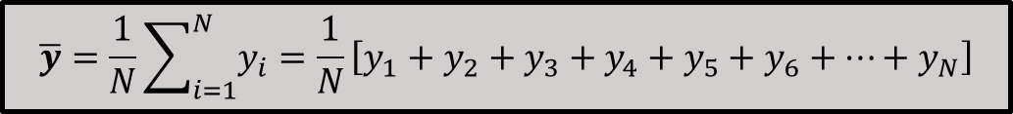
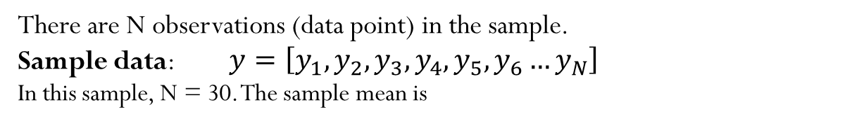
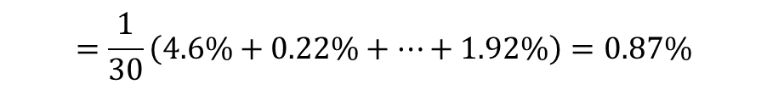
1.2 The Sample Mean
These are percentages of share ownership of 33 CEOs in the US in 2015.
4.60% 0.22% 0.01% 0.21% 0.12% 0.10% 0.78% 0.40% 0.63% 0.12% 0.29%
0.67% 0.43% 0.91% 0.12% 9.36% 0.12% 0.21% 0.38% 0.03% 0.11% 0.53%
0.00% 0.01% 0.14% 3.14% 0.05% 0.04% 0.11% 0.23% 2.86% 0.02% 1.92%
There are N observations (data point) in the sample.
Sample data: $y=\left[y_{1},y_{2},y_{3},y_{4},y_{5},y_{6}…y_{N}\right]$
In this sample, N = 30. The sample mean is
$$\overline{y}=\frac{1}{N}\sum_{i=1}^{N}{y_{i}}=\frac{1}{N}\left[y_{1}+y_{2}+y_{3}+y_{4}+y_{5}+y_{6}+…+y_{N}\right]$$
$$=\frac{1}{30}\left(4.6\%+0.22\%+…+1.92\%\right)=0.87\%$$

Slide 5
1.2 The Sample Mean
Averaging trending time series observations is usually not informative
Note how the mean changes completely depending on what time interval is used to compute it
Does the mean over the entire observation period mean anything? (Does it estimate anything meaningful?)
2,120.0
1,655.0
2,000.0

Slide 6
1.3 The Sample Median
Median = the middle observation after data are sorted
Odd number: Central observation:
  Med [1, 2, 4, 6, 8, 9, 17] = 6
Even number: Midpoint between the two central observations:
  Med [1, 2, 4, 6, 8, 9, 14, 17] = (6+8)/2 = 7

Slide 7
1.3 The Sample Median
Sample median of sorted CEO share ownership data
These are percentages of share ownership of 33 CEOs in the US in 2015.
0.00% 0.01% 0.01% 0.02% 0.03% 0.04% 0.05% 0.10% 0.11% 0.11% 0.12% 0.12% 0.12% 0.12% 0.14% 0.21% 0.21% 0.22% 0.23% 0.29% 0.38% 0.40% 0.43% 0.53% 0.63% 0.67% 0.78% 0.91% 1.92% 2.86% 3.14% 4.60% 9.36%
Median = 0.12%
Mean = 0.87%

Slide 8
1.4 Mean vs. Median
Skewed common equities distribution
Common equities of public US companies in year 2013:
N = 1,728
Median = USD 955 mil
Mean = USD 2,681 mil
These data are skewed to the right
The mean will exceed the median when the distribution is skewed to the right. (The skewness is in the direction of the long tail.)

Slide 9
1.4 Mean vs. Median
Extreme observations distort means but Not Medians
Outlying observations (outliers) distort the mean
  Med [1, 2, 4, 6, 8, 9, 17] = 6
  Mean [1, 2, 4, 6, 8, 9, 17] = 6.174
  Med [1, 2, 4, 6, 8, 9, 17000] = 6
  Mean [1, 2, 4, 6, 8, 9, 17000] = 2432.8
Do you expect extreme outliers in any of the following datasets:
  CEO salary (check out how much base salary Steve Job earned)
  One-day stock return of FTSE 350 companies on 1st Feb 2025
  Age

Slide 10
1.5 Data Dispersion
The problem with the mean or median as a description of a sample – more information is usually needed
Narrow
Narrow
frequency
Narrow
frequency
frequency
frequency
Both data sets have a mean of 7.8
Wide
Wide
frequency
Wide
frequency
frequency

Slide 11
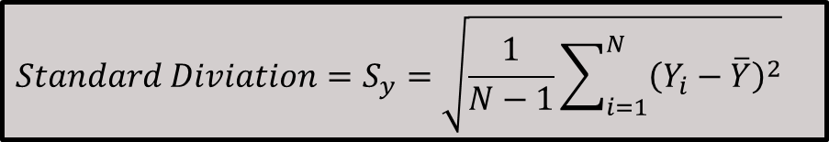
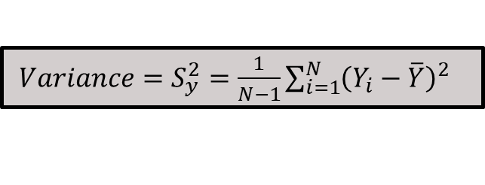
1.5 Data Dispersion
We can quantify the variation of the values around the mean.
A measure of dispersion is the Standard Deviation. You need to compute the variance to get the standard deviation.
$Variance=S_{y}^{2}=\frac{1}{N−1}\sum_{i=1}^{N}{{\left(Y_{i}−\overline{Y}\right)}^{2}}$
$$Standard Diviation=S_{y}=\sqrt{\frac{1}{N−1}\sum_{i=1}^{N}{{\left(Y_{i}−\overline{Y}\right)}^{2}}}$$
Note the units of measurement. The standard deviation has the same units as the mean. The standard deviation is the standard measure for the dispersion (spread) of a set of values (sample of observations).

Slide 12
1.5 Data Dispersion
Y | Deviation from mean | Squared Deviation
1 | -2.1 | 4.41
4 | 0.9 | 0.81
6 | 2.9 | 8.41
0 | -3.1 | 9.61
3 | -0.1 | 0.01
2 | -1.1 | 1.21
6 | 2.9 | 8.41
4 | 0.9 | 0.81
4 | 0.9 | 0.81
1 | -2.1 | 4.41
SUM | 0.0 | 38.90
Sum = 31
Mean = 31/10=3.1
Sum of squared deviations = 38.90
Variance = 38.90/(10-1) = 4.322
Standard Deviation = 2.079

Slide 13
2. Descriptive Statistics – Multiple Datasets

Slide 14
2.1 Correlation
Observe the following two datasets
Household Income Level | House Value
129 | 880
1106 | 7099
190 | 1467
235 | 1274
280 | 1627
213 | 919
489 | 2535
687 | 3104
665 | 2555
707 | 3549
434 | 2202
752 | 3503
474 | 2491
What is the relationship between the household income level and house value in the region?

Slide 15
2.1 Correlation
Variables X and Y vary together
Correlation
  The simultaneous movement through a statistical relationship
Does the movement in X “cause” movement Y in some metaphysical sense?
Are these movements induced by the variation of a third effect?

Slide 16
2.1 Correlation
Correlation is NOT causality. Observe the following three plots:
CEO salary and corporate leverage ratios are not positively “related” to each other. However, they are both positively related to “time.”
The positive relationship on the left is spurious.

Slide 17
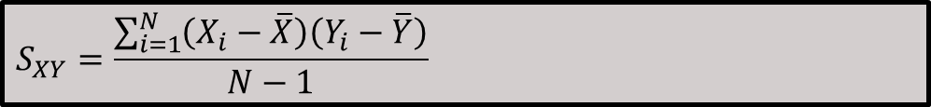
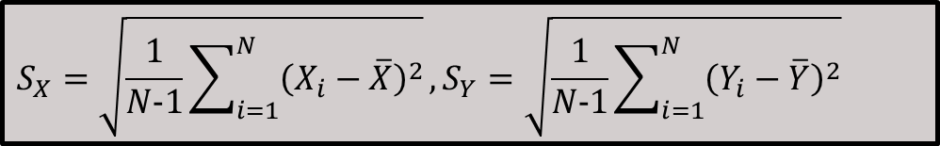
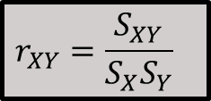
2.1 Correlation
In order to compute correlation, we must compute covariance and the two standard deviations first.
$$S_{X}=\sqrt{\frac{1}{N−1}\sum_{i=1}^{N}{{\left(X_{i}−\overline{X}\right)}^{2}}}, S_{Y}=\sqrt{\frac{1}{N−1}\sum_{i=1}^{N}{{\left(Y_{i}−\overline{Y}\right)}^{2}}}$$
Standard Deviations:
$$S_{XY}=\frac{\sum_{i=1}^{N}{\left(X_{i}−\overline{X}\right)\left(Y_{i}−\overline{Y}\right)}}{N−1}$$
Covariance:
$$r_{XY}=\frac{S_{XY}}{S_{X}S_{Y}}$$
Correlation:
-1 < r_{XY} < +1 Units free. A pure number.

Slide 18


2.1 Correlation
$$\overline{Income}$$
$$\overline{Value}$$
r_{Income,House} _{Value} = +0.864

Slide 19
2.1 Correlation
r = +0.64
r = +1.0
r = -0.09

