Slide 1

Institute of Inner-City Learning, Birmingham Campus
BSc (Hons) Health and Social Care
TITLE: Contributing Factor Analysis to Mental Health Issues Among Different Ethnic Groups Within University Students in the United Kingdom
Your Full Name: Farha Bano
Student Number: 2238827
Module Code: BMHP6020
Module Title: Independent Project
Tutor: Chloe Harries

Slide 2
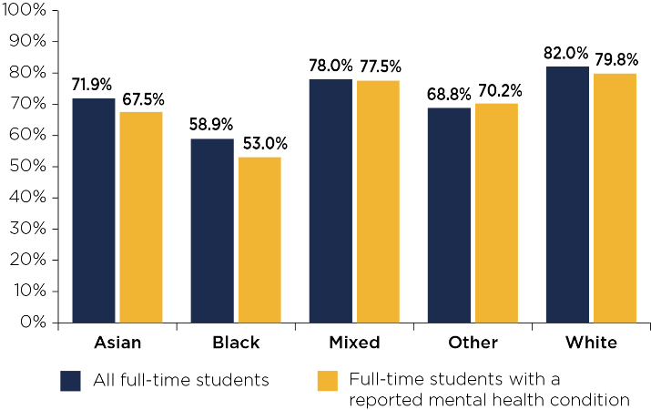
Introduction
In the UK, mental health issues are now a key public health concern, with about one in four university students having a mental health condition, including anxiety, depression or stress disorders (Fauzi et al., 2021).
The level of mental health experiences is not the same across groups of students, however.
Ethnic minority students experience further barriers such as discrimination, cultural stigma, language difficulties, and the lack of culturally relevant support services (Ahad et al., 2023).
Though UK higher education is increasingly diverse, there is limited comparative work examining mental health variables in relation to the ethnic groups (Campbell et al., 2022).
Source | Currency | Relevance | Authority | Accuracy | Purpose
Bains and Gutman (2021) | 2021 – recent | UK ethnic minority youth | Academic researchers | Large UK dataset | Inform/educate
Tao et al. (2024) | 2024 – very recent | Student focus but non-UK | Peer-reviewed journal | Large sample (6,710) | Inform/educate
Jones Nielsen et al. (2025) | 2025 – extremely recent | UK university ethnic minorities | Academic researchers | Mixed-methods | Improve services
Jaspal and Lopes (2021) | 2021 – recent | UK ethnic discrimination | Psychology experts | Statistical modelling | Inform/educate
Birch (2024) | 2024 – very recent | UK higher education | Doctoral research | Mixed-methods | Improve policy
Medlicott et al. (2021) | 2021 – recent | Student wellbeing | Psychology researchers | Validated measures | Inform/educate
Kodish et al. (2022) | 2022 – recent | US context | Psychiatry researchers | Large online study | Improve equity
Sheldon et al. (2021) | 2021 – recent | Student risk factors | Systematic review | Meta-analysis | Inform/educate
Hyseni Duraku et al. (2023) | 2023 – recent | Non-UK but transferable | Public health academics | Mixed-methods | Inform/educate
Busby et al. (2021) | 2021 – recent | Ethnic minority focus (US) | Health researchers | Large survey (1,559) | Inform/educate
Research Aim
To clearly examine the multitude of social, cultural, environmental and psychological forces that influence the prevalence and severity of mental health problems affecting university students of various ethnic backgrounds across the UK.
Search Strategy
A structured search strategy was designed with words from the dissertation title "mental health", "ethnic groups", "university students" and "United Kingdom".
Other terms were added like "psychological distress", "ethnic minority students", "wellbeing services" and "help-seeking behaviour.
Searches were narrowed by using Boolean operators (AND, OR, NOT) (Wang et al., 2024).
A Source Tracking Table (STT) was systematically created for all search combinations and the outputs found.
Database searching included Google Scholar, PubMed, and ScienceDirect, due to their peer-reviewed psychological and public health research (Bin Abdulrahman et al., 2025).
A number of filters were applied, such as publication periods (2021–2025), peer-reviewed articles, English studies, and ethnic minority studies (children only).
Picture / Graph / Visual Aid / Statistics
National data indicate that anxiety and depression are the most commonly reported mental health issues among UK university students (Office for Students, 2019).
The degree attainment gap between black and white students with a mental health condition is extremely high at 26.8%.
Inclusion Criteria | Exclusion Criteria
Peer-reviewed journal articles, systematic reviews, and academic studies (2021–2025) | Opinion blogs and newspaper articles
Focus on mental health, ethnicity, discrimination, and well-being support services among university students. | Out-of-date publications (pre-2021)
Studies on ethnic minority groups in higher education | Non-English studies
Research conducted in the UK | Literature not related to university students
Research Validation
The CRAAP test was applied to each of the sources, examining Currency, Relevance, Authority, Accuracy and Purpose (Ong et al., 2026).
Recent articles and peer-reviewed articles with academic validity were given priority.
For example, Jones Nielsen et al. (2025) took a mixed-methods approach and examined ethnic minority students in London universities, and Sheldon et al. (2021) used a systematic review methodology.
Author & Year | Article Title | Summary
Bains and Gutman (2021) | Mental health in ethnic minority populations in the UK | Ethnic minority children showed different mental health trajectories than White children, even after controlling for socioeconomic factors.
Tao et al. (2024) | Centrality and bridge symptoms of anxiety, depression, and sleep disturbance among college students | Identified poor sleep, worry, guilt, and irritability as central symptoms connecting mental health disorders during COVID-19.
Jones Nielsen et al. (2025) | Utilisation of Embedded University Wellbeing Services by Ethnic Minority Students in London | Barriers included stigma, privacy concerns, and cultural barriers. Recommended culturally responsive counselling.
Jaspal and Lopes (2021) | Discrimination and mental health outcomes in British Black and South Asian people | Discrimination increased anxiety, depression, and fear while reducing life satisfaction during COVID-19.
Birch (2024) | Interventions to Signpost Students to University Mental Health Support | Barriers included a lack of trust and concerns about effectiveness. Recommended improved communication.
Medlicott et al. (2021) | Effectiveness of a mindfulness-based course for university students | Mindfulness programme improved wellbeing, resilience, academic motivation, and mental health.
Kodish et al. (2022) | Enhancing racial/ethnic equity in college student mental health | Students of colour were less likely to access prior treatment but engaged equally when services were accessible.
Sheldon et al. (2021) | Prevalence and risk factors for mental health problems in undergraduates | Major predictors included financial difficulties, childhood adversity, and existing mental health conditions.
Hyseni Duraku et al. (2023) | Barriers to seeking psychological help among university students | Lack of trust and self-disclosure concerns acted as barriers to support despite high anxiety and depression levels.
Busby et al. (2021) | Black college students are at an elevated risk of suicide | Many at-risk students received no support due to a lack of awareness, time concerns, and perceptions of problem severity.
Ethical Consideration
This dissertation is conducted as secondary research and not primary data collection with any participants.
Academic integrity was maintained by using the right quotation and proper referencing of all sources, and avoiding misinterpretation of studies (Panjaitan et al., 2024).
Relevant and credible literature was selected to ensure transparency and credibility, while there was no bias in source selection (Shaheen et al., 2023).
Conclusion
From the literature reviewed, three primary themes were identified that influence mental health inequalities among ethnically diverse UK university students: ethnic discrimination and psychological distress, cultural stigma and help-seeking barriers, and institutional support and culturally responsive wellbeing services.
This study clearly showed that ethnic minority students face more distress because of structural inequality, stigma and unequal access to services. Staff mental health training, early intervention screening systems and culturally inclusive peer support programmes are all recommended.

Slide 3
References
Ahad, A.A., Sanchez-Gonzalez, M. and Junquera, P., (2023). Understanding and addressing mental health stigma across cultures for improving psychiatric care: A narrative review. Cureus, 15(5), p.e39549.
Bin Abdulrahman, K. A., Alshehri, H. A., and Alhussaini, K. I. (2025). Search Techniques for Reliable Information in Health Profession Education. In Essential Learning Skills for Health Professions Students (pp. 105-114). Singapore: Springer Nature Singapore.
Campbell, F., Blank, L., Cantrell, A., Baxter, S., Blackmore, C., Dixon, J. and Goyder, E., (2022). Factors that influence mental health of university and college students in the UK: a systematic review. BMC Public Health, 22(1), p.1778.
Fauzi, M.F., Anuar, T.S., Teh, L.K., Lim, W.F., James, R.J., Ahmad, R., Mohamed, M., Abu Bakar, S.H., Mohd Yusof, F.Z. and Salleh, M.Z., (2021). Stress, anxiety and depression among a cohort of health sciences undergraduate students: the prevalence and risk factors. International journal of environmental research and public health, 18(6), p.3269.
Jones Nielsen, J. D., Thomas, R., and Fett, A. K. (2025). A Mixed-Methods Exploration of the Utilisation of Embedded University Wellbeing Services by Ethnic Minority Students in London. Education Sciences, 15(9), 1263.
Office for Students (2019). Mental health: Are All Students Being Properly supported? - Office for Students. [online] www.officeforstudents.org.uk. Available at: https://www.officeforstudents.org.uk/publications/mental-health-are-all-students-being-properly-supported/ [Accessed 15 Jun. 2026].
Ong, J. S. H., Loh, K. X., Han, J. Y., and Fung, F. M. (2026). Integrating the CRAAP Framework to Support Critical Thinking and Information Literacy. Journal of Chemical Education.
Panjaitan, A. O., Novelyn, S., and Angreni, F. (2024). The impact of proper citation on academic integrity and scholarship. Asian Journal of Advanced Research and Reports, 18(10), 192-201.
Shaheen, N., Shaheen, A., Ramadan, A., Hefnawy, M. T., Ramadan, A., Ibrahim, I. A., ... and Flouty, O. (2023). Appraising systematic reviews: a comprehensive guide to ensuring validity and reliability. Frontiers in research metrics and analytics, 8, 1268045.
Sheldon, E., Simmonds-Buckley, M., Bone, C., Mascarenhas, T., Chan, N., Wincott, M., ... and Barkham, M. (2021). Prevalence and risk factors for mental health problems in university undergraduate students: A systematic review with meta-analysis. Journal of Affective Disorders, 287, 282-292.
Wang, J., Huang, J. X., Tu, X., Wang, J., Huang, A. J., Laskar, M. T. R., and Bhuiyan, A. (2024). Utilizing bert for information retrieval: Survey, applications, resources, and challenges. ACM Computing Surveys, 56(7), 1-33.

