Slide 1
Strategic Management
Strategic Management for Business
Porter’s Generic Strategies & Bowman’s Strategy Clock
Competitive Strategy

Slide 2
Lecture Outline
Porter's Generic Strategies — Overview
Cost Leadership Strategy
Differentiation Strategy
Focus Strategy
Stuck in the Middle — risks of no clear strategy
Bowman's Strategy Clock — Overview
The 8 Positions of the Strategy Clock
Comparing Porter vs Bowman
Group Activity
Summary & References

Slide 3
What is Competitive Strategy?
Competitive strategy refers to how an organisation achieves a sustainable competitive advantage over its rivals in a specific market.
It answers the question: how do we compete?

Slide 4
What is Competitive Strategy?
According to Porter (1980), there are only two fundamental sources of competitive advantage: cost and differentiation.
Johnson et al. (2023) define competitive strategy as the basis on which an organisation seeks to compete in its markets.
Key strategic question: Should the organisation compete on price, unique features, or focus on a specific niche?

Slide 5
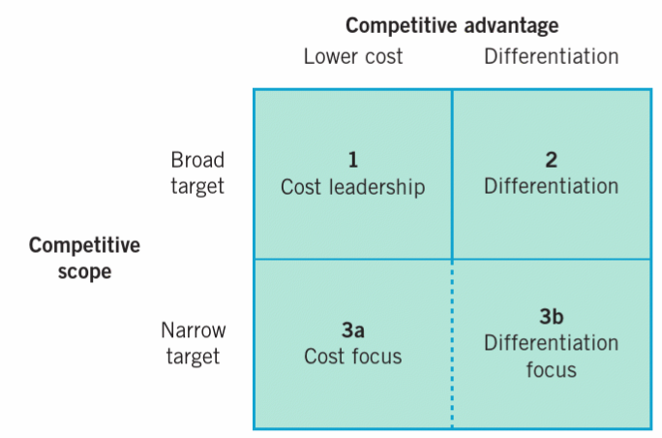
Porter's Generic Strategies — Overview
Michael Porter (1980) identified three generic strategies that can be applied across industries:
Cost Leadership: be the lowest cost producer
Differentiation: offer something uniquely valuable
Focus: serve a narrow segment either through cost or differentiation

Slide 6
Porter's Generic Strategies
The two key dimensions of the model are:
Competitive Advantage (lower cost vs. differentiation)
Competitive Scope (broad market vs. narrow segment)
Important: A firm must choose one strategy clearly — attempting more than one risks being 'stuck in the middle'.

Slide 7
Porter's Generic Strategies
COMPETITIVE ADVANTAGE
Competitive Scope
Lower Cost
Differentiation
Broad Target
1. Cost Leadership
Competing by being the lowest-cost producer in the industry while maintaining acceptable profit margins.
e.g. Ryanair, IKEA, Aldi
2. Differentiation
Competing by offering unique products or services that customers value and are willing to pay a premium for.
e.g. Apple, BMW, Dyson
COMPETITIVE SCOPE
Narrow Target
3a. Cost Focus
Competing in a narrow market segment by offering the lowest cost within that niche.
e.g. Poundland, EasyJet (specific routes)
3b. Differentiation Focus
Competing in a narrow segment by offering unique, premium features tailored to that niche.
e.g. Rolls-Royce, Ferrari, Montblanc
Source: Porter, M.E. (1980). Competitive Strategy. Free Press; Johnson et al. (2023). Exploring Strategy, 12th ed. Pearson.

Slide 8
Cost Leadership Strategy
Definition: A firm pursues cost leadership by becoming the lowest-cost producer in its industry while maintaining acceptable quality and profitability.
How firms achieve cost leadership:
Economies of scale: producing at large volume to reduce unit costs
Process efficiency: lean manufacturing, automation, Six Sigma
Supply chain leverage: bulk purchasing, vertical integration
Learning/experience curve effects

Slide 9
Cost Leadership - Business Examples
Business examples:
Ryanair: cost stripped from every process (no frills, ancillary revenue, fast turnarounds)
IKEA: flat-pack design, self-assembly, high-volume global supply chains
Aldi/Lidl: limited SKUs, private labels, efficient store layouts
Risk: Technological disruption, competitors matching costs, or price wars eroding margins (Porter, 1980).

Slide 10
Differentiation Strategy
Definition: Offering products or services that customers perceive as unique and valuable, enabling the firm to command a premium price.
Sources of differentiation:
Product innovation and design
Brand strength and reputation
Superior customer service or experience
Technology and R&D investment

Slide 11
Differentiation - Business examples
Business examples:
Apple: design, ecosystem integration, brand prestige
BMW: engineering quality, 'Ultimate Driving Machine' brand
Dyson: patented engineering innovation in household products
Risk: Imitation by competitors, customers becoming price-sensitive, or the premium being eroded over time.

Slide 12
Focus Strategy
Definition: Targeting a narrow customer segment or niche market and serving it better than broad-market competitors.
Two variants:
Cost Focus (3a): Serving a niche at lower cost than competitors — e.g. budget airlines on specific routes, Poundland
Differentiation Focus (3b): Serving a niche with unique, tailored offerings at a premium — e.g. Rolls-Royce, Ferrari, Montblanc, specialist medical devices

Slide 13
Focus Strategy
Why focus?
Niche segments may be overlooked by large competitors
Deep customer knowledge creates a loyalty moat
Enables resource efficiency — less spread
Risk: Niche may shrink, or a broad-market firm may move into the niche with greater resources.

Slide 14
Stuck in the Middle
Definition: A firm that fails to achieve any of the three generic strategies is said to be 'stuck in the middle'.
Characteristics of being stuck in the middle:
Not cheap enough to compete on cost
Not distinctive enough to command a premium
Not focused enough to serve a niche effectively
Consequence: Poor strategic clarity leads to below-average industry returns and vulnerability to competition from both ends (Porter, 1980).

Slide 15
Stuck in the Middle Example
Example: Many high-street fashion retailers in the 2010s (e.g. Debenhams, BHS) struggled as they were undercut on price by Primark and outclassed on experience by premium brands, eventually losing market position entirely.

Slide 16
Bowman's Strategy Clock — Overview
Cliff Bowman and David Faulkner (1997) developed the Strategy Clock as a more nuanced extension of Porter's framework.
Key difference from Porter:
Porter's matrix focuses on internal cost vs. differentiation capability
Bowman's Clock focuses on customer perception — the trade-off between price paid and perceived value received

Slide 17
Bowman's Strategy Clock
The model maps 8 strategic positions on two axes:
Perceived Added Value (PAV) — vertical axis (low to high)
Price — horizontal axis (low to high)
Key insight: Viable strategies must match price to perceived value. Positions 6–8 are generally non-viable long-term as they deliver poor value for money.

Slide 18
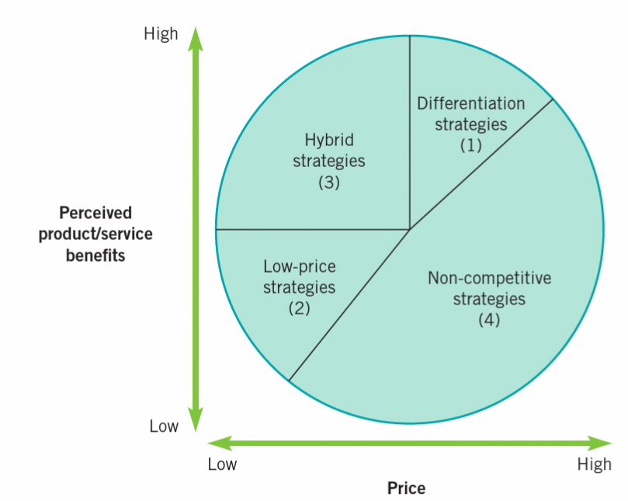
Bowman's Strategy Clock
Strategy Options
1-2: Price-based
Viable if low cost base
3: Hybrid
Low cost + differentiation
4-5: Differentiation
High Price
Added value at premium
6-7: High price
Risk — low value perceived
8: Loss of share
Uncompetitive position
Low Perceived Value
Source: Bowman, C. & Faulkner, D. (1997). Competitive and Corporate Strategy. Irwin; Johnson et al. (2023). Exploring Strategy, 12th ed. Pearson.

Slide 19
Bowman's Strategy Clock — Positions 1 to 4
Position 1 — No Frills: Low price and low perceived value. Targets price-sensitive segments. Viable only with a very low cost base.
Example: Basic supermarket own-brand products.
Position 2 — Low Price: Low price but reasonable perceived value. Attracts cost-conscious customers without sacrificing core quality.
Example: Aldi, Primark.

Slide 20
Bowman's Strategy Clock — Positions 1 to 4
Position 3 — Hybrid: Combines low prices with higher perceived value than competitors — a difficult but powerful position if sustained.
Example: IKEA — design-led, affordable, strong brand.
Position 4 — Differentiation: High perceived value at a mid-to-high price. The classic quality and brand strategy.
Example: Nike, John Lewis.

Slide 21
Bowman's Strategy Clock — Positions 5 to 8
Position 5 — Focused Differentiation: Very high perceived value at a premium price, targeting a narrow luxury or specialist segment.
Example: Rolex, Ferrari, Harrods.
Position 6 — Risky High Margins: High price without commensurate value — only sustainable where competition is weak or there is customer lock-in.
Example: Some legacy software vendors or monopoly utilities.

Slide 22
Bowman's Strategy Clock — Positions 5 to 8
Position 7 — Monopoly Pricing: Very high price, low value — unsustainable unless regulatory barriers protect the firm.
Example: Regulated utilities in protected markets.
Position 8 — Loss of Market Share: Standard price, low perceived value — customers will migrate to competitors. This position is strategically indefensible.
Example: Struggling legacy brands with outdated products.

Slide 23
Comparing Porter's Model and Bowman's Strategy Clock
Porter's Generic Strategies
Focus: Internal capabilities — cost vs. differentiation
Scope: Broad market or narrow segment
3 core strategies (+ stuck in the middle)
Internal, supply-side focus
Simple but powerful for strategic choice
Criticised for being binary — markets are more nuanced
Best used for: Strategic positioning decisions, analysing competitive advantage
Bowman's Strategy Clock
Focus: Customer perception — price vs. perceived value
Scope: 8 strategic positions on a continuum
More nuanced representation of market positions
External, demand-side focus
Reflects real-world positioning more closely
Best used for: Market positioning analysis, brand strategy, pricing decisions
Notes:
Strengths of Porter's Framework:
Provides a clear, simple framework for strategic choice
Widely tested across industries and geographies
Strong link to profitability and industry structure (Five Forces)
Limitations of Porter's Framework:
Assumes static industries — ignores dynamic capabilities (Teece et al., 1997)
Binary choice may not reflect modern hybrid strategies (e.g. Apple: premium and mass-market simultaneously)
Ignores resource-based view and internal capabilities (Barney, 1991)
Limitations of Bowman's Clock:
Relies heavily on consumer perception which is hard to measure precisely
Does not account for dynamic market changes or digital disruption
Johnson et al. (2023) note both models are most useful in combination with other strategic tools

Slide 24
Summary
Porter's Generic Strategies: Three ways to compete — cost leadership, differentiation, and focus. Firms must commit clearly or risk being stuck in the middle.
Cost Leadership: Compete by being the lowest-cost producer — e.g. Ryanair, IKEA, Aldi.
Differentiation: Compete on unique value — e.g. Apple, BMW, Dyson.
Focus: Serve a niche through cost or differentiation — e.g. Ferrari, Poundland.
Bowman's Strategy Clock: 8 positions mapping price against perceived value. Extends Porter to reflect customer perception more finely.
Viable positions: 1–5. Positions 6–8 are generally unsustainable without market protection.
Key insight: Both models are complementary. Use Porter for strategic choice and Bowman for market positioning and pricing decisions.

Slide 25
References
Barney, J. (1991). Firm resources and sustained competitive advantage. Journal of Management, 17(1), pp. 99–120.
Bowman, C. & Faulkner, D. (1997). Competitive and Corporate Strategy. London: Irwin.
Johnson, G., Whittington, R., Scholes, K., Angwin, D. & Regnér, P. (2023). Exploring Strategy: Text and Cases, 12th ed. Harlow: Pearson.
Porter, M.E. (1980). Competitive Strategy: Techniques for Analysing Industries and Competitors. New York: Free Press.
Porter, M.E. (1985). Competitive Advantage: Creating and Sustaining Superior Performance. New York: Free Press.
Teece, D.J., Pisano, G. & Shuen, A. (1997). Dynamic capabilities and strategic management. Strategic Management Journal, 18(7), pp. 509–533.

