Slide 1
Programme: BA (Hons) Leadership and Management Skills for the Workplace
Module Title: Managing Business Information
Module Code: LCLM5004
Student Name :Ana Maria Solcan, Student ID: 2427756
Student Name:Alexandrina Lupu, Student ID: 2415930
Student Name: Livia Dobrica, Student ID: 2335250
Student Name: Stela Irina Balaban, Student ID: 2413136
Lecturer: Amitave Banik

Slide 2
Managing Business Information(LCLM5004_LON)
Name: Ana Maria Solcan
ID:2427756
Topic: Introduce different Information Systems: Explain their role in business operations, highlighting their importance for efficiency, decision-making, and competitive advantage. Provide a brief overview of different types and their impact.
Lecturer: Amitave Banik

Slide 3
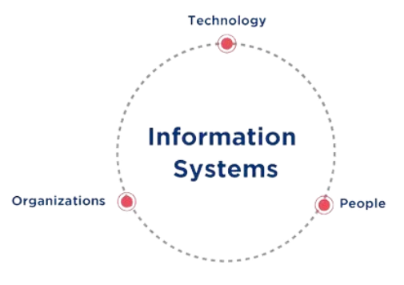
Information System
Information systems combine people, technology, processes and data to manage organizational information (Bandara et al., 2024).
It collects, processes, stores and distributes data to support business activities and operations effectively (Jo and Park, 2023).
It connects organizational components to improve communication and coordination across departments.
It transforms raw data into meaningful, useful information for decision-making.
Notes:
Information systems are discussed in the context of a total system composed of a combination of people, technology, processes and data. This allows organisations to capture, process, store and disseminate information effectively, fostering communication and decision-making in the process.

Slide 4
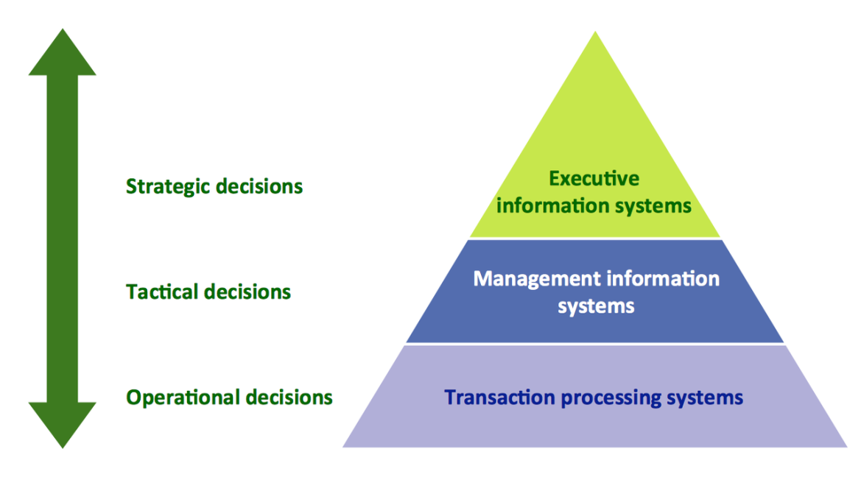
Key Types of Information Systems
Transaction Processing Systems handle daily business transactions and ensure accuracy and speed in operations ( Wahsheh et al., 2023).
Management Information Systems generate reports to support routine management decisions (Biswas, Hossain and Comite, 2024).
Decision Support Systems assist managers in solving complex and unstructured problems.
Enterprise systems such as ERP integrate all business processes into one central system (Bandara et al., 2024).
Notes:
Different functions of information systems in the organisations. The day-to-day activities are handled by a transaction processing system, routine reports are provided by a management information system, decision making on complex decisions is facilitated by a decision support system and enterprise systems integrate all the activities of business.

Slide 5
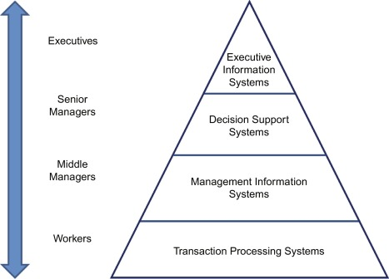
Role in Business Operations
Information systems automate routine business tasks such as transactions and payroll processing to improve efficiency (Nour, 2023).
They enhance communication and information sharing between departments within organisations.
They support coordination by integrating different business functions into a unified system (Bandara et al., 2024).
They improve operational performance by reducing errors and increasing process speed.
Notes:
Information systems support the operation of businesses by making communications between various business units possible and automating tasks. Information systems can be integrated to improve the organisation's efficiency and performance by streamlining business processes.

Slide 6
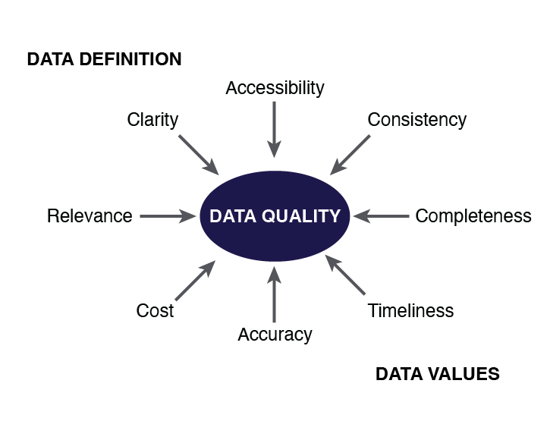
Supporting Decision-Making
Information systems provide accurate and timely data that support managerial decision-making processes (Jo and Bang, 2023).
They help managers analyze data and identify trends for better strategic planning.
They reduce uncertainty and risks by offering reliable and structured information (Jo and Bang, 2023).
They enable organizations to adopt data-driven strategies and improve overall performance.
Notes:
Information systems facilitate managers to get accurate information in their decision-making process. This helps them understand trends, spot business opportunities, reduce uncertainties and plan strategically so that organisations can use data-driven strategies to enhance their performance and competitiveness.

Slide 7
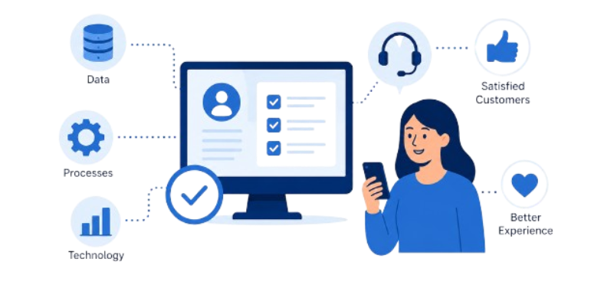
Creating Competitive Advantage
Information systems help organizations gain a competitive advantage by improving efficiency and productivity (Gessa, Jiménez and Sancha, 2023).
They enhance customer experience by providing personalized services and faster responses.
They support innovation and digital transformation in modern business environments.
They reduce operational costs through automation and better resource management (Anaya, Flak and Abushakra, 2023).
Notes:
Information systems can generate a competitive advantage by being efficient, innovative and enhancing the customers' experience. By using automation and proper resource management, companies can reduce expenses, speed up their digital transformation process and gain a competitive edge.

Slide 8
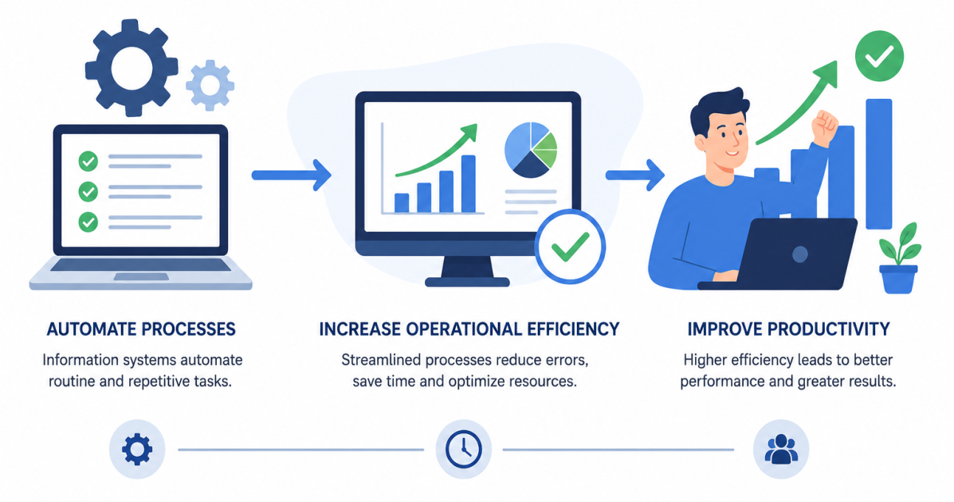
Impact on Organisations
Information systems improve productivity by automating processes and increasing operational efficiency (Nour, 2023).
They enhance decision-making quality by providing accurate and real-time information.
They improve customer satisfaction through better service delivery and responsiveness.
They support global business expansion by enabling digital integration and coordination (Massa et al., 2023).
Notes:
The effect of information systems in organisations is positive, as it makes organisational productivity better, improves the quality of decision-making in the organisation and makes the customers satisfied. Further, as far as international growth is concerned, information systems facilitate connectivity, integration and coordination of operations that are geographically dispersed.

Slide 9
Reference List
Anaya, L., Flak, L. and Abushakra, A., (2023). Realizing sustainable value from ERP systems implementation. Sustainability, 15(7), p.5783.
Bandara, F., Jayawickrama, U., Subasinghage, M., Olan, F., Alamoudi, H. and Alharthi, M., (2024). Enhancing ERP responsiveness through big data technologies: an empirical investigation. Information Systems Frontiers, 26(1), pp.251-275.
Biswas, T.R., Hossain, M.Z. and Comite, U., (2024). Role of management information systems in enhancing decision-making in large-scale organizations. Pacific Journal of Business Innovation and Strategy, 1(1), pp.5-18.
Gessa, A., Jiménez, A. and Sancha, P., (2023). Exploring ERP systems adoption in challenging times. Insights of SMEs stories. Technological Forecasting and Social Change, 195, p.122795.
Jo, H. and Bang, Y., (2023). Understanding continuance intention of enterprise resource planning (ERP): TOE, TAM, and IS success model. Heliyon, 9(10).
Jo, H. and Park, D.H., (2023). Mechanisms for successful management of enterprise resource planning from user information processing and system quality perspective. Scientific Reports, 13(1), p.12678.
Massa, S., Annosi, M.C., Marchegiani, L. and Messeni Petruzzelli, A., (2023). Digital technologies and knowledge processes: new emerging strategies in international business. A systematic literature review. Journal of Knowledge Management, 27(11), pp.330-387.
Nour, M.A., (2023). The impact of ERP systems on organizational performance: The role of antecedents and moderators. International Journal of Enterprise Information Systems (IJEIS), 19(1), pp.1-29.
Wahsheh, F.R., Marie, Z., Farea, M.M., Al-Haithami, W.A., Mohamad, F.S. and Bisht, N., (2023). Operational Level System: Transaction Processing System and Decision Making. In 2023 International Conference on Computer Science and Emerging Technologies (CSET) (pp. 1-7). IEEE.

Slide 10
Managing Business Information(LCLM5004_LON)
Name: Alexandrina Lupu
ID:2415930
Topic: Analyse and Compare Systems- Examine at least three Information Systems, comparing their functions, benefits, and limitations in driving business success.
Lecturer: Amitave Banik

Slide 11
Comparing the functions of information system
Transaction Processing System (TPS) | Management Information System (MIS) | Decision Support System (DSS)
Records daily business transactions such as sales, payments and inventory updates(Laudon & Laudon, 2012) | Convert TPS data into meaningful reports that support planning, monitoring and management control. (Stair & Reynolds, 2021) | Analyses business data and evaluates different alternatives to support strategic-decision making. (Mustafa et al., 2024)
Used by operational staff to ensure fast, accurate and reliable processing of routine activities. | Used by middle managers to monitor performance, allocate resources and improve departmental efficiency | Used by senior managers to assess risks, identify opportunities and make long-term business decisions.
Provides the accurate data required by other information systems and improves operational efficiency. | Produces summaries and performance reports that support tactical decision- making and organisational control. | Supports forecasting, market adaptation and innovation by analysing trends and predicting future outcomes.
Analysis
TPS is the foundation of business operations by capturing and processing high volume of routine transactions accurately and efficiently.(Laudon & Laudon, 2012).
MIS uses this data to create reports for managers.
DSS analyses the information to support strategic decisions.

Slide 12
Comparing benefits and limitations
Transaction Processing System (TPS)
Benefits
Processing high volume of routine transactions quickly and accurately, improving operational efficiency. (Baltzan, 2020)
Provides reliable and timely data that support others information system. (Rainer & Prices, 2021)
Limitations
Primarily focuses on routine operational tasks and cannot support complex managerial decisions.(Stair & Reynolds, 2021)
Does not support strategic decisions.
Management Information System (MIS)
Benefits
Convert operational data into meaningful reports that support planning, monitoring and managerial control.( Laudon & Laudon, 2012)
Supports planning and monitoring.
Limitations
Relies mainly on historical and structured data, making it less effective in rapidly changing environments. (Baltzan, 2020)
Less effective for unexpected situations.
Decision Support System (DSS)
Benefits
Improves decision-making.
Assist managers in risk analysis, scenario planning and evaluating business alternatives. (Mustafa et al., 2024)
Limitations
Can be expensive to develop, implement and maintain.(Laudon & Laudon, 2012)
Requires skilled users to interpret results effectively. (Alter, 2002)

Slide 13
Overall comparison and Business impact
How These Systems Support Business Success
TPS | MIS | DSS
Improves operational efficiency by automating routine business processes and reducing errors.. | Improves organisational control through regular reports and performance analysis.(Rainer & Prince, 2021) | Improves strategic decision-making by evaluating multiple business scenarios. (Turban, Sharda & Delen, 2018)
Ensure reliable and accurate business records for daily operations. (O`Brien & Marakas , 2011). | Helps managers identify trends and make informed tactical decisions.(Stair & Reynolds, 2021) | Support long-term planning, innovation and competitive advantage.
Provides the data required by MIS and DSS to generate meaningful insights. | Acts as a bridge between operational data and strategic planning. (Rainer & Prince, 2021) | Enables organisations to adapt to changing markets using data-driven decisions. (Perlson, Saunders & Galletta, 2019)

Slide 14
Conclusion and references
Although TPS, MIS and DSS have different roles, they work together to improve business performance. TPS records important business data, MIS transforms this data into useful reports, and DSS analyses the information to help managers make informed decisions. Using these systems together allows organizations to improve efficiency, reduce risks, and gain a competitive advantage
Baltzan, P. (2021) Business Driven Information Systems. 8th edn. New York: McGraw-Hill Education.
Laudon, K.C. and Laudon, J.P. (2022) Management Information Systems: Managing the Digital Firm. 17th edn. Harlow: Pearson.
O'Brien, J.A. and Marakas, G.M. (2019) Management Information Systems. 11th edn. New York: McGraw-Hill Education.
Pearlson, K.E., Saunders, C.S. and Galletta, D.F. (2020) Managing and Using Information Systems: A Strategic Approach. 7th edn. Hoboken: John Wiley & Sons.
Stair, R. and Reynolds, G. (2020) Principles of Information Systems. 13th edn. Boston: Cengage Learning.
Turban, E., Pollard, C. and Wood, G. (2021) Information Technology for Management: Driving Digital Transformation to Increase Local and Global Performance, Growth and Sustainability. 12th edn. Hoboken: John Wiley & Sons.

Slide 15
Managing Business Information(LCLM5004_LON)
Name: Livia Dobrica
ID :2335250
Topic: Ethical Considerations: Discuss data privacy, security, and ethical concerns, including AI decision-making, employee monitoring, and bias. Suggest ways to mitigate risks and ensure responsible use.
Lecturer: Amitave Banik

Slide 16
What is Data Privacy?
Data privacy is the protection of personal and sensitive information from unauthorised use.
Why is it important?
Protects personal and confidential data
Builds customer trust.
Helps companies comply with data protection laws.
Data Privacy
Data Privacy Across the Information System Pyramid
TPS: Collects customer and employee data during daily transactions.
MIS: Uses data to produce reports, while protecting confidential information.
DSS: Analyses business data to support decision-making while ensuring sensitive information is protected.
EIS: Provides senior executives with secure access to strategic business information.
Mitigation 1: Role-Based Access Control
Only authorised employees can access personal or sensitive data.
Reduces the risk of unauthorized access or misuse.
Mitigation 2: Follow Data Protection Regulations
Comply with laws such as GDPR.
Collect only necessary personal data and obtain user consent before collecting or sharing it.

Slide 17
Security
What is Security?
Security protects business data and systems from unauthorized access and cyber threats.
Why is it important?
Protects sensitive business and customer information.
Prevents cyberattacks and data breaches.
Maintains customer trust and legal compliance.
Security Across the Pyramid:
TPS: Protects customer transaction, payment details and employee records from fraud and cyber attacks.
MIS: Secures management reports containing financial and operational information.
DSS: Protects analytical data and business insights used to support decision-making.
EIS: Safeguards confidential strategic information accessed by senior executives.
Mitigation 1: Strong Cyber security
Encryption, MFA, Firewalls, and software updates.
Mitigation 2: Employee Training
Recognise phishing emails.
Use strong passwords and follow security policies.

Slide 18
What are Ethical Issues: AI, EMPLOYEE MONITORING & BIAS?
Ethical issues arise when AI systems, employee monitoring, or biased data lead to unfair, inaccurate, or non-transparent decisions.
Why is it important?
Ensures fair and unbiased decision making.
Protects employee privacy and rights.
Builds trust in business decisions and AI systems.
Ethical Issues: AI, Employee Monitoring & Bias
Ethical Issues Across the Information System Pyramid:
TPS: Employee monitoring may collect excessive employee data, raising privacy concerns.
MIS: Inaccurate or biased reports can result in unfair performance evaluations and management decisions.
DSS: AI may produce biased recommendations if it is trained on incomplete or biased data.
EIS: Executives may make strategic decisions based on biased AI insights, affecting employees, customers, and the organisation.
Mitigation 1: Human Oversight & Ethical Policies
Be transparent about AI use and employee monitoring.
Ensure humans review important AI-supported decisions.
Mitigation 2: Regular AI Audits
Test AI systems for bias, fairness, and accuracy.
Update datasets regularly to improve decision quality.

Slide 19
Reference list
Laudon, K. C., & Laudon, J. P. (2022). Management Information Systems: Managing the Digital Firm (17th ed.). Pearson.
Stair, R., & Reynolds, G. (2021). Principles of Information Systems (14th ed.). Cengage Learning.
European Union. (2016). General Data Protection Regulation (GDPR) (Regulation (EU) 2016/679).
National Institute of Standards and Technology. (2024). Artificial Intelligence Risk Management Framework (AI RMF 1.0).
Daza, M. T., & Ilozumba, U. J. (2022). A survey of AI ethics in business literature: Maps and trends between 2000 and 2021. Frontiers in Psychology, 13.
Vidgen, R., Hindle, G., & Randolph, I. (2020). Exploring the ethical implications of business analytics with a business ethics canvas. European Journal of Operational Research, 281(3), 491–501.
Stahl, B. C., et al. (2021). Organisational responses to the ethical issues of artificial intelligence. AI & Society.
Bock, A., España, S., Gulden, J., Nweke, L. O., & Richter, A. (2021). The ethics of business information systems: The present state of the discussion and avenues for future work. European Conference on Information Systems (ECIS).

Slide 20
Managing Business Information(LCLM5004_LON)
Name: Stela Irina Balaban
ID:2413136
Topic : Real-World Case Studies: Present examples of companies using these systems, detailing challenges, solutions, and ethical issues. Assess their impact on business performance and key takeaways.
Lecturer: Amitave Banik

Slide 21

Amazon - Transaction Processing System (TPS)
The transaction processing system at Amazon is capable of processing thousands of customer orders accurately every day, which allows for fast order fulfilment and inventory management (Chaturvedi, 2024).
Scalability and real-time processing issues arose as the number of transactions increased significantly.
Cloud-based automation and integration of databases increased efficiency, enhanced visibility of inventory and coordinated operations.
Ethical considerations include customer privacy, employee surveillance and safe management of payment information (Herath et al., 2024).
Notes:
Amazon relies on the Transaction Processing System for processing millions of customer orders. It is fast in order fulfilment and updating inventory. An increasing number of transactions posed scalability issues that were solved by cloud automation. Issues of ethics revolve around customer privacy and employee payments.

Slide 22

Microsoft - Enterprise Resource Planning (ERP)
Microsoft employs the ERP Sustainability Manager for efficient procurement, environmental reporting and supplier data collection (Backer et al., 2023).
The expansion of the supplier network led to verification delays and problems with reporting consistency.
Automation helped reduce supplier review times by about 94%, improving reporting accuracy (Mohammed, 2020).
Ethical issues related to AI include its transparency, supplier data privacy and sustainable reporting.
Notes:
Microsoft uses an ERP-based Sustainability Manager for procurement, environmental reporting, and supplier information management. Delayed verification due to increased suppliers. AI automation helped with accurate reporting. The ethical issues include transparency of AI, supplier confidentiality, and environmental reporting.

Slide 23

Zara - Enterprise Resource Planning (ERP)
Integration of the Enterprise Resource Planning system for better coordination of production, inventory management and worldwide distribution at Zara (Mahajan, 2025).
Changes in customer demand posed difficulties in forecasting and managing inventory (Rai, 2025).
The solution of using an integrated ERP system helped in efficient inventory management and rapid replenishment.
Ethical concerns include supplier transparency, sustainability reporting and responsible sourcing throughout the supply chain.
Notes:
Zara uses enterprise resource planning systems for managing production, inventory, and distribution on a global scale. The changes in consumer demand had an effect on forecasting and the availability of the products. Ethical concerns include supplier transparency, sustainability reporting and responsible sourcing.

Slide 24

Salesforce - Customer Relationship Management (CRM)
Salesforce CRM centralises customer interactions to improve personalised services and strengthen long-term customer relationships (Al Kalach, 2025).
Rapid customer growth created fragmented customer information and inconsistent communication across business departments.
Cloud-based CRM analytics improved customer insights, marketing effectiveness and service responsiveness significantly (Agarwal and Gupta, 2024).
Ethical challenges include customer consent, personal data protection and responsible use of predictive analytics (Khan, Akter and Islam, 2024).
Notes:
Customer interaction at Salesforce is conducted via Customer Relationship Management. An increased number of customers led to the fragmentation of information in different departments. Analytics through the cloud made the company aware of its customers. Ethical concerns relate to the consent of customers, privacy and predictive analytics.

Slide 25
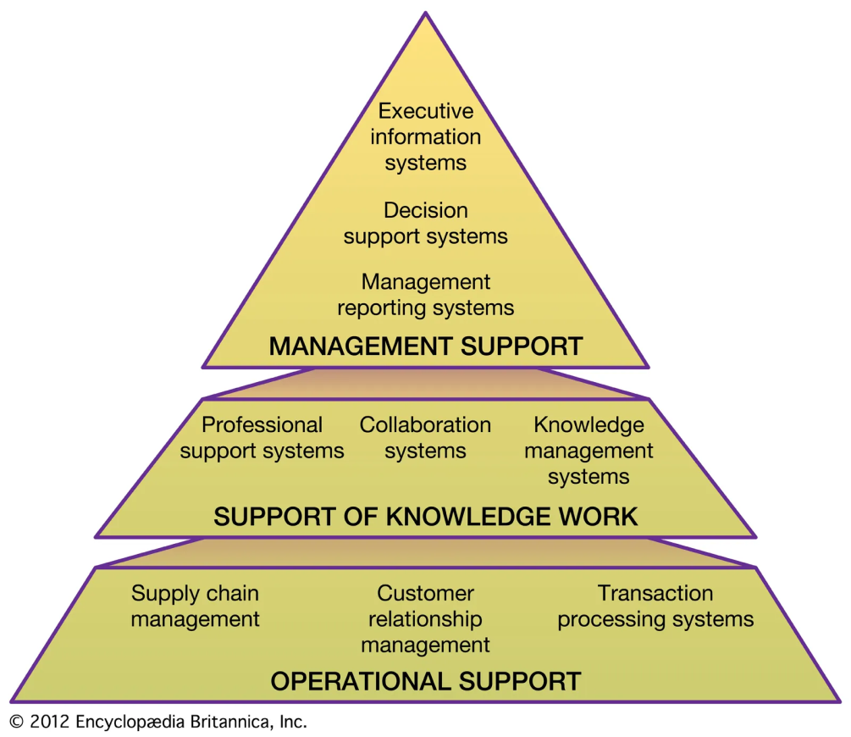
Business Performance Impact
These information systems increased operational efficiency through automation, integration and real-time business information availability (Seun et al., 2023).
Companies gained from quick decision-making, lower cost of operations and higher levels of client satisfaction.
Good governance ensured trust in organisations through data protection and the minimisation of ethical hazards (Mahmood et al., 2024).
Implementation involved employee training, organisational commitment and technological improvements.
Notes:
These information systems raised efficiencies due to automation, integration and real-time information. Organisations made quick decisions at reduced costs while satisfying customers. The implementation of good governance ensured that there were no ethical issues. Good governance entailed training, commitment to the organisation and technology development.

Slide 26
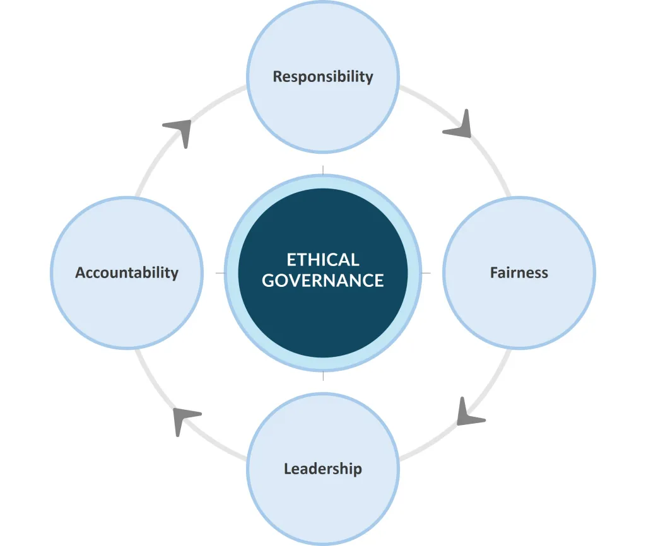
Key Takeaways
Information systems provide sustainable competitive advantages if these systems are consistent with organisational objectives and business strategies (Van Thuy, 2025).
The successful implementation of these systems is contingent upon leadership commitment, employee involvement and organisational culture (Vasudevan et al., 2025).
Ethical governance continues to be a necessary component for maintaining stakeholders' trust and compliance within the digital space.
Organisations can achieve maximum business performance by constantly innovating through information systems.
Notes:
Competitive advantage through information systems is sustainable when the latter are compatible with the business. Their implementation is dependent on good leadership and organisational culture. Information ethics ensures stakeholder trust. Innovation sustains optimal business performance through information systems.

Slide 27
Reference List
Al Kalach, N., (2025). AI-Driven Customer Relationship Management: Enhancing Salesforce Efficiency Through Predictive Analytics. International Journal of Advance Industrial Engineering, 13(01), pp.22-35.
Backer, C.R., Slaman, M., Haddara, M. and Langseth, M., (2023). Towards Sustainable ERP Systems: Bridging the Gap Between Current Capabilities. In Proceedings of the Future Technologies Conference (FTC) 2023, Volume 4 (Vol. 4, p. 216). Springer Nature.
Chaturvedi, R.K., (2024). Current Research Trends in Business and Technology Management.
Herath, H.M.S.S., Herath, H.M.K.K.M.B., Madhusanka, B.G.D.A. and Guruge, L.G.P.K., (2024). Data protection challenges in the processing of sensitive data. In Data Protection: The Wake of AI and Machine Learning (pp. 155-179). Cham: Springer Nature Switzerland.
Khan, M.A.R., Akter, M.S. and Islam, R., (2024). Big data analytics and predictive analysis in enhancing customer relationship management (CRM): a systematic review of techniques.
Mahajan, R., (2025). Collaborative Planning and Design of Digital Supply Chain. In Flexibility and Emerging Perspectives in Digital Supply Chain Management (pp. 41-61). Singapore: Springer Nature Singapore.
Mahmood, H.S., Abdulqader, D.M., Abdullah, R.M., Rasheed, H., Ismael, Z.N.R. and Sami, T.M.G., (2024). Conducting in-depth analysis of AI, IoT, web technology, cloud computing, and enterprise systems integration for enhancing data security and governance to promote sustainable business practices. Journal of Information Technology and Informatics, 3(2), pp.297-332.
Mohammed, I.A., (2020). Optimizing Supply Chain Performance with AI, ML, and ERP Integration for Proactive Supplier Quality Management.
Rai, D., (2025). Challenges in Demand Forecasting for New Product Launches: An Industry Survey. In International Conference on Data Science and Applications (pp. 438-454). Cham: Springer Nature Switzerland.
Seun, E.B.I.E.S.U.W.A., Babajide, G.E.G.E.L.E.S.O., Taye, F.A.L.A.N.A., Aderonke, A.D.E.G.B.E.N.J.O. and Olabode, B.A.M.I.S.I.L.E., (2023). Impact of information systems on operational efficiency: A comprehensive analysis. Indian journal of computer science and engineering, 14(4), pp.661-673.
Van Thuy, N., (2025). Developing Management Information Systems Creates Competitive Advantages for Businesses. Journal of Organizational Behavior Research, 10(1-2025), pp.15-19.
Vasudevan, A., Salim, I., Mohammad, S.I., Wenchang, C., Krishnasamy, H.N., Parahakaran, S., Al-Adwan, A.S. and Alshurideh, M.T., (2025). Sustainable leadership and employee performance: the role of organizational culture in Malaysia’s information science sector. Appl. Math, 19(1), pp.101-113.

Slide 28

Ending slide

