Slide 1

The Meaning and nature of Performance Management
Or, insidious, corporate scam?

Slide 2

Last week
We reflected upon the vital role of the line manager
We heard some great presentations

Slide 3
But what does HR do?
To conclude our work on the role of the line manager we need to reflect upon the role of HR
In groups, please provide an overview of the business partner model AND outline how managers are supported in the vital role
What do we mean by the three-legged stool?
40 minutes

Slide 4


Driving Performance
IMPACT OF PERFORMANCE MANAGEMENT APPROACHES AND HOW PERFORMANCE MANAGEMENT DATA CAN BE USED TO DRIVE IMPROVEMENTS

Slide 5

What is it?
Not a single activity
Establishes objectives in line with mission and strategy
Improves performance
Holds people to account
Two-way, regular, open

Slide 6
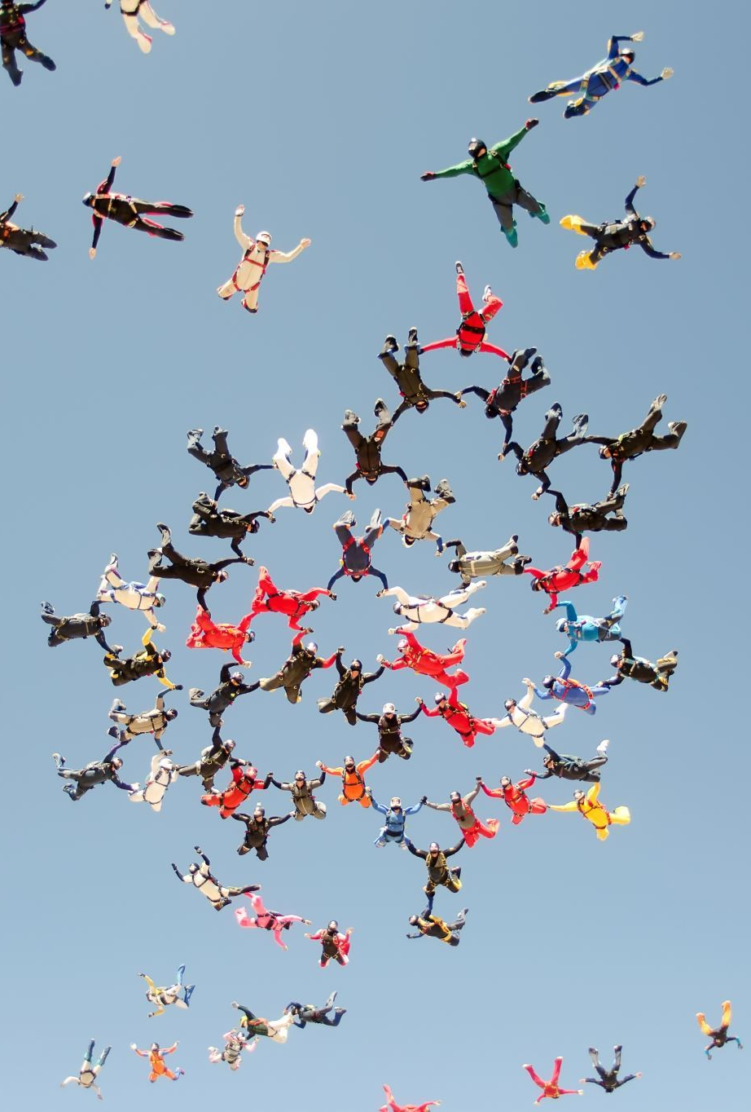
What does it look like in your organisation?
Group discussion

Slide 7

Defined
"A broad set of activities aimed at improving employee performance" (DeNisi and Pritchard, 2006)
"The process of improving performance by setting individual and team goals that are aligned to the strategic goals of the organisation" (Armstrong, 2022)

Slide 8
Components (Armstrong, 2022)
Alignment to strategic objectives
Planning performance to achieve the goals
Reviewing and assessing performance
Developing the knowledge, skills and abilities of people

Slide 9
Distinct from performance appraisal
Performance management
Appraisal
A broad set of activities that includes appraisal
Term arose when practitioners and scholars began talking about transforming appraisal from an event to a process
Aims to improve performance
A discrete, formal event, once or twice a year, which has clearly stated dimensions and an evaluation process.
Measures performance

Slide 10
The nature of performance management
Performance management is about leadership and managing the business

Slide 11
The role of the line manager
Clarify what is expected of team members & set direction
Ensure the team has the right skills and resources
Motivate them
Secure their engagement
Monitor progress
Keep them informed of how they are doing
Develop their skills through coaching
Take corrective action if required

Slide 12

Aims of performance management
A well-designed and well-accepted performance management system has a four-fold purpose:
  Strategic communication
  Relationship building
  Employee development
  Employee evaluation

Slide 13
Benefits to the employee
Know what is expected of them
Know where they stand
Know what they need to do to achieve objectives
Be given the opportunity to develop careers
Discuss their development needs with their manager

Slide 14

What management can gain
Integrate individual, team and corporate objectives
Guide individual and team effort to meet business needs
Motivate and engage employees
Recognise individual contribution
Plan individual careers
Introduce relevant the effective learning and development programmes

Slide 15

Impact
Armstrong, 2022 – measuring impact of performance management is problematic:
Determining link between cause and effect is a problem
Correlation does not imply causation
May well be other variables that improved performance:
"although it is nice to believes that more HR practices leads to higher economic return, it is just as possible that it is successful firms that can afford more extensive HRM practices" Purcell et al, 2003

Slide 16
How well is it working?
Low quality, low rates of coverage
"Insidious, this corporate sham" (professor from UCLA Anderson School of Management)
Pulakos and O'Leary 2011 "performance management is broken"
Cappelli and Travis 2016 "something is fundamentally with them" (appraisals)
IES: complex and bureaucratic

Slide 17
What is wrong with it? Armstrong 2022
The nature of typical performance management systems
The annual review or appraisal
The practice of rating
Objective setting
The link to performance pay
Line managers who lack skills and/or interest

Slide 18

Overcoming the problems
IES: should be about how people are managed all year round
Should consist of discussion about:
  Priorities
  Feedback
  Development
  How these link to business results
  Not HR led

Slide 19

Leadership not judgement
The modern emphasis upon the manager as a leader who strives to help his team achieve both their own and the company's objectives is inconsistent with the judicial role demanded by most appraisal plans
McGregor, 1957

Slide 20
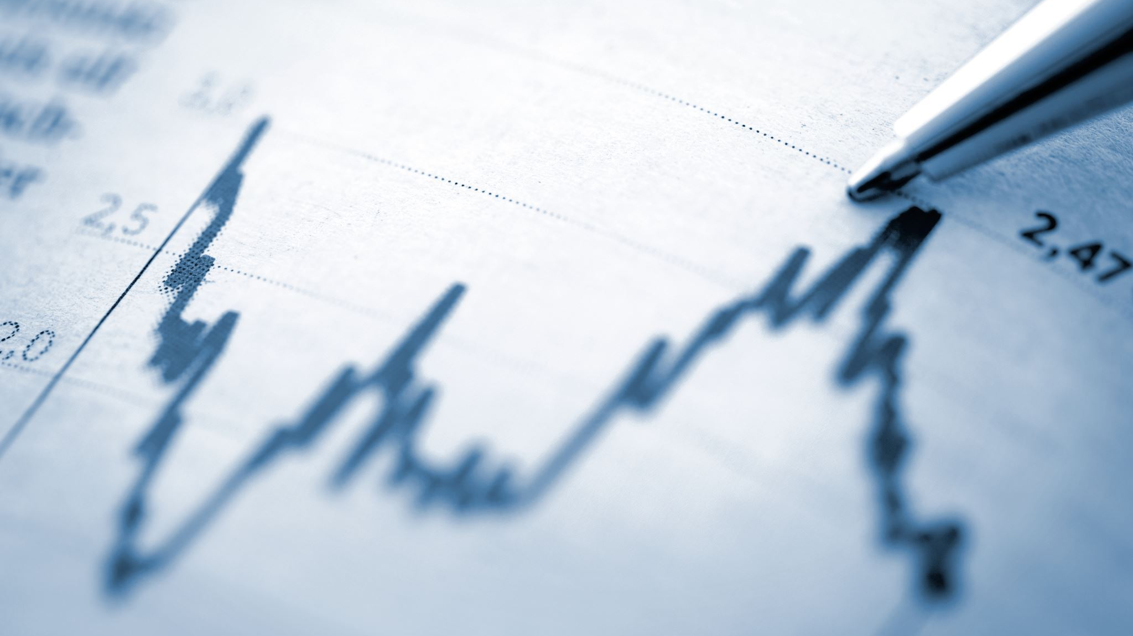
Conversations that Count
Cappelli and Tavis (2016) pointed out that:
  Conversations take place when projects finish, milestones are met, challenges pop up and so forth
  This allows people to solve problems in current performance and develop skills for the future
  Replace the annual discussion with frequent performance and development discussions

Slide 21

Priorities rather than objectives

Slide 22

More on this next week

Slide 23
Hybrid v Office based
What differences might there be?

