Slide 1
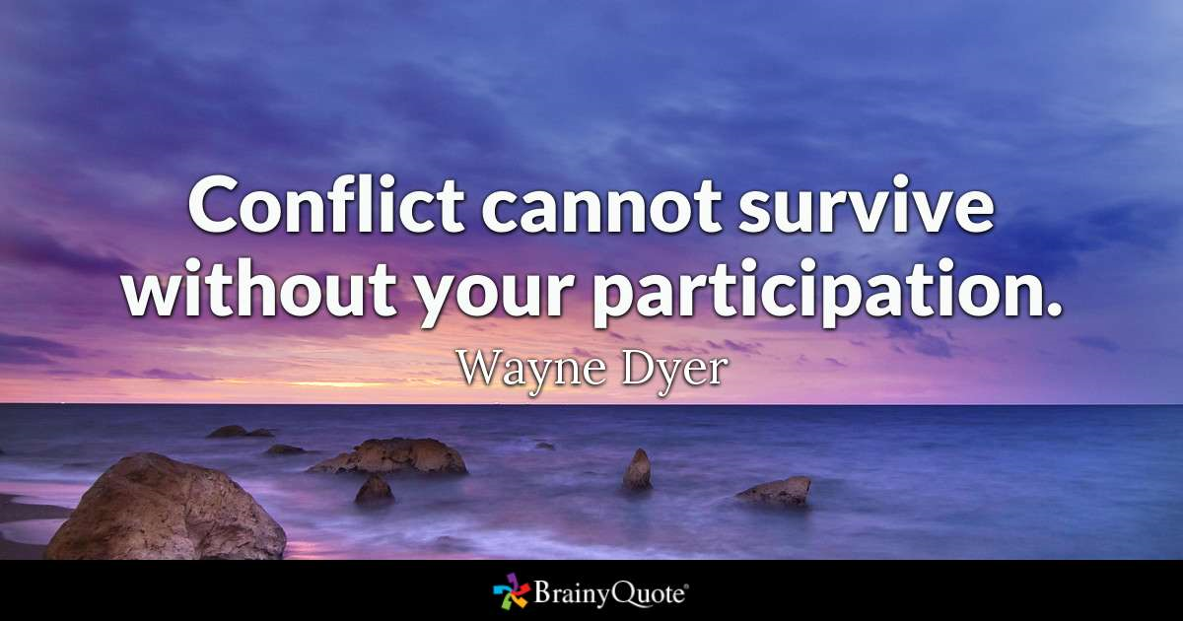
Researcher and Presenter:
Rita M Patterson.

Slide 2
Why do Bullies, Bully
Disseminate my Research from the Focus Group.
Empirical Research Skills.
M6X00966

Slide 3
This Presentation will summarise the findings from my Independent Project, more specifically the Research Proposal assignment and finally the Triad work (Assignment 1,2 and 3)are all going to be synthesised (Patterson 2018).

Slide 4
Historical - Independent Project
Qualitative Research- Literary Review.
Review and Search and Evaluate the literature on the subject selected.
The main objective was the Surveys, Synthesise, Critically Evaluate the subject.
The presentation of this project in the form of assignment(Patterson,2018).

Slide 5
Approved -Ethical Committee.
What makes a Bully, Bully?
(Environment, Nurture, Power, Genetics)
(Brendgen and Troop-Gordon, 2015; Hasan, 2010; Juvonen and Graham, 2014; Malaby, 2009; Wolke and Lereya, 2015).
How to identify a Bully ?
(Characteristics)
Bowes et al., 2013; Bredgen and Poulin, 2009; Harvey et al., 2006; Hogh and Dofradottir, 2001; Salmivalli, 2017).
Why do bullies, Bully ?
(Motivations, Behaviour)
(Hall and Lynch, 1998; Mackay, 2013; Salmivalli, 2017).
How do we get bullies into Counselling ?
(Sanctions, Self- referral)
(Cornell and Brockenbrough, 2004).
Historical -Research Proposal

Slide 6
Note: Issued documentation to all participants prior to focus group(including receiving them from other Focus Group).
Method / Planning / Resources
Covering Letter : Invitations to join a Focus Group.
Information sheet: What, how, when and why, about the topic to be discussed.
Reiteration/Review: Ethics, discussion and any other questions.
Consent Form: – Signed, Dated, Accepted
Participants Problems: Awareness.
Room: space for focus group

Slide 7
Opening Round
Greeting and thanking the attendees
Safety issues
Ethical Issues
Discuss/issuing
Record Audio and Video
Closing round
(Braun and Clarke, 2006; Decker et al., 2011
Focus Group – Facilitation
Notes:
Greeting and thanking the attendees; for their participation(all female, varying ages).
Safety issue; Continues Ethical observations, Health and Well-Being of all participates. Health and Safety rules of the University.
Discuss/issuing the following; covering letter
Information sheet for Focus groups , ethical form, content form. Reiterate the intentions from the research proposal and repeat over arching question and follow up with the three question needed in the focus group and at the end go over the debriefing.
Ensuring that the well-being is paramount and they have the choice to leave throughout the discussion and their recordings with be upheld or dismiss. Autonomy.
Record all spoken word, with the view to creating a transcript and analysis. These codes and themes will be in the presentation.

Slide 8
Method / Planning / Resources
Focus Group; consisted of 4 other students and a lecturer from this course, recorded audio and visual.
Notes of any emotions and demeaner. Ethical procedure was paramount (Decker et al 2012) .
The plans included Audio and Video recordings as a way of collecting data.
A copy was held by the facilitator to use the data in the trial of Thematic Analysis, which goes on to form this presentation. This was used for the data corpus.

Slide 9
Thematic Analysis
Identifies: looking for pattern coding, themes of the reasons, from my subjective positionings. Aiming for data reduction.
Social constructionist approach allows the recordings and reporting to be reflective and with a certainty of reality.
Active Choices and the reflection allows for my interpretation -assumption. (Braun & Clark, 2006:79)

Slide 10
Focus Group – Facilitating
Overarching Questions,
Why do Bullies, Bully?
Questions
1) What does bullying mean to you?
2) What are the main characteristics of a bully? Age and environment?
3) How does the environment and genetic factors influence a bully’s actions?
4) How can we get the bully to talk about their behaviour?

Slide 11
Developing a method of listening, transcribing, reading and identifying, analysing, patterns (themes) from the data received from the focus group (5) Data Corpus.
Collating and organising the data which is relevant to analysis used. The data set (1)will be subjective and interpretive.
This will, in turn, give the data richness in the details.
(Braun & Clark, 2006:79)
Research Method
Thematic Analysis
Notes:
TA- Used as a qualitative analytic tool in psychology and counselling. Data set 1 is my focus group

Slide 12
Discussion and Process
The following steps were used in the conversion of the focus group discussions with the aim of data reduction: The main areas was the semantic (language and the meaning of it).
Coding manually allowed the themes to be revealed. Constantly reading the data: theoretical approach of counselling within mental health and counselling.
Coding started with the first initial of the participants
Reduced to Genetic factors, Underlaying issues, Personal feelings, Environment and finally Characteristics.
Reduced further to Psychological Attitudes, interpersonal Relationships, Personal Development.
Social Constructivism, sociological theories of Knowledge, how social phenomena develop in social context.
Epistemology researcher digs deep to uncover evidence – reality uncovers that which exists independently. It is not sculptured or created. (Braun & Clark, 2006:79)
Notes:
Latent definition is — present and capable of emerging or developing but not now visible, obvious, active, and capable of emerging or developing but not now visible, obvious, active,

Slide 13
Output of the TRANSCRIPT – Data Set (1)
Conclusions
Keywords/ Themes | Psychological Attitude | Interpersonal Relationships | Personal Development
Genetics Factors | Helpfulness | Confidant | Support
Underlying Issues | Self-esteem | Jealously | Frustration
Personal Feelings | Self-confidence | Dependant | Emotional
Home/School/Work | Confidence | Single Person | Jealousy
Characteristics | Frustration | Frustration | Self-esteem

Slide 14
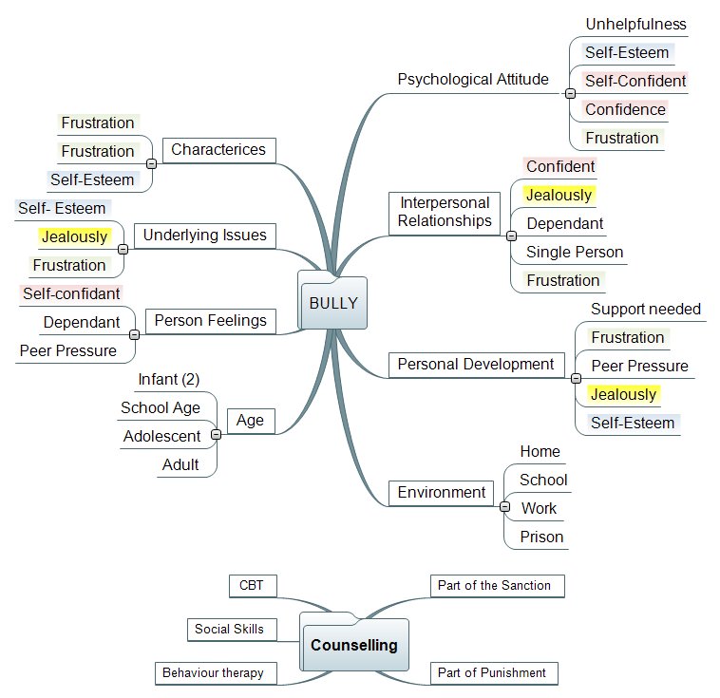

Slide 15
Did all these research methods give any concrete answers to the question.
Why do Bullies Bully?

Slide 16
Conclusions: Why Bullies Bully?
Home - Infant
No Boundaries, New Events, Relationships Parenting Skills, Social Skills.
School - Adolescent
Frustration, Jealousy, Lack of Social skills
Work - Adult
Management Style, Lack of skills
Prison – Domestic Violence
Notes:
Home – School – Self referral
Behaviour theory that needs to be completed after the events, not withdrawing from School.
Group Facilitation.
Expel student from school.
Mental Health Assessment.
Home – Work, Self-referral
Relationship counselling.
Change of Management style.
Prison – Counselling – Self referral
Conditions of Penalty.

Slide 17
Thank you for attending this presentation
Rita Patterson P144236

Slide 18
References 1
Bowes, L., Maughan, B., Ball, H., Shakoor, S., Ouellet-Morin, I., Caspi, A., Moffitt, T.E., Arseneault, L., (2013). Mothers’ Parenting and Young Economically Disadvantaged Children’s Relational and Overt Bullying. Dev. Psychopathol. Camb. 25, 333–46. http://dx.doi.org/10.1017/S0954579412001095
Braun, V., Clarke, V.,( 2006). Using thematic analysis in psychology. Qual. Res. Psychol. Lond. 3, 77–101. http://dx.doi.org/10.1191/1478088706qp063oa
Bredgen, M., Poulin, F., (2009). It Takes Two: Rethinking the Aggressor-Victim Relationship. Presented at the Society for Research in Child Development, Link.springer., pp. 1327–1338. https://doi.org/10.1007/s10802-017-0314-5
Brendgen, M., Troop-Gordon, W., (2015). School-related Factors in the Development of Bullying Perpetration and Victimization: Introduction to the Special Section. J. Abnorm. Child Psychol. 43, 1–4. https://doi.org/10.1007/s10802-014-9939-9
Cornell, D.G., Brockenbrough, K.,(2004). Identification of Bullies and Victims: A Comparison of Methods. J. Sch. Violence 3, 63–87. https://doi.org/10.1300/J202v03n02_05
Curtner-Smith, M.E., Culp, A.M., Culp, R., Scheib, C., Owen, K., Tilley, A., Murphy, M., Parkman, L., Coleman, P.W.,( 2006). Mothers’ Parenting and Young Economically Disadvantaged Children’s Relational and Overt Bullying. J. Child Fam. Stud. 15, 177–189. https://doi.org/10.1007/s10826-005-9016-7
Decker, S.E., Naugle, A.E., Carter-Visscher, R., Bell, K., Seifert, A.,(2011). Ethical Issues in Research on Sensitive Topics: Participants’ Experiences of Distress and Benefit. J. Empir. Res. Hum. Res. Ethics 6, 55–64. https://doi.org/10.1525/jer.2011.6.3.55

Slide 19
References 2
Decker, S.E., Naugle, A.E., Carter-Visscher, R., Bell, K., Seifert, A.,(2011). Ethical Issues in Research on Sensitive Topics: Participants’ Experiences of Distress and Benefit. J. Empir. Res. Hum. Res. Ethics 6, 55–64. https://doi.org/10.1525/jer.2011.6.3.55
Hall, D., Lynch, M.A.,(1998). Violence begins at home. BMJ Br. Med. J. Lond. 316, 1551. http://dx.doi.org/10.1136/bmj.316.7144.1551
Harvey, M., Heames, J., Richey, R., Leonard, N., (2006). Bullying: From the Playground to the Boardroom. J. Leadersh. Organ. Stud. 12, 1–11. https://doi.org/10.1177/107179190601200401
Hasan, N.T., (2010). American Psychological Association of Graduate Students, in: Weiner, I.B., Craighead, W.E. (Eds.), The Corsini Encyclopedia of Psychology. John Wiley & Sons, Inc., Hoboken, NJ, USA. https://doi.org/10.1002/9780470479216.corpsy0045
Hogh, A., Dofradottir, A., (2001). Coping with bullying in the workplace. Eur. J. Work Organ. Psychol. 10. https://doi.org/10.1080/13594320143000825
Juvonen, J., Graham, S., (2014). Bullying in Schools: The Power of Bullies and the Plight of Victims. Annu. Rev. Psychol. 65, 159–185. https://doi.org/10.1146/annurev-psych-010213-115030
Mackay, P., (2013). Government Introduces Legislation to Crack Down on Cyberbulling(Braun and Clarke, 2006; Decker et al., 2011. Marketwired.
Malaby, M., (2009). Public and secret agents: personal power and reflective agency in male memories of childhood violence and bullying. Gend. Educ. 21, 371–386. https://doi.org/10.1080/09540250902785939

Slide 20
References 3
Mohl, A.S., (2010). The Family, Culture and Psychohistory. J. Psychohist. N. Y. 37, 335–348.
Ria, A., Agarwal, A.U., (2016). Workplace Bullying: A Review and Future Research Directions. South Asian J. Manag. 23, 27–57.
Salmivalli, C., (2017). Peer Victimization and Adjustment in Young Adulthood: Commentary on the Special Section. J. Abnorm. Child Psychol. 1–6. https://doi.org/10.1007/s10802-017-0372-8
Witkow, M., (2011). Bullying is good! [Parenting]. Times India Online New Delhi.
Wolke, D., Lereya, S.T.,( 2015). Long-term effects of bullying. Arch. Dis. Child. Lond. 100, 879–885. http://dx.doi.org/10.1136/archdischild-2014-306667

