Slide 1


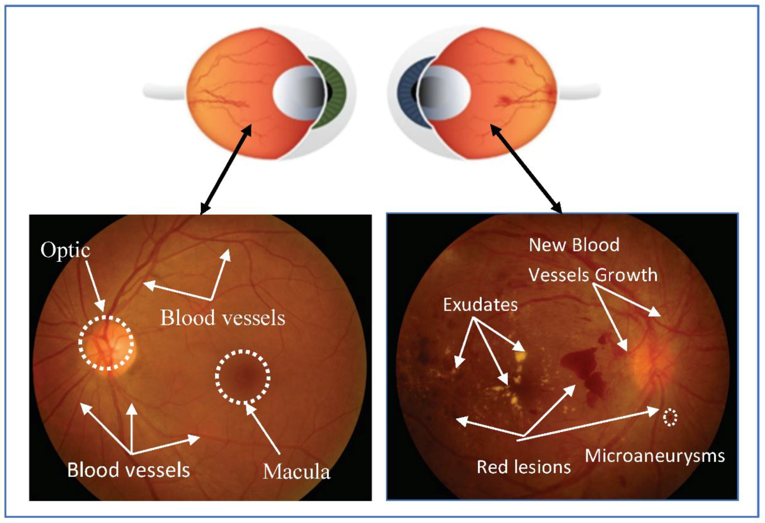
Autonomous Artificial Intelligence for Diabetic Retinopathy Screening
Student Name: Manpreet kaur
Student ID: 2246813
Module Code: BMHP6026
Lecturer: Lecturer’s Name: zakiyyah ahmed
Focus Areas: Workforce and Service Delivery

Slide 2
Introduction
Diabetic retinopathy causes avoidable vision loss, and many patients miss screening due to access barriers worldwide.
Autonomous AI systems analyse retinal images and give immediate referable or non-referable results at clinics.
IDx DR received FDA De Novo authorisation in 2018 and led to further real-world deployments.
This presentation evaluates workforce changes and service delivery impact to inform safe and equitable implementation planning.
Notes:
I will present the issue of diabetic retinopathy and its necessity of screening. I describe what autonomous AI is and mention such regulatory milestones as IDx DR FDA approval. I provide the purpose of the presentation in order to assess the workforce and service delivery effects. I will be relying on peer reviewed research and policy reports to make recommendations. The idea is to reveal how this innovation can be applied in health services in the present day in a safe and fair manner.

Slide 3

Overview of the Innovation
Autonomous AI analyses retinal photographs with deep learning to detect referable diabetic retinopathy at the point of care (Wolf et al., 2024).
The system gives a clear binary result that directs either immediate referral or reassurance to the patient (Nguyen et al., 2022).
IDx DR gained regulatory authorisation and acts as the first widely adopted autonomous diagnostic example in medicine (Liu et al., 2021).
Implementations appear in primary care community clinics and screening pilots improving reach for underserved populations and equity (Khan et al., 2025).
Notes:
I will give you a description of what autonomous AI is and why it is important. Deep learning analyses retina photos to identify referable disease and provides a clear answer regarding whether or not the patient is referred to another specialist, I explain. I record IDx DR regulatory milestone and demonstrate typical settings of primary care and community clinics. I will indicate that it may be helpful to make access improve, and I will point out the findings indicating safety and accuracy of recent reviews including large systematic analyses.

Slide 4
Overview of the Innovation Cont.
Typical workflow starts with technician capturing non mydriatic fundus images then AI returns instant result for action (Khan et al., 2025).
Autonomous systems provide a final decision without routine clinician readback compared with assistive AI that supports human review (Kumar and Paul, 2023).
Required hardware includes a fundus camera or tabletop plus validated AI software and reliable internet and local processing (Liu et al., 2021).
Pivotal trials and meta-analyses report high sensitivity for referable disease but note variable specificity across settings (Wolf et al., 2024).
Notes:
I will identify the clinical workflow and technical requirements of autonomous AI screening. I describe the principles of image capture of non-mydriatic fundus cameras and how the AI provides instant results of guidance on same day referral. I compare autonomous decisions with assistive AI which needs review by clinic providers. I focus on hardware requirements, internet processing or local processing and supporting evidence in trials and meta-analysis indicating clinical accuracy and mentioning the variation depending on setting constraints.

Slide 5
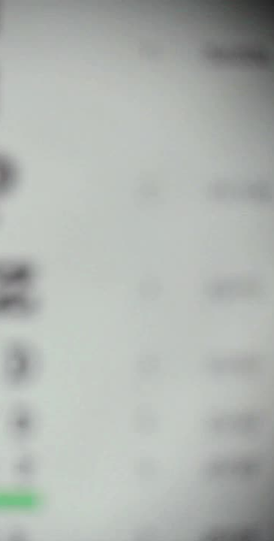
Impact on Workforce
Autonomous AI shifts screening from ophthalmologists to nurses and technicians who now capture images and deliver results (Wolf et al., 2024).
This redistribution reduces specialist workload but requires new clinical competencies and training for non-specialist staff (Yenice, 2021).
Training focuses on image quality, patient communication, and understanding AI results to ensure safe clinical interpretation (Opie, 2021).
Continuous competency checks and audits maintain image standards and prevent diagnostic errors linked with poor capture quality (Chappell et al., 2021).
Notes:
I will describe the way autonomous AI transforms the workforce structure shifting the screening process on-train to ophthalmologists to trained nurses and technicians. I explain how this decreases the workload of specialists but increases the new skills. Employees have to be taught responsible image capturing, counselling of the patient, and interpretation of AI results. Constant training and audits are essential to the maintenance of high accuracy and confidence. I will point out the impact of professional standards and credentialing in the implementation of safety in different settings of care.

Slide 6
Impact on Workforce Cont.
Role expansion demands updated credentialing systems and support for professional development to maintain safety and accountability (Chappell et al., 2021).
Legal accountability remains shared since clinicians oversee referrals and must verify results for complex or uncertain cases (Khan, 2022).
Studies note improved job satisfaction among staff gaining digital skills but anxiety among graders facing possible role loss (Wolf et al., 2021).
Workforce planning should reassign graders to quality assurance and clinical governance to protect expertise and employment (Althaus et al., 2021).
Notes:
I will explain how the new roles demand credentialing and ongoing professional development. Sharing of accountability is present since the clinicians control the referrals of patients which will provide safety in cases where AI outputs are not certain. I refer to research where the morale of drilled employees increased and there was a tendency of insecurity in the traditional graders. The key to this is a workforce planning to retrain the graders to be in the grader roles of governance and QA since the skills of these individuals would be retained, but safe utilization of this technology is required in all the services.

Slide 7
Impact on Service Delivery
New pathway enables same day screening during routine visits reducing delays and increasing early detection opportunities (Liu et al., 2021).
It replaces multi step referrals to eye clinics with immediate action but may increase referrals to specialists (Wolf et al., 2024).
Improved access in underserved areas depends on camera availability trained staff and reliable connectivity for AI processing (Kumar and Paul, 2023).
Monitoring referral volumes and specialist capacity is essential to avoid bottlenecks and ensure timely follow up (Nguyen et al., 2022).
Notes:
I will describe how autonomous AI will transform the processes of service delivery by allowing same day screening in the regular visits and cutting down on delays and accelerating the process of diagnosis. I will contrast this to previous traditional multi-step referral pathways that took a long while to be attended to. I will also insure that the benefits depend on cameras, trained personnel and connectivity. I will also emphasize the necessity to check the number of referrals received and capacity levels of the specialists to limit bottlenecks and provide a patient with the timely follow-up.

Slide 8
Impact on Service Delivery Cont.
High sensitivity reduces missed disease, but false positives can raise anxiety and overload specialist clinics quickly.
Strategies include triage thresholds human confirmatory reads and staged referral pathways to manage specialist demand effectively.
EHR integration secure data flows and audit trails are required for safe service delivery and accountability (Lee et al., 2025).
Ongoing quality assurance must monitor model drift camera failures and population performance across demographic groups regularly (Kotronoulas et al., 2025).
Notes:
I will address the performance of diagnosing and downstream implications of autonomous AI. High sensitivity assists in the early detection of disease but may cause false positives and extra work of specialists. I will explore such solutions as triage thresholds, human confirmatory reads and staged referrals as ways of managing demand. I will emphasise the great necessity of integrating EHR, secure reporting and audit trails. I will conclude by emphasizing quality assurance of routine to identify ability to detect model drift and make fair performances across populations.

Slide 9

Challenges and Recommendations
High initial cost of cameras and AI software limits adoption in smaller clinics without funding support (Adler-Milstein et al., 2022).
Limited staff skills and digital confidence reduce effective use, requiring structured training and protected learning time.
Interoperability issues between AI systems and EHR platforms slow integration and threaten data flow efficiency and accuracy (Althaus et al., 2021).
Governance frameworks should define accountability, update cycles, and continuous monitoring to ensure safe and equitable long-term use.
Notes:
I will highlight the key difficulties in the implementation of autonomous AI screening. I am going to describe how equipment and software prices are still an obstacle particularly to smaller services. I will single out low digital competence in employees and the necessity of continuous education and guidance. I will also comment on the problem of EHR interoperability and accountability, emphasizing the importance of clear governance, finance systems, and model oversight to provide this innovation as a future of healthcare systems that are safe, sustainable, and fair.

Slide 10
Conclusion
Autonomous AI for diabetic retinopathy is a validated innovation improving access, speed, and accuracy of eye screening.
1
Its success relies on trained staff, strong governance, and effective system integration across all healthcare levels.
2
Continuous evaluation ensures fairness, safety, and sustainable impact without increasing inequalities or overloading specialist services.
3
With proper funding, workforce planning, and policy support, this technology can prevent avoidable vision loss globally.
4
Notes:
Conclusively, I shall underline the fact that autonomous AI screening is a tested and secure innovation capable of increasing access and accelerating the rate of detection of diabetic eye disease. I will point out that its success will rely on training of workforce, governance and integration into health systems. I will emphasize on constant monitoring in order to promote fairness and quality. Lastly, I will conclude with a lot of confidence that with the right backing, this innovation could help prevent needless vision losses in the world to a large extent.

Slide 11
References
Adler-Milstein, J., Aggarwal, N., Ahmed, M., Castner, J., Evans, B.J., Gonzalez, A.A., James, C.A., Lin, S., Mandl, K.D., Matheny, M.E. and Sendak, M.P., 2022. Meeting the moment: addressing barriers and facilitating clinical adoption of artificial intelligence in medical diagnosis. NAM perspectives, 2022, pp.10-31478.
Althaus, C., Carson, L. and Smith, K., 2021. Rethinking the commissioning of consultants for enhancing government policy capacity. Policy Sciences, 54(4), pp.867-889.
Chappell, K.B., Howard, M.S., Lundmark, V. and Ivory, C., 2021. Credentialing and certification: overview, science, and impact on policy, regulation, and practice. International Nursing Review, 68(4), pp.551-556.
Khan, M.N.I., 2022. A Systematic Review of Legal Technology Adoption In Contract Management, Data Governance, And Compliance Monitoring. American Journal of Interdisciplinary Studies, 3(01), pp.01-30.
Khan, Z., Gaidhane, A.M., Singh, M., Ganesan, S., Kaur, M., Sharma, G.C., Rani, P., Sharma, R., Thapliyal, S., Kushwaha, M. and Kumar, H., 2025. Diagnostic accuracy of IDX-DR for detecting diabetic retinopathy: a systematic review and meta-analysis. American Journal of Ophthalmology, 273, pp.192-204.
Kumar, V. and Paul, K., 2023. Fundus imaging-based healthcare: Present and future. ACM Transactions on Computing for Healthcare, 4(3), pp.1-34.
Lee, M., Kim, K., Shin, Y., Lee, Y. and Kim, T.J., 2025. Advancements in Electronic Medical Records for Clinical Trials: Enhancing Data Management and Research Efficiency. Cancers, 17(9), p.1552.
Liu, J., Gibson, E., Ramchal, S., Shankar, V., Piggott, K., Sychev, Y., Li, A.S., Rao, P.K., Margolis, T.P., Fondahn, E. and Bhaskaranand, M., 2021. Diabetic retinopathy screening with automated retinal image analysis in a primary care setting improves adherence to ophthalmic care. Ophthalmology Retina, 5(1), pp.71-77.
Nguyen, T., Hampton, D. and Eydelman, M.B., 2022. FDA facilitating innovation of ophthalmic devices while balancing the need for safety and effectiveness. JAMA ophthalmology, 140(4), pp.309-311.
Wolf, R.M., Channa, R., Lehmann, H.P., Abramoff, M.D. and Liu, T.A., 2024. Clinical implementation of autonomous artificial intelligence systems for diabetic eye exams: considerations for success. Clinical Diabetes, 42(1), pp.142-149.
Wolf, R.M., Liu, T.A., Thomas, C., Prichett, L., Zimmer‐Galler, I., Smith, K., Abramoff, M.D. and Channa, R., 2021. The SEE study: safety, efficacy, and equity of implementing autonomous artificial intelligence for diagnosing diabetic retinopathy in youth. Diabetes Care, 44(3), pp.781-787.
Yenice, S., 2021. Training and competency strategies for point-of-care testing. Ejifcc, 32(2), p.167.

