Slide 1

Contemporary Issues in Policing
Kendra Wedgwood

Slide 2
Contents
Foundations of policing
Structural evolution
Crisis and reform
Contemporary policing
Vulnerability and safeguarding
Reform and future direction
Summary
Notes:
I will begin this presentation by outlining policing by consent and the Peelian principles, which established policing as a public service grounded in legitimacy. I will then examine the structural evolutions of policing in England and Wales, including key developments such as increasing specialisation. I will then explore contemporary policing, particularly the growing focus on vulnerability and safeguarding, alongside the impact of serious and organised crime and cyber-enabled threats. Finally, I will examine current reform proposals including the recently published White Paper, before concluding with key findings about how policing continues to operate within a more complex environment.

Slide 3
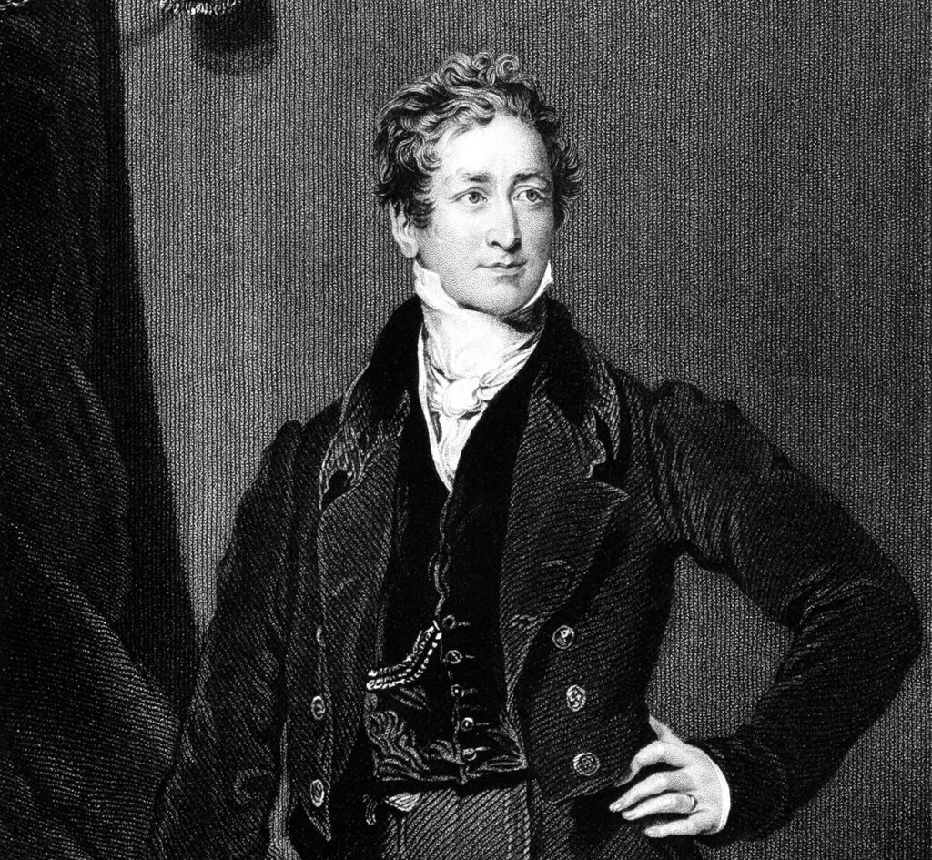
Foundations of Policing
Metropolitan Police Act 1829
Public approval
Minimal force
Citizen in uniform
Photo - Available at: Robert-Peel-Adobe-Stock-1024x945.jpg (1024×945)
Notes:
The Peelian principles established policing as a public service grounded in legitimacy rather than coercion. The effectiveness of policing is linked to public approval and cooperation, rather than reliance on force (Reiner, 2010). Officers were expected to act as citizens in uniform, maintaining order through engagement with the public. This model positioned policing as visible, locally focussed and dependant on public trust (Newburn, 2017). Policing in England and Wales developed through this framework, with legitimacy, public cooperation and minimal use of force forming its foundation. Over time, however, policing has evolved in response to increasing complexity in crime and public expectations. This has resulted in structural reform, increased specialisation and an expanded role in public protection. What this means in practice is that policing depends on public trust and cooperation, rather than the use of force. This is important because it explains why legitimacy is central to policing in England Wales.

Slide 4
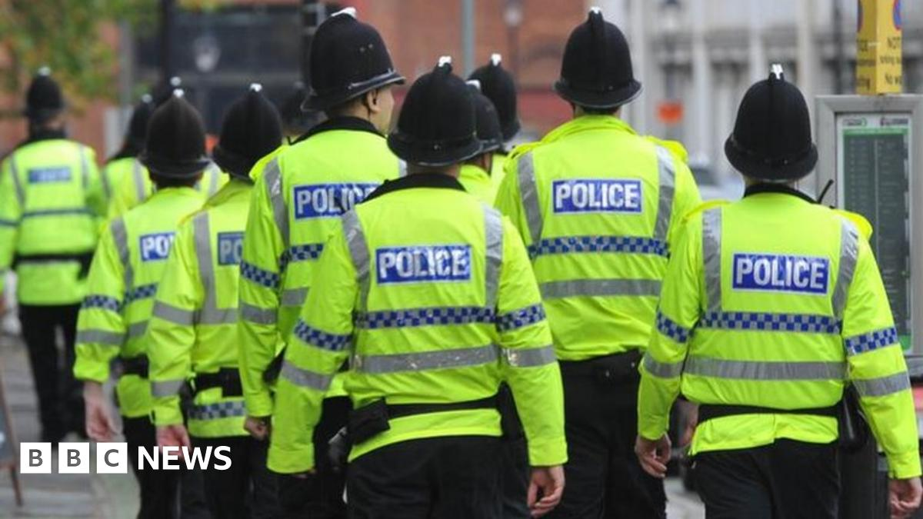
Structural Evolution
Expansion through legislation
National policing structure
CID created
Increasing specialisation
Photo – Available at: _65637031_police-bbc.jpg (1200×675)
Notes:
Policing expanded across England and Wales through legislation, establishing a national policing structure. Over time, policing developed increasing levels of specialism. The creation of the Criminal Investigation Department (CID) formalised investigative work and separated it from uniform duties. This marked a shift away from the generalist constable model towards a more specialised policing system (Reiner, 2010). Newburn (2017) identifies this as part of a broader process of professionalism, where policing increasingly required distinct roles, expertise and organisational structure. This development is significant because it demonstrates how policing began to move away from a purely visible, community-based model towards a more complex system.

Slide 5
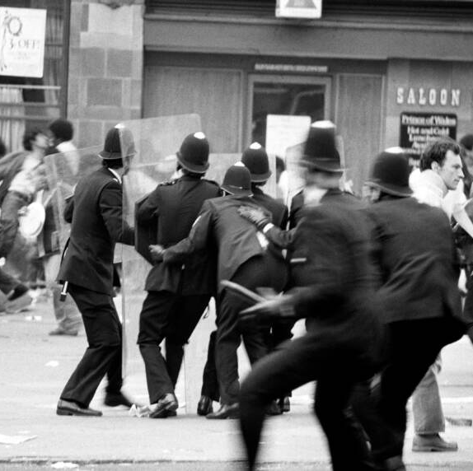
Crisis and Reform
Brixton riots 1981
Scarman Report
Macpherson Report
Accountability reforms
Photo – Available at: brixton-riot.jpg (900×572)
Notes:
Events such as the Brixton riots highlighted tensions between policing and communities, particularly in relation to stop and search and public confidence. The Scarman Report identified weaknesses in police-community relations and emphasised the need for improved engagement and accountability (Scarman, 1981). The Macpherson Report later identified institutional racism within the Metropolitan Police and led to reforms focussed on fairness, transparency and public confidence (Macpherson, 1999). These developments demonstrate that policing legitimacy is not fixed. It requires ongoing review and reform in response to public scrutiny and changing societal expectations.

Slide 6
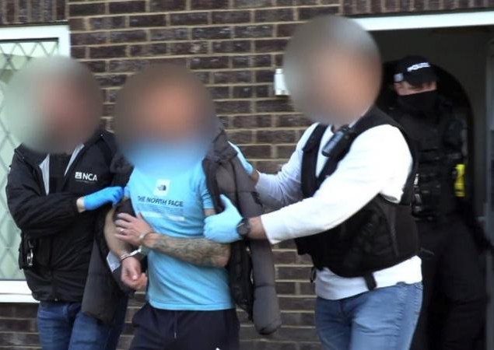
Contemporary Policing
Specialist units
National threats
Reduced visibility
Coordinated policing
Photo – Available at: _129275635_b43371e5-2866-40a5-95b0-71847aea815b.jpg (800×450)
Notes:
Contemporary policing is shaped by a range of complex threats, including serious and organised crime, terrorism and cyber-enabled offending. What is significant here is the nature of these threats. Serious and organised crime, terrorism and cyber-related offending often operate across geographical boundaries, which means individua forces cannot respond in isolation. The Strategic Policing Requirement identifies these as national threats requiring specialist capabilities and coordinated response across forces (Home Office, 2023). This is why national coordination becomes necessary. The Strategic Policing Requirement sets out these threats at a national level, ensuring that forces maintain the capabilities required to respond effectively. Similarly, the Government Cyber Security Strategy highlights the increasing scale and complexity of cyber threats and the need for enhanced capability across the public sector (HM Government, 2022). Much of this activity takes place outside routine public visibility. These developments indicate a shift towards more specialist and less visible policing functions, while still operating within a framework of legitimacy. As a result, much of contemporary policing activity takes place outside routine public visibility, reflecting a shift towards specialist functions rather than traditional visible policing.

Slide 7

Vulnerability and Safeguarding
Focus on vulnerability
Public protection units
Multi agency working
Risk management
Photo – Available at: child-protection-safeguarding-organization-clip-art-png-favpng-QHi6LeUkWK79GJLgRNZBDt8j5.jpg (820×818)
Notes:
A significant development in policing is the increased focus on vulnerability. This includes areas such as domestic abuse, child protection and exploitation, alongside broader safeguarding responsibilities. Policing now involves collaboration with other agencies and structured approaches to risk and harm management. Brothers (2015) highlights the increasing centrality of vulnerability within policing practice. Chanan and Miller (2013) emphasise the importance of partnership working while James, Mullins and Bovaird (2012) identify the shift towards preventative and safeguarding approaches. This demonstrates that policing has expanded beyond traditional enforcement into a broader protection role.

Slide 8
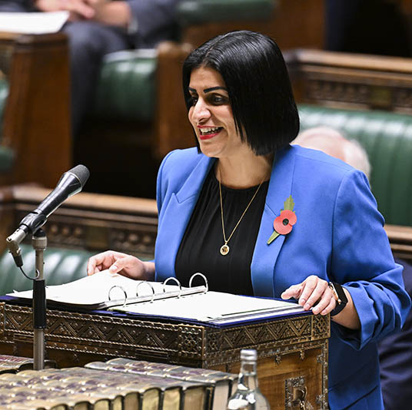
Reform and Future Direction
White Paper reform
Amalgamation of forces
National coordination
Cyber threats
Photo – Available at: https://sl.bing.net/eiN7l31mDYG
Notes:
This slide focusses on recent reform proposals and how they respond to the challenges identified in contemporary policing. Recent reform proposals identify challenges within the current policing structure, including fragmentation and inconsistency in capability. The White Paper local to national: a new model for policing, proposes increased regionalisation and stronger national coordination (Home Office, 2026). What this highlights is that variation in capability across forces has become a key issue, particularly in relation to specialist areas such as serious crime and cyber capability. These reforms are presented as a response to serious and organised crime, cross-border criminality and uneven capability across the existing forty-three force structure. The Government Cyber Security Strategy also highlights the need for stronger capability to address digital threats (HM Government, 2022). Together, these developments indicate a continued shift towards centralisation and increased specialisation within policing. Taken together, these developments indicate a move towards greater national coordination and consistency while maintaining local policing structures.

Slide 9
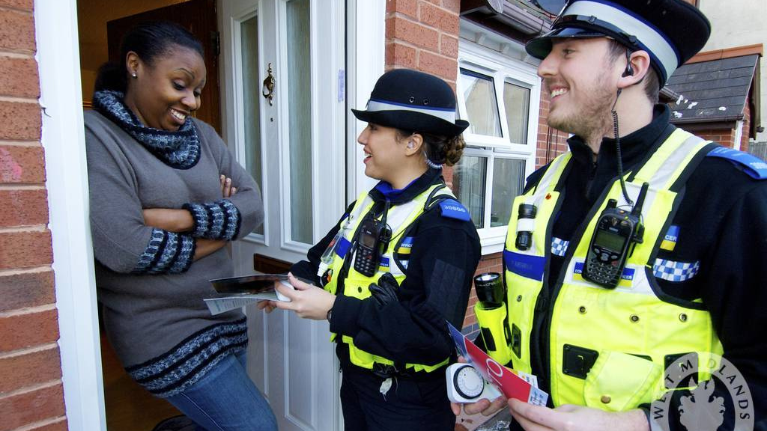
Summary
Policing remains grounded in legitimacy and consent
Structural changes have increased specialisation
Policing includes safeguarding and risk-based functions
Contemporary policing operates across multiple levels
Photo – Available at: policing by consent uk - Search Images
Notes:
Policing in England and Wales continues to be grounded in principles of legitimacy and public consent. However, structural development and increasing specialisation have expanded the role of policing. Policing now incorporates safeguarding, risk management and national level coordination, reflecting a broader public protection function. These developments demonstrate that while policing retains its foundational principles, it now operates within a more complex and multi-functional system.

Slide 10
References
Brothers, J. (2015) Rebalancing Public Partnership: Innovative Practice Between Government and Nonprofits from Around the World. Oxford: Routledge.
Chanan, G. and Miller, C. (2013) Rethinking Community Practice: Developing Transformative Neighbourhoods. Bristol: Policy Press.
HM Government (2022) Government Cyber Security Strategy: 2022 to 2030. London: Cabinet Office.
Home Office (2023) Strategic Policing Requirement. London: Home Office.
Home Office (2026) From local to national: a new model for policing. London: Home Office.
James, R., Mullins, D. and Bovaird, T. (2012) Partnership Working. Birmingham: Third Sector Research Centre.
Macpherson, W. (1999) The Stephen Lawrence Inquiry. London: The Stationery Office.
Newburn, T. (2017) Criminology. 3rd edn. London: Routledge.
Reiner, R. (2010) The Politics of the Police. 4th edn. Oxford: Oxford University Press.
Scarman, L. (1981) The Brixton Disorders 10–12 April 1981: Report of an Inquiry. London: HMSO.

Slide 11
AI Acknowledgement
I acknowledge the use of ChatGPT to support the structuring and organisation of this presentation. AI tools were used to assist with organising content and refining clarity. All material has been reviewed and presented in line with academic standards and sources have been appropriately referenced.

