Slide 1
Student: Calin Matei
Student ID: 1916953
Module: LCBB4007 Introduction to Business
Assignment: Group presentation (Resit)

Slide 2
Introduction
Main Body
Company Overview: eBay
Structure, Size and Function: eBay
Internal Environment
SWOT Analysis
External Environment
PESTEL Analysis
Shareholder: eBay
Ethical Consideration and Corporate Social Responsibilities
Conclusion
References
Content

Slide 3

Introduction
Business component can be termed as the fundamental concept in software development which help in enabling the creation of a system that is module, reusable and maintainable by summarize specific business functionalities. So, this report will briefly discuss about eBay’s business components by analysing the business internal and external environment with the help of SWOT and PESTLE framework.

Slide 4

Company Overview: eBay
Main Body
eBay is an American based multinational e-commerce marketplace founded by Pierre Omidyar in the year 1995. The business main purpose is to connect buyers and sellers online (Comberg and Velamuri, 2017). The business usually operates through online auctions and fixed price with over 190 market worldwide, facilitating transaction between individuals, businesses and government

Slide 5

Structure, Size and Functions: eBay
eBay is a global e-commerce brand and marketplace where people and businesses can buy and sell goods and services online. The business work as hierarchical business structure with a large global user base and functions like facilitating transactions, managing auctions and insurance of its user reputation.

Slide 6

SWOT Analysis
Internal Environment
Strengths: eBay can be considered world’s largest internet marketplace with and positive brand reputation.
Weaknesses: However, the business one of biggest weakness is its high platform fees with no further growth strategy (Namugenyi, Nimmagadda and Reiners, 2019).
Opportunities: eBay could open its online marketplace in other large and growing economics in Asia and Europe to sustain its current growth level
Notes:
Threats: eBay receives only certain part of its foreign operations income which has to be converted in US dollars and can be affect by the exchange rates.

Slide 7
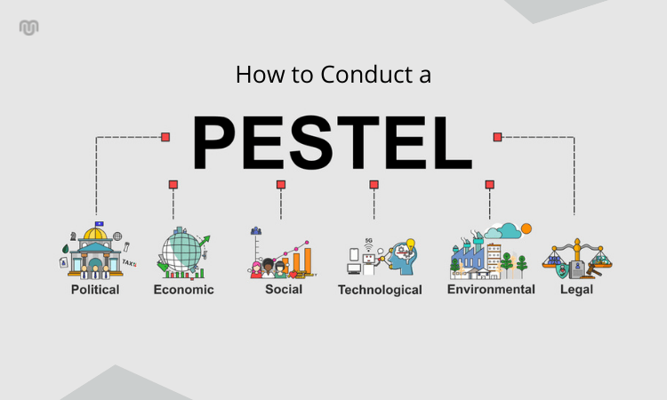
PESTEL Analysis
External Environment
Political: Political relations between countries can impact the cross border trade between businesses.
Economic: Being an international brand eBay deals with various currency. And fluctuation in the currency exchange rates can impact the customer’s purchasing power and seller’s profitability (Gani, Shuib and Yadegaridehkordi, 2018).
Social: Change in demography such as age can change their purchasing behavior and product preferences.
Technological: Advancement in cloud technology can help eBay scale its operations more properly and efficiently.
Notes:
Environmental: eBay could implement guidelines or perhaps provide resources for sellers on electric waste disposer.
Legal: As a global business with employees in various regions eBay must adhere to local employment laws.

Slide 8

Stakeholder: eBay
eBay key stakeholders include product or service sellers, buyers and business employees. The following discuss briefly about the business stakeholders:
Sellers: eBay platform rely heavily on seller as their success is directly tied to the business success making their interest crucial.
Buyers: On the other hand, buyer satisfaction is important for eBay continued operation.
Notes:
Employees: eBay’s employees are crucial for its day to day operations and innovation

Slide 9

Ethical consideration and Corporate Social Responsibilities: eBay
eBay like any large business faces ethical considerations and has many responsibilities to act conscientiously which includes upholding ethical values such as seller transparency and buyer protection, safeguarding the marketplace, human rights, protecting stakeholders while contributing to a sustainable future which can be helpful in strengthening its brand image (Sheehy, 2015).

Slide 10

Conclusion
In conclusion, eBay’s existing business components involved a global online marketplace which connected buyers and sellers online while generating revenue through transaction fees and marketing services and mainly focuses on market penetration through its e-commerce platform. So the main objective of this report is to understand the business components of American based multinational e-commerce marketplace eBay with the help of SWOT and PESTEL framework.

Slide 11
Reference
Comberg, C. and Velamuri, V.K. (2017). The introduction of a competing business model: the case of eBay. International Journal of Technology Management, 73(1/2/3), p.39. doi:https://doi.org/10.1504/ijtm.2017.082356.
Gani, A., Shuib, L. and Yadegaridehkordi, E. (2018). Pestel Analysis. [online] Available at: https://www.researchgate.net/profile/Elaheh-Yadegaridehkordi/publication/341190360_COMRAP_2018/links/5eb2ec0b45851523bd4708f1/COMRAP-2018.pdf#page=43.
Namugenyi, C., Nimmagadda, S.L. and Reiners, T. (2019). Design of a SWOT Analysis Model and Its Evaluation in Diverse Digital Business Ecosystem Contexts. Procedia Computer Science, [online] 159(159), pp.1145–1154. Available at: https://www.sciencedirect.com/science/article/pii/S1877050919314802.
Sheehy, B. (2015). Defining CSR: Problems and Solutions. Journal of Business Ethics, 131(3), pp.625–648. doi:https://doi.org/10.1007/s10551-014-2281-x.

