Slide 1
Contemporary Challenges
Unit 3
Design Thinking

Slide 2
The same advice as always re: course content
These session are based on contextual – occasionally abstract- creative skills that are used and useful in theatre and production.
Please continue to make you own way through the online content on Moodle and take part in tasks and readings to support your development.
My session content builds upon an application of the main content.
You will be assessed in line with the details in the module handbook.

Slide 3
Assessment details
Submission deadline w/c 22nd April 2024 – the first Friday back after Easter break.
Both Components to be presented on the same day.
Component 1 = 3 x blog style posts – Wordpress is good for this.
Component 2 = Group presentation (recorded) that responds to the prompt:
‘Is working for the ‘exposure’ a satisfactory situation for an up-and-coming creative artist?’

Slide 4
Assessment details
We will revise the assignment briefs again – 15th April.
Please read the handbook before the session and prepare any questions.
After this week there we need to be trouble-shooting / problem solving / revision session afterwards.

Slide 5
Unit 3: Design thinking
https://www.youtube.com/watch?v=-ySx-S5FcCI
Design thinking is a nonlinear process that supports a ‘step-by-step’ approach to dealing with problems.
Nonlinear means that you do not always have to follow the steps in exactly the same order to achieve the best results.
Sometimes being inspired to revisit a previous idea, step or concept will help in the process of developing a new and improved ‘next step’.

Slide 6
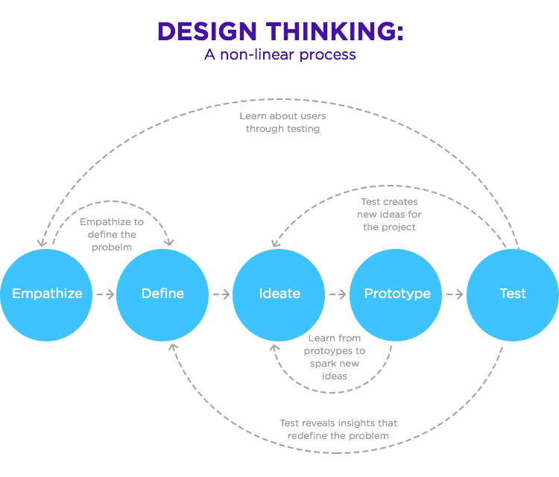
Unit 3: Design thinking

Slide 8
Unit 3: Design thinking
Very brief version of DT:
’Starts with humans. Learning by making – prototyping to see what’s working. Encouraging participation, rather than consumption. Allows us to identify what the problem really is.’
Notes:
From module content

Slide 9
Unit 3: Design thinking
https://www.youtube.com/watch?v=UAinLaT42xY
This is a good video – but for time’s sake – 3:55 to 7:12 is a good place to start.
13:08 also interesting but does begin to consider that DT has ‘wider impact’.

Slide 10
Unit 3: Design thinking: Mindset, Skillset, Toolset
Barrett (2015) suggests that for Design Thinking to be effective, those using it need to be aware of three key elements:
Mindset – How you see, perceive, view. Without a change in mindset, the world cannot be viewed differently.
Notes:
Module content

Slide 11
Unit 3: Design thinking: Mindset, Skillset, Toolset
Skillset – How you do, act, behave. Not just your abilities, knowledge and understanding, but also your motivation and ability to use them.
Notes:
Module content

Slide 12
Unit 3: Design thinking: Mindset, Skillset, Toolset
Toolset – How you get, have, use. Using one of a variety of methods, approaches or frameworks for a particular stage of the process.
Notes:
Module content

Slide 13
Unit 3: Design thinking: Mindset, Skillset, Toolset
For more detail on the way that mindset, skillset and toolset interact with the steps of Design Thinking (DT), remember to refer to the online Moodle content.
Notes:
Module content

Slide 14
Design Thinking: The Steps
Empathised
Define
Ideate
Prototype
Test

Slide 15
Empathise
Empathy
Empathy is a skill where you understand and can share what someone else is thinking or feeling. This is paired with the ability to imagine how someone else might be thinking or feeling.
Empathy is Stage 1 of the Design Thinking process.
This will include discussing ideas with end users
Notes:
Module content

Slide 16
Define
Define
An important question is, how would you define “define”?
Define means “to show or describe something clearly and completely.
In relation to this section, Define is the second stage in the Design Thinking process.
Notes:
Module content

Slide 17
Ideation
Ideate
This is where you can generate some ideas for how you can solve the problem you identified, for the users you identified, in a new and innovative way. Remember the empathy and define stage are related to identifying the problem you are trying to solve, not the solution.
Notes:
Module content

Slide 18
Prototype
Prototyping
Prototyping is stage 4 of the design thinking process. One of the best ways to gain insight into the practicality of your ideas is to try them out. Prototyping should be quick, early and inexpensive and is often scaled down.
The lessons you learn from prototyping may cause you to reflect on and refine earlier stages of the process, or they may lead you to quickly develop a second, third or fourth version, each one fixing some of the issues uncovered by the last version.
Notes:
Module content

Slide 19
Test
Testing
Having developed a prototype, you may decide you want to revisit previous stages of the design thinking process. You may decide what you have learned so far means you want to re-define your problem or identify an alternative solution to prototype.
You should agree as a group what your next steps will be.

Slide 20
Pros and Cons
Pros
DT provides a useful structure to support idea development
Clearly identifiable steps help users feel comfortable in a process
Some inspirational results could appear
Cons
This is not the only way to develop work
The word ‘design’ may have alternate meanings for the performing arts
Consulting audiences for creative input could result in creative limitations that do not represent social issues

Slide 21
Other ideas about DT
Natasha Jen doesn’t like Design Thinking.
This is worth watching so that you can appreciate a sound critical perspective on DT from a designer point of view.

Slide 22
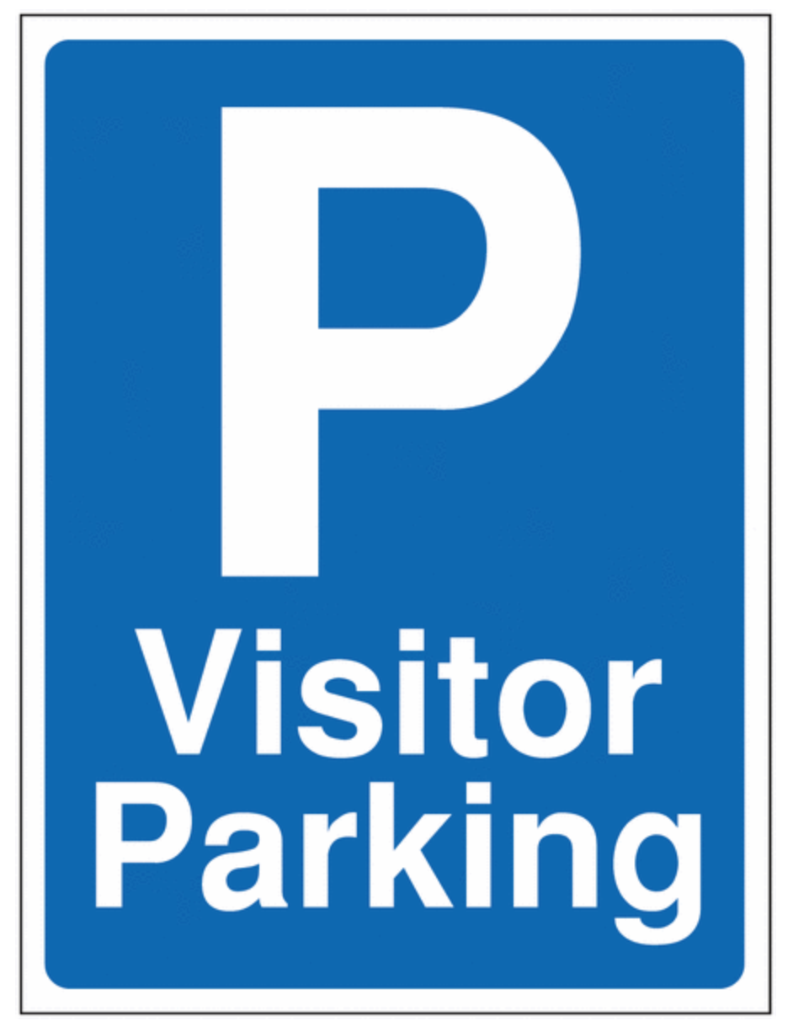
Notes:
Park that for now…

Slide 23
Stop here

Slide 24
Task from last week:
Interpretation and theatre
You were asked to watch Marc Rees’ ‘Now The Hero’ on Digital Theatre Plus.
You may have considered Pavis’ questionnaire from the last module.
You may have enjoyed the performance for what it is/was.
You may have strongly appreciated the design of the doc/film.
But - what was it?

Slide 25
Now the Hero / Nawr yr Arwr
Multi layered site specific contemporary performance – a mix of morality play and documentary theatre?
Exploration of narrative through arts (plural) narratives.
A collision of eras/times, ideas, responses, reimagined.
An interpretation of an ancient poem, social and global acts, and…
A response and a presentation back to the community that exists ‘there’ now.
Notes:
Gwyr a aeth gatraeth oed fraeth eu llu.
glasved eu hancwyn a gwenwyn vu.
trychant trwy beiryant en cattau.
a gwedy elwch tawelwch vu.

Slide 26
Interpretation and theatre
What is interpretation?

Slide 27
Merriam Webster
Verb 1
: to explain or tell the meaning of, or, present in understandable terms
interpret dreams
needed help interpreting the results
2
: to conceive in the light of individual belief, judgment, or circumstance : CONSTRUE
interpret a contract
3
: to represent by means of art, to bring to realization by performance or direction
Notes:
https://www.merriam-webster.com/dictionary/interpret accessed 050323
transitive verbs, denoting actions that affect someone

Slide 28
Interpretation and theatre
What is interpretation?
The demonstration of plot context in theatre language?
The use of semiotics to communicate themes from a play?
What examples of ‘interpretation’ are hidden in plain sight?
https://www.pbs.org/wnet/gperf/blog/7-shakespeare-plays-adapted-on-screen/

Slide 29
So a task for today…
Work as a group to create an idea for a piece of contemporary theatre.
Chose a poem
Chose a place
Chose and audience
Chose a medium
Chose a current affair – something from a news source
Chose your own creative medium…

Slide 30
So a task for today…
Use the layers identified (text, location, style etc) to propose an idea for a performance.
(Roughly) use the process of Design Thinking to create a workable project.
You will present this to your peers in 1 hour and consider any and all feedback.

Slide 31
Short Spring Poems for Kids That Rhyme
It Must Be Spring
By May Fenn
Hush, can you hear it?
The rustling in the grass,
Bringing you the welcome news that
Winter’s day is past.
Soft, can you feel it?
The warm caressing breeze,
Telling you the sticky buds
Are bursting on the trees.
Look, can you see them?
The primrose in the lane.
Now you must believe it —
Spring is here again.
Notes:
https://allnaturaladventures.com/short-spring-poems-for-kids/

Slide 32
Short Spring Poems for Kids That Rhyme
It Must Be Spring
By May Fenn
Hush, can you hear it?
The rustling in the grass,
Bringing you the welcome news that
Winter’s day is past.
Soft, can you feel it?
The warm caressing breeze,
Telling you the sticky buds
Are bursting on the trees.
Look, can you see them?
The primrose in the lane.
Now you must believe it —
Spring is here again.
Location: Empty Tesco Carpark
Notes:
https://allnaturaladventures.com/short-spring-poems-for-kids/

Slide 33
Short Spring Poems for Kids That Rhyme
It Must Be Spring
By May Fenn
Hush, can you hear it?
The rustling in the grass,
Bringing you the welcome news that
Winter’s day is past.
Soft, can you feel it?
The warm caressing breeze,
Telling you the sticky buds
Are bursting on the trees.
Look, can you see them?
The primrose in the lane.
Now you must believe it —
Spring is here again.
Location: Empty Tesco Carpark
Audience: Invited guests: a group of people
that may have never cooked a meal from scratch.
Local farmers.
School children
Notes:
https://allnaturaladventures.com/short-spring-poems-for-kids/

Slide 34
Short Spring Poems for Kids That Rhyme
It Must Be Spring
By May Fenn
Hush, can you hear it?
The rustling in the grass,
Bringing you the welcome news that
Winter’s day is past.
Soft, can you feel it?
The warm caressing breeze,
Telling you the sticky buds
Are bursting on the trees.
Look, can you see them?
The primrose in the lane.
Now you must believe it —
Spring is here again.
Location: Empty Tesco Carpark
Audience: Invited guests: a group of people
that may have never cooked a meal from scratch.
Local farmers.
School children
Media:
Contemporary theatre
Notes:
https://allnaturaladventures.com/short-spring-poems-for-kids/

Slide 35
Short Spring Poems for Kids That Rhyme
It Must Be Spring
By May Fenn
Hush, can you hear it?
The rustling in the grass,
Bringing you the welcome news that
Winter’s day is past.
Soft, can you feel it?
The warm caressing breeze,
Telling you the sticky buds
Are bursting on the trees.
Look, can you see them?
The primrose in the lane.
Now you must believe it —
Spring is here again.
Location: Empty Tesco Carpark
Audience: Invited guests: a group of people
that may have never cooked a meal from scratch.
Local farmers.
School children
Current affair:
Shortage of produce that can be grown in the UK
Media:
Contemporary theatre
Notes:
https://allnaturaladventures.com/short-spring-poems-for-kids/

Slide 36
Short Spring Poems for Kids That Rhyme
It Must Be Spring
By May Fenn
Hush, can you hear it?
The rustling in the grass,
Bringing you the welcome news that
Winter’s day is past.
Soft, can you feel it?
The warm caressing breeze,
Telling you the sticky buds
Are bursting on the trees.
Look, can you see them?
The primrose in the lane.
Now you must believe it —
Spring is here again.
Location: Empty Tesco Carpark
Audience: Invited guests: a group of people
that may have never cooked a meal from scratch.
Local farmers.
School children
Current affair:
Shortage of produce that can be grown in the UK
Media:
Contemporary theatre
My creative media:
Trolley dance + Audience interaction
Choir song – known tune – alternate lyrics
Big tech – flashlight from store
Pre-set videos accessible on phones - didactic
Notes:
https://allnaturaladventures.com/short-spring-poems-for-kids/

Slide 37
Short Spring Poems for Kids That Rhyme
It Must Be Spring
By May Fenn
Hush, can you hear it?
The rustling in the grass,
Bringing you the welcome news that
Winter’s day is past.
Soft, can you feel it?
The warm caressing breeze,
Telling you the sticky buds
Are bursting on the trees.
Look, can you see them?
The primrose in the lane.
Now you must believe it —
Spring is here again.
Location: Empty Tesco Carpark
Audience: Invited guests: a group of people
that may have never cooked a meal from scratch.
Local farmers.
School children
Current affair:
Shortage of produce that can be grown in the UK
Media:
Contemporary theatre
Outcomes:
Awareness of costs of production.
Encourage new discussions about food
and availability.
Reduce fear of speaking up.
Intergenerational cohesion.
A fun and interesting event that sparks a
conversation.
My creative media:
Trolley dance + Audience interaction
Choir song – known tune – alternate lyrics
Big tech – flashlight from store
Pre-set videos accessible on phones - didactic
Notes:
https://allnaturaladventures.com/short-spring-poems-for-kids/

Slide 38
Step 2: Some information to change your ideas
Here are 2 sources of funding that could be available to a collaborative, creative practice. Both have connections with sustainability and nature – how might you adapt your creative ‘task’ ideas to make them applicable for this funding?
Arts Council of Wales funding:
(an example) Cyngor Celfyddydau Cymru, Arts Council of Wales
Alternate funding that could be applied:
(an example) Esmee Fairbairn

Slide 39
Nonlinear process
Return to your groups and consider how you might be able to adapt your ideas to align with criteria to receive funding from these specific sources.
Consider the Design Thinking steps to support this development.
You would be moving from prototype to ideate again…

Slide 40
Is this a process that you can use?
Does design thinking make sense to your creative process?
How can you apply it to your work?
What issues can you identify with DT that would negatively impact your work?
What traits can you identify with DT that would positively impact your work?

Slide 41
Other ideas about DT
Natasha Jen doesn’t like Design Thinking.
This is worth watching so that you can appreciate a sound critical perspective on DT from a designer point of view.

