Slide 1
Referencing other people’s work
Dr Rachel Alexander FHEA MIET

Slide 2
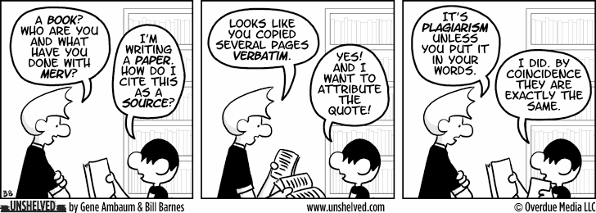
How not to plagiarise

Slide 3
When you are writing about someone else’s idea, whether it is found in a book, paper, website, journal or even lecture notes
YOU MUST CITE YOUR REFERENCES
If you do not, it is PLAGIARISM

Slide 4
If you copy and paste from a website and then add a reference,
This is still plagiarism
So how can we write about research without plagiarising?

Slide 5
Paraphrasing
The original passage:
Students frequently overuse direct quotation in taking notes, and as a result they overuse quotations in the final [research] paper. Probably only about 10% of your final manuscript should appear as directly quoted matter. Therefore, you should strive to limit the amount of exact transcribing of source materials while taking notes. Lester, James D. Writing Research Papers. 2nd ed. (1976): 46-47.
A legitimate paraphrase:
In research papers students often quote excessively, failing to keep quoted material down to a desirable level. Since the problem usually originates during note taking, it is essential to minimize the material recorded verbatim (Lester 46-47).
An acceptable summary:
Students should take just a few notes in direct quotation from sources to help minimize the amount of quoted material in a research paper (Lester 46-47).
A plagiarized version:
Students often use too many direct quotations when they take notes, resulting in too many of them in the final research paper. In fact, probably only about 10% of the final copy should consist of directly quoted material. So it is important to limit the amount of source material copied while taking notes.

Slide 6
Paraphrasing
Original Quote | Paraphrase
“New tracks aside, the challenge is at the bare minimum to bring light and air into this underground purgatory and, beyond that, to create for millions of people a new space worthy of New York, a civic hub in the spirit of the great demolished one, more attuned to the city’s aspirations and democratic ideals.” – Michael Kimmelman, The New York Times | Besides replacing the railroad tracks, the toughest part is to at least bring air and light to Penn Station. Millions of people in New York are deserving of a new civic hub, constructed in the same essence of the one that was levelled so many years ago. Moving forward with such a development ties in with the city’s enthusiasm for beauty and architecture
http://www.easybib.com/guides/students/research-guide/paraphrasing-patchwriting-direct-quotes/c-an-example-of-a-poor-paraphrase/

Slide 7
Poor paraphrasing
Original Quote | Poor Paraphrase
“New tracks aside, the challenge is at the bare minimum to bring light and air into this underground purgatory and, beyond that, to create for millions of people a new space worthy of New York, a civic hub in the spirit of the great demolished one, more attuned to the city’s aspirations and democratic ideals.” – Michael Kimmelman, The New York Times | Besides replacing the railroad tracks, the toughest part is to at least bring air and light to Penn Station. Millions of people in New York are deserving of a new civic hub, constructed in the same essence of the one that was levelled so many years ago. Moving forward with such a development ties in with the city’s enthusiasm for beauty and architecture
The paraphrase has a very similar sentence structure to the original quote, it essentially has a few different words from the original quote and does not flow well.
The term “civic hub” is not in quotes (it should be as it is a unique phrase used in the original quote).
There is no citation crediting the source of the idea.
http://www.easybib.com/guides/students/research-guide/paraphrasing-patchwriting-direct-quotes/c-an-example-of-a-poor-paraphrase/

Slide 8
Paraphrasing
Original Quote | Paraphrase
“New tracks aside, the challenge is at the bare minimum to bring light and air into this underground purgatory and, beyond that, to create for millions of people a new space worthy of New York, a civic hub in the spirit of the great demolished one, more attuned to the city’s aspirations and democratic ideals.” – Michael Kimmelman, The New York Times | One of the biggest issues facing Penn Station’s revitalisation is developing a brighter airier space. It is an abysmal “underground purgatory”, and with so many New Yorkers and tourists travelling in and out of its doors every day, should be reconstructed to better reflect the endeavours and passions of the city. (Kimmelman)

Slide 9
Effective paraphrasing
Original Quote | Effective Paraphrase
“New tracks aside, the challenge is at the bare minimum to bring light and air into this underground purgatory and, beyond that, to create for millions of people a new space worthy of New York, a civic hub in the spirit of the great demolished one, more attuned to the city’s aspirations and democratic ideals.” – Michael Kimmelman, The New York Times | One of the biggest issues facing Penn Station’s revitalisation is developing a brighter airier space. It is an abysmal “underground purgatory”, and with so many New Yorkers and tourists travelling in and out of its doors every day, should be reconstructed to better reflect the endeavours and passions of the city. (Kimmelman)
The paraphrase reflects the same ideas as the original quote but is in its own words and writing style.
The term “underground purgatory” is placed in quotes, as it is a unique phrase used in the original quote.
There is a parenthetical citation, citing the source of the idea

Slide 10
How to Paraphrase Method 1
Read the source several times until you understand the paragraph.
Decide which parts of the paragraph would help you make a point in your paper.
Put the source away.
Write some notes on the ideas in the paragraph as if you were telling someone else (a friend) what the source said.
Put the notes away for a day then use them to draft your own paragraph in your own style

Slide 11
How to Paraphrase Method 2
Change the structure
Start at a different place in the passage, this will make you change the sentence round. Break up long sentences, combine short ones, add more information for clarity or reduce information to make it concise.
Change the words
Use a thesaurus to find synonyms or phrases meaning the same. If you have to use the same words put quote marks around them unless it is shared language (technical terms such as chemical names)
You may need to repeat the process till you are happy

Slide 12
Paraphrase Exercise

Slide 13
) Condenser microphones have been a part of society for a long time now. Because of their fantastic sound quality that has been little to no innovation in the mic industry for over 30 years now. The basics of condenser mic have remained the same which allow countless many new manufacturers to create great mic for low prices. One such example of this comes from China where the patent laws are quite loose. Now anyone can buy a decent condenser mic just under the price of a pizza.

Slide 14
Referencing

Slide 15
Harvard referencing manual:
http://libweb.anglia.ac.uk/referencing/files/Harvard_referencing_2016.pdf
https://ilrb.cf.ac.uk/citingreferences/tutorial/index.html

Slide 16
Harvard Reference List Citations for Books with One Author
The structure for a Harvard Reference List citation for books with one author includes the following:
Last name, First initial. (Year published). Title. Edition. (Only include the edition if it is not the first edition) City published: Publisher, Page(s).
If the edition isn’t listed, it is safe to assume that it is the first addition, and does not need to be included in the citation.
Example: One author AND first edition:
Patterson, J. (2005). Maximum ride. New York: Little, Brown.
Example: One author AND NOT the first edition
Dahl, R. (2004). Charlie and the chocolate factory. 6th ed. New York: Knopf.

Slide 17
In the text we cite like this:
Harvard Numeric
When loaded with tensile stresses, hard solids pass from elastic to fracture behaviour and invariably fail by crack extension. Thus, hard solids are usually brittle, i.e., they have small capacity to convert elastic energy into plastic deformation at room temperature (Dieter, 1981).
Advanced ceramics have been widely adopted as functional as well as structural engineering materials (Chiang et al.1997).
Micro-drilling (nominal diametric range:0.03–3.0 mm) can be considered as a key manufacturing enabler for a number of applications such as printed circuit boards in the electronics industry, fibre composite structures in the aerospace industry, lenses/glasses for optical applications and for orthopaedic procedures in the medical industry [1]. Conventional fluted micro-drills are generally produced from carbon steels or tungsten carbide that are readily workable using processes such as mechanical micro- grinding or electro-discharge machining [2].
https://ieee-dataport.org/sites/default/files/analysis/27/IEEE%20Citation%20Guidelines.pdf

Slide 18
Reference Lists are located at the end of the work and display full citations for sources used in the assignment.
Here is an example of a full citation for a book found in a Harvard Reference list:
Fitzgerald, F. (2004). The great Gatsby. New York: Scribner.

Slide 19
At the end of the text there is a list of references cited and there could also be a Bibliography
What is the difference between them?

Slide 20
Reference list or Bibliography
The reference list should include details for everything that you cite in your assignment. A reference list is always required when you cite other people’s work within your assignment
If you use Harvard the reference list should be in alphabetical order by author.
If you use the numeric system the references should be in numerical order; the same order they first appeared in the text.
Bibliography. This is a list of relevant items that you have used to help you prepare for the assignment but which are not necessarily cited in your text, e.g. general background reading to familiarise yourself with the topic.

Slide 21
You may come across a summary of another author’s work in the source you are reading, which you would like to make reference to in your own piece of work, this is called secondary referencing.
A direct in-text citation would be:
Research recently carried out in the Greater Manchester area by Brown (1966 cited in Bassett, 1986, p.142) found that
In this example, Brown is the work which you wish to refer to, but have not read directly for yourself. Bassett is the secondary source, where you found the summary of Brown’s work.
An indirect in-text citation would be:
(Brown, 1966 cited in Bassett, 1986, p.142)
It is important to realise that Bassett may have taken Brown’s ideas forward, and altered their original meaning. If you need to cite a secondary reference it is recommended that, where possible, you read the original source for yourself rather than rely on someone else’s interpretation of a work. For this reason it is best to avoid using secondary referencing.
The reference list at the end of your document should only contain works that you have read. In the above example you would only list the work by Bassett.

Slide 22
Your Turn
Question 1 in handout
Go to www.sciencedirect.com
Search for Machining of Composite Materials by R Teti
Write a sentence from this paper in your own words. Cite it and add a reference list

Slide 23
Reference List
Numeric:
Author, title, journal title, City, Publisher, year, volume, page
Teti,R, Machining of composite materials, CIRP Ann. Manuf. Technol., 2002,Vol 51 pp. 611–634
Harvard: author, year, title, publication, volume, page
Teti,R, (2002), Machining of composite materials, CIRP Ann. Manuf. Technol(51), pp611-634

Slide 24
What if there is more than one author?
Try Question 2 and 3

Slide 25
Harvard Reference List Citations for Books with Two or More Authors
When creating a citation that has more than one author, place the names in the order in which they appear on the source. Use the word “and” to separate the names.
Last name, First initial. and Last name, First initial. (Year published). Title. City: Publisher, Page(s).
Example:
Desikan, S. and Ramesh, G. (2006). Software testing. Bangalore, India: Dorling Kindersley, p.156.
Vermaat, M., Sebok, S., Freund, S., Campbell, J. and Frydenberg, M. (2014). Discovering computers. Boston: Cengage Learning, pp.446-448.
Daniels, K., Patterson, G. and Dunston, Y. (2014). The ultimate student teaching guide. 2nd ed. Los Angeles: SAGE Publications, pp.145-151.

Slide 26
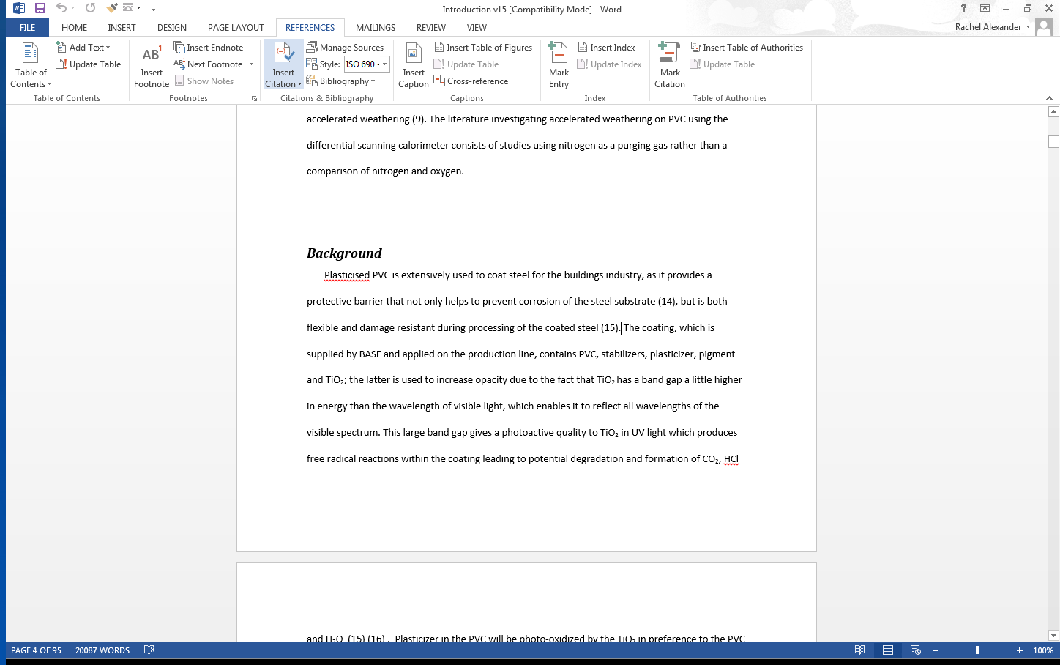
Cite with Microsoft WORD

Slide 27
Try Question 4

Slide 28
Referencing styles
There are many styles of referencing; the two most common systems are Harvard and Numeric. Styles differ between schools or departments.
Harvard system (author and date)
In the text use the surname(s) of the author(s) and the year of publication.
References should then be listed alphabetically by author at the end of the work, with the year of publication placed immediately after the author's name.
When referencing more than one work by the same author you can distinguish between them by adding letters after the year eg (Turner, 1998a) and (Turner, 1998b)
When citing a particular quote put quotation marks around the quotation. You must include the page number(s) of the quotation, e.g. Treatments for cancer "can disrupt economic and social function" (Fallowfield 1990, p. 92).
Only use direct quotations when necessary. It is usually preferable to re-word (paraphrase) information.

Slide 29
Example of Harvard referencing
A typical piece of text might read:
Searcy and Whatley (1984) also found evidence for functions in Thermoplasma. They do not seem to form de novo in the cytoplasm (Opperdoes and Michels 1989; Tabak and Diestel 1989). This is symbiant-like behaviour, but there is no trace of a genome in microbodies.
The reference list would arrange references in alphabetical order of author, e.g.
OPPERDOES, F. R. and P.A.M. MICHELS, 1989. Biogenesis and evolutionary origin of peroxisomes. In: J. M. TAGER, Organelles in Eukaryotic Cells. New York: Plenum, pp.5-10.
SEARCY, D. G. and F. R. WHATLEY, 1984. Thermoplasma acidophilum cell membrane. Zentralblatt fur Bakteriologie Mikrobiologie und Hygiene 1 Abteilung Originale, C3, 245-257.
TABAK, H. F. and B. DIESTEL, 1989. Biogenesis of peroxisomes. In: J. M. Tager, Organelles in Eukaryotic Cells. New York: Plenum, pp.5-10.
When referencing more than one author the first author is listed by surname first, followed by their initials. The second author is listed by initials first, followed by surname.
Notice that when using the Harvard system, the year of publication is positioned after the author names.

Slide 30
Numeric system
In the Numeric system of referencing, numbers inserted in the text refer to a numerical sequence of references at the end. The first reference is numbered 1, the second 2, and so on. The numbers can be written in superscript or in brackets
When citing a particular quote put quotation marks around the quotation. You must include the page number(s) of the quotation, e.g. Treatments "can disrupt economic and social function" (2, p. 92).
Only use direct quotations when necessary. It is usually preferable to re-word (paraphrase) information.

Slide 31
Example of numeric referencing
A typical piece of text might read:
Searcy and Whatley¹ also found evidence for functions in Thermoplasma. They do not seem to form de novo in the cytoplasm^{2,3}. This is symbiant-like behaviour, but there is no trace of a genome in microbodies¹.
The reference list would give each reference in numerical order:
SEARCY, D G. and F. R. WHATLEY. Thermoplasma acidophilum cell membrane. Zentralblatt fur Bakteriologie Mikrobiologie und Hygiene 1 Abteilung Originale, 1984, C3, 245-257.
OPPERDOES, F. R. and P. A. M. MICHELS. Biogenesis and evolutionary origin of peroxisomes. In: J. M. Tager, Organelles in Eukaryotic Cells. New York: Plenum, 1989, pp. 5-10.
TABEK, H. F. and B. DIESTREL. Biogenesis of peroxisomes. In: J. M. TAGER, Organelles in Eukaryotic Cells New York: Plenum, 1989, pp. 5-10

Slide 32
When referencing more than one author the first author is listed by surname first, followed by their initials.
The second author is listed by initials first, followed by surname.
Notice that the year of publication has now been positioned towards the end of the reference for books and before the volume, part/issue and page number details for journals.

Slide 33
The End

