Slide 1
Module Name : Radio Frequency Systems
Module Code : ACDA5019
Lecture : 7
Topic : Noise in DSBSC
Lecture By,
Mrs. Jenifer Prince Devaraj,
Lecturer - Embedded Electronics,
Faculty of Applied Computing,
UWTSD
Email:j.prince-devaraj@uwtsd.ac.uk

Slide 2
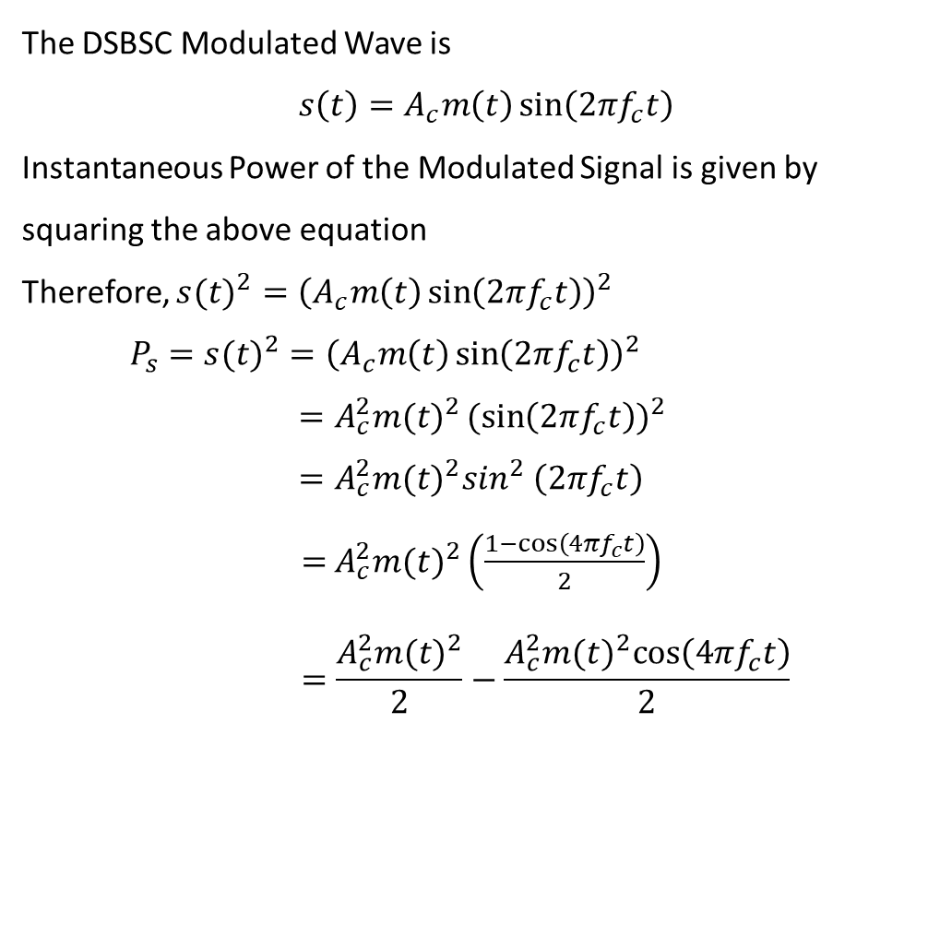
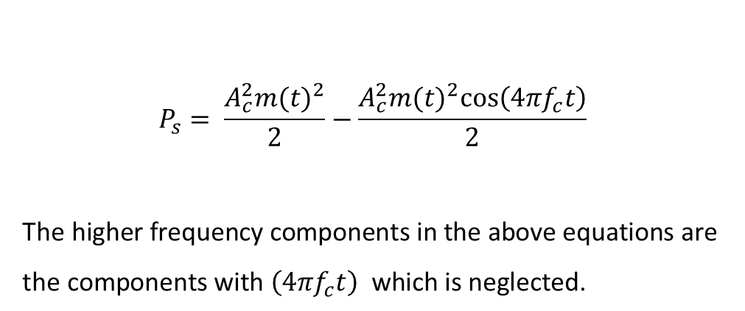
Noise in DSB SC Receivers using Coherent Detection
The DSBSC Modulated Wave is
$s\left(t\right)=A_{c}m\left(t\right)\sin\left(2πf_{c}t\right)$
Instantaneous Power of the Modulated Signal is given by squaring the above equation
Therefore, ${s(t)}^{2}={\left(A_{c}m\left(t\right)\sin\left(2πf_{c}t\right)\right)}^{2}$
$$P_{s}={s(t)}^{2}={\left(A_{c}m\left(t\right)\sin\left(2πf_{c}t\right)\right)}^{2}$$
$=A_{c}^{2}{m(t)}^{2}{(sin\left(2πf_{c}t\right))}^{2}$
$=A_{c}^{2}{m(t)}^{2}\sin^{2}$ $\left(2πf_{c}t\right)$
    $=$ $A_{c}^{2}{m(t)}^{2}\left(\frac{1−cos⁡\left(4πf_{c}t\right)}{2}\right)$
    $$=\frac{A_{c}^{2}{m(t)}^{2}}{2}−\frac{A_{c}^{2}{m(t)}^{2}cos⁡\left(4πf_{c}t\right)}{2}$$
$$P_{s}= \frac{A_{c}^{2}{m(t)}^{2}}{2}−\frac{A_{c}^{2}{m(t)}^{2}cos⁡\left(4πf_{c}t\right)}{2}$$
$$\text{The} \text{higher} \text{frequency} \text{components} \text{in} \text{the} \text{above} \text{equations} \text{are} \text{the} \text{components} \text{with} \left(4πf_{c}t\right) \text{which} \text{is} \text{neglected}\text{. }$$

Slide 3
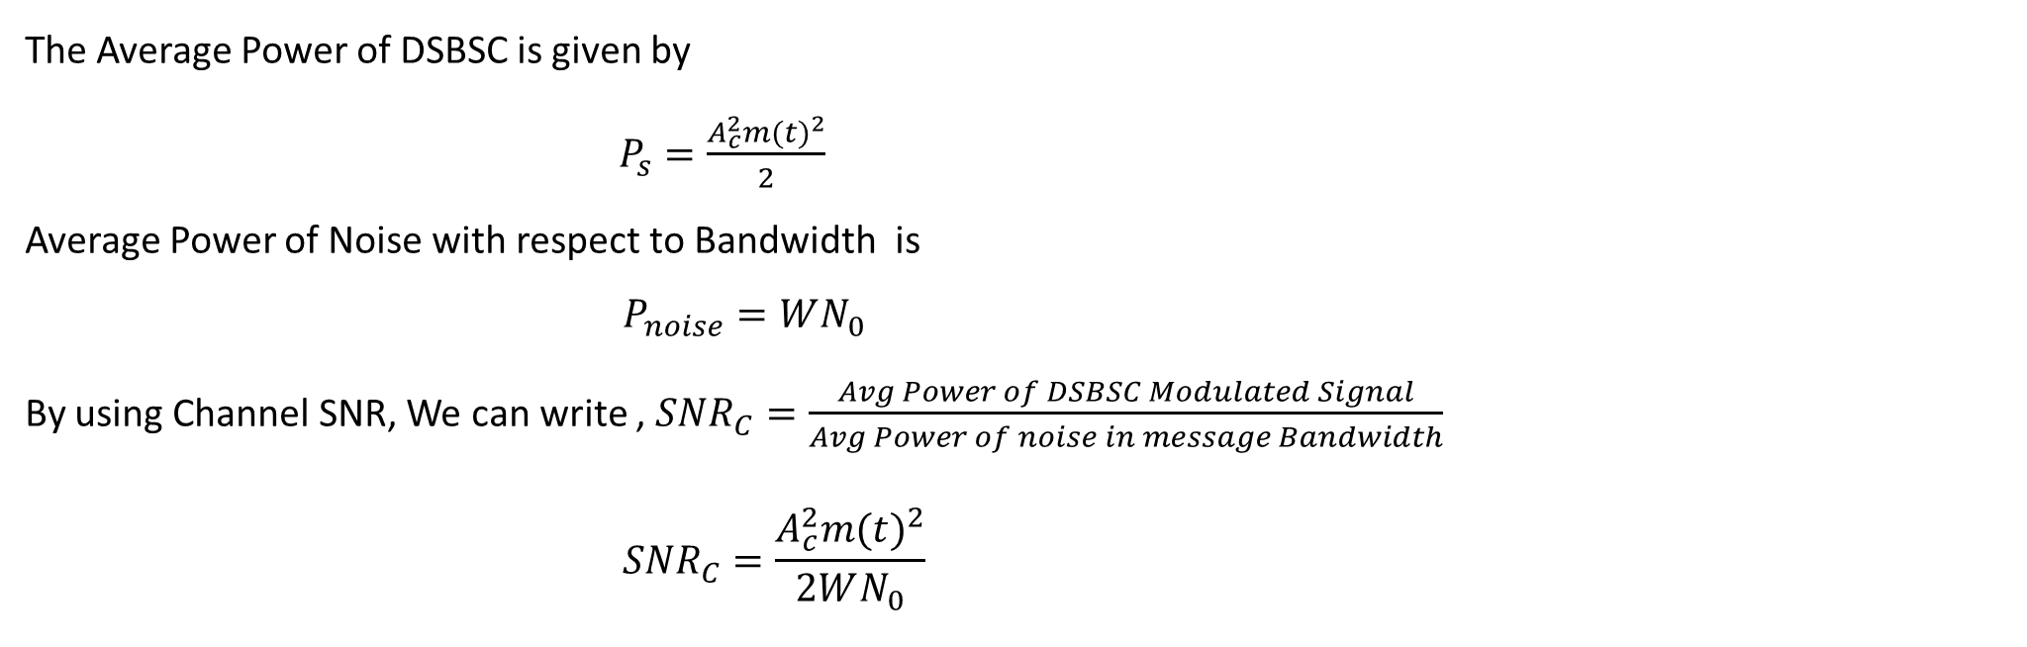
Radio Frequency Systems
Noise in DSB SC Receivers using Coherent Detection
The Average Power of DSBSC is given by
$P_{s}=\frac{A_{c}^{2}{m(t)}^{2}}{2}$
Average Power of Noise with respect to Bandwidth is
$$P_{noise}=WN_{0}$$
By using Channel SNR, We can write , ${SNR}_{C}=\frac{Avg Power of DSBSC Modulated Signal}{Avg Power of noise in message Bandwidth}$
$${SNR}_{C}=\frac{A_{c}^{2}{m(t)}^{2}}{2WN_{0}}$$

Slide 4
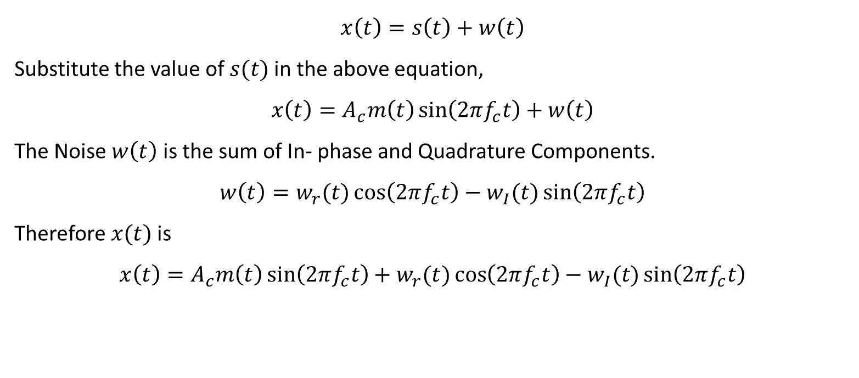
Radio Frequency Systems
Noise in DSB SC Receivers using Coherent Detection
Find the output of the Bandpass filter $x(t)$
$$x\left(t\right)=s\left(t\right)+w\left(t\right)$$
Substitute the value of $s(t)$in the above equation,
$$x\left(t\right)=A_{c}m\left(t\right)\sin\left(2πf_{c}t\right)+w\left(t\right)$$
The Noise $w\left(t\right)$ is the sum of In- phase and Quadrature Components.
$$w\left(t\right)=w_{r}(t)\cos\left(2πf_{c}t\right)−w_{I}(t)\sin\left(2πf_{c}t\right)$$
Therefore $x(t)$is
$$x\left(t\right)=A_{c}m\left(t\right)\sin\left(2πf_{c}t\right)+w_{r}(t)\cos\left(2πf_{c}t\right)−w_{I}(t)\sin\left(2πf_{c}t\right)$$

Slide 5
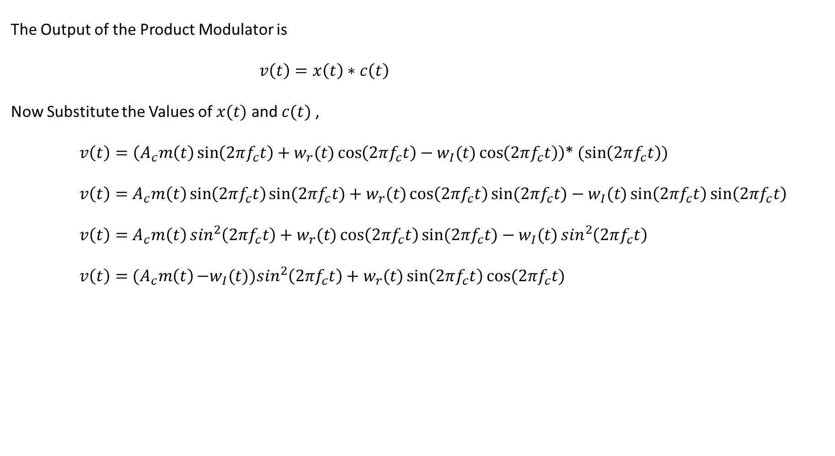
Radio Frequency Systems
Noise in DSB SC Receivers using Coherent Detection
Find the Output of the Product Modulator
The Output of the Product Modulator is
$v\left(t\right)=x\left(t\right)∗c\left(t\right)$
Now Substitute the Values of $x(t)$ and $c(t)$ ,
    $v\left(t\right)=\left(A_{c}m\left(t\right)\sin\left(2πf_{c}t\right)+w_{r}(t)\cos\left(2πf_{c}t\right)−w_{I}(t)\cos\left(2πf_{c}t\right)\right)$* $(\sin\left(2πf_{c}t\right))$
    $v\left(t\right)=$ $A_{c}m\left(t\right)\sin\left(2πf_{c}t\right)sin⁡(2πf_{c}t)+w_{r}(t)\cos\left(2πf_{c}t\right)sin⁡(2πf_{c}t)−w_{I}(t)\sin\left(2πf_{c}t\right)$ $\sin\left(2πf_{c}t\right)$
    $v\left(t\right)=$ $A_{c}m\left(t\right)\sin^{2}\left(2πf_{c}t\right)+w_{r}(t)\cos\left(2πf_{c}t\right)sin⁡(2πf_{c}t)−w_{I}(t)\sin^{2}\left(2πf_{c}t\right)$
    $v\left(t\right)=$ ${(A}_{c}m\left(t\right)−w_{I}(t))\sin^{2}\left(2πf_{c}t\right)+w_{r}(t)\sin\left(2πf_{c}t\right)$ $cos⁡(2πf_{c}t)$

Slide 6
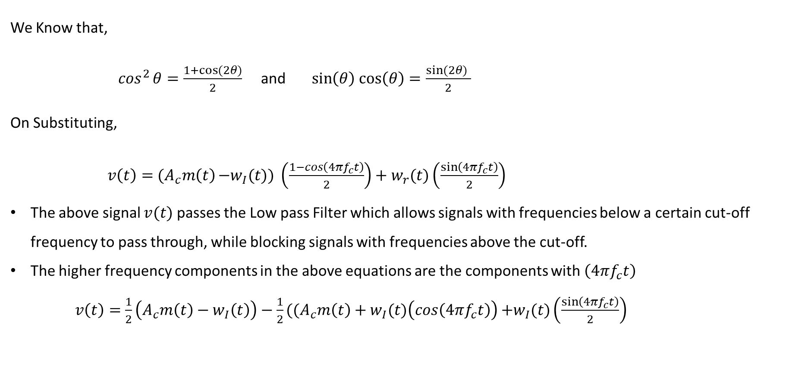
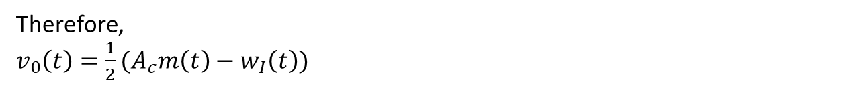
Radio Frequency Systems
Noise in DSB SC Receivers using Coherent Detection
We Know that,
$\cos^{2}{θ}=\frac{1+cos⁡(2θ)}{2}$ and $\sin\left(θ\right)$ $\cos\left(θ\right)=\frac{sin⁡(2θ) }{2}$
On Substituting,
      $v\left(t\right)=$ ${(A}_{c}m\left(t\right)−w_{I}(t))\left(\frac{1−cos\left(4πf_{c}t\right)}{2}\right)+w_{r}(t)\left(\frac{sin⁡\left(4πf_{c}t\right)}{2}\right)$
The above signal $v(t)$passes the Low pass Filter which allows signals with frequencies below a certain cut-off frequency to pass through, while blocking signals with frequencies above the cut-off.
The higher frequency components in the above equations are the components with $\left(4πf_{c}t\right)$
$v\left(t\right)=$ $\frac{1}{2}\left(A_{c}m\left(t\right)−w_{I}\left(t\right)\right)−\frac{1}{2}((A_{c}m\left(t\right)+w_{I}(t)\left(cos\left(4πf_{c}t\right)\right)$ $+w_{I}(t)\left(\frac{sin⁡\left(4πf_{c}t\right)}{2}\right)$
Therefore,
$v_{0}\left(t\right)=$ $\frac{1}{2}(A_{c}m\left(t\right)−w_{I}\left(t\right))$

Slide 7
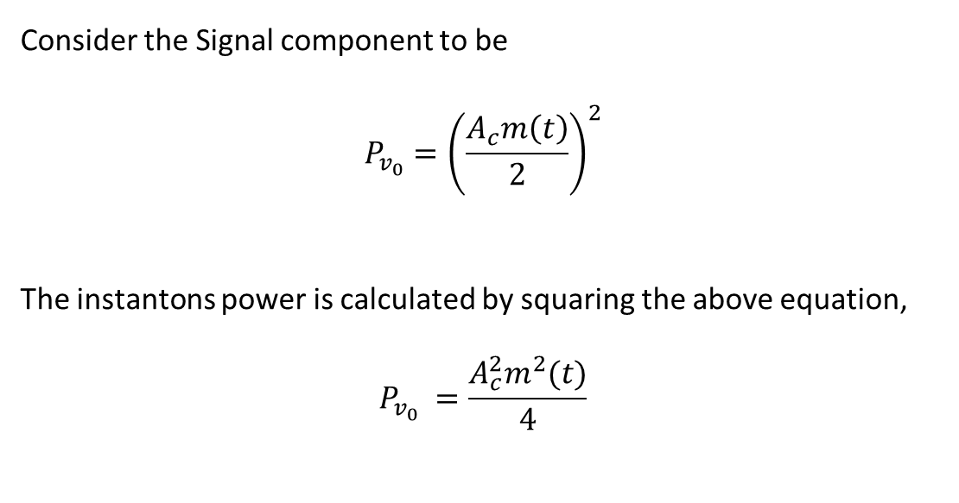
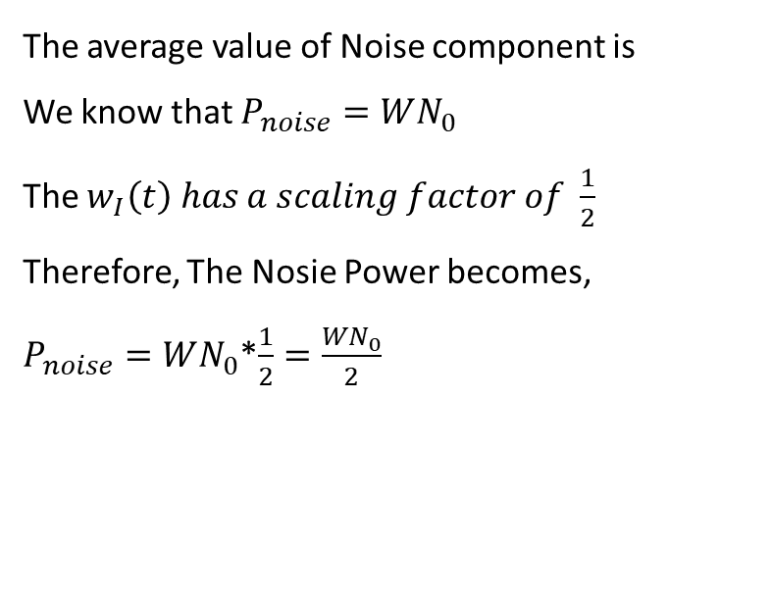
Radio Frequency Systems
Noise in DSB SC Receivers using Coherent Detection
Find the Average power of signal component
The average value of Noise component is
We know that $P_{noise}=WN_{0}$
The $w_{I}\left(t\right) has a scaling factor of \frac{1}{2}$
Therefore, The Nosie Power becomes,
$P_{noise}=WN_{0}$*$\frac{1}{2}=\frac{WN_{0}}{2}$
Consider the Signal component to be
$$P_{v_{0}}={\left(\frac{A_{c}m\left(t\right)}{2}\right)}^{2}$$
The instantons power is calculated by squaring the above equation,
$$P_{v_{0}} =\frac{A_{c}^{2}m^{2}(t)}{4}$$
${SNR}_{c}$ $=\frac{A_{c}^{2}m^{2}(t)}{2WN_{0}}$

Slide 8

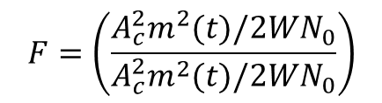
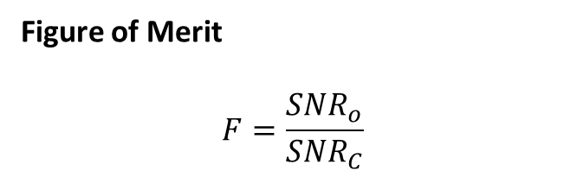
Radio Frequency Systems
Noise in DSB SC Receivers using Coherent Detection
To find the value of output SNR
we have,
Figure of Merit
$$F=\frac{{SNR}_{o}}{{SNR}_{C}}$$
${SNR}_{O}$ $=\frac{Average power of demodulated message signal}{Average power of noise at demodulated output}$
${SNR}_{O}$ $=\left(\frac{A_{c}^{2}P/4}{\frac{1}{2}WN_{0}}\right)$
$$F=\left(\frac{A_{c}^{2}m^{2}(t)/2WN_{0}}{A_{c}^{2}m^{2}(t)/2WN_{0}}\right)$$
${SNR}_{O}$ $=\frac{A_{c}^{2}m^{2}(t)}{2WN_{0}}$
$$F=\left(\frac{A_{c}^{2}m^{2}(t)}{2WN_{0}}\right)∗\left(\frac{2WN_{0}}{A_{c}^{2}m^{2}(t)}\right)=1$$

Slide 9
Radio Frequency Systems
Coherent Technique

Slide 10
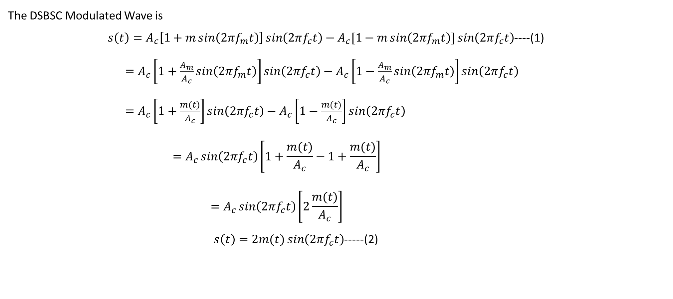
Noise in DSB SC Receivers using Balanced Modulator
The DSBSC Modulated Wave is
$s\left(t\right)=A_{c}\left[1+m\sin\left(2πf_{m}t\right)\right]\sin\left(2πf_{c}t\right)−A_{c}[1−m\sin\left(2πf_{m}t\right)]\sin\left(2πf_{c}t\right)$----(1)
$=A_{c}\left[1+\frac{A_{m}}{A_{c}}\sin\left(2πf_{m}t\right)\right]\sin\left(2πf_{c}t\right)−A_{c}\left[1−\frac{A_{m}}{A_{c}}\sin\left(2πf_{m}t\right)\right]\sin\left(2πf_{c}t\right)$
$=A_{c}\left[1+\frac{m(t)}{A_{c}}\right]\sin\left(2πf_{c}t\right)−A_{c}\left[1−\frac{m(t)}{A_{c}}\right]\sin\left(2πf_{c}t\right)$
$$=A_{c}\sin\left(2πf_{c}t\right)\left[1+\frac{m(t)}{A_{c}}−1+\frac{m(t)}{A_{c}}\right]$$
$$=A_{c}\sin\left(2πf_{c}t\right)\left[2\frac{m(t)}{A_{c}}\right]$$
$s\left(t\right)=2m(t)\sin\left(2πf_{c}t\right)$-----(2)

Slide 11
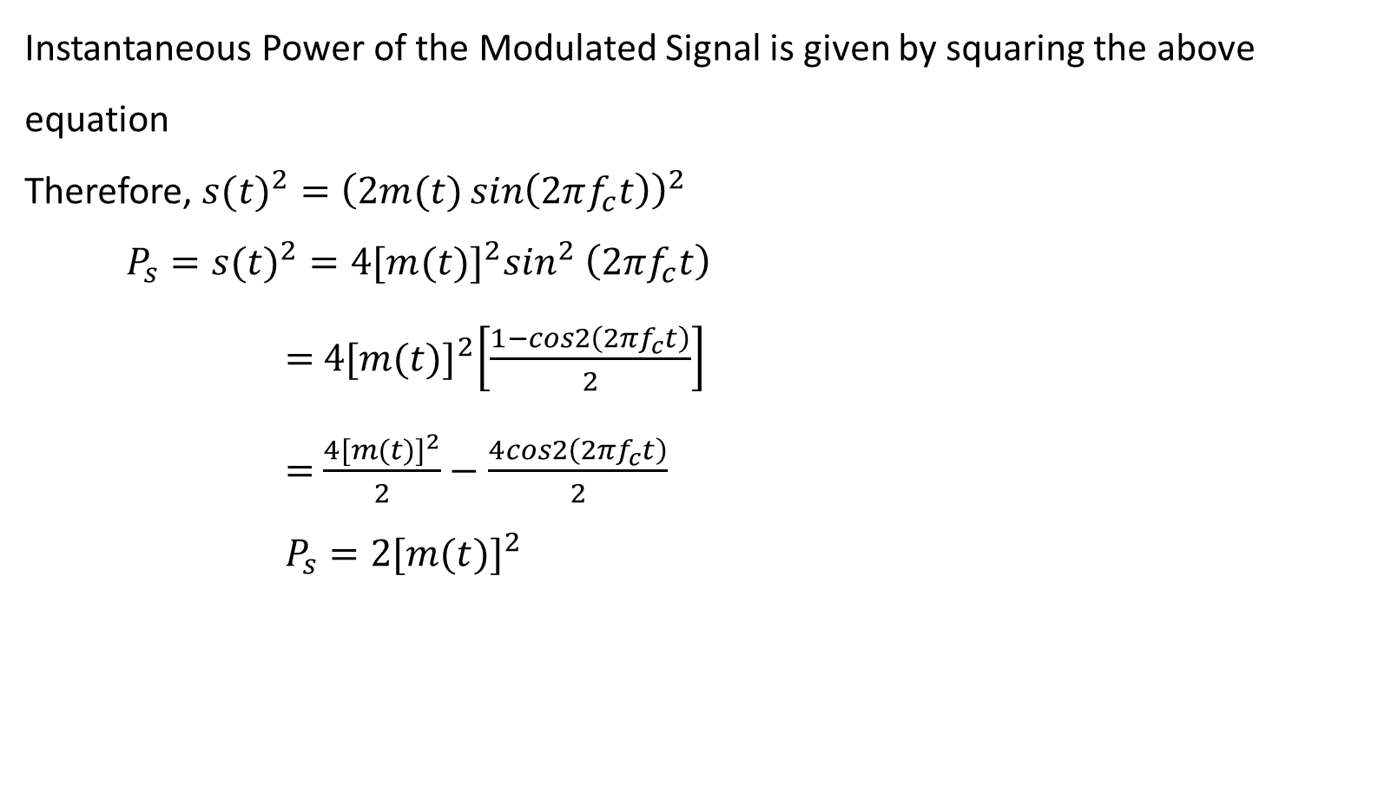
Noise in DSB SC Receivers using Balanced Modulator
Instantaneous Power of the Modulated Signal is given by squaring the above equation
Therefore, ${s(t)}^{2}={\left(2m(t)\sin\left(2πf_{c}t\right)\right)}^{2}$
$$P_{s}={s(t)}^{2}=4{[m(t)]}^{2}\sin^{2} \left(2πf_{c}t\right)$$
$=$ $4{[m(t)]}^{2}\left[\frac{1−cos2\left(2πf_{c}t\right)}{2}\right]$
$=$ $\frac{4{[m(t)]}^{2}}{2}−\frac{4cos2\left(2πf_{c}t\right)}{2}$
$P_{s}=2{[m(t)]}^{2}$

Slide 12
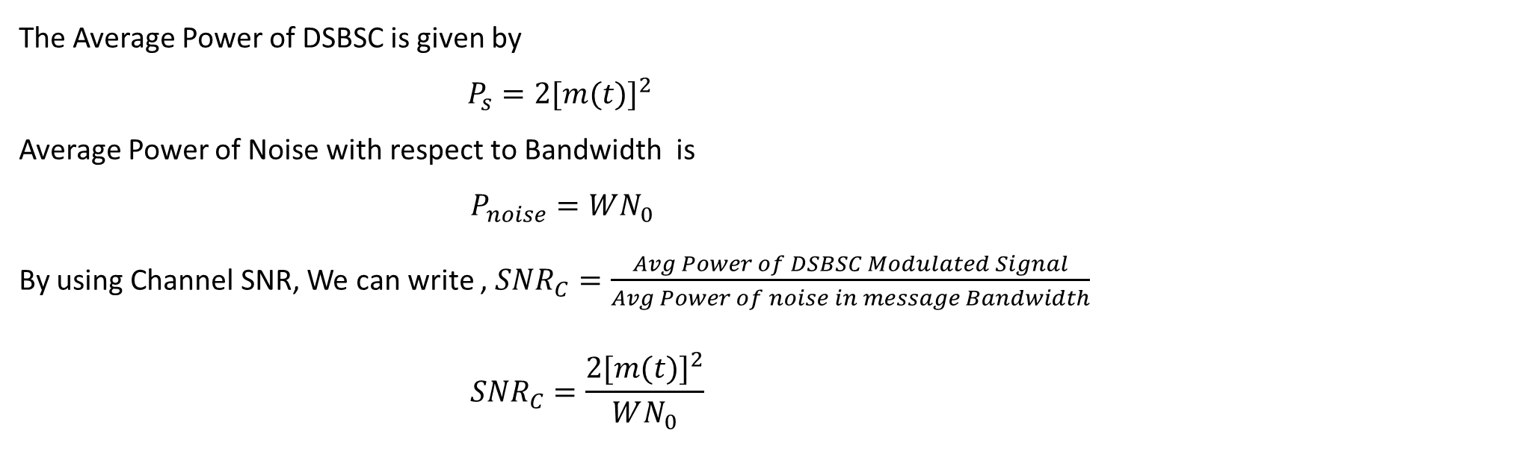
Radio Frequency Systems
Noise in DSB SC Receivers using Balanced Modulator
The Average Power of DSBSC is given by
$P_{s}=2{[m(t)]}^{2}$
Average Power of Noise with respect to Bandwidth is
$$P_{noise}=WN_{0}$$
By using Channel SNR, We can write , ${SNR}_{C}=\frac{Avg Power of DSBSC Modulated Signal}{Avg Power of noise in message Bandwidth}$
$${SNR}_{C}=\frac{2{[m(t)]}^{2}}{WN_{0}}$$

Slide 13
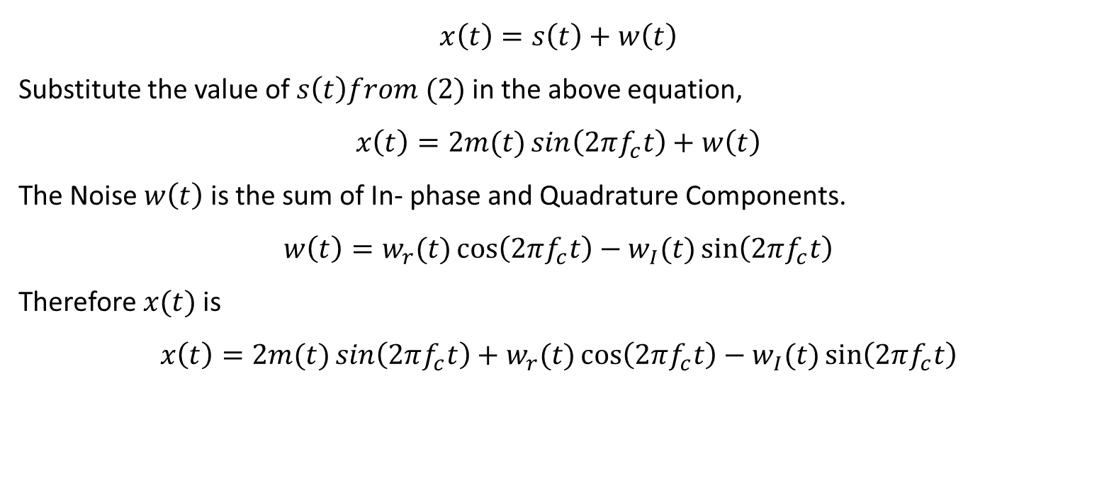
Radio Frequency Systems
Noise in DSB SC Receivers using Balanced Modulator
Find the output of the Bandpass filter $x(t)$
$$x\left(t\right)=s\left(t\right)+w\left(t\right)$$
Substitute the value of $s\left(t\right)from (2)$in the above equation,
$$x\left(t\right)=2m(t)\sin\left(2πf_{c}t\right)+w\left(t\right)$$
The Noise $w\left(t\right)$ is the sum of In- phase and Quadrature Components.
$$w\left(t\right)=w_{r}(t)\cos\left(2πf_{c}t\right)−w_{I}(t)\sin\left(2πf_{c}t\right)$$
Therefore $x(t)$is
$$x\left(t\right)=2m(t)\sin\left(2πf_{c}t\right)+w_{r}(t)\cos\left(2πf_{c}t\right)−w_{I}(t)\sin\left(2πf_{c}t\right)$$

Slide 14
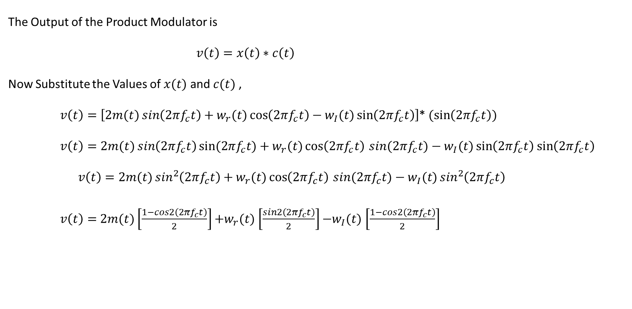
Radio Frequency Systems
Noise in DSB SC Receivers using Balanced Modulator
Find the Output of the Product Modulator
The Output of the Product Modulator is
$v\left(t\right)=x\left(t\right)∗c\left(t\right)$
Now Substitute the Values of $x(t)$ and $c(t)$ ,
    $v\left(t\right)=\left[2m(t)\sin\left(2πf_{c}t\right)+w_{r}(t)\cos\left(2πf_{c}t\right)−w_{I}(t)\sin\left(2πf_{c}t\right)\right]$* $(\sin\left(2πf_{c}t\right))$
    $v\left(t\right)=2m(t)\sin\left(2πf_{c}t\right)sin⁡(2πf_{c}t)+w_{r}(t)\cos\left(2πf_{c}t\right)⁡sin(2πf_{c}t)−w_{I}(t)\sin\left(2πf_{c}t\right)$ $\sin\left(2πf_{c}t\right)$
    $$v\left(t\right)=2m(t)\sin^{2}\left(2πf_{c}t\right)+w_{r}(t)\cos\left(2πf_{c}t\right)⁡sin(2πf_{c}t)−w_{I}(t)\sin^{2}\left(2πf_{c}t\right)$$
    $v\left(t\right)=$ $2m(t)\left[\frac{1−cos2\left(2πf_{c}t\right)}{2}\right]$ $+w_{r}(t)$ $\left[\frac{sin2\left(2πf_{c}t\right)}{2}\right]$ $−w_{I}(t)$ $\left[\frac{1−cos2\left(2πf_{c}t\right)}{2}\right]$

Slide 15
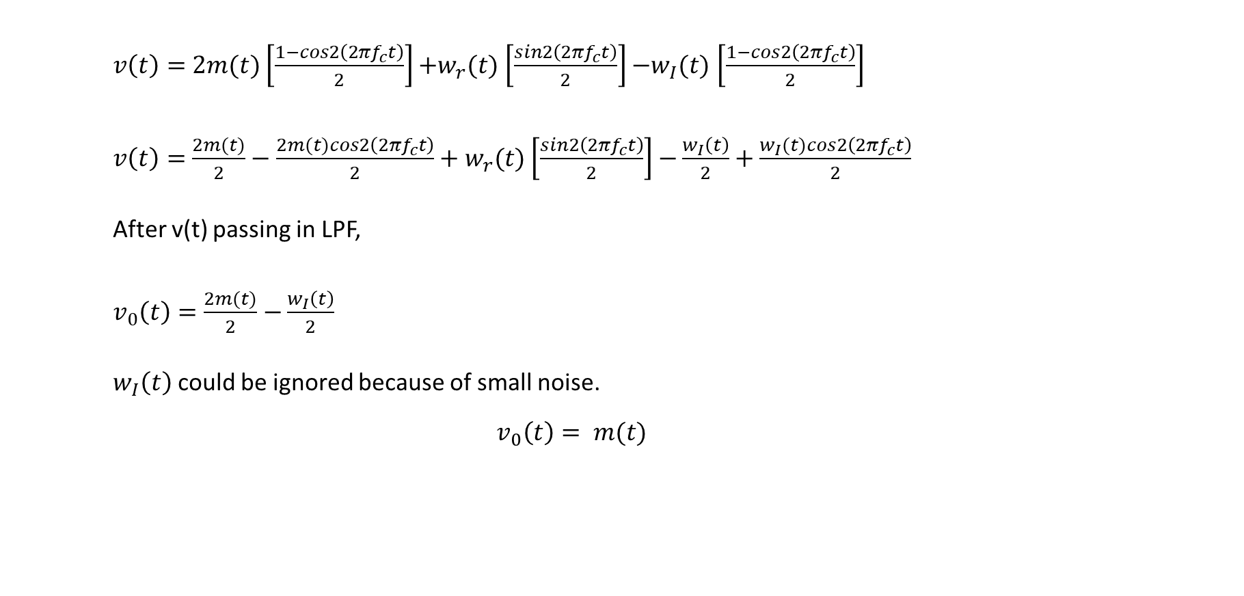
Radio Frequency Systems
Noise in DSB SC Receivers using Balanced Modulator
Find the Output of the Product Modulator
    $v\left(t\right)=$ $2m(t)\left[\frac{1−cos2\left(2πf_{c}t\right)}{2}\right]$ $+w_{r}(t)$ $\left[\frac{sin2\left(2πf_{c}t\right)}{2}\right]$ $−w_{I}(t)$ $\left[\frac{1−cos2\left(2πf_{c}t\right)}{2}\right]$
    $v\left(t\right)=$ $\frac{2m(t)}{2}−\frac{2m(t)cos2\left(2πf_{c}t\right)}{2}+w_{r}(t)$ $\left[\frac{sin2\left(2πf_{c}t\right)}{2}\right]$ $−\frac{w_{I}\left(t\right)}{2}+\frac{w_{I}(t)cos2\left(2πf_{c}t\right)}{2}$
    After v(t) passing in LPF,
    $v_{0}\left(t\right)=\frac{2m(t)}{2}$ $−\frac{w_{I}\left(t\right)}{2}$
    $w_{I}\left(t\right)$ could be ignored because of small noise.
$$v_{0}\left(t\right)= m(t)$$

Slide 16

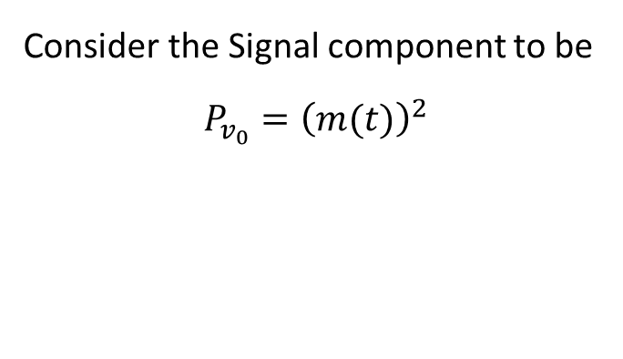
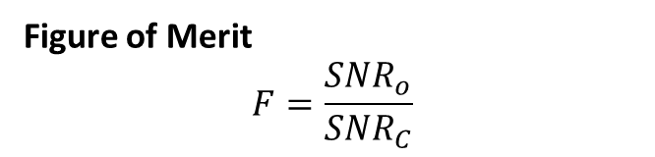
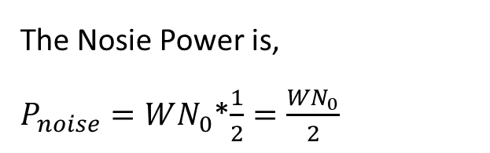
Radio Frequency Systems
Noise in DSB SC Receivers using Balanced Modulator
To find the value of output SNR
Find the Average power of signal component
Consider the Signal component to be
$$P_{v_{0}}={\left(m(t)\right)}^{2}$$
${SNR}_{O}$ $=\frac{Average power of demodulated message signal}{Average power of noise at demodulated output}$
${SNR}_{O}$ $={2\left(m(t)\right)}^{2}/WN_{0}$
The Nosie Power is,
$P_{noise}=WN_{0}$*$\frac{1}{2}=\frac{WN_{0}}{2}$
Figure of Merit
$$F=\frac{{SNR}_{o}}{{SNR}_{C}}$$
$$F=\frac{\left(\frac{2{\left(m(t)\right)}^{2}}{WN_{0}}\right)}{\left(\frac{{2\left(m(t)\right)}^{2}}{WN_{0}}\right)}=1$$

Slide 17
Radio Frequency Systems
References:
[1] S. Haykin and M. Moher, Introduction to Analog & Digital Communications, 2nd ed. Hoboken, NJ: Wiley, 2007.
[2] Tutorialspoint, "Angle Modulation - Principles of Communication," Tutorialspoint.com. https://www.tutorialspoint.com/principles_of_communication/principles_of_communication_angle_modulation.htm.

Slide 18
Thank you

