Slide 1
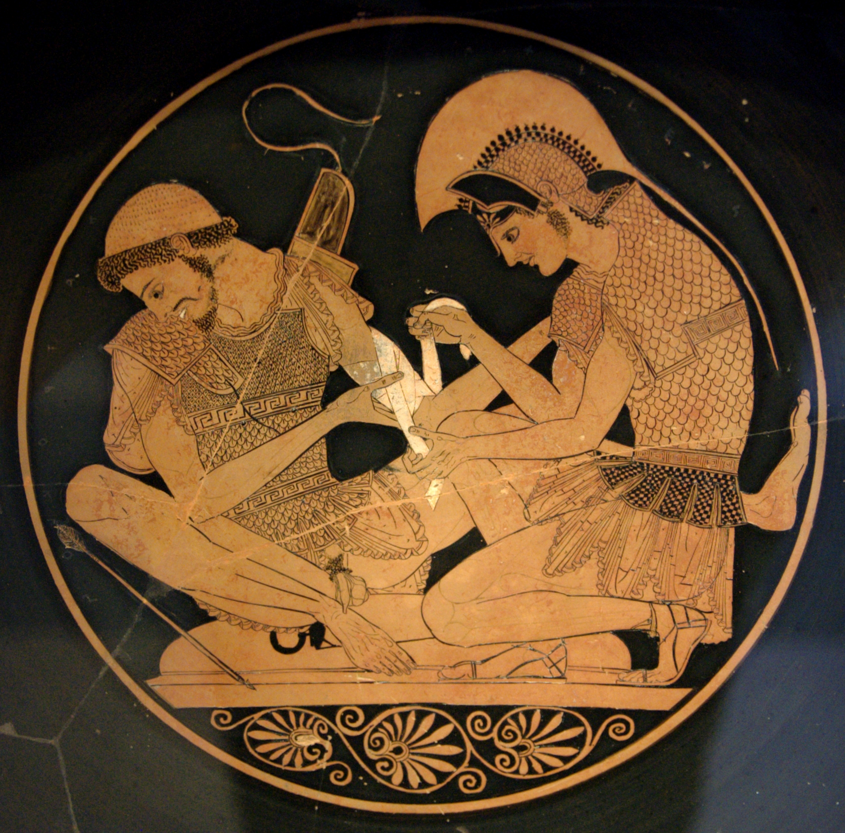
consequences

Slide 2
Jason’s “abduction” of Medea as an aetion for the Trojan conflict.
Jupiter’s speech in Valerius Flaccus: after Medea’s “abduction”, will come Paris’ abduction of Helen and the start of the Trojan war:
“But now her last day is hastening on and we are leaving Asia tottering to her fall, while the Greeks now claim of me their time of prosperity. Therefore have my oak trees, the tripods and the spirits of their ancestors sent forth this band upon the sea. For thee, Bellona, has a path been fashioned through the billows and through storms. Nor is it the fleece alone that is fated to rouse resentment and the still closer pang that comes from a ravished maid [Medea], but also—and no resolve is more firmly fixed in my mind—there shall soon come from Phrygian Ida a shepherd who shall bring lamentation and like rage and a rich requital to the Greeks.

Slide 3
Jason’s “abduction” of Medea as an aetion for the Trojan conflict.
“Ah, what wars shalt thou see when the suitors pour forth from the fleet! How many times shall Mycenae bewail its wintry bivouacs before Troy! How many a prince, how many sons of gods, how many a mighty man shalt thou see fall, and Asia yield to the high fates! Thereafter am I resolved upon the end of the Danai, and shortly will take other nations into my care.” (Val. Fl. Arg. 1.542-56)
Which nation might we think of?
What text?

Slide 4
relationships
Chronology (events of Catullus 64 – events of Achilleid- events of Iliad) :
Hinds (Allusion and Intertext 1998) has showed how Catullus 64 establishes the Iliad as a prequel and how Statius establishes Catullus 64 as a prequel
NB Parkes ‘Sed tardum (Ach. 1.47): Valerius Flaccus’ Argonautica as prequel to Statius’ Achilleid’, Materiali e discussioni 63 (2009), 107-113
“Valerius Flaccus establishes his Argonautica as a pre-text for the Homeric epic, since the Argo’s voyage took place a generation or two before the Trojan war. Thus the Iliad itself now becomes Apollonius’ and Valerius’ sequel...

Slide 5
relationships
“And Statius exploits this relationship to position his own epic, the Achilleid, as a wedge in-between, as a sequel to Valerius’ poem and as a prequel to the Iliad, bringing the epic tradition full-circle back to its origins, in a meta-literary pattern of ring composition, or as I would like to call “future perfect”, that is, events that will have taken place before the events recounted in the ur-text, the ur-epic, Homer’s Iliad.” (Augoustakis, A. ‘Achilles and the Poetics of Manhood: Re(de)ﬁning Europe and Asia in Statius’ Achilleid’, CW 109.2 (2016). 195-219) (+Achilleid as pretext to Vergil’s Aeneid)

Slide 6
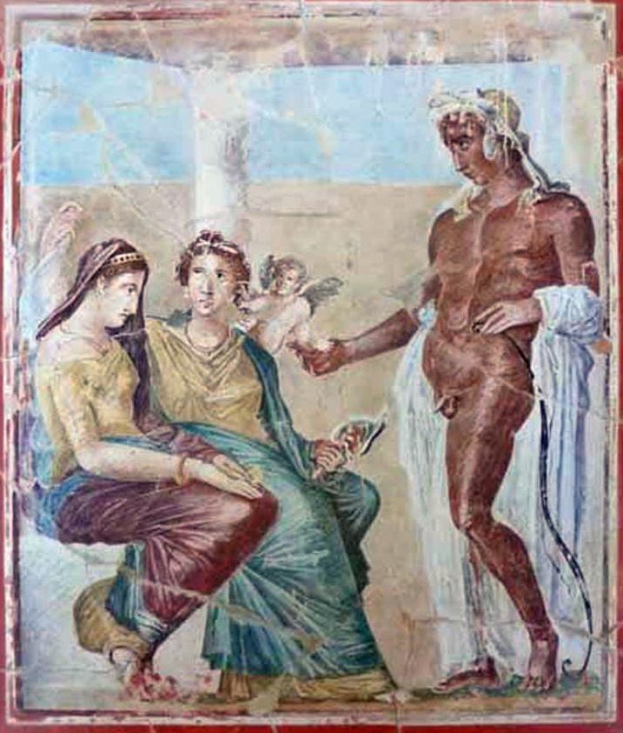
consequences
The Statian Thetis tries to provoke Neptune into causing a storm and sinking the fleet:
“Sins of the lands sail in safety since the Pagasaean bark ruptured the laws and secluded majesty of the deep with Jason’s rapine [Medea]. Behold, the temerarious arbiter of unjust Ida [Paris] makes voyage, freighted with another crime of theft and spoils of hospitality, to give what groans, alas, to earth and heaven, and what to me.” (Stat. Ach. 1.63-9, Thetis to Neptune)

Slide 7
consequences
Neptune’s reply:
“Tis ordained and ratified of the gods that Europe and Asia mingle bloody hands. Jupiter has proclaimed war’s decree and years sad with slaughter. There victorious what a son shall you see in Sigean dust, what obsequies of Phrygian mothers, when your scion of Aeacus shall now drench the Teucrian plains in warm blood, now forbid the thickened rivers their outlets, slowing his chariot with Hector’s corpse, overturning my walls —that lost labour! Cease now to complain of Peleus and misalliance. Men shall believe you bore a son to Jupiter.” (Stat. Ach. 1.81-90)

Slide 8
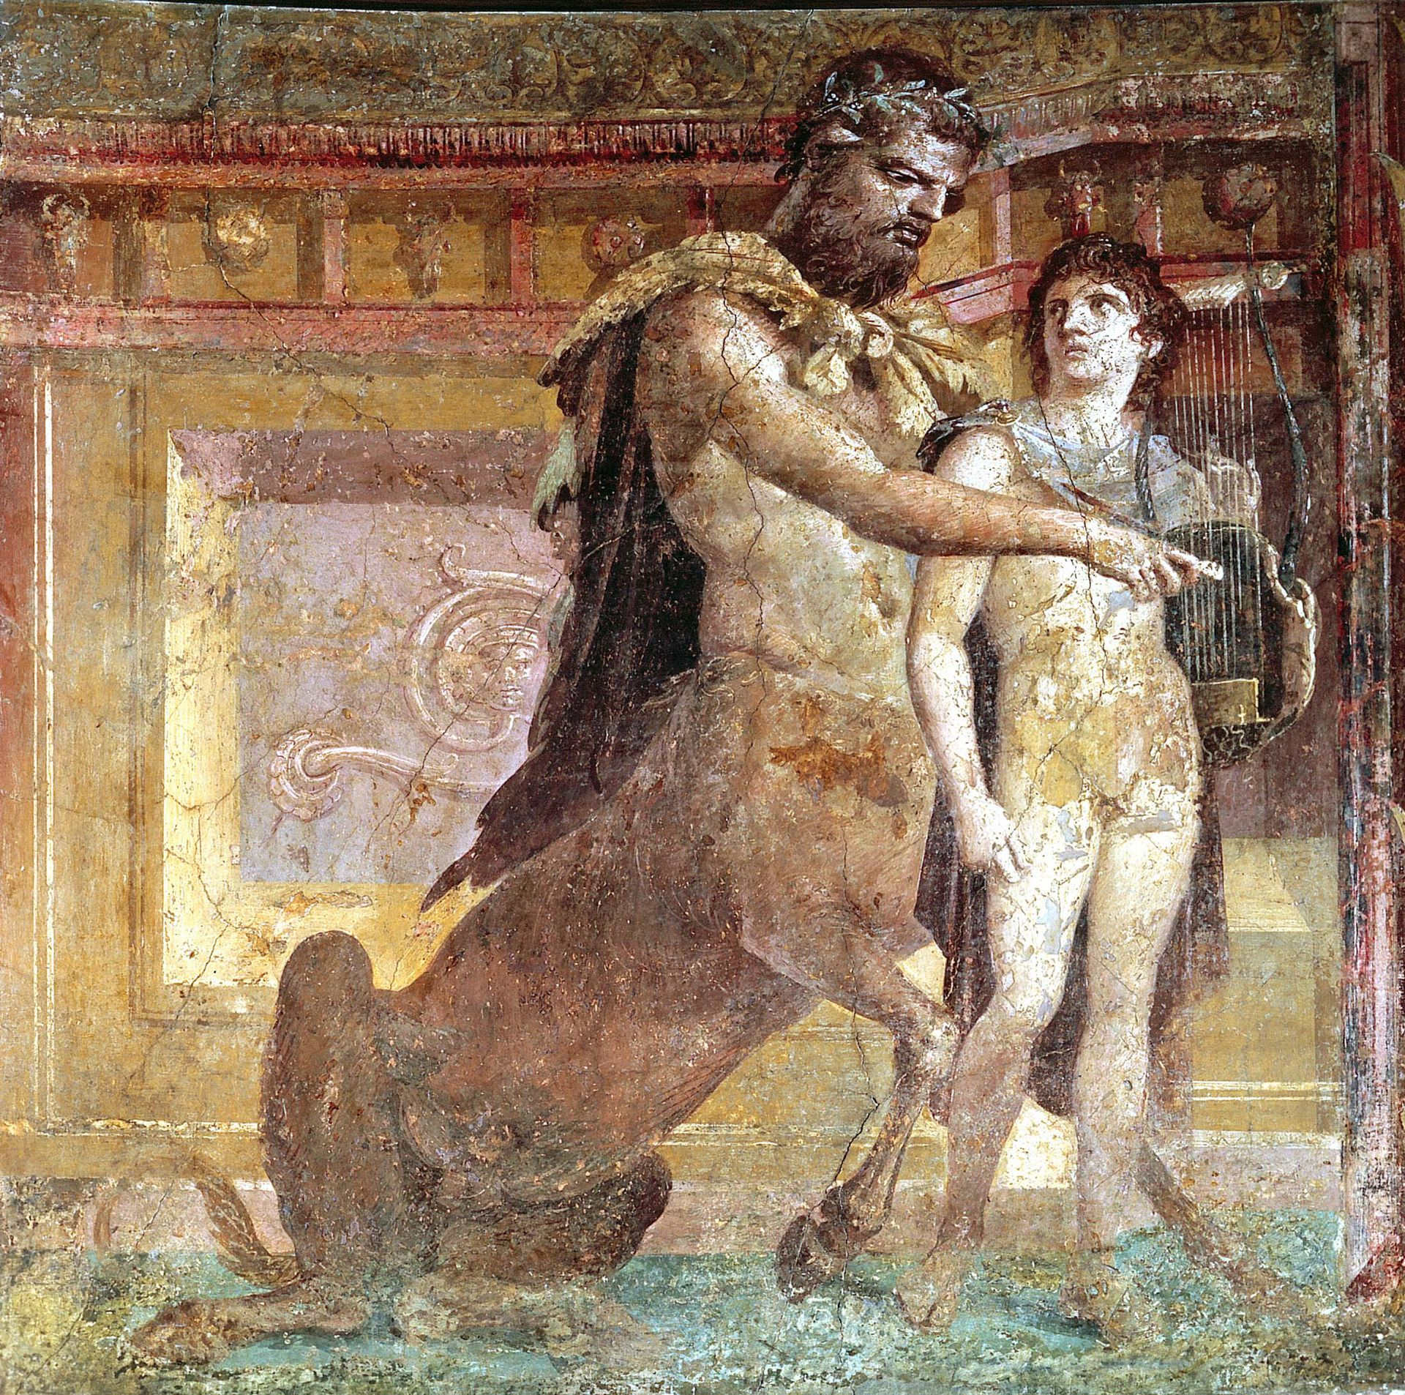
Achilles’ upbringing in Thessaly with Chiron
Thetis: “For why did I trust Pelion to the child for cradle and the grim master’s cave? There, if I mistake not, he plays at Lapith battles and already measures himself with his father’s spear,” (Ach. 1.38-41)

Slide 9
Consequences
Achilles:‘They say that in my tender years, still crawling, when the old man of Thessaly [Chiron] received me on his stark mountain, I took no ordinary food nor satisfied hunger from nurturing breasts, but tore at the tough flesh of lions and offal of a she-wolf still half alive. This was my first bread, this the gift of happy Bacchus, thus that father of mine used to feed me. Presently he taught me to go with him through the trackless wilderness, drawing me on with his wider stride, and to laugh when I saw wild beasts and not to fear rocks shattered by rushing torrents and the silences of the vast forest. Even then arms were in my hand, even then a quiver at my neck, precocious love of steel, …” (Ach. 2.96-108)

Slide 10
Consequences
Achilles’ heroic mindset comes from his upbringing with Chiron, an upbringing which Thetis herself is partly responsible for as her comment at Ach. 1.38-39 reveals (“For why did I trust..”)
no suggestion in Valerius’ poem that Thetis helped organize her son’s rearing BUT the Achilleid’s engagement with the Argonautica encourages us to read back Thetis’ involvement into Valerius’ text.

Slide 11
Consequences
We seem in part to be directed towards Valerius’ treatment of raising.
See Peleus to Chiron: “Let my little son marvel to hear thee speak of clarions and of wars; do thou teach him to wield his boyish weapons in the chase, and ere long to grasp my spear.” (V. Fl. 1.268-270)
Statian Chiron has carried out the Valerian Peleus’ wishes: e.g. fostered a love of war though his tales; taught his charge to bear weapons and hunt whilst still a child, encouraged Achilles to follow in his father’s warrior footsteps: (Ach. 1.41 already measures himself with his father’s spear”)

Slide 12
Consequences
NB gestures to Achilles’ Iliadic future where he wields his father’s spear
Achilles boasts that even as a child he bore arms and quivers (Ach. 2.106) and that his love of iron was ‘accelerated’ (properatus, 2.107: loeb “precocious love of steel”)
Such training directs Achilles onto the path which leads to his doom. Prompted to snatch the shield and spear brought by Ulysses and thereby reveal himself, he will end up arming himself with another shield and Peleus’ spear (Il. 19.373-80; 387-91) at Troy before reentering the conflict.”
Thetis now regrets heroic ethos such an education was designed to inculcate ...

Slide 13
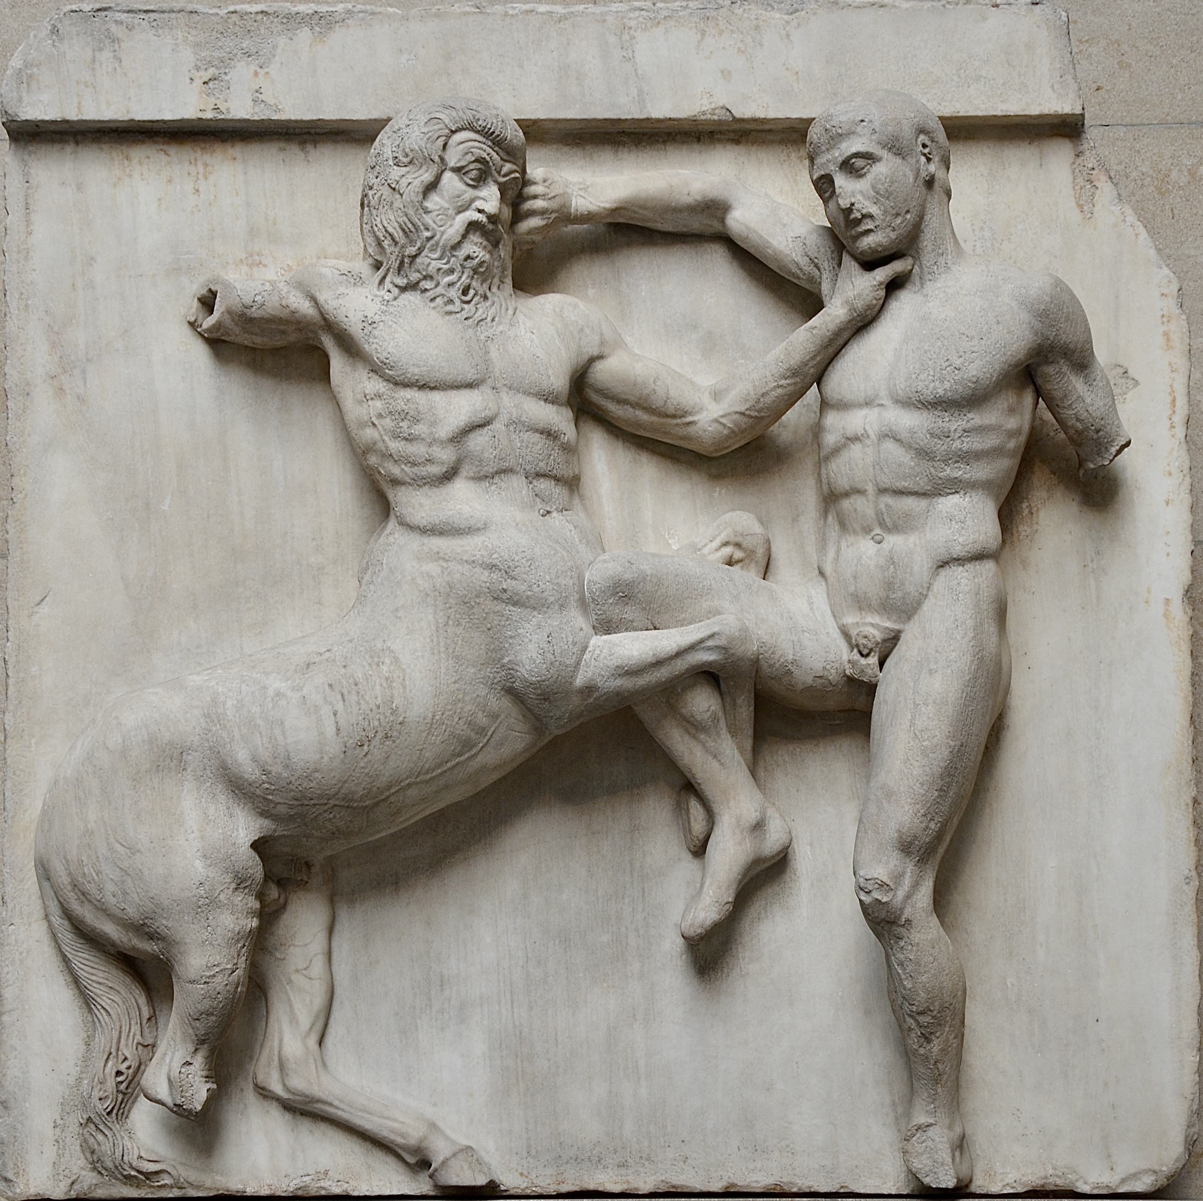
cave
“High up his lofty dwelling bores through the mountain, upholding Pelion with its lengthy vault. Part was excavated by hand, part its own age had ruptured. But tokens and couches of the gods are to be seen, showing which place each deity had hallowed with his reclining and his familiar spirit. Within spread the Centaur’s lofty stalls, a contrast to his villainous brethren. Here are no darts that have tasted human blood, no ash trees fractured in festive combats, nor mixing bowls shattered upon kindred foes, but innocent quivers and empty hides of wild beasts” (Ach. 1.106-115)

Slide 14
Ovidian intertexts
This alludes to two Ovidian episodes:
Peleus’ rape of Thetis at Metamorphoses 11.221–65 at a Thessalian cave (Met. 11.229-237) [See e.g. Dilke, O. A. W. Statius, Achilleid (1954) 91-2; Heslin, P. The Transvestite Achilles (2005) 263-4.]
and the Centauromachy at Metamorphoses 12.210-535.
[Cf. D. Mendelsohn, “Empty Nest, Abandoned Cave: Maternal Anxiety in Achilleid I” Classical Antiquity 9 (1990) 303; Newlands, C. Statius, Poet between Rome and Naples (2012) 65-6.]
e.g. references to ash trees (Ach. 1.113) and broken wine-bowls (1.114) look to Ov. Met. 12.339-40 (Dictys impaled by a broken ash-tree) and 12.235-7 (the bowl hurled by Theseus).

Slide 15
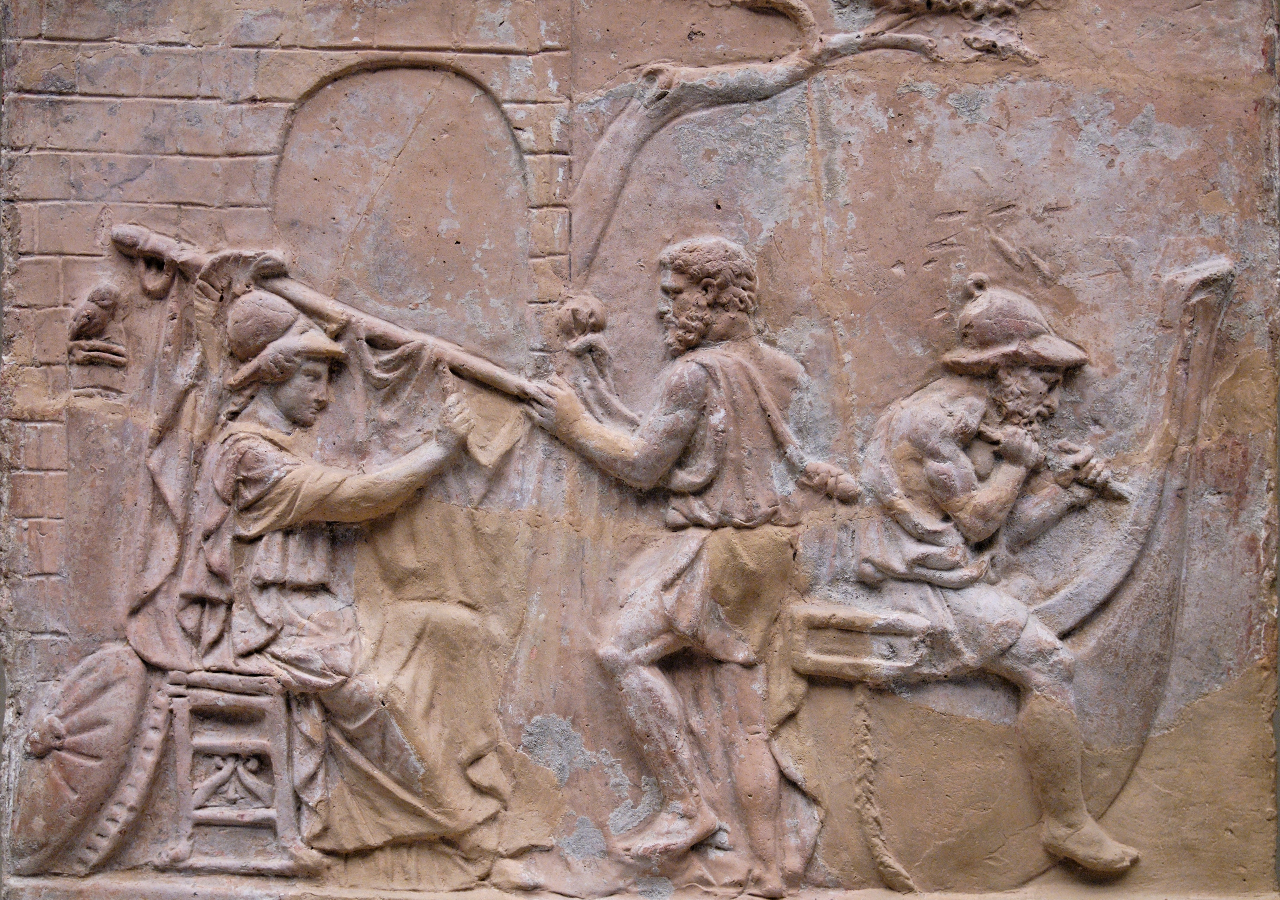
Valerius Flaccus intertexts
Also engages with Valerius’ description of the ship’s ornamentation at Argonautica 1.130-48 (which itself alludes to these scenes)

Slide 16
decoration on Valerius’ Argo
On one side = Thetis’ marriage (V. Fl. 1.130–9):
“On one side Thetis, whom a god had hoped to win, is being borne upon the back of a Tyrrhene fish to the bridal chamber of Peleus; the dolphin is speeding over the sea; she herself is sitting with her veil drawn down over her eyes, and is sorrowing that Achilles shall not be born greater than Jupiter. Panope and her sister Doto and Galatea with bare shoulders, revelling in the waves, escort her toward the caverns; Cyclops from the Sicilian shore calls Galatea back. Opposite to this is a fire and a bed of green leaves, a banquet and wines, and in the midst of the sea-gods the son of Aeacus with his wife; they have drunk, and now Chiron is touching the lyre.

Slide 17
decoration on Argo
Centauromachy: battle of Centaurs and Lapiths (V. Fl. 1.140–8)
“On the other side is Pholoe and Rhoetus mad with much wine, and the strife that broke out over the Atracian maid [Hippodameia]. Bowls and tables are flying, altars of the gods and cups, the marvellous work of ancient craftsmen. Here may one recognise Peleus, lord of the spear, and here Aeson raging with his sword. Monychus is toiling beneath the weight of his conqueror Nestor, mounted on his unwilling back; Clanis is dealing death to Actor with a blazing oak tree; Nessus the black centaur is fleeing, and in the midst of all Hippasus leaning against the coverlets is burying his head in an empty golden goblet.” (V. Fl. 1.130–48)

Slide 18
Statius/Valerius
Statius’ narratorial juxtaposition of references to Thetis’ wedding (Ach. 1.109-10) and the Centaur-Lapith battle (Ach. 1.111-13) gestures to Valerius’ narratorial juxtaposition of scenes from the marriage (V. Fl. 1.130-9) and Centauromachy (V. Fl. 1.140-8) in the ecphrasis.

