Slide 1
Topic 7 – Transaction Isolation Levels in PostgreSQL

Slide 2
Four Isolation Levels
The SQL standard defines four different isolation levels for transactions.
  Serializable;
  Read Repeatable;
  Read Committed;
  Read Uncommitted:
    Not supported in PostgreSQL.

Slide 3
Serializable
The most strict isolation level is Serializable, while the three other isolation levels are defined in terms of effects that are allowed to happen when running transactions concurrently.
The Serializable isolation level guarantees that concurrent transactions run as they would if you would run sequentially one by one in order.

Slide 4
Read Repeatable
One step weaker is the Read Repeatable isolation level that allows Phantom Reads to happen in the transaction.
Contrary to transactions running in the Serializable mode, the set of rows that is returned by two consecutive select queries in a transaction can differ.
This can happen if another transaction adds or removes rows from the table we are querying.

Slide 5
Read Committed
Even weaker is the Read Committed isolation level.
Two consecutive select statements in a transaction can return different data.
Contrary to the Read Repeatable level, this level allows not only the set of rows to change, but also the data that those rows contain.
This can happen if another transaction modifies the rows.

Slide 6
Read Commited (Default Setting)
Before we dig into the theoretical explanation, let’s observe the default behaviour of PostgreSQL transactions.
We want to explore what happens if two concurrent process access the same values in the database.
Are the two transactions totally isolated from each other?

Slide 7
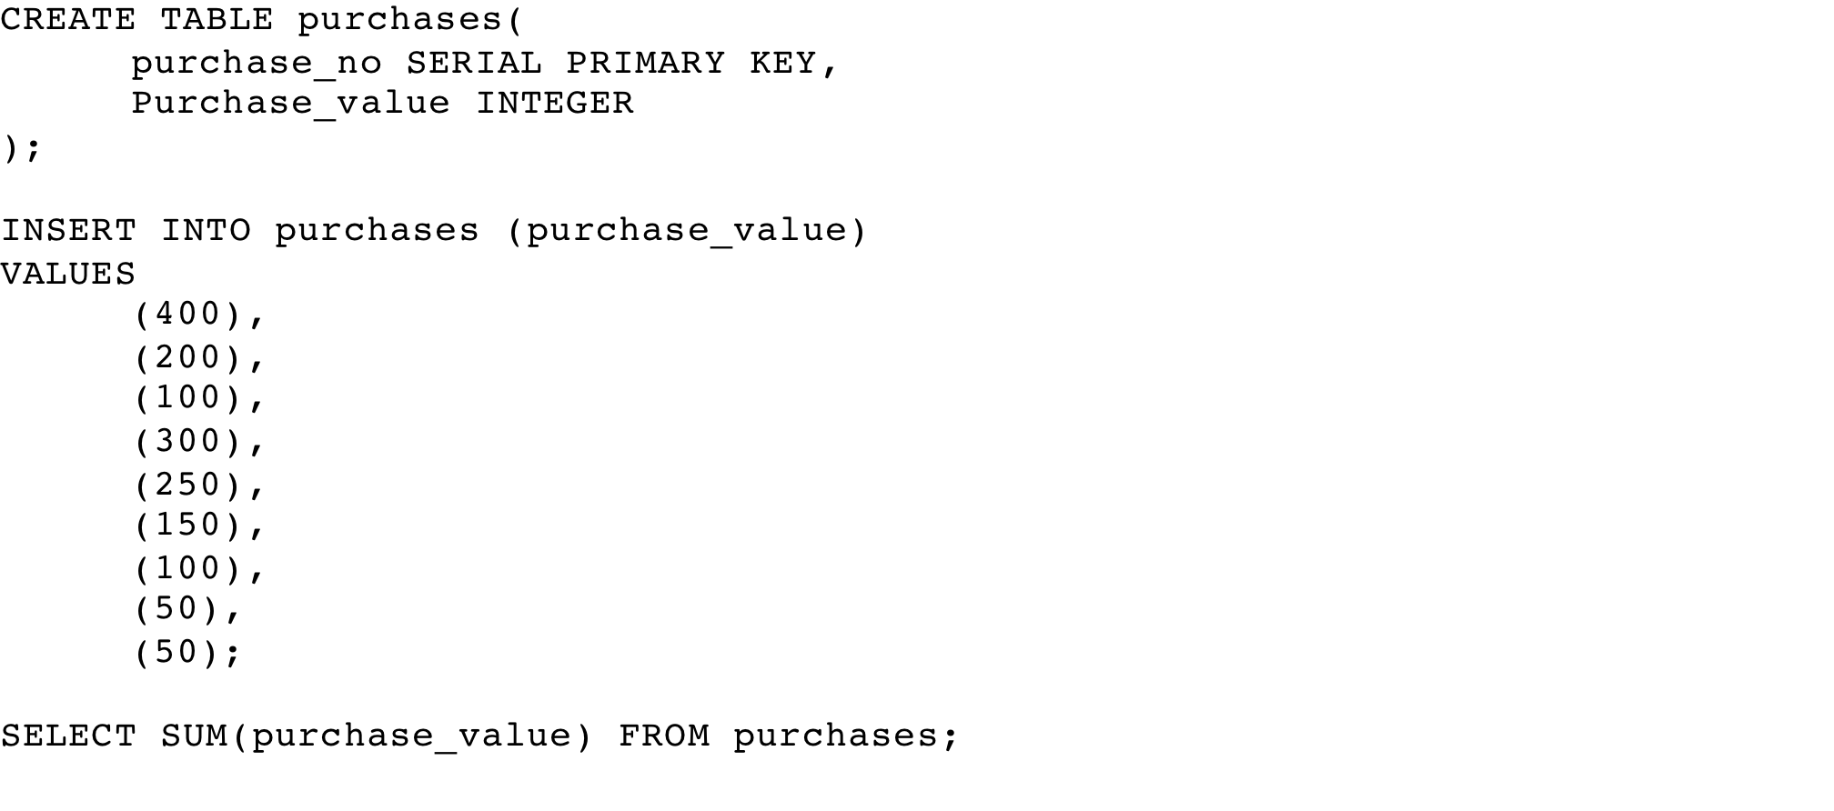
Sample Table and Data

Slide 8
Transaction Exercise
Open 2 pgAdmin4 Instances;
  Run Process A in the first instance;
  Run Process B in the second instance;
  Note the progress of the two processes:
    Data output against expectations.
  Note any error messages.

Slide 9
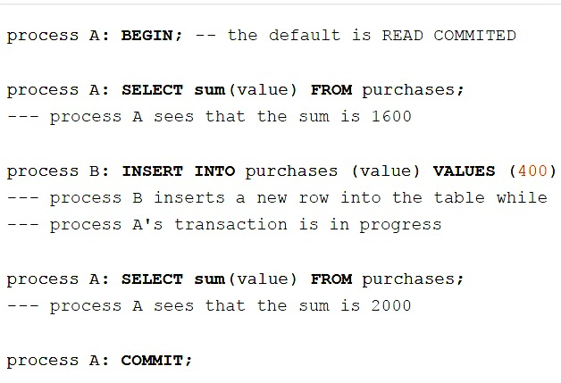
Read Commited

Slide 10
Read Commited
By default, transactions in SQL are isolated with the Read Committed isolation level.
Two successive select commands can return different data in the same transaction.
  In the above example, process A first calculated the sum 1600, and then after the process B made changes, it calculated a different value of 2000.
Most developers would actually expect the two select queries to return the same value in a single transaction.
This is not true, and can lead to bizarre bugs if the developers don’t expect changes during transactions.

Slide 11
Process A1 – Read Committed
-- Process A1
BEGIN TRANSACTION ISOLATION LEVEL READ COMMITTED;
SELECT SUM(purchase_value) FROM purchases;
-- Run Process B1 at this point
SELECT SUM(purchase_value) FROM purchases;
COMMIT TRANSACTION;

Slide 12
Process B1
-- Process B1
BEGIN TRANSACTION;
INSERT INTO purchases (purchase_value) VALUES (400);
COMMIT TRANSACTION;
SELECT SUM(purchase_value) FROM purchases;

Slide 13
Repeatable Read
If we want to avoid the changing sum value in process A during the lifespan of the transaction, we can use the repeatable read transaction mode.

Slide 14
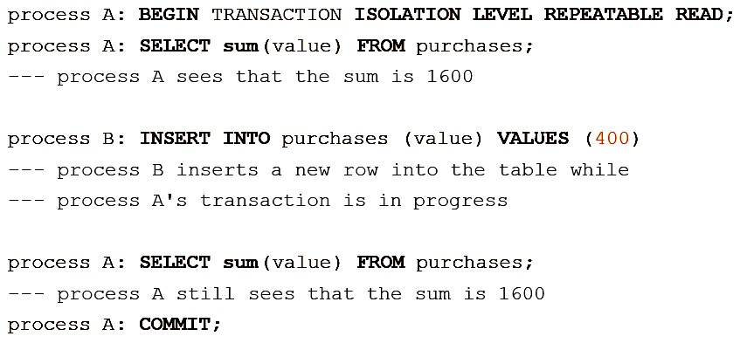
Repeatable Read

Slide 15
Repeatable Read
The transaction in process A fill freeze its snapshot of the data and offer consistent values during the life of the transaction.
Repeatable reads are not more expensive than the default read commit transaction.
There is no need to worry about performance penalties.
However, applications must be prepared to retry transactions due to serialization failures.

Slide 16
Process A2 – Repeatable Read
-- Process A2
BEGIN TRANSACTION ISOLATION LEVEL REPEATABLE READ;
SELECT SUM(purchase_value) FROM purchases;
-- Run Process B2 at this point
SELECT SUM(purchase_value) FROM purchases;
COMMIT TRANSACTION;

Slide 17
Process B2
-- Process B2
BEGIN TRANSACTION;
INSERT INTO purchases (purchase_value) VALUES (400);
COMMIT TRANSACTION;
SELECT SUM(purchase_value) FROM purchases;

Slide 18
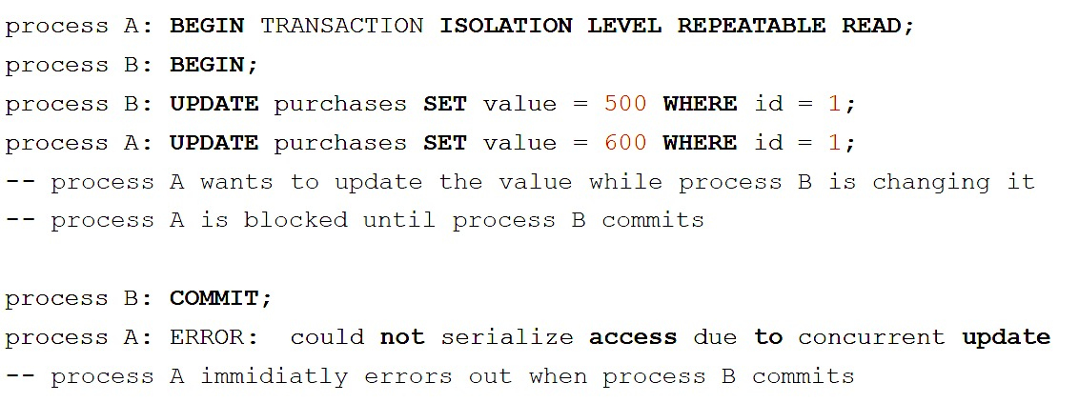
Repeatable Read

Slide 19
Process A3 – Repeatable Read
-- Process A3
BEGIN TRANSACTION ISOLATION LEVEL REPEATABLE READ;
-- Run Process B at this point
UPDATE purchases SET purchase_value = 600 WHERE purchase_no = 1;
-- Run Process B at this point
COMMIT;

Slide 20
Process B3
-- Process B3
BEGIN TRANSACTION;
UPDATE purchases SET purchase_value = 500 WHERE purchase_no = 1;
-- Run Process A3 at this point
COMMIT;

Slide 21
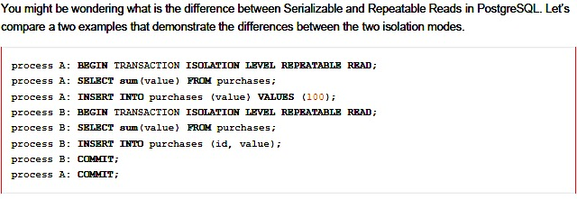
Read Repeatable vs Serializable

Slide 22
Process A4 – Repeatable Read
-- Process A4
BEGIN TRANSACTION ISOLATION LEVEL REPEATABLE READ;
SELECT SUM(purchase_value) FROM purchases;
INSERT INTO purchases (purchase_value) VALUES (100);
-- Run process B4 at this point
COMMIT;

Slide 23
Process B4
-- Process B4
BEGIN TRANSACTION ISOLATION LEVEL REPEATABLE READ;
SELECT SUM(purchase_value) FROM purchases;
INSERT INTO purchases (purchase_value) VALUES(1000);
COMMIT;

Slide 24
Read Repeatable vs Serializable
With Repeatable Reads everything works.
If we run the same thing with a Serializable isolation mode:
  process A will error out.

Slide 25
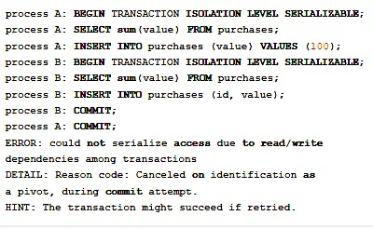
Read Repeatable vs Serializable

Slide 26
Process A5 - Serializable
-- Process A5
BEGIN TRANSACTION ISOLATION LEVEL SERIALIZABLE;
SELECT SUM(purchase_value) FROM purchases;
INSERT INTO purchases (purchase_value) VALUES (100);
-- Run process B5 at this point
COMMIT;

Slide 27
Process B5
--Process B5
BEGIN TRANSACTION ISOLATION LEVEL SERIALIZABLE;
SELECT SUM(purchase_value) FROM purchases;
INSERT INTO purchases (purchase_value) VALUES(1000);
COMMIT;

Slide 28
Read Repeatable vs Serializable
Both transactions have modified what the other transaction would have read in the select statements.
If both would allow to commit this would violate the Serializable behaviour,
  because if they were run one at a time,
    one of the transactions would have seen the new record inserted by the other transaction.

