Slide 1
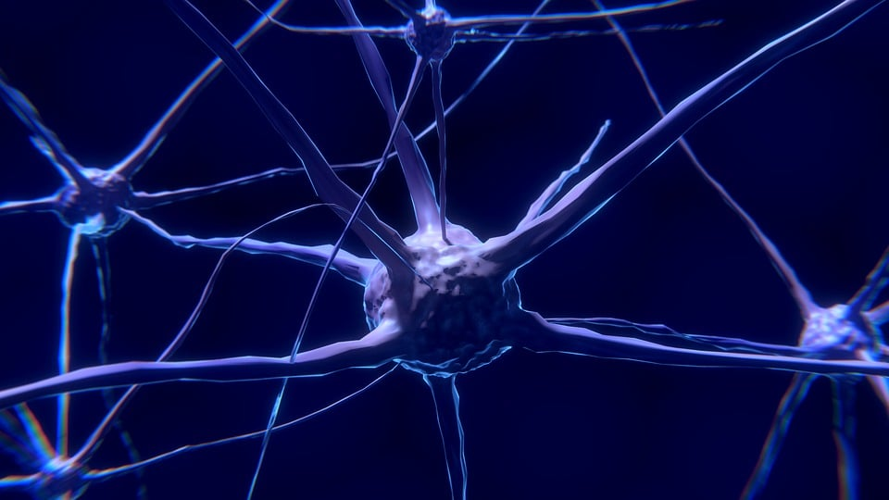
The Nervous System
Student name: Joliana Dede
Student number: 2121171
Module: Introduction to Physiology
Module code: BMHP5003_BIRM
Lecture name: Gillian Weaver

Slide 2
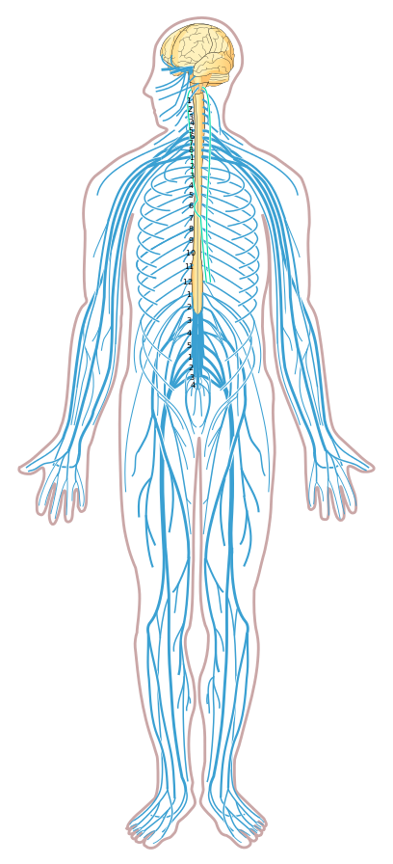

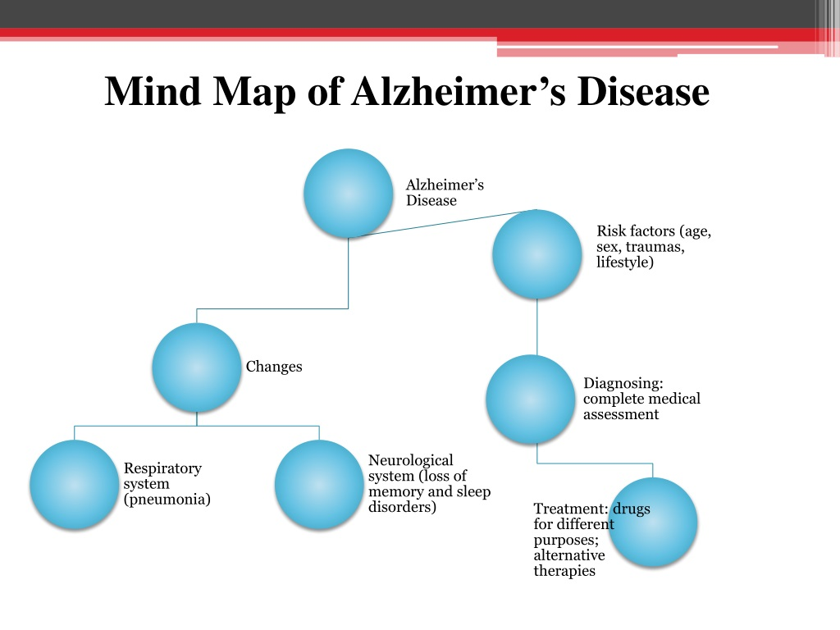
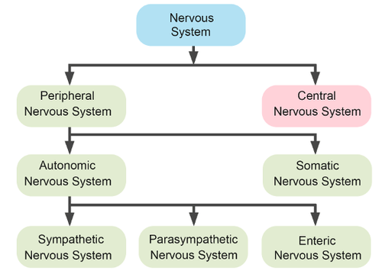
What is nervous system .
The nervous system is the body's command centre. Originating from the brain, it controls movement, thoughts and automatic responses to the world around us. It also controls other systems and processes of the body, such as digestion, respiration and sexual development (puberty).
Our nervous system governs almost everything we do, think, say, or feel. It controls complex processes like movement, thinking and memory. plays an essential role in things our body does without thinking, such as breathing,
The nervous system affects every aspect of health, including:
Memory, thoughts, learning and feelings.
Movements as balance and coordination. How brain interpret what you see, hear, taste, touch and feel.
Nervous system is active all the time
Parts of the nervous system?
The nervous system has two main parts, containing billions of cells called neurons, or nerve cells. These special cells send and receive electrical signals through the body to tell it what it needs to do.
Central nervous system
The brain uses the nervous system to send message to the rest of the body
Peripheral nervous system
Considered of many nervous that branch out from nervous system. This system relays information from brain and spinal cord to arm, leg, finger, and toes.
Somatic nervous system .
Autonomic nervous system . The study’s lead author, Dr James Ruffle, said by better understanding how the autonomic nervous system is regulated within the brain, researchers can better characterise its dysregulation within the brain from disease.
When we talk about the nervous system, we think about some of symptom's signal of nervous system dysfunction often include:
Lack of coordination, sleep issues, muscle rigidity or spasm, cramping, muscle wasting, memory loss .etc.
Alzheimer’s disease is a progressive brain disorder that gradually destroy a person’s memory and ability to learn, reason, make judgments communication and carry out daily activities.
Symptoms of Alzheimer's disease often appear slowly. It can start when someone finds it hard to remember things that just happened.. But over time, the problems get worse. People in the later stages of the disease can't usually live alone or take care of themselves.
Risk factors:
-- AGE
--FAMILY HISTORY
--SEX
--PASTHARD TRAUMA
--LIFESTYLE
3 interesting facts:
A new-born baby’s brain grows almost 3 time during the course its first year.
If we Lined up all the neurons in our body, it would be around 600mils long
The left side of human brain controls the right side of the body and the right side of the brain control the left side of the body.

Slide 3
Reference list
Snider, W.D., 1994. Functions of the neurotrophins during nervous system development: what the knockouts are teaching us. Cell, 77(5), pp.627-638.
Study reveals new network of brain linked to nervous system disorders (26 August 2021)
ttps://www.ucl.ac.uk/brain-sciences/news/2021/aug/study-reveals-new-network-brain-linked-nervous-system-disorders.
Beier, M. (2005). Alzheimer’s disease: Epidemiology and risk factors. Advanced Studies in Pharmacy, 2(4), 116-124.
Talamo, B. R., Rudel, R. A., Kosik, K. S., Lee, V. M.-Y., Neff, S., Adelman, L., & Kauer, J. S. (1989). Pathological changes in olfactory neurons in patients with Alzheimer's disease. Nature, 337(6209), 736-739.
Journal of the autonomic nervous system. (1979). Amsterdam: Elsevier/North-Holland.
Waugh, A. (2018). Ross and Wilson anatomy & physiology in health and illness. Elservier. Amsterdam.

