Slide 1
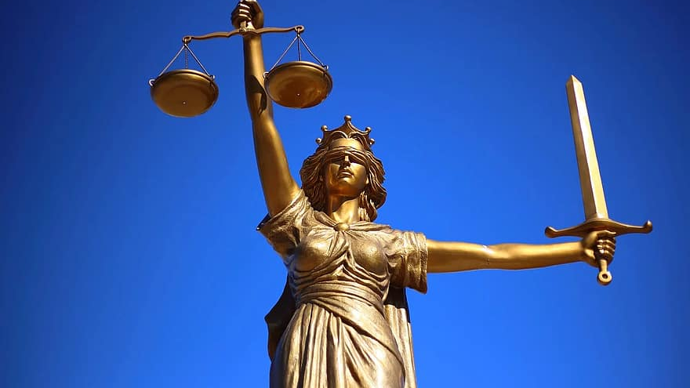
An introduction to Legal Process
By Zita Draper

Slide 2
Content
Aims and Learning Objectives
How will these sessions run?
Scheme of Work.
The Moodle page.
Teams
Assignments
Activities
Thank you, any questions?

Slide 3
Aims and Learning Objectives
The aim of today's session is to introduce you to the module and how these sessions will run.
By the end of today's session students should be able to demonstrate their understanding of what the module entails.

Slide 4
How will these sessions run?
2-hour lecture.
2-hour workshop.
You are required to ensure that you engage in these lessons.

Slide 5
Scheme of work!
Date | Topic | Notes
27th January 2025 | An introduction to legal process
3rd February 2025 | Where does the law come from? Part 1
10th February 2025 | Where does the law come from? Part 2
17th February 2025 | Human Rights and the Equality Act 2010
24th February 2025 | Devolution
3rd March 2025 | Draft session
10th March 2025 | Professional talks session | No taught classes this week
17th March 2025 | The Justice system
24th March 2025 | The Criminal Justice system
31st March 2025 | The Civil Justice System
7th -25th April 2025 | Easter Break
28th April 2025 | Presentation Assessment Session | Assessment 2 due

Slide 6

The Moodle page!
Please ensure that you have access to the Moodle page.
As this is where all the content from the lectures and workshops will be.
In addition, the assignment information can be located here.
Let’s take a look….

Slide 7
Assessments
Within the course of this module, you will have 2 assessments;
1. Written assignment – which will be discussed today.
2. Group Presentation – We will discuss this after the professional talk week.

Slide 8
Let’s take a look at your first assessment
Go to Moodle and the Assessment 1 tile.
You will have access to the assessment after today’s session.
If you have any questions after we have discussed the assessment today, please do not hesitate to ask, either in person or via email.

Slide 9
Let’s break the question down!
Let’s break it down!
What is it asking us?
How do you answer it?
Let’s take a look at the assignment brief.

Slide 10
Further information
Must be submitted on time.
If it is up to a week late it is capped at 40%.
If it is over a week late it is capped at 0%.
If you are unable to submit your assignment, you need to apply for extenuating circumstances.

Slide 11
Expectations
Engagement in lessons.
Attendance in lessons.
Tell you tutor if you are unable to attend their class.
Respect other students and staff in the classroom.
You must stay for the full duration of the class, or you will be marked as absent.

Slide 12

Legal Process
An intodcution!

Slide 13

Activity
What is legal process?
Discuss in groups and prepare to feedback to the class.
Everyone must share their answer.

Slide 14

Legal Process is....

Slide 15


Slide 16
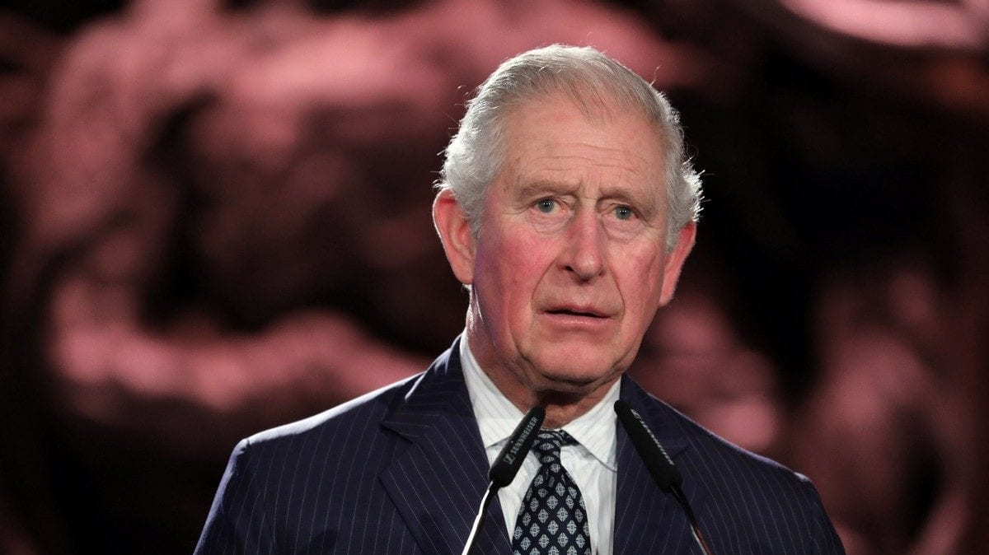

Slide 17
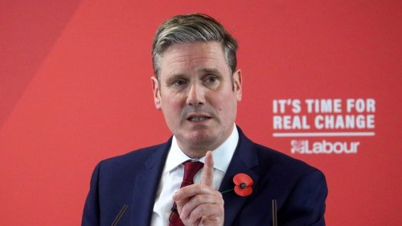

Slide 18


Slide 19
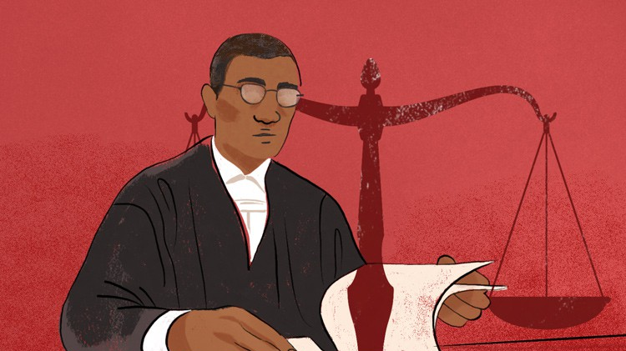

Slide 20
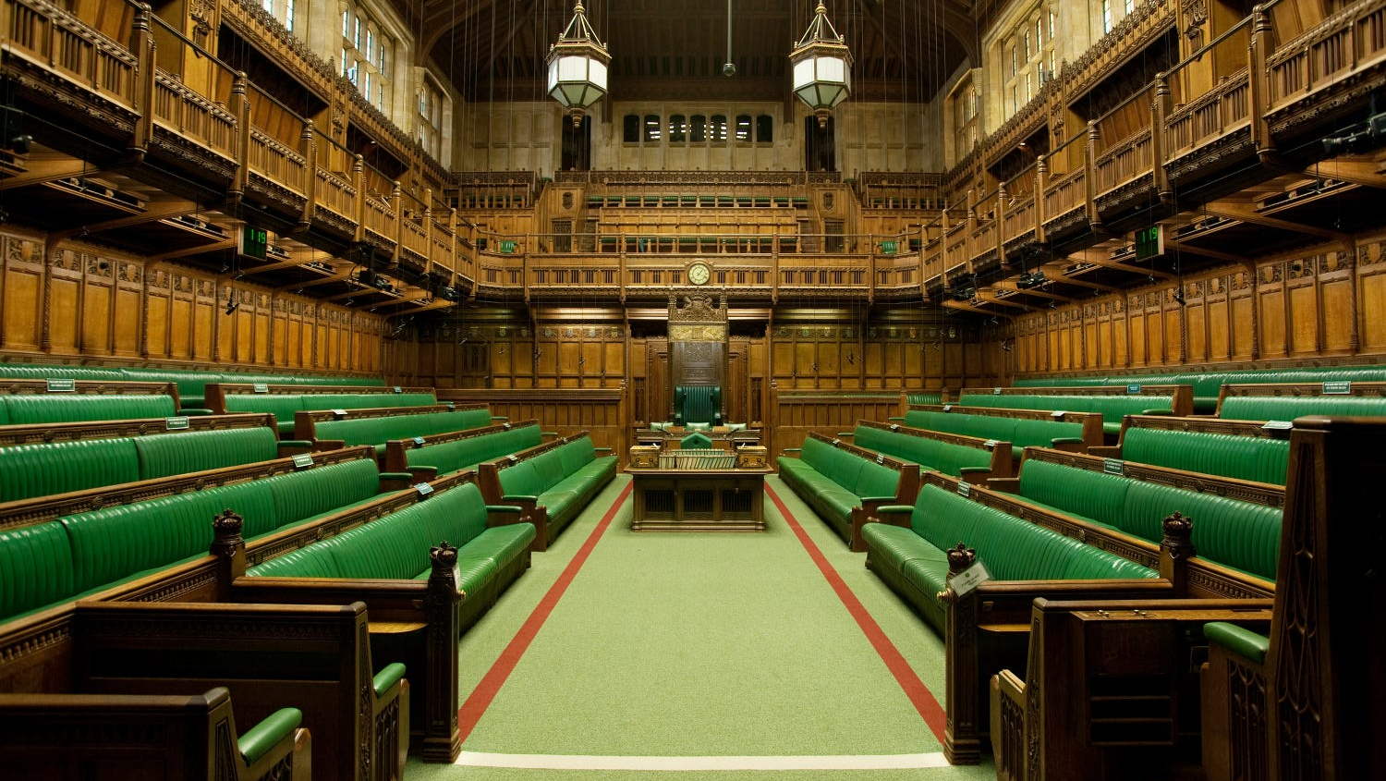

Slide 21
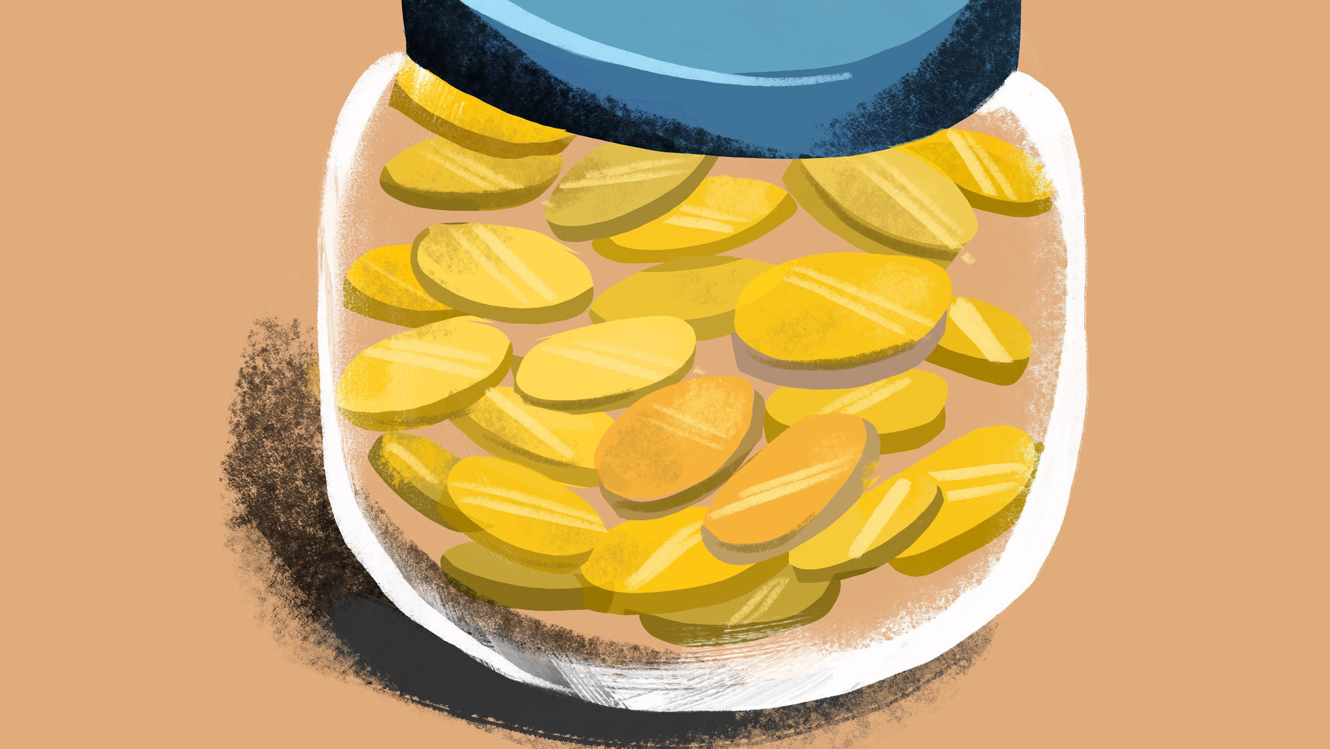

Slide 22
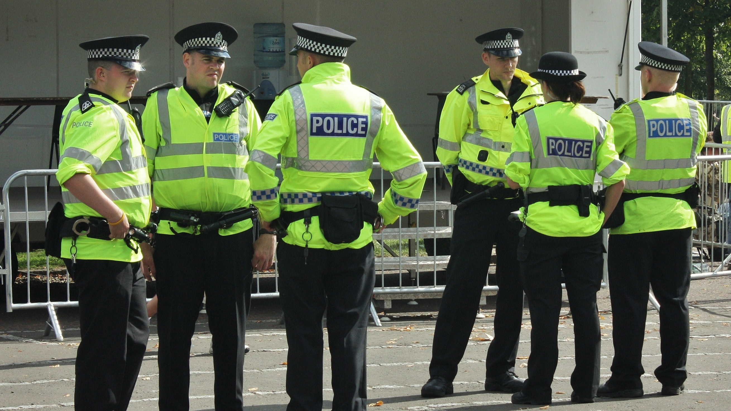

Slide 23
Legal Process
When we consider what legal process is, we recognise it includes a vast number of topics.
Some of which we won’t have time to cover in this module.
But it is all there to achieve the same aim.

Slide 24

One thing we need to know
You must remember that there are three different legal systems within the United Kingdom.
There is the English and Welsh justice system.
There is the Scottish justice system.
There is the Northern Ireland Justice system.

Slide 25

What is law?

Slide 26
What is law?
Laws/ statutes that govern the way we must act within society and we must follow these laws.
But we also have other things such as a code of conduct. Is this law?
Does it have consequences?

Slide 27
If a student misbehaves in school, what is the punishment?
If you speed in your car, what is the punishment?

Slide 28
So, what is law?
‘’One of the key defining characteristics of law is that it is created and enforced through governmental institutions. Laws are created by institutions of the state’’.
Notes:
But we must also note that we can also have regulations which can change, an example is the covid 19 pandemic and the regulations introduced during this time.

Slide 29
Where does the law come from?
Legislation/ statute.
Two types.
Primary legislation.
Secondary legislation also known as secondary/subordinate legislation.

Slide 30
Primary legislation
Act of parliament.
Created by parliament.
Main source of Uk law.
An example is the Offences Against the Persons Act 1861.

Slide 31

Secondary legislation
Also known as delegated/ secondary/ subordinate.
Includes how legislation is applied.
Made by government ministers.
An example is the Covid-19 pandemic and the legislation
implemented at that time.
Wales had different regulations compared to England.

Slide 32
Others
Case law (Precedent)
International law.
European Convention on Human Rights 1998.

Slide 33
Case law
Created by Judges.
Also known as precedent.
Reason for the decision in the case.
Apply the law which is clear but needs to be interpreted in another way.
Case example; Airedale NHS Trust v Bland [1993].
Other courts will follow the reasoning in a case depending on which court the case is heard in.

Slide 34
International law
Laws that govern relations between different countries.
Includes relations between states, individuals, the states and organisations.
‘’ The UK signs international treaties, they are binding in international law but not in domestic law’’.
This means that you cannot bring a case under international law in England and Wales.
European Convention on Human Rights is international legal system.

Slide 35
European Union
European Economic Community
Legal system which is binding on the domestic legal systems.
Could bring cases on the basis of EU law in the United Kingdom.
European Union (Withdrawal) Act 2018.

Slide 36
Different types of laws
Public v Private law.
Public law – state and private individual.
One example is the Human Rights Act 1998.
Private law – Individual and individual.

Slide 37
Continued…..
Criminal law v Civil Law.
Criminal law – punishment.
Proof beyond reasonable doubt.
Crown prosecution service.
Civil law – Rights and duties owed by both individuals and organisations to each other.
An example is duty of care in tort law.
Burden on the claimant – Balance of probabilities.

Slide 38
Common law and equity
Developed over the years.
Reasoning in cases becomes precedent.
Only remedy in common law in the past was damages.

Slide 39
Equity
Equity has been around since the 13th Centruy.
It means fairness, which is the main reason that it was created.
Developed elements such as mortgages and trusts.
It does not cover every area of law, it job is to fill in the gaps of the common law.
And was used where common law made unjust decisions.
An area of law that is impacted by equity is contract law where most of the principles come from.

Slide 40
Continued
Judicature Acts 1873-75- common law and equity have merged.
Where there is conflict equity prevails.
Because of the court of chancery, we now have elements such as the trusts and mortgages which form part of property law.

Slide 41
Equitable maxims
Created by the court of chancery
As part of the reasoning in a case. (Legal reasoning)
However, if court feel that the common law principles are satisfactory, they will not look at equitable maxims.

Slide 42
Continued
Some of the key maxims include;
‘’He who comes to equity must come with clean hands’’.
‘’He who seeks equity must do equity’’.
“Equity follows the law.”

Slide 43
Equitable remedies
Injunctions
Specific performance
Recission
Rectification

Slide 44
Legal persons
Someone who is able to act in law.
Examples include solicitors.
Legal persons include organisations, companies and many more.
Notes:
England and Wales have a common law system.

Slide 45
Summary
Sources of Uk law.
01
Primary and secondary legislation.
02
Case law/ precedent.
03
International law.
04
ECHR.
05

Slide 46
Thank you!
Any Questions?

