Slide 1
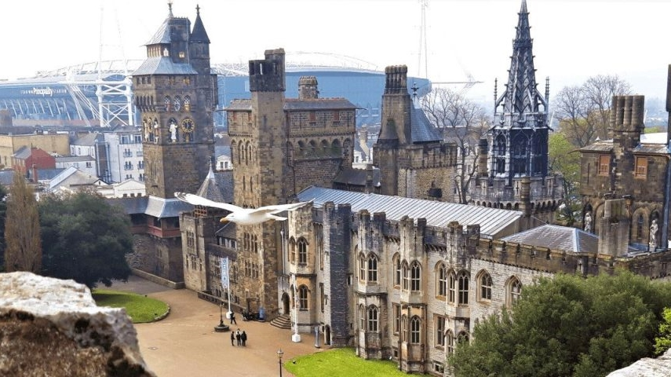
Feasibility plan for an international event
VISIT WALES’ - “YEAR OF CROESO 2025”
Croeso Connect 2025: Welsh Hospitality Leaders’ Summit
Module Name: International meetings management
Student Name: Elena Stenic
Student Id: 2246472
Lecture name: Kathryn Flynn
Notes:
Good afternoon. Welcome to this presentation. I am here today to present a detailed feasibility study for an inaugural global MICE event called Croeso Connect 2025, designed specifically in line with the Welsh Government's "Year of Croeso" initiative. This event will position Wales as a vibrant and culturally unique MICE destination, using its dual heritage language, green infrastructure, and increasing hospitality reputation worldwide. I shall walk you through the rationale, operational approach, finance planning, risk management, and wider legacy benefits of the event (Jackson, 2025).

Slide 2
I acknowledge the use of Grammarly (https://www.grammarly.com/) on 17 May 2025 to check my work using the prompt(s):
Please check the following text for readability, grammar and syntax.
I confirm that I have not presented any AI generated text as my own work. I confirm I have copies of my drafts, notes, and other resources I used before, and after the use of AI tools which I may be asked to provide in evidence.

Slide 3
Event Overview
Event Name: Croeso Connect 2025
Type: 1.5-day MICE leadership summit
Venue: ICC Wales, Newport
Theme: "Welsh Hospitality as a Global Benchmark"
Date: June 25–26, 2025 (Dwyer et al., 2001).
Notes:
Croeso Connect 2025 is a two-day hybrid-formatted leadership conference being held at the ICC Wales, Newport, chosen for its state-of-the-art facilities and sustainable reputation. With a "Welsh Hospitality as a Global Benchmark" theme, the event blends strategic industry debate with cultural narrative. It will welcome 300+ delegates from throughout Europe, Asia-Pacific, the Americas, and the Middle East. The sessions will be attended by keynote speakers, bilingual workshops, Welsh supplier exhibitions, and a dynamic cultural evening with music, food, and painting.

Slide 4

Aims and Objectives
Market Wales as a developing MICE destination
Enhance global awareness of bilingual hospitality practice
Create business opportunities for Welsh SMEs
Promote a sustainable and culturally sensitive guest experience
Notes:
Our goals are strategic and quantifiable. This summit will be a vehicle for positioning Wales in the competitive global MICE economy. We have the goal of drawing high-quality delegates and stakeholders who can build commercial links with Welsh providers. An additional primary aspiration is to leverage this platform to showcase the bilingual distinctiveness of hospitality, where cultural respect and linguistic inclusion provide a value-added guest experience, in line with worldwide DEI (Diversity, Equity, and Inclusion) trends.

Slide 5
Target Market
Primary: General Managers, Directors of Operations, Event Strategists
Secondary: Tourism officials, sustainability experts, hospitality educators
Geography: UK, EU, USA, UAE, Southeast Asia
Capacity: 350 delegates on-site, 100 virtual (Graham and Kennedy, 2022).
Notes:
Our main market is senior decision-makers working within the hospitality and tourism industries. These individuals are directly responsible for procurement, partnerships, and operational policy. We also engage secondary markets such as regional tourist boards, academics, and sustainability professionals. This broadened stakeholder group allows for both business opportunity and thought leadership. The hybrid format makes it accessible globally, particularly for delegates who experience budgetary or travel constraints.

Slide 6

Market Opportunity and Demand
MICE industry post-COVID recovery drives regional growth
Demand for authentic, culturally significant destinations
Greater focus on sustainability and DEI within events
Visit Wales 2025 "Year of Croeso" campaign creates synergy (Lekgau and Tichaawa, 2023).
Notes:
Market dynamics verify that post-pandemic MICE activity is moving towards local destinations with distinctive character and sustainable facilities. Wales, with its lively culture and increasing international recognition, presents an untapped yet compelling opportunity. International appeal is moving away from transactional conferences toward experiential and values-led connection. This summit captures these trends with culture, community, and climate responsibility woven into its value proposition.

Slide 7
Competitive Context
Competitors: Scottish Tourism Expo, London Hospitality Show
Gaps: Welsh-specific industry platforms lacking
Unique Proposition: Bilingual practice + cultural immersion
Strategic Edge: Institutional and governmental support (Hudson and Hudson, 2023).
Notes:
The competitive environment has a high clustering of hospitality events in key UK cities such as London and Edinburgh. There is no prominent event celebrating Welsh hospitality as an independent topic. Croeso Connect 2025 bridges this gap by targeting Wales as an identity-strong and forward-looking destination. Its niche positioning, backed by Visit Wales and educational institutions, provides credibility, differentiation, and long-term value.

Slide 8
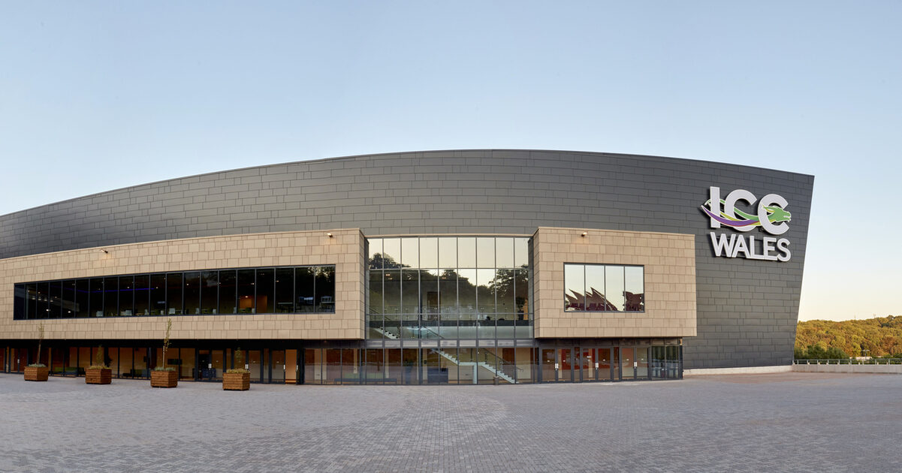
Venue & Operational Feasibility
ICC Wales: Tier 1 venue with 1,500-seat capacity
Transport links: M4 corridor, Cardiff and Bristol airports
Inclusive facilities: Accessibility, hybrid tech, on-site hotel
Bilingual signage, wayfinding, and interpretation are available
Notes:
ICC Wales isn't only appropriate — it's ideal. The facility is up to international standards in technical infrastructure, health and safety, digital integration, and accessibility. Its green credentials include ISO 20121 accreditation and provision for low-waste catering. Plus, its proximity to two international airports guarantees easy international connectivity, while its bilingual signage accommodates our objective of cultural inclusivity.

Slide 9
Resource and Staffing Requirements
Event agency-led project with 10 full-time staff
Collaboration with Cardiff Metropolitan University
25 bilingual student volunteers for logistics
Key partners: Visit Wales, HOSPA, Welsh Food & Drink cluster (Phillips, 2023).
Notes:
Human resources will be organised through a professional event agency, backed by trained volunteers from Welsh hospitality programmes. In this way, quality of service is assured while minimising labour expense and capability building in the local talent pool. Strategic alliances with national and local institutions will enhance credibility and enable further resourcing for content, logistics, and marketing.

Slide 10
Event Programme & Experience
Keynote: "Global Hospitality, Local Roots"
Masterclass: Delivering Welsh Bilingual Experiences
Panel: Climate Strategy in Boutique Hotels
Cultural Evening: Welsh cuisine, harp music, storytelling
Closing Session: The Future of Regional MICE (Bowdin et al., 2023).
Notes:
The programme design provides a robust mix of knowledge exchange and cultural experience. We provide bilingual content, workshops led by experts, and experience-based learning. For instance, the cultural evening will include Welsh-language storytelling with a locally sourced tasting menu. These experiential elements are not merely decorative — they're pedagogical devices that resonate with the event's objectives.

Slide 11

Marketing & Communications Strategy
Strategy: Digital-first, culturally themed, B2B focus
Platforms: LinkedIn, HOSPA, ICC Wales, Welsh Government websites
Early bird campaign
Influencer partnerships
Content-led outreach through blogs & webinars
Notes:
Our campaign will be led by high-ROI digital channels, amplified by stakeholder co-branding. We will partner with the Welsh Government and HOSPA to leverage their platforms to raise awareness of the event. Influencer marketing and targeted email will be used to encourage early sign-ups. Content marketing, behind-the-scenes video in particular, adds authenticity and pre-event engagement.

Slide 12
Financial Feasibility – Income
Income Source | Amount (£)
Delegate Fees (300 x £150) | £45,000
Visit Wales Grant | £20,000
Sponsors (5 x £5,000) | £25,000
Expo Booths (20 x £500) | £10,000
Total | £100,000
Notes:
This income estimate strikes a balance between affordability and commercial success. The Visit Wales Year of Croeso event funding stream is expected to provide the grant. Sponsorships from regional banks, local producers, and sustainable tourism brands are anticipated. This diversified income model adds financial stability.

Slide 13
Financial Feasibility – Costs
Expense Item | Amount (£)
Venue + AV | £30,000
Catering & F&B | £12,000
Speaker Fees & Travel | £5,000
Staffing & Interpretation | £10,000
Marketing & Promotion | £8,000
Decor & Materials | £5,000
Contingency | £10,000
Total | £90,000
Notes:
High levels of provision are built into our budget for top-quality AV, bilingual services, and contingency. Low-cost initiatives — such as the use of volunteers and partner-subsidised refreshments — enable us to direct more resources to delegate experience and promotion. Flexibility or reinvestment is secured by the £10,000 margin.

Slide 14
Legacy and Sustainability
Carbon-light travel incentives for speakers
Zero-plastic policy and biodegradable materials
Post-event report: White paper on bilingual hospitality
Free access to session recordings and the Welsh supplier directory (Chersulich Tomino, Perić and Wise, 2020).
Notes:
Sustainability is not only a theme; it's inherent in the design. We promote train travel, provide digital content, and employ compostable F&B packaging. A white paper will record lessons learned and provide recommendations for future Welsh events. This provides legacy, knowledge sharing, and alignment with international SDG objectives.

Slide 15
Risk Assessment and Mitigation
Risk | Mitigation
Low registrations | Early discounts, PR campaign
Funding delay | Tiered budget with priority expenses
Key speaker unavailable | Multiple speaker backups, hybrid setup
Weather/cancellation | Indoor venue, force majeure insurance
Notes:
A comprehensive risk register has been created, including operational, reputational, and financial risks. Mitigations involve hybrid contingency plans, multi-tiered budgets, and backup suppliers. Because external events are unpredictable, resilience and flexibility are embedded in all decisions.

Slide 16
Conclusion and Alignment
Aligns with the Welsh Government's Croeso 2025 initiative
Economically, socially, and environmentally sustainable
Provides cultural worth and global exposure
Completely viable with a high return on investment
Notes:
To conclude, Croeso Connect 2025 is a viable, innovative, and value-driven MICE event that reinforces Wales' global hospitality profile. It is financially viable, operationally deliverable, and strategically coherent with government, academic, and business agendas. I thank you for your time and look forward to answering your questions.

Slide 17
References:
Arcodia, C. and Barker, T., 2003. The employability prospects of graduates in event management: Using data from job advertisements. Current Issues in Tourism, 6(4), pp.345–366.
Bowdin, G.A., Allen, J., Harris, R., Jago, L., O’Toole, W. and McDonnell, I., 2023. Events management. Routledge.
Chersulich Tomino, A., Perić, M. and Wise, N., 2020. Assessing and considering the wider impacts of sport-tourism events: A research agenda review of sustainability and strategic planning elements. Sustainability, 12(11), p.4473.
Connell, J. and Page, S.J., 2005. Evaluating the economic and spatial effects of an event: The case of the World Rally Championship. Tourism Geographies, 7(3), pp.276–296.
Dredge, D. and Whitford, M., 2011. Event tourism governance and the public sphere. Journal of Sustainable Tourism, 19(4–5), pp.479–499.
Dwyer, L., Mistilis, N., Forsyth, P. and Rao, P., 2001. International price competitiveness of Australia’s MICE industry. International Journal of Tourism Research, 3(2), pp.123–139.
Getz, D. and Page, S.J., 2016. Event studies: Theory, research and policy for planned events. 3rd ed. London: Routledge.
Graham, C. and Kennedy, R., 2022. Quantifying the target market for advertisers. Journal of Consumer Behaviour, 21(1), pp.33–48.
Holloway, J.C., Humphreys, C. and Davidson, R., 2009. The business of tourism. 8th ed. Harlow: Pearson Education.
Hudson, S. and Hudson, L., 2023. Marketing for tourism, hospitality & events: A global & digital approach. Sage Publications Limited.
Jackson, T., 2025. The Care Economy. John Wiley & Sons.
Kaplanidou, K. and Vogt, C., 2007. The interrelationship between sport event and destination image and sport tourists’ behaviours. Journal of Sport & Tourism, 12(3–4), pp.183–206.
Ladkin, A., 2011. Exploring tourism labor. Annals of Tourism Research, 38(3), pp.1135–1155.
Lee, J.S. and Kim, H., 2020. Authenticity in cultural tourism: A case of bilingual marketing in heritage sites. Tourism Management Perspectives, 34, p.100672.
Lekgau, J. and Tichaawa, T.M., 2023. Examining the glocal forces that determined the MICE tourism recovery post-Covid-19 pandemic. GeoJournal of Tourism and Geosites, 49(3), pp.1195–1203.
Li, S., Robinson, P. and Oriade, A., 2017. Destination marketing: The use of technology since the millennium. Journal of Destination Marketing & Management, 6(2), pp.95–102.
Morgan, N., Pritchard, A. and Pride, R., 2011. Destination brands: Managing place reputation. 3rd ed. Oxford: Butterworth-Heinemann.
Park, E., Kim, H.S. and Ko, M., 2020. The role of social media in tourists’ decision making process. International Journal of Tourism Cities, 6(3), pp.447–463.
Phillips, J.M., 2023. Strategic staffing. SAGE Publications.
Whitford, M. and Ruhanen, L., 2020. Indigenous tourism businesses and the UN sustainable development goals. Journal of Sustainable Tourism, 28(10), pp.1569–1586.

Slide 18

THANK YOU!

