Slide 1
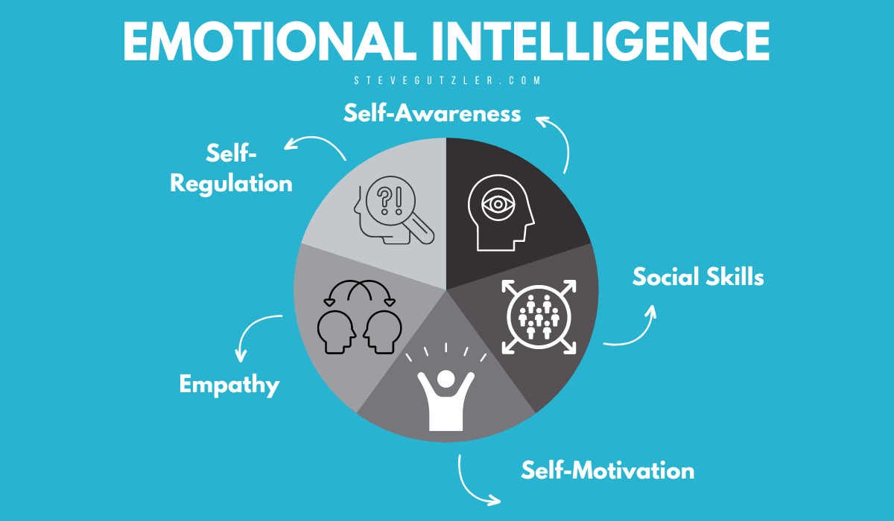
The Impact of Self-Awareness on Emotional Intelligence in Higher Education
“If you are tuned out of your own emotions, you will be poor at reading them in other people.” – Daniel Goleman
Name: AMALIA TERENTE | Student Number: 2329447 | Module: LCLM5006 | Lecturer: Abdallah Naser | Assignment: Emotional Intelligence Poster
Introduction
Controlling My Emotions & Developing Mindfulness
Addressing Emotional Intelligence Challenges
• Emotional Intelligence (EI) involves recognising and managing emotions
• Self-awareness is the foundation of EI (Goleman, 1995)
• EI supports stress management and academic success.
• Reflecting on Daniel Goleman, self-awareness is the foundation of emotional intelligence. When I ignore my stress or anxiety, I become reactive and less effective academically and socially.
Emotional Regulation
Reframe challenges positively
Use breathing/grounding techniques
Plan tasks to reduce stress
Mindfulness
Stay present in lectures & study
Limit distractions
Practise brief daily reflection
Outcome: Better focus, resilience, and empathy toward others.
• Stress & Anxiety
Use breathing techniques
Break tasks into manageable steps
Apply structured time management
Low Motivation
Set SMART academic goals
Connect studies to long-term career aspirations
Fear of Feedback
Reframe criticism as growth
Seek clarification instead of reacting emotionally
Group Conflict
Practise active listening
Respond assertively, not defensively.
Method
• Secondary research approach
• Academic journals and EI literature
• Reflective analysis of student experience.
References: Goleman (1995; 1998); Mayer & Salovey (1997); Kabat-Zinn (2003)
Goleman, D. (1995). Emotional Intelligence.
Goleman, D. (1998). Working with Emotional Intelligence.

