Slide 1
BMSW6101
Emergent Leadership Skills
Week 10
Motivation and Organisational Performance

Slide 2
Edwin Locke’s Goal-setting Theory
For goal-setting to be successful with desired outcomes, they must contain the following specific points (Lunenberg & Samaras, 2011):
  Clarity: goals need to be specific;
  Challenging: goals must be difficult yet attainable;
  Goals must be accepted;
  Feedback must be provided on goal attainment;

Slide 3
Edwin Locke’s Goal-setting Theory (contd.)
  Goals are more effective when they are used to evaluate the performance;
  Deadlines improve the effectiveness of goals;
  A learning goal orientation leads to higher performance than a performance goal orientation;
  Group goal-setting is as important as individual goal-setting.

Slide 4
Academic Sources
Journal Articles – PDF avalable at Google Scholar
  Lunenburg, F.C., 2011. Goal-setting theory of motivation. International journal of management, business, and administration, 15(1), pp.1-6.
  Latham, G.P., 2004. The motivational benefits of goal-setting. Academy of Management Perspectives, 18(4), pp.126-129.
  Latham, G.P. and Locke, E.A., 2006. Enhancing the benefits and overcoming the pitfalls of goal setting. Organizational dynamics, 35(4), pp.332-340.

Slide 5
Critical Evaluation o the Theory
In your assessment you are required to conduct a critical evaluation of the theory. It is a discussion of what other academics have said about the theory: how they have praised, critiqued and/or developed the theory.

Slide 6
Student Activity – Critical Evaluation
Latham, G.P. and Locke, E.A., 2007. New developments in and directions for goal-setting research. European Psychologist, 12(4), pp.290-300. (PDF available at Google Scholar)
Locke, E.A. and Latham, G.P., 2006. New directions in goal-setting theory. Current directions in psychological science, 15(5), pp.265-268. (PDF available at Google Scholar)
Choose anyone article from the above and write at least 2 paragraph on critical evaluation of the theory.

Slide 7
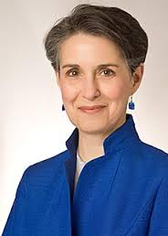

Inner Work Life Theory (2007)
Teresa Amabile & Steven J. Kramer

Slide 8
Inner Work Life Theory (2007)
Inner Work Life Theory is about how we perceive events in life, and how these affect our perceptions, emotions and motivation (the stuff in our head) before we engage in more work.
For the people fascinated by emotions and identity!
Notes:
We’ll be going through all of these on the slides, but I’d rather introduce the key ideas now.

Slide 9
Inner Work Life Theory (2007)
Developed by Teresa Amabile and Steven Kramer (2007) argues that:
“Our behaviour and work performance are influenced by the way in which our perceptions, motives, and emotions interact with each other, triggered by everyday events.”
Notes:
Our private thoughts and feelings may not be visible to others, but we do not leave them at home when we go to work.
People experience a constant stream of emotions, perceptions, and motivations as they react to and make sense of the events of the workday.
So, an understanding of inner work life is critical to facilitating high-level performance.

Slide 10
The Study
To find out how the dynamics of our inner work life can affect performance, Amabile and Kramer asked 238 professionals from 26 project teams to complete a personal diary, everyday for the duration of their projects.
The researcher sent daily emails to each professional, asking for a description of an event that stood out in their mind that day and how that made them feel.
The researchers had 12,000 diary entries to analyse
What they found, reveals the richness and intensity of people’s inner work life, what they call ‘the reality that management never sees’

Slide 11
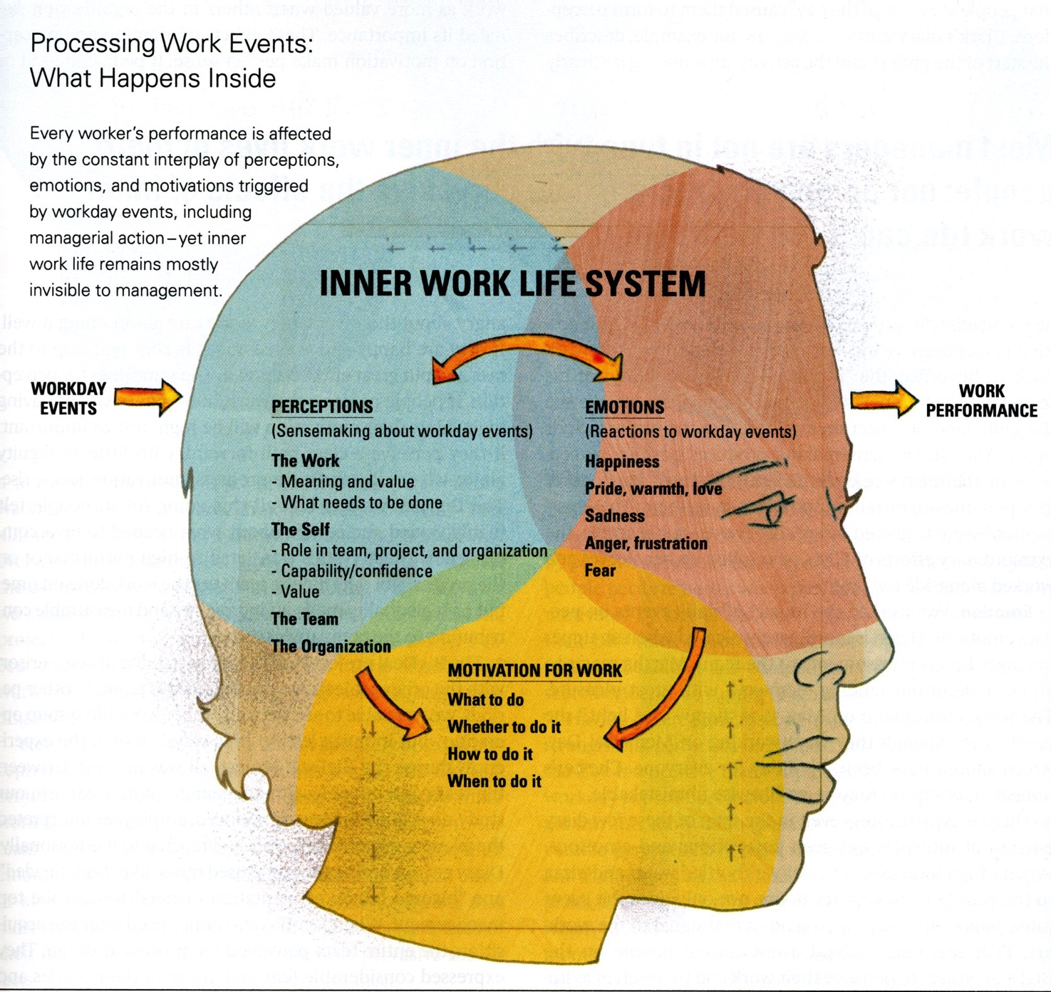
The Findings
Notes:
One of the most important implications of this perspective concerns the role of emotions.
Neuroscience has shown that cognition (including perceptions and emotions) are closely linked.
Events at work trigger a combination of perceptual and emotional processe, impacting motivation for work; thus influencing our behaviour and our performance at work.
Amabile and Kramer conclude that we perform better when our experiences at work include more positive emotions, favourable perceptions of the work/team/organisation and therefore stronger intrinsic motivation.

Slide 12

If You Do The Inner Work Anything Is Possible For You
https://www.youtube.com/watch?v=ru9k-RRVwBg

Slide 13
Practical Management Implications
Implications of this research differ from those of other motivation theories, which emphasise the ‘daily pat on the back’ and attempts to make work fun.
This research suggests that the two most important management behaviours involve ‘enabling people to move forward in their work’ (enabling progress) and ‘treating them decently as human beings’(manage with a human touch).
Notes:
Recent research in neuroscience has found that emotion and cognition (which includes perception of events) are tightly intertwined. Areas of the brain associated with rational thought and decision making have direct connections to areas associated with feelings. They do not exist in separate psychological compartments, and they interact in complex ways. Like any system, the brain cannot be understood simply by looking at each individual component. Inner work life functions the same way: It is crucial to consider all components and their interactions.
Most managers are not in tune with the inner work lives of their people; nor do they appreciate how pervasive the effects of inner work life can be on performance.
how work performance is influenced by people’s subjective experiences at work.
To explore inner work life more fully, we’ll take a closer look at each of its three components: perceptions (also called thoughts or cognitions), emotions (or feelings), and motivation (or drive).

Slide 14
Key Journal Article
Amabile, T.M., and Kramer, S.J., (2007). 'Inner work life: understanding the subtext of business performance'. Harvard Business Review, 85 (5), pp. 2-13.
Amabile, T.M. and Kramer, S.J., 2011. Meeting the challenges of a person-centric work psychology. Industrial and Organizational Psychology, 4(1), pp.116-121.

Slide 15

Group Activity 1
Please read this article and discuss the concept of the inner work lives of employees.
How leaders kill meaning at work

Slide 16

Any Questions?
Thank You ☺

