Slide 1
Data Analysis and Visualisation
Lecture 4
Descriptive Statistics

Slide 2
Descriptive Statistics
Frequency distributions are good for getting a graphical view of data, sometimes an actual number is what is required
  Average MP’s salary
  Average number of minutes spent on FB each day
Single numbers can be misleading, as we also need to know how the scores vary within a dataset
To do this we need to look at
  Measures of central tendency
  Selecting a measure of central tendency
  Measures of variability

Slide 3

Measures of central tendency
These provide an average or typical score that describes the level of a set of scores
  Useful when comparing individual scores with the group or an external standard
The most commonly-used measure of centre is the mean
  Add up all of the scores and divide by the number of scores
  $\overline{X}=\frac{\sum{X}}{N}$ where X is the set of scores and N is the number of scores
$\overline{X}$ is used when talking about the mean of a set
$μ$ is used when talking about mean of the population from which a set is drawn (this difference is important later on)

Slide 4

Example
Maths Score |  | Reading Score
14 |  | 25
19 |  | 37
13 |  | 26
9 |  | 20
13 |  | 19
$$\overline{X}=\frac{\sum{X}}{N}=\frac{68}{5}=13.6$$ |  | $$\overline{Y}=\frac{\sum{Y}}{N}=\frac{127}{5}=25.4$$

Slide 5
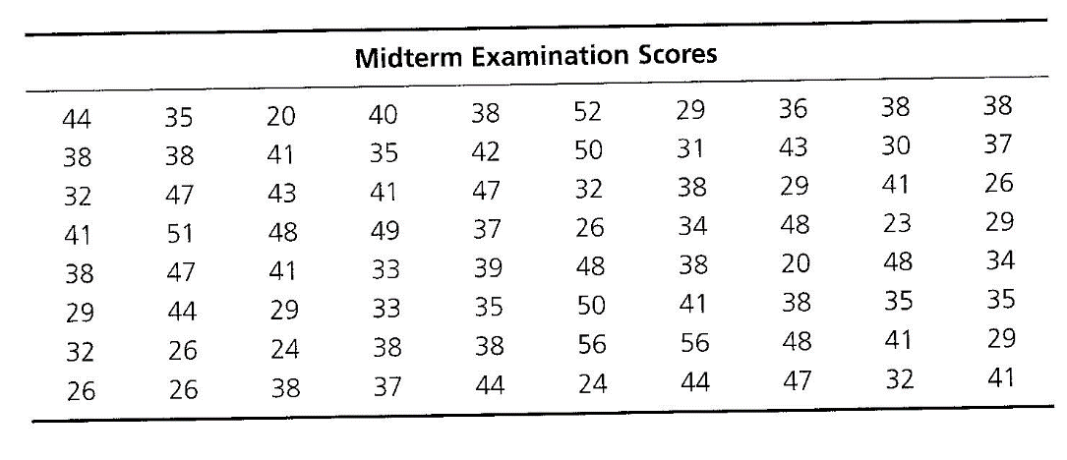
Exercise
Determine the mean of the midterm examination dataset (80 students)

Slide 6
Measures of central tendency
The median is the score that divides the frequency distribution in half, i.e. the middle score
  The easiest way to find this is to order the scores from lowest to highest and to find the middle score
Given an odd set of scores: 113, 95, 94, 133, 112
  Rearrange: 94, 95, 112, 113, 133
  Take the middle value: 112
Given an even set of scores: 113, 95, 94, 133, 112, 102
  Rearrange: 94, 95, 102, 112, 113, 133
  Take the mean of the middle two values: (102 +112)/2 = 107

Slide 7
Measures of Central Tendency
The mode is the most frequently occurring score in a set of scores
  This is the largest column on the frequency distribution
Given a set of scores 110.105, 100, 100, 100, 100, 99, 98
  100 appears 4 times, more than any other, so is the mean
Given a set of scores 110.105, 105, 103, 100, 100, 99, 98
  105 and 100 both appear twice so we have two modes
  Bimodal and multimodal distributions are possible

Slide 8
Exercise
Determine the median and mode(s) of the midterm examination dataset (80 students)

Slide 9
Selecting a measure of central tendency
In a symmetrical unimodal distribution the mean, median and mode will have the same values.
The mean is the ‘balance point’ of a distribution
  It reflects the position of every score in a dataset and is the most affected by any skewness in the dataset
If a dataset is skewed then it is better to report the median than the mean

Slide 10
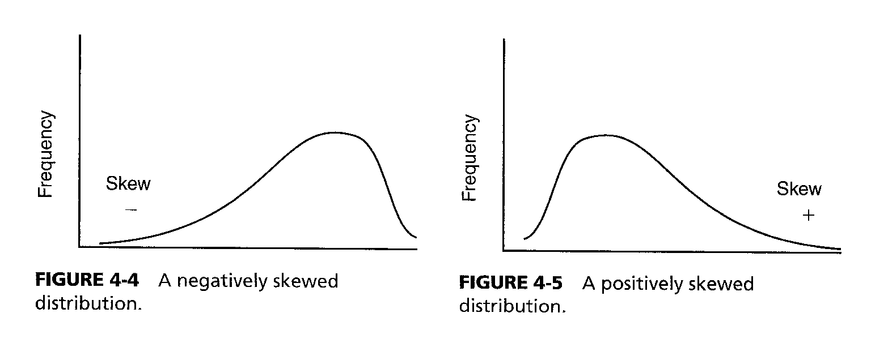
Skewed distributions
The Normal distribution is symmetrical, but some frequency curves are not
  If a test is very easy most people get high scores
  If a test is very difficult most people get low scores
Depending on which way the bulk of the scores have shifted we can say if a curve is positively skewed or negatively skewed

Slide 11

variation with skewness
Dataset X: 1, 2, 2, 2, 3
Mean $\overline{X}$ = 2
Median = 2
Mode = 2
Dataset Y: 1, 2, 2, 2, 3, 6
Mean $\overline{Y}$ = 2.667
Median = 2
Mode = 2
Dataset Z: 1, 2, 2, 2, 3, 6, 7, 8
Mean $\overline{Z}$ = 3.875
Median = 2.5
Mode = 2

Slide 12

Measures of variability
The mean, median and mode give us a single score to represent the level of an entire set
Using the central measure alone can be misleading though – consider the two score sets below:
The means are the same but there is clearly more variability in the Classroom X scores
Classroom X Exam Score |  | Classroom Y Exam Score
160 |  | 102
130 |  | 101
100 |  | 100
70 |  | 99
40 |  | 98
$$\overline{X}=\frac{\sum{X}}{N}=\frac{500}{5}=100$$ |  | $$\overline{Y}=\frac{\sum{Y}}{N}=\frac{500}{5}=100$$

Slide 13
Range
The simplest measure of variability is the range
The range is simply the highest score (H) minus the lowest score (L)
  Range = H – L
In classroom X
  Range = H – L = 160 – 40 = 120
In classroom Y
  Range = H – L = 102 – 96 = 4
This gives a very basic measure of overall variability as it doesn’t take any skewness into account
Better measures are the variance and the standard deviation

Slide 14

variance
The variance is the most commonly used measure of variability
It is defined as the mean of the sum of the squares of the deviation scores
  ${SD}^{2}= \frac{\sum{{\left(X−\overline{X}\right)}^{2}}}{N−1}$
$\left(X−\overline{X}\right)$ is the deviation score
  Positive scores are above the mean
  Negative scores are below the mean
  If we calculated the mean deviation these would cancel out, so we square them to change all negatives to positives (common statistical technique) then take the mean value of the squared scores

Slide 15


variance
To calculate the variance first calculate the deviations χ then square and sum them, then divide by N-1
    $${SD}_{χ}^{2}= \frac{\sum{{\left(X−\overline{X}\right)}^{2}}}{N−1}=\frac{40}{5−1}=10$$
Scores (X) | $$(X−\overline{X})$$ | $$χ$$ | $(X−\overline{X})$²
9 | 9 – 5 | 4 | 16
7 | 7 – 5 | 2 | 4
5 | 5 – 5 | 0 | 0
3 | 3 – 5 | -2 | 4
1 | 1 – 5 | -4 | 16
$\sum{X=25}$ | $\sum{\left(X−\overline{X}\right)}$=0 | $\sum{χ=0}$ | $\sum{{\left(X−\overline{X}\right)}^{2}}$=40

Slide 16


Variance
Calculating the deviation for every point is a pain
An alternative formula exists that eliminates rounding errors and is easier to compute
  ${SD}^{2}=\frac{\sum{X^{2}− \frac{{\left(\sum{X}\right)}^{2}}{N}}}{N−1}$
  ${SD}^{2}=\frac{\sum{X^{2}− \frac{{\left(\sum{X}\right)}^{2}}{N}}}{N−1}$ $=\frac{165 − \frac{625}{5}}{4}=\frac{165−125}{4}=\frac{40}{4}=10$
Scores (X) | Scores Squared (X)²
9 | 81
7 | 49
5 | 25
3 | 9
1 | 1
$\sum{X=25}; {\left(\sum{X}\right)}^{2}=625$ | $\sum{X^{2}=165}$

Slide 17

Standard deviation
Another common measure of variation is the standard deviation
This is easy – take the square root of the variance
Scores (X)
9 | Mean $\overline{X}$ = 5
7 | Variance SD² = 10
5 | Standard Deviation SD = 3.16
3
1

Slide 18

Exercise
Find the mean $\overline{X}$, range R, variance SD² and standard deviations for each of the following groups of scores. Carry our all calculations the three decimal places and round them correct to two places
Classroom X Exam Score |  | Classroom Y Exam Score
160 |  | 102
130 |  | 101
100 |  | 100
70 |  | 99
40 |  | 98

Slide 19
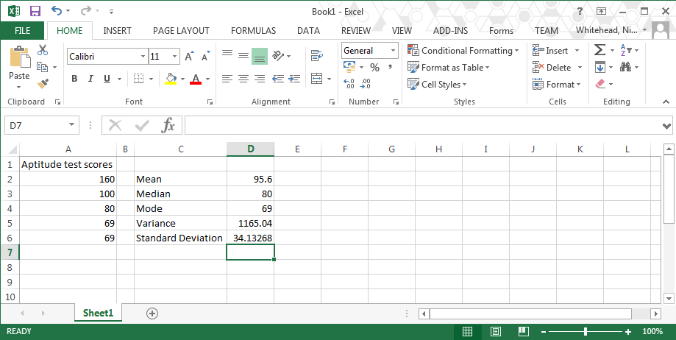
Using excel
Calculating the means, variances and standard deviations can be done by hand but is better done with a spreadsheet or a statistical package
This year we will use Excel; next year we’ll move on to SPSS and the statistical programming language R

Slide 20
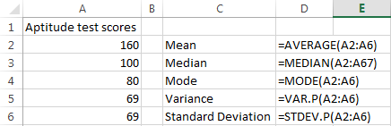
Using Excel
The five main Excel functions are:
  Mean: AVERAGE(range)
  Median: MEDIAN(range)
  Mode: MODE(range)
    If there is no mode then it will return the value #N/A
  Variance: VAR.P(range)
    This will ignore any non-numerical cells in the range
  Standard Deviation(range)
    This will ignore any non-numerical cells in the range

Slide 21
Exercise
Download the file Midterms.xlsx and calculate the mean, median, mode, variance and standard deviation of the data therein

Slide 22
Summary
All of today’s material looked at descriptive statistics of univariate data
  Measures of central tendency
  Selecting a measure of central tendency
  Measures of variability
  Using Excel for statistics
Next session we’ll look at the Normal curve and how this can be used to tell us more about a dataset

Slide 23
Coming soon
Next session: The Normal curve
Homework: Read chapter 5 of Statistics for the Terrified.

