Slide 1

The GLOBE project
Global Leadership Dimensions

Slide 2
GLOBE 2020
A unique, large-scale study of cultural practices, leadership ideals, interpersonal trust in 150 countries
GLOBE stands for Global Leadership and Organizational Behaviour Effectiveness
Founded by Robert House in 1991
Multi-phase, multi-method, multi-sample research project
So far, three distinct but interrelated phases

Slide 3
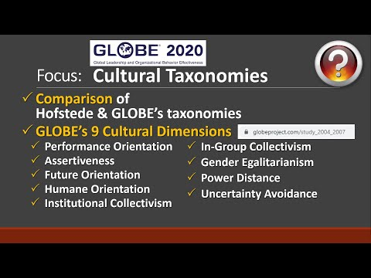
HOFSTEDE V GLOBE

Slide 4
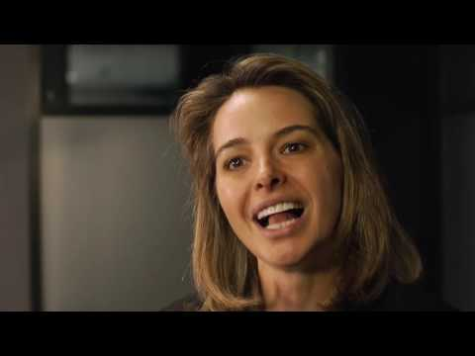
ERIN MEYER – THE CULTURE MAP

Slide 5
READ ABOUT ERIN MEYER'S CULTURE MAPPING TOOL
https://erinmeyer.com
Watch and listen to the resources: https://erinmeyer.com/resources/
Don't forget you can reference podcasts and youtube videos in your assignment but be mindful of credibility.

Slide 6
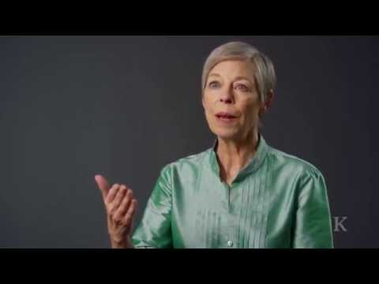
MANAGING CONFLICT: RATTLING BIKE

Slide 7
READ MORE....HAVARD BUSINESS REVIEW
https://hbr.org/2013/12/how-to-argue-across-cultures?utm_source=feedburner&utm_medium=feed&utm_campaign=Feed%3A+harvardbusiness+%28HBR.org%29

Slide 8
Corporate social responsibility in different countries
Cultural and contextual influences on corporate social responsibility
Ya-Hui, Ling
.
Cross Cultural & Strategic Management
; Bingley Vol. 26, Iss. 2, (2019): 290-310. DOI:10.1108/CCSM-02-2018-0024
https://www.proquest.com/docview/2242120496/fulltextPDF/B8027086F042469CPQ/1?accountid=130472

Slide 9
Six global leadership STYLES
Charismatic/value based
Team-orientated
Participative
Humane-orientated
Autonomous
Self-protective

Slide 10
GROUP TASK
Define the leadership styles
What does it look like in practice?
Advantages & disadvantages

