Slide 1
Qualification: CIPD Diploma in Applied Human Resources
Module Name: Understanding the Link between Individual and Organisational Performance
Assessment: Managing and Improving Performance
Word Count: Presentation 221 words, Notes 3,026 words, Total 3,247 words
Student Name: Melanie Gough
Student Number: 1910141
CIPD Membership Number: 54660544
By signing below, I confirm that the work/evidence presented is my own, unaided work. I understand the regulations pertaining to candidate malpractice and the action that may be taken as a result.
Signed: M R Gough
Date: 30/10/2020

Slide 2
Managing and Improving Performance

Slide 3
Aims and Objectives
Understand the concept of high-performance working and how it can benefit individuals and the organisation
Understand the contribution of the performance management process to high levels of performance
Understand the role of line managers in performance management processes

Slide 4
The Concept and Key Components of High-performance Working
Becker and Huselid (1998) define a high-performance work system (HPWS) as “an internally consistent and coherent HRM system that is focussed on solving operational problems and implementing the firm’s competitive strategy”
(Armstrong & Taylor, 2016, p. 139)
Notes:
Much research exists that suggests that people perform better when they are motivated and several studies have identified the key components of high-performance working, from the more traditional views of Taylor (1911) who argues that employees “are driven by the desire to earn as much money as possible” (Hutchinson, 2013, p. 53) to the more contemporary views of Dan Pink (2010) who believes that “autonomy, mastery and purpose” are the key ingredients of genuine motivation (p. 49).

Slide 5
Key Components of High-performance Working
(Taylor and Woodhams, 2016, p. 199)
Key Components of HPW
Rigorous and sophisticated recruitment and selection
High levels of investment in training and development
Relatively high levels of pay driven by performance
Internal promotion systems based on merit
Team-based approaches to work
Information sharing
A high degree of participation in decision-making
Grievance procedures that can be used without fear of repercussions
An effective performance appraisal system
Flexible working
A high degree of job security
Provision of a good work-life balance
A high level of harmonisation in respect of terms and conditions
Notes:
Taylor and Woodhams (2016) identify “a bundle of distinct human resource management policies and practices”, which they believe are the components that underpin high-performance working, which include “rigorous and sophisticated recruitment and selection” and “high levels of investment in training and development”. (p. 199)
Organisations that adopt high-performance work practices are more likely to attract and retain employees who display the behaviours of a high-performance worker - engaged, committed and motivated. Likewise, employees that work for organisations that have adopted high-performance work practices are more likely to be benefit in terms of receiving training and development, job security and a good work-life balance.

Slide 6

Rigorous and Sophisticated Recruitment & Selection
Google “takes it’s hiring seriously”
Laszlo Bock
Notes:
With a reputation for hiring and retaining exceptional talent, it is no surprise that Google are often ranked by Fortune as one of the ‘Best Companies to Work For’. Spending “twice as much of its people budget on hiring than the average company”, (Bock, 2016) Google believe this investment saves time and resource managing poor performers. This view is reinforced by Lisa Stern Haynes, Staffing Lead at Google, who’s passion is “bringing amazing talent to the best place on earth to work”. (2018)
Laszlo Bock, former Senior VP of People Operations at Google, inc. and author of Work Rules! introduced people analytics to the Google’s People Operations team, which resulted in a more streamlined recruitment and selection process. Google revealed that structured interviews were “highly predictive indicators of future performance scores of our employees”. (Langshur & Stern Haynes, 2018)
Bock (2016) revealed that candidates were previously interviewed between 15-25 times per opening, but later reported that “four interviews were enough” (p. 103) to predict candidate success with 86 percent confidence, thus significantly reducing the average time spent hiring from 6 months to around 47 hours. The recruitment and selection process is rigorous, but it’s about getting the right candidate, whatever the cost and Google defend their rigorous process by reinforcing that “hiring better is the single best way to do it” as “a bad hire can have a really long-lasting negative effect on a team or a company’s culture”. (Langshur & Stern Haynes, 2018) as well as a financial impact.

Slide 7

High Levels of Investment in Training & Development
Training is “one of the most widely quoted and important elements of high-commitment HRM”
(Marchington, et al 2016 p. 62)
Notes:
The “growing recognition of the importance of individual and organisational learning” (Marchington, et al., 2016 p. 62) is supported by the government’s Workplace Employment Relations Study (WERS) 2011, which identified that “training has been extended to more employees in the workplace since 2004” (Van Wanrooy, et al., 2013). The study highlighted that despite the recession reducing the duration of training, employee satisfaction with training had increased. Equally, the study highlighted that those organisations that reduced their investment in training as a result of the recession reported a decrease in employee satisfaction with training, therefore reinforcing the link between training and development and employee satisfaction.
Forbes reported that “an employer who doesn’t focus on learning is going to lose out — in performance, engagement and retention.” (Biro, 2018) thus highlighting the importance of developing employees, while the link between training and retention is highlighted in the LinkedIn’s 2018 Workforce Learning Report, which found that “94% of employees say that they would stay at a company longer if it invested in their career development”. (Spar, et al., 2018)

Slide 8
The Link Between High-performance Working, Competitive Advantage and Sustainable Organisation Performance
HRM practices “can help to create a source of sustained competitive advantage, especially when they are aligned with a firm’s competitive strategy” (Huselid, 1995)
Research studies:
Huselid's High performing work practices
Pfeffer's Seven practices of successful organizations
MacLeod's Engaging for Success
Hertzberg’s Two-Factor Theory
Purcell’s Unlocking the ‘Black Box’
Gallup’s ‘It’s the Manager’
Notes:
Many research studies have been undertaken to understand the link between human resource management (HRM) and positive organisational outcomes, from Huselid's high performing work practices, to Pfeffer's seven practices of successful organizations and Macleod's Engaging for Success.
Mark Huselid (1995) evaluated the link between high-performance work practices and organisational performance. His research found that investments in high-performance work practices result in “lower employee turnover and greater productivity and corporate financial performance”. (Huselid, 1995) Specifically, in terms of competitive advantage and sustainable organisation performance, Huselid found that “a one-standard-deviation increase in High Performance Work Practices yields a $27,044 increase in sales and a $3,814 increase in profits. (Huselid, 1995)
John Purcell’s (2003) study ‘Unlocking the Black Box’ identified 11 HR policies and practices that motivate employees and “help induce discretionary behaviour” (p. ix) which in turn makes them perform better in their role. The study also found “clear evidence that HR policies and practices are a source of competitive advantage” (p. 37), but essentially how line managers implement those policies and practices are the key differentiators. This is supported by Cappelli and Crocker-Hefter (1996) who argue that “distinctive human resource practices help to create unique competencies that differentiate products and services and, in turn, drive competitiveness”. (Armstrong & Taylor, 2020, p. 29)
MacLeod’s Report ‘Engaging for Success’ established that employee engagement was fundamental for organisational success, in particular its positive impact on organisational competitiveness. The study identified ‘four enablers’ - strategic narrative, engaging managers, employee voice and organisational integrity, that were “commonly agreed to lie behind successful engagement approaches”. (MacLeod & Clarke, 2009, p. 33) Employee engagement is “irrefutable proof that engagement isn't just something nice to have, it brings substantial return on investment and competitive advantage”
While these studies conclude that there is a positive link between HRM and organisation outcomes, they do not inform us how or why HR policies and practices translate into employee performance – this is known as ‘the black box’. John Purcell’s (2003) study examined the impact of people management on organisational performance, with its main purpose being to unlock the ‘black box’ to show the way in which HR practices impact on performance. One of the key findings was the crucial role of line managers in implementing HR policies and practices, in particular the “need to examine the exercise of line manager discretion”. (Purcell, et al 2003, p. 13)
The line manager is integral for individual and organisational performance. Gallup’s study on The Future of Work, and their subsequent book ‘It’s the Manager’ highlights that the quality of managers is at the heart of an organisations long-term success. Gallup believe that managers “behaving like bosses, rather than coaches” contributes to “70% of the variation between great workplace engagement and lousy workplace engagement” (Kruse, 2019)
Fleetwood and Hesketh (2010) challenge the link between organisational performance and HRM, arguing that “a quantifiable, measurable, empirical and statistical link” (p xii) does not exist, and that research studies that suggests otherwise, do not fully consider or appreciate “the complexities of organisations and the full range of issues that influence individual performance”.

Slide 9

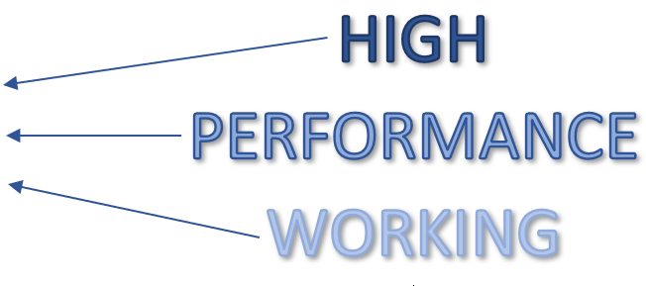
The Link Between High-performance Working and Employee Well-being
Notes:
Many studies have been carried out to evaluate the link between high-performance working and employee well-being, and evidence demonstrates that “good working practices – such as autonomy, good management and work-life balance – are fundamental to both wellbeing and productivity” (Hancock & Cooper, 2018) This is supported by the CIPD’s view that “an effective workplace well-being programme can deliver mutual benefit to people, organisations, economies and communities” (Suff, 2020).
While Hancock & Cooper (2018) are concerned that “employers are failing to see the link between employee wellbeing and productivity” the findings of a survey of employers carried out by Buck, found that 97 per cent of employers surveyed did recognise “the benefits that wellbeing initiatives can bring”, yet “only a quarter of UK businesses have a wellbeing programme in place” (Churchill, 2019), making it increasingly important for organisations to introduce a strategy to promote a culture of health and well-being in the workplace.
One of the main causes of short-term and long-term absence is stress. According to the American Institute of Stress, the main causes of stress in the workplace are workload, people issues, juggling work and personal lives and lack of job security. Stress can have a detrimental impact on a person’s mental health, physical health, behaviour, relationships and work performance, so recognising the signs of stress and early intervention are vital in managing stress. While “stress-related absence continues to increase among UK employees”, (Suff, 2020) the CIPD’s 2020 ‘Health and Wellbeing at Work’ survey has reported the lowest average absence rate recorded at just 5.8 days absence per employee. However, the report indicates that this is partly due to increases in ‘presenteeism’ and ‘leavism’ – employees working when they are unwell or on leave.

Slide 10
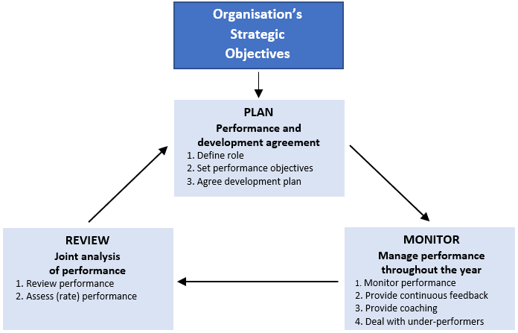
The Main Stages of the Performance Management Cycle
(Armstrong & Taylor, 2020, p.444)
Notes:
The performance management cycle is a continuous self-renewing process, which according to Armstrong and Taylor (2000) encompasses three main stages, which they believe “flows from the organisation’s objectives and then through processes of planning, monitoring and reviewing” (p. 444) allowing both managers and employers to work towards achieving the organisations strategic objectives. While organisations develop their own performance management models, fundamentally the main stages of the performance management cycle are similar.
The planning stage involves communication the organisation’s vision and goals, defining the role, setting performance objectives, and agreeing a development plan. At this stage it is important to identify any training and development needs – knowledge, skills and behaviours, that employees may need to develop to be able to achieve their objectives.
Performance should be managed regularly throughout the year with continuous feedback provided. Feedback should be objective, unbiased, and transparent and conversations regarding underperformance should be positive.
Finally, it is essential to the performance management cycle to review and assess employee performance to determine if goals have been met and link back to the organisation’s goals.

Slide 11
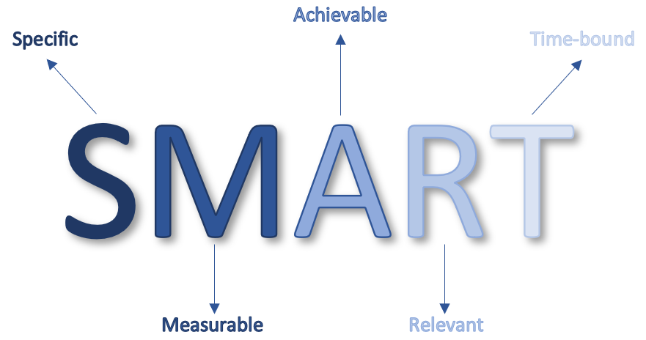
Key Performance Management Activities
Notes:
The CIPD define performance management as the activities that “establish objectives”, “improve performance” and “hold people to account”. (Gifford, 2019)
Performance management is a “strategically relevant business activity, not a perfunctory end-of-year duty” (Schrage, et al., 2019). There are arguments for and against formal performance management. Bloom et al (2012) argues that on average, organisations were “23% more productive” (Taylor & Woodhams, 2016, p. 205) when they had formal performance management processes in place. The opposing views of management expert Elaine Pulakos’, are that “performance reviews are especially unhelpful and potentially harmful” (Woolston, 2019) while Laszlo Bock believes that “intrinsic motivation is the key to growth, but conventional performance management systems destroy that motivation.” (2016, p167)
A Harvard Business Review discussed the bias and awkwardness that people experience during the annual performance review, which they believe has contributed to several Fortune 500 companies, such as Microsoft, abandoning performance evaluations altogether. Yet they also remind us that decisions regarding pay and promotions still needed to take place, meaning that employees do continue to be evaluated, they are just not present, making the evaluation more subjective and less transparent. When a CEB global survey asked 9,000 managers and employees about performance evaluations, they reported that “not having evaluations is worse” (Goler, et al., 2016) findings that are supported by a survey that Facebook conducted amongst its staff that revealed, “87% of people wanted to keep performance ratings”. (Goler, et al., 2016) But the CIPD acknowledge that “the dreaded annual appraisal” (Gifford, 2019) is outdated, and recommends that HR should be fostering “ongoing performance conversations”. (Gifford, 2019)
One of the key performance management activities is setting departmental and individual performance objectives. It is important for individual performance objectives to be aligned to the organisation’s strategic objectives. While employees must feel that they are able to achieve their goals, Laszlo Bock argues that “If you’re achieving all your goals, you’re not setting them aggressively enough.” (2016, p155) Traditionally, objectives should be ‘SMART’ (specific, measurable, achievable, realistic, and time-bound), but the CIPD’s ‘Could do better?’ report challenges this goal setting tool, stating that SMART objectives only work “in relatively straightforward and predictable tasks” (Gifford, 2016) and that in “less predictable work, unspecific ‘do-your-best’ outcome goals can be more effective” (Gifford, 2016), supporting the CIPD view that objectives can be outcomes-focused:
Specific and challenging
focused on doing one’s best, or
focused on behaviour or learning

Slide 12
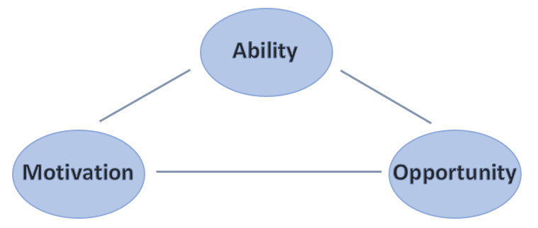
How Performance Management Activities can Enhance Employee Capability & Commitment
Notes:
Performance management activities, such as identifying and addressing training needs can enhance employee capability and commitment as it provides “the provision of opportunities to achieve, scope to develop skills, and guidance on career paths”, (Armstrong, 2019, p. 99) which in turn can motivate employees, thus enhancing employee capability and commitment.
The theory that performance is a function of Ability, Motivation and Opportunity (AMO) was referred to in the 2003 study conducted by Purcell, et al., ‘Understanding the People and Performance Link: Unlocking the black box’, which found that “people have discretion or some degree of choice on how, and how well, they are to do the job” (p. 5), which suggests that an individual’s performance is dependent on whether they have the ability to do the job, the motivation to do the job and the opportunity to perform. The study also found “clear evidence of a link between positive attitudes towards HR policies and practices, levels of satisfaction, motivation and commitment” (p. 72) and that the role of line managers in implementing HR policies and practices is crucial, in particular, the “way in which managers exercise their own discretion” affects employee discretion to go above and beyond. (p. x)

Slide 13

How Performance Management Activities Recognise & Reward Talent
Notes:
Performance management activities can recognise and reward talent in “the form of recognition through feedback”. (Armstrong, 2007, p. 151) Telling employees when they are doing a good job and giving them the opportunity to respond to feedback is an important element of performance management activities. Armstrong (2007) argues that recognition through feedback is motivational, long lasting and can have “a more powerful impact than financial rewards” (p. 151).
In a Harvard Business Review Article called ‘Tough Love Performance Reviews, in 10 Minutes
(2015), Mona Patel, Founder and CEO at Motivate Design describes the innovative way she conducts performance management reviews with her staff – by holding a meaningful conversation in just ten minutes. Starting the conversation by asking the employee, on a scale of 1 to 10 “how do you feel like receiving advice today” (Patel, 2015), dictates the tone of the conversation, but importantly, it “gives control to the employee”(Patel, 2015). Since implementing the ‘tough love’ method, Patel confirmed that they have seen “a significant constructive change” (2015) in their employees.

Slide 14
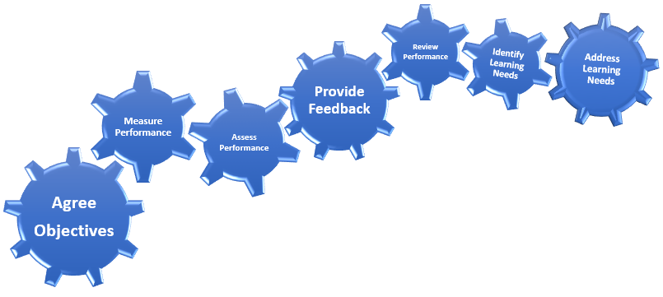
The Role of Line Managers in Performance Management Processes
Notes:
According to Armstrong (2018) “managing performance is what line managers do and performance management is supposed to help them do it”, (p. 8) while Truss (2001) state the line manager’s role is to “mediate between individuals and HR practices”. (Taylor & Woodhams, 2016) This is supported by John Purcell’s (2003) study ‘Unlocking the Black Box’, which found that line managers have “a pivotal role in implementing and enacting HR policies and practices” (p. 13) However, the role of the line manager goes beyond this, as the CIPD highlights that “people managers are central to performance management” (Gifford, 2019) and their role extends to “assessing and recognising performance”. (George & Hayden, 2019) including setting objectives, measuring performance, assessing performance, providing continual feedback, reviewing progress and identifying and addressing training needs.
ACAS suggest that “the key relationship in the workplace is between an individual employee and their immediate line manager”, (2012) so understanding what motivates their staff and having an effective performance management system in place will help line managers to get the best out their team. However, research has highlighted that not all line managers have the skills necessary to lead the performance management process. The CIPD’s ‘Strengths Based Performance Conversations’ report points out the difficulties that line managers have instigating discussions around underperformance, and how they feel that they are “not skilled or confident enough in approaching them”. (Gifford, et al., 2017) This is supported by an Institute of Employment Services (IES) report which aimed to “understand how ‘engaging managers’ – people who inspire and motivate their teams to perform well – behave”, (Robinson, 2009) particularly when faced with a difficult situation. The research indicated that although ‘engaging managers’ also found difficult conversations about performance unappealing, they were inclined to tackled the issue head on, which highlights the importance of dealing with difficult conversations in order to turn performance around.

Slide 15
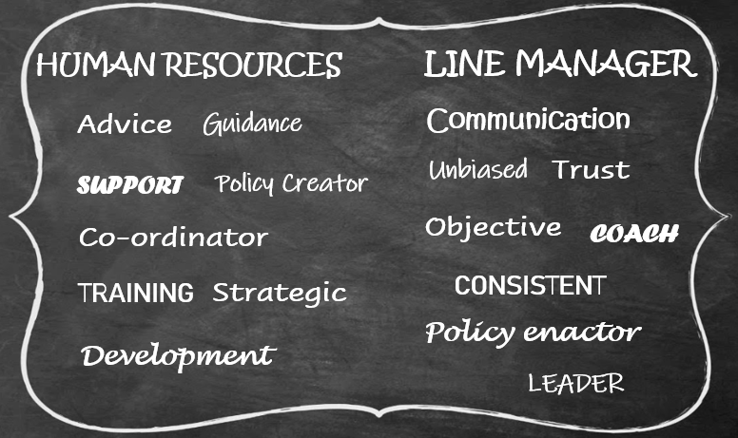
How HR and Line Managers can Work Together in Performance Management Processes
Notes:
The HR function and line managers need to work together to ensure successful people and performance management. While the HR function has overall responsibility for people and performance management, the evolving role of HR means that many of the people responsibilities previously carried out by HR have been redirected to line managers, allowing HR to take a more strategic role, such as developing the performance management practices that will lead to improved performance. Although the responsibility for pay, benefits and employee relations tend to stay with the HR function, line managers are responsible for day-to-day people management, including identifying training needs, allocating work, monitoring workload and leading the performance management process. As line managers have regular contact with their direct reports, it’s understandable that they would be the first point of contact when an employee raises a concern. It is important that HR works closely with line managers to develop their capabilities to ensure consistency, transparency and fairness when dealing with such issues.
The role of HR is crucial to provide advice, guidance and support to line managers, from recruitment and selection through to ensuring compliance with HR policies and procedures, and also “providing them with the tools which help them to secure higher performance from individual employees”. (Taylor & Woodhams, 2016) According to Rees & French (2016) another key role of HR in the performance management process involves “facilitating communication and training for both appraisers and appraisees”. (p, 275) It is important that HR works closely with line managers to develop their capabilities to ensure they are able to conduct fair, unbiased and objective performance reviews, that are applied consistently.

Slide 16
CONCLUSION
Notes:
Much research exists that explains the positive link between high-performance working and organisational performance. Organisations are more likely maximise and sustain organisational performance if they embrace a culture of high-performance working – through implementing HR policies and practices consistently together with effective performance management processes. Research highlights the importance of performance management with the emphasis on how performance is managed, in particular the crucial role that line managers play in creating and maintaining a positive employment relationship that builds trust and drives motivation, commitment and performance. Both employees and organisations benefit from organisations that have adopted high-performance working practices.

Slide 17
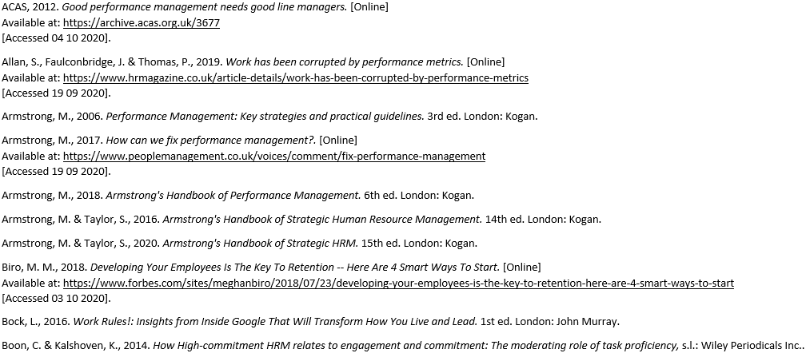
References & Bibliography

Slide 18
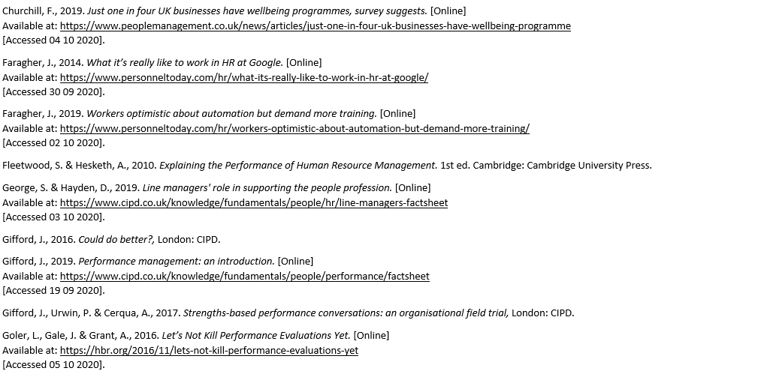

Slide 19
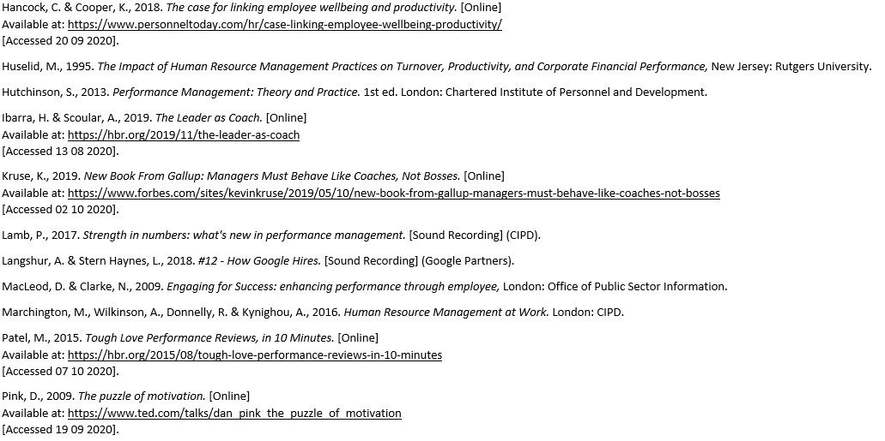

Slide 20


